Slide 1
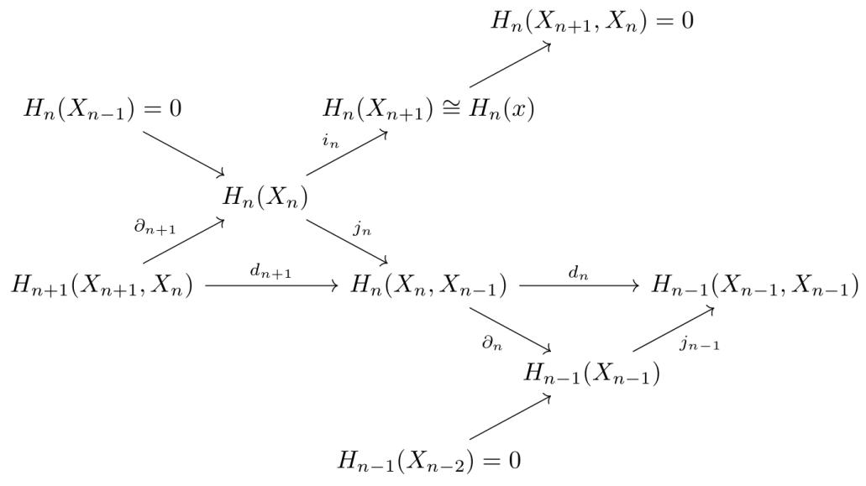

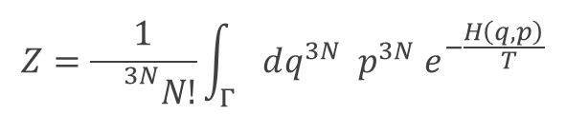






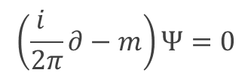
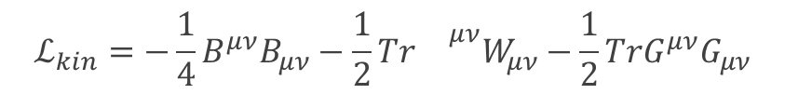




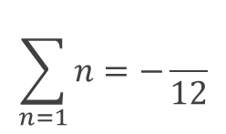
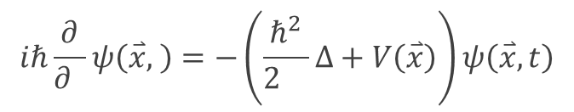






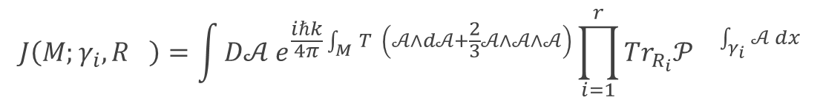


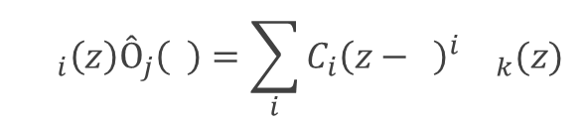
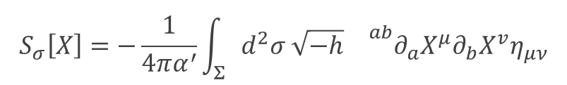




kʷetwórī́k̑m̥̥tihdwóh₁
$$Z=\frac{1}{{}^{3N}N!}\int_{Γ}{{dq^{3N} p^{3N} e}^{−\frac{H\left(q,p\right)}{ T}}}$$
$$d$$
$$h$$
$$∞$$
$$\sum_{n=1}{n}=−\frac{}{12}$$
$$h$$
$$1$$
$$\left(\frac{i }{2π}∂−m\right)Ψ=0$$
$$\backslash$$
$$iℏ\frac{∂}{∂ }ψ\left(\overset{⃑}{x}, \right)=−\left(\frac{ℏ^{2}}{2 }Δ+V\left(\overset{⃑}{x}\right)\right)ψ\left(\overset{⃑}{x},t\right)$$
$$t$$
$$t$$
$$m$$
$$∗$$
$$e^{ π}+1=0$$
$$J\left(M;γ_{i},R_{}\right)=\int{D𝒜 e^{\frac{iℏk}{4π}\int_{M}{T \left(𝒜∧d𝒜+\frac{2}{3}𝒜∧𝒜∧𝒜\right)}}\prod_{i=1}^{r}{Tr_{R_{i}}𝒫{}^{\int_{γ_{i}}{𝒜 dx}}}}$$
$$i$$
$$r$$
$$e$$
$${}_{i}\left(z\right)Ô_{j}\left( \right)=\sum_{i}{C_{i}{\left(z− \right)}^{i}{}_{k}(z)}$$
$$Ó$$
$$w$$
$$w$$
$$Ó$$
$$S_{σ}\left[X\right]=−\frac{1}{4πα^{′}}\int_{Σ}{d^{2}σ \sqrt{−h}{}^{ab}∂_{a}X^{μ}∂_{b}X^{v}η_{μν}}$$
$$S(E,T)={}_{B}\ln{Ω(E,T)}$$
$$k$$
$$h$$
$$ℒ_{kin}=−\frac{1}{4}B^{μν}B_{μν}−\frac{1}{2}Tr{}^{μν}W_{μν}−\frac{1}{2}TrG^{μν}G_{μν}$$
*(indo-european) 42
$$W$$
Notes:
Formeln: Kanonische Zustandssumme – Ramanuyan-Summe – Dirac-Gleichung – Schrödingergleichung – Zelluläre Homologie – Eulersche Identität – Verallgemeinertes Jones-Polynom – Höhere Kategorientheorie – Operator-Product-Expansion – Polyakov-Wirkung – Entropie – Kinetischer Eichterm im Standardmodell

