Slide 1

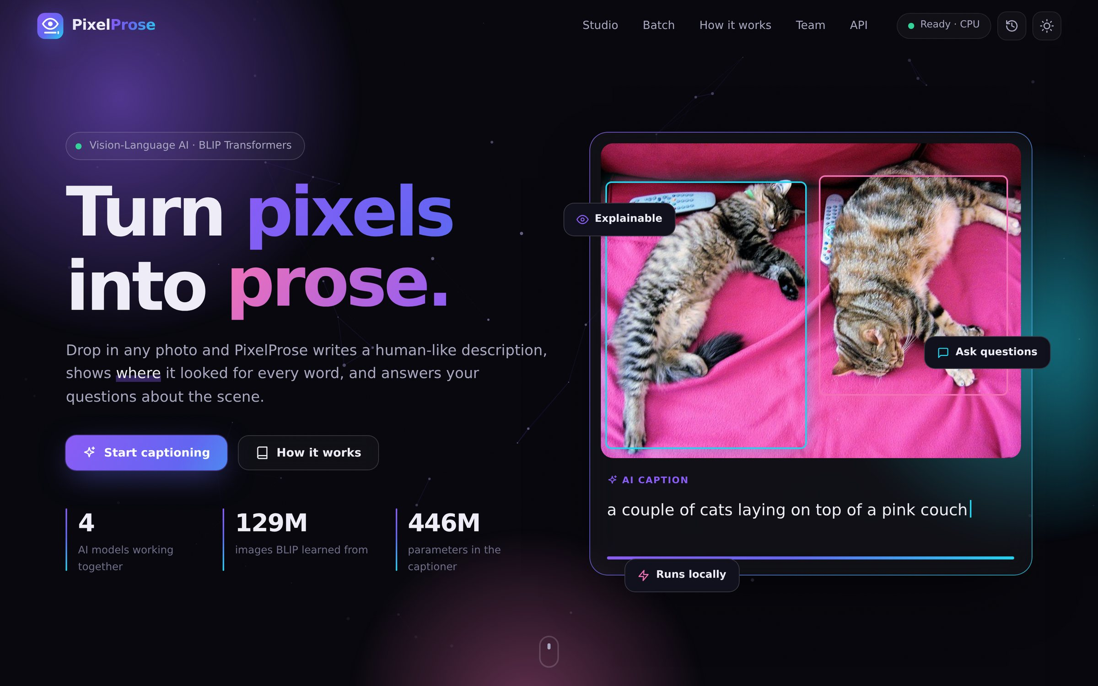
ADVANCED ARTIFICIAL INTELLIGENCE · PROJECT PRESENTATION
PixelProse
Explainable AI Image Caption Generator
Upload any photo → get a human-like caption, see where the AI looked for every word, and ask it questions. Runs fully offline on a laptop.
Kartik Verma
Dhir Thakar
Kushal Soni
Computer Engineering · Salesforce BLIP · PyTorch · FastAPI
Notes:
SPEAKER: Kartik Verma (~50 s)
Good morning everyone. We are Kartik Verma, Dhir Thakar and Kushal Soni, and our Advanced AI project is PixelProse, an explainable image caption generator.
In one line: you give it any photo, and it writes a human-like sentence describing it. More importantly, it can show you where it looked for every word, and it can answer questions about the image.
Everything you'll see today runs locally on this laptop's CPU, with no cloud API. We'll also do a live demo in a few minutes.

Slide 2





THE PROBLEM
Machines need to describe what they see
2.2 B
Where captioning is used
Accessibility
people live with a near or distance vision impairment
Automatic alt-text for screen readers
WHO World Report on Vision, 2019
Search & indexing
Find photos by what's in them
>50%
Social & content
Captions, hashtags and moderation
of the top 1 million home pages contain images with missing alt-text
Robotics & assistants
WebAIM Million report
Describe surroundings in real time
It combines two hard problems: computer vision (understand the scene) + natural language generation (say it fluently).
PixelProse 2
Notes:
SPEAKER: Kartik Verma (~60 s)
Why does this matter? According to the WHO, at least 2.2 billion people live with a vision impairment. They rely on screen readers, and screen readers rely on alt-text, a written description of every image. Yet more than half of the web's most popular home pages have images with no alt-text at all.
Beyond accessibility, automatic captions power image search, social media and content moderation, and robots or smart assistants that need to describe what they see.
Describing an image sounds trivial for a human, but for a computer it combines two hard problems: computer vision to understand the scene, and natural language generation to express it fluently.

Slide 3






OBJECTIVES
What we set out to build
01
02
03
Accurate captions
Explainable
Interactive
Grounded, fluent sentences, not just plausible ones
Show where the model looked for every word
Ask follow-up questions about the image
04
05
06
Beautiful & usable
Runs on a laptop
Measurable
Modern, animated, responsive, accessible UI
Offline, private, no GPU or paid API required
Benchmark with BLEU, ROUGE-L and CIDEr-D
PixelProse 3
Notes:
SPEAKER: Kartik Verma (~45 s)
We set ourselves six goals.
One: captions that are genuinely accurate, not just plausible.
Two: explainability, because the AI shouldn't be a black box.
Three: interactivity, so you can ask follow-up questions.
Four: a clean, modern interface that anyone can use.
Five: it must run on an ordinary student laptop without a GPU or paid API.
And six: we wanted to measure quality with the standard research metrics instead of just claiming it's good.

Slide 4
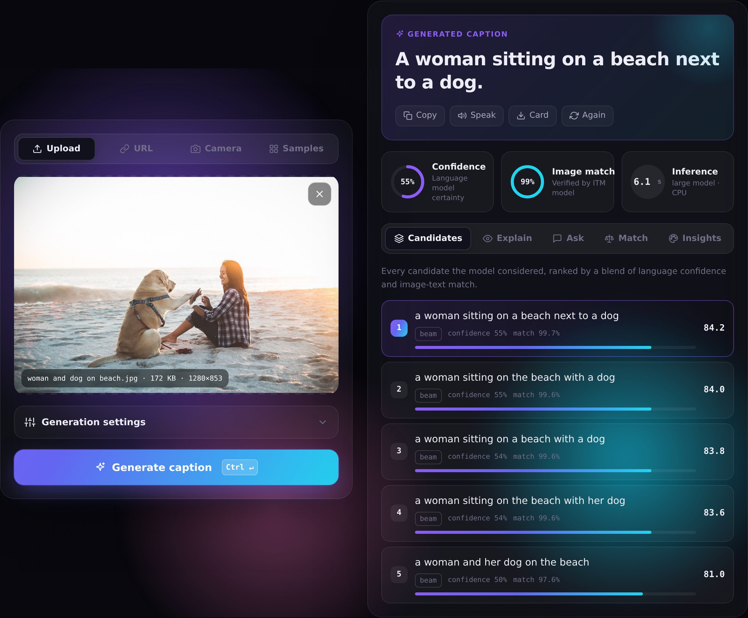


THE PRODUCT
Meet PixelProse
Caption
Accurate sentence + confidence + image-match score
Explain
Per-word attention heatmaps over the photo
Ask
Chat with the image — visual question answering
Match
Score any description against the image
5 ways in: upload · drag & drop · paste · URL · webcam (+ 44 samples)
PixelProse 4
Notes:
SPEAKER: Kartik Verma (~50 s)
This is PixelProse. On the left you pick an image: upload, drag and drop, paste, a URL, your webcam, or one of 44 built-in samples.
On the right you get the caption, with a confidence score and an independent image-match score.
Then there are four tabs. Candidates shows every sentence the model considered. Explain shows attention heatmaps. Ask is a chat for questions. Match lets you test your own descriptions.
Dhir will show all of this live in a few minutes.

Slide 5
SYSTEM DESIGN
Architecture
FRONTEND
API SERVER
SERVICES
MODELS (PyTorch)
Web UI
HTML · CSS · JS modules
no build step
FastAPI
REST + OpenAPI docs
validation · errors
GZip · static hosting
Captioner
encode · decode · score
BLIP-large captioner
ViT-L/16 · 446M
Matcher
ITM · ITC · Grad-CAM
BLIP-base captioner
ViT-B/16 · fast mode
Heatmap canvas
Grad-CAM rendering
QuestionAnswerer
visual Q&A
BLIP ITM
matching · 224M
LRU caches
images by SHA-1
deterministic results
Browser storage
history · settings · theme
Model Manager
lazy load · device · locks
BLIP VQA
questions · 361M
JSON / multipart over HTTP · image uploaded once, then referenced by a 40-char id · CUDA → Apple MPS → CPU auto-selection
PixelProse 5
Notes:
SPEAKER: Kartik Verma (~60 s)
Under the hood there are three layers.
The frontend is plain HTML, CSS and JavaScript modules, so there is no build step and it's easy to run anywhere.
It talks over a REST API to a FastAPI server written in Python. FastAPI validates every request and also generates interactive API documentation automatically.
The server has independent services: the Captioner, the Matcher, the question answerer and image utilities. A Model Manager loads four transformer networks lazily, picks the best device (NVIDIA GPU, Apple Silicon or CPU), and makes sure requests don't fight over the processor.
Caches mean an image is uploaded once, and repeated requests are instant.
HANDOVER: "Now Kushal will explain the AI model itself."

Slide 6






THE MODEL
Inside BLIP: vision meets language
Bootstrapping Language-Image Pre-training · Li et al., Salesforce Research · ICML 2022
Image
576 patches
Vision Transformer
Image embeddings
Text decoder
resized to
384 × 384
16 × 16 px each
(a 24 × 24 grid)
ViT-L/16 · 24 layers
self-attention
577 vectors ×
1024 numbers
12-layer BERT · writes
word by word with
cross-attention
Output: “a woman sitting on a beach next to a dog”
129M
image-text pairs in pre-training
446M
parameters (large captioner)
CapFilt
synthetic captions + noise filter
PixelProse 6
Notes:
SPEAKER: Kushal Soni (~70 s)
Our core model is BLIP, "Bootstrapping Language-Image Pre-training", published by Salesforce Research at ICML 2022. It has two halves.
First, a Vision Transformer. The image is resized to 384 by 384 and cut into 576 small patches of 16 by 16 pixels, a 24 by 24 grid. Each patch becomes a vector, and 24 layers of self-attention let every patch look at every other patch. The output is 577 vectors of 1024 numbers each (576 patches plus one global token), a numeric "understanding" of the image.
Second, a text decoder similar to BERT writes the caption one word at a time. At every word it uses cross-attention to look back at the image patches.
BLIP was pre-trained on 129 million image-text pairs. Its key trick, CapFilt, uses a captioner to write synthetic captions and a filter to throw away noisy web captions, which cleans the training data.
The large model we use has 446 million parameters.

Slide 7
OUR CONTRIBUTION
A caption pipeline, not a single guess
1
Encode once
ViT runs a single time; every candidate reuses the embeddings
Final score
0.65 × image-match
+ 0.35 × confidence
2
Generate drafts
Beam search keeps the 5 best sentences; Detailed mode adds nucleus sampling (p = 0.9)
Clean & dedupe
Fluent and grounded in the picture: the model writes drafts, a second model fact-checks them.
3
Strip prompt & artefacts, block repeats (no-repeat 3-grams)
4
Score every word
Real example: re-ranked drafts
One batched pass → token probabilities → confidence = 1 / perplexity
1. a woman sitting on a beach next to a dog
84.2
5
Fact-check & re-rank
2. a woman sitting on the beach with a dog
84.0
Image-Text Matching model re-reads each draft with the image
3. a woman sitting on a beach with a dog
83.8
4. a woman and her dog on the beach
81.0
PixelProse 7
Notes:
SPEAKER: Kushal Soni (~70 s)
We didn't just call the model once. We built a pipeline around it.
Step one: encode the image only once. That's the expensive part, so we reuse it.
Step two: generate several candidate sentences. Beam search keeps the 5 most probable partial sentences at every step, which is accurate. In the Detailed mode we also add nucleus sampling, which picks words from the top 90% of the probability mass: more varied and natural.
Step three: clean them and remove duplicates. We also block repeated phrases like "a dog and a dog".
Step four: score every word's probability in a single batched pass. That gives us a confidence value, which is the inverse of perplexity.
Step five: a second network, the Image-Text Matching model, re-reads each sentence together with the image and says how well they match.
The final score is 65% match plus 35% confidence, so the winner is both fluent AND grounded in the picture. It's like having the model write several drafts and asking a fact-checker to pick the best one.
HANDOVER: "Dhir will now show how we made the AI explain itself."

Slide 8
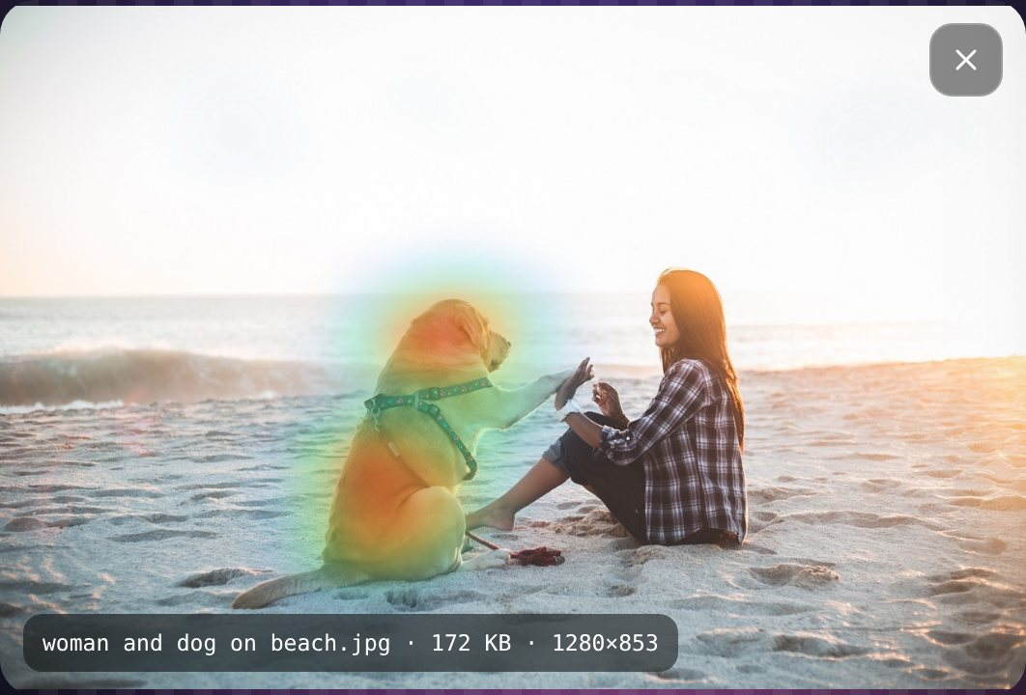
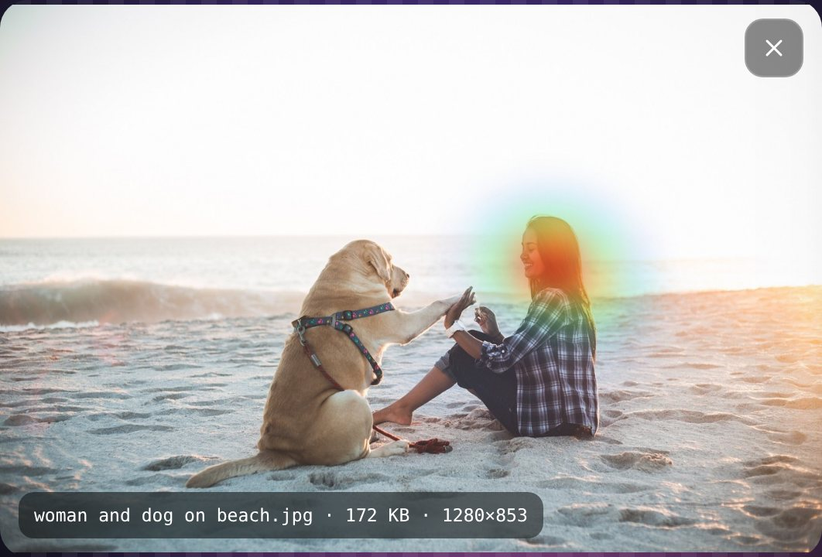
EXPLAINABLE AI
Where did the model look?
Grad-CAM on cross-attention
Take the attention between each word and the 576 image patches (layer 8).
Weight it by the gradient of the match score (how much it mattered).
Keep the positive part → a 24 × 24 heatmap per word.
Rendered in the browser with a colour map; hover a word or press Play.
“dog”
“woman”
Plus a per-word probability chart: orange bars mark words where the model hesitated.
CAM = mean_heads( A ⊙ ReLU(∂s/∂A) )
PixelProse 8
Notes:
SPEAKER: Dhir Thakar (~60 s)
A common criticism of deep learning is that it's a black box. PixelProse opens the box.
For every word in the caption we compute a heatmap with Grad-CAM. We take the cross-attention between the word and the 576 image patches, and weight it by the gradient of the match score, which tells us how much that attention actually mattered for the decision.
Look: for the word "dog", the dog lights up. For "woman", the heat moves to her. These maps are real outputs from our app.
The app also shows a bar chart of how confident the model was about each individual word. Orange bars mark words where it hesitated.

Slide 9
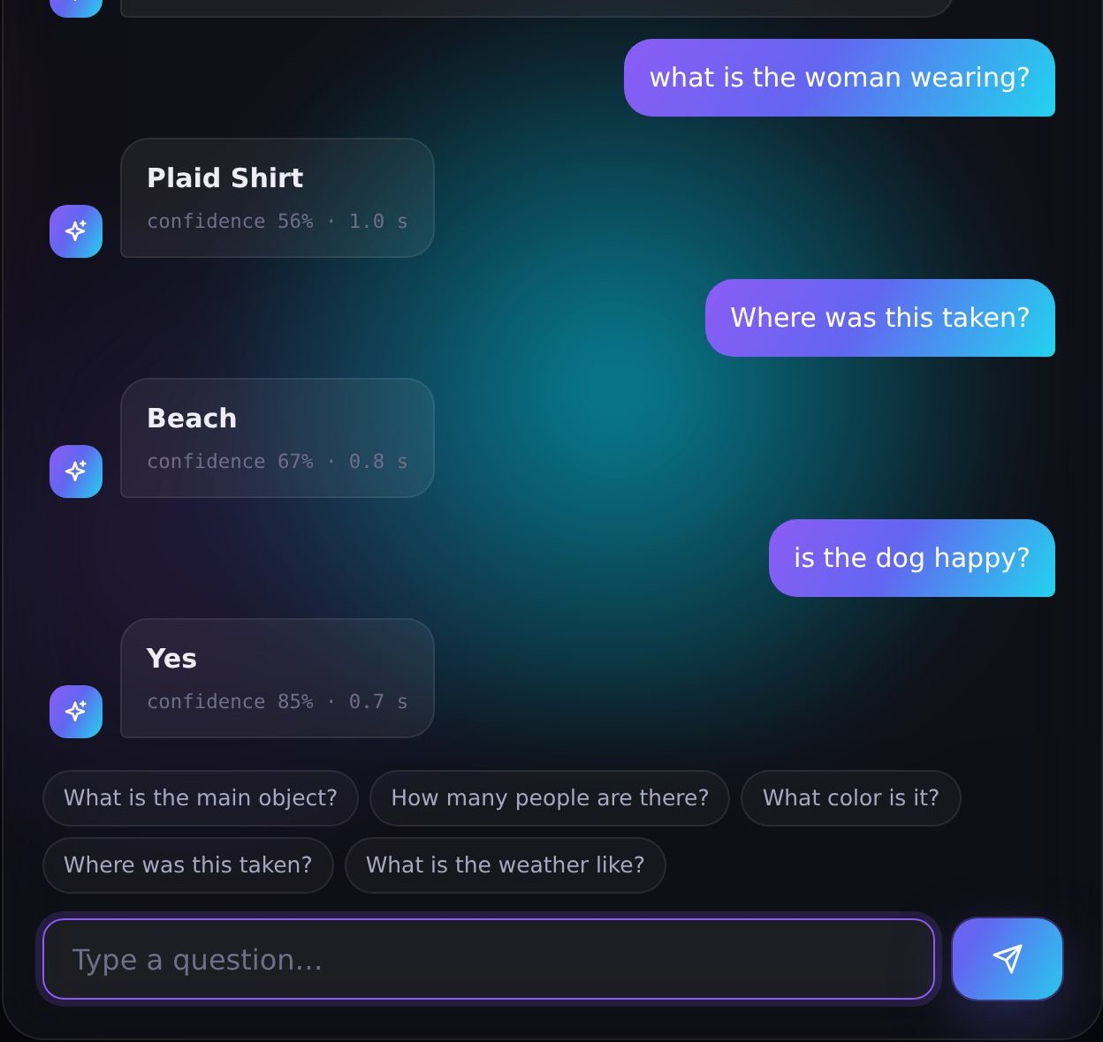
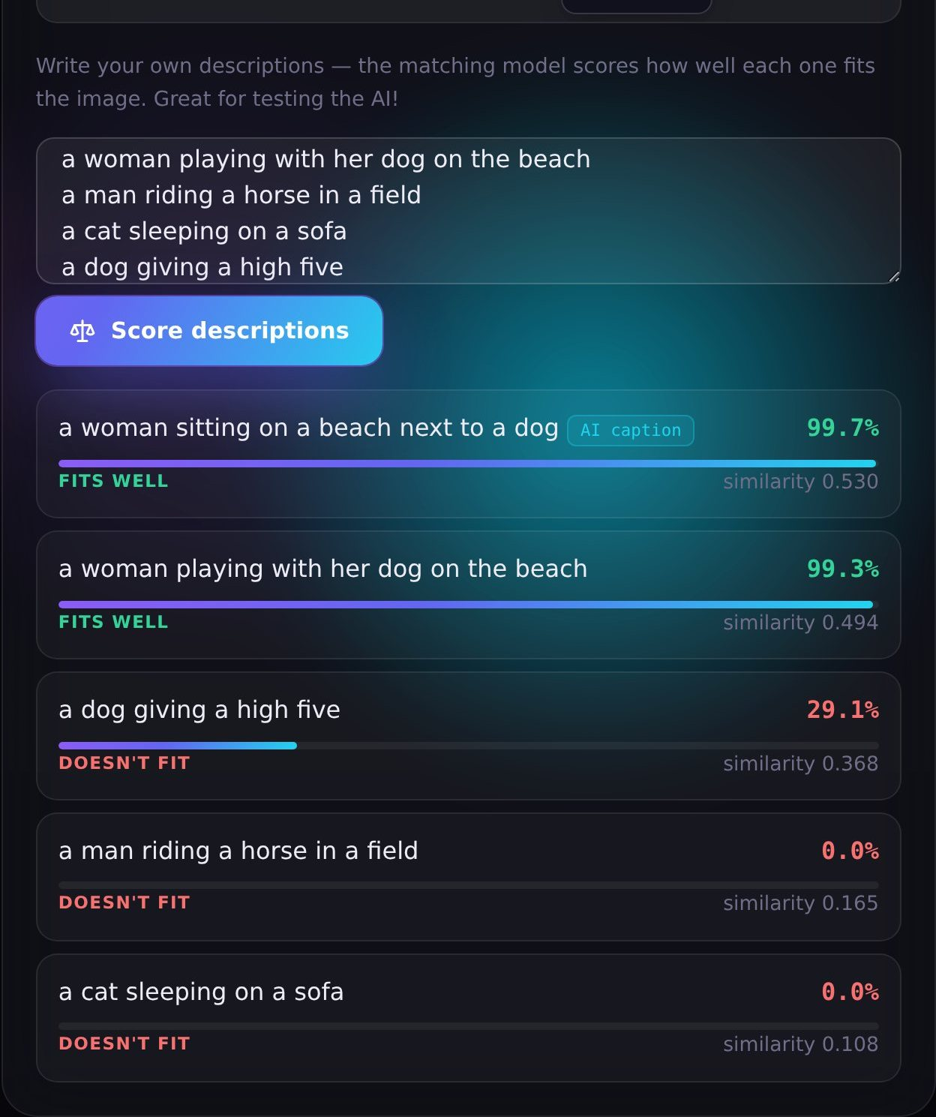
INTERACT WITH THE IMAGE
Ask questions. Test descriptions.
Ask · BLIP-VQA encodes the question together with the image, then generates a short answer.
Match · ITM probability + ITC cosine similarity for any sentence you type.
PixelProse 9
Notes:
SPEAKER: Dhir Thakar (~50 s)
The Ask tab uses a third network, BLIP-VQA, for Visual Question Answering. It encodes your question together with the image, and a decoder generates a short answer. For example: "What is the woman wearing?" gives "plaid shirt", and "Is the dog happy?" gives "yes", each with a confidence.
The Match tab turns the matching model into a playground. Type any descriptions and it scores each one. A correct description scores near 100%, a wrong one like "a cat sleeping on a sofa" scores 0%. Notice "a dog giving a high five" gets 29%: partly right, since it misses the woman. The model is genuinely reading the whole scene. It's a great way to probe what the model really understands, and we'll let you try it in the demo.

Slide 10











EVERYTHING INCLUDED
Features beyond the caption
Guided captions
Fast / accurate switch
Keywords & hashtags
Colour palette
“a painting of…” prefixes
BLIP-base vs BLIP-large
one click to copy
dominant colours + hex
Alt-text HTML
Text-to-speech
Caption card
Batch mode
ready for websites
reads captions aloud
shareable 1080×1350 PNG
12 images → CSV / JSON
History
Webcam capture
REST API + docs
Command line
last 30 results, restorable
snap and caption
Swagger UI at /docs
python cli.py folder/
22 features in total: see docs/FEATURES.md
PixelProse 10
Notes:
SPEAKER: Dhir Thakar (~50 s)
Beyond the core AI we added a lot of practical features:
guided captions like "a painting of…", a fast/accurate model switch, keywords and hashtags, the image's colour palette, accessible alt-text HTML ready to paste into a website, text-to-speech, a downloadable caption card for social media, batch mode for up to 12 images with CSV or JSON export, a history drawer, webcam capture, a REST API with interactive documentation, and a command-line tool.
All 22 features are documented in docs/FEATURES.md.

Slide 11
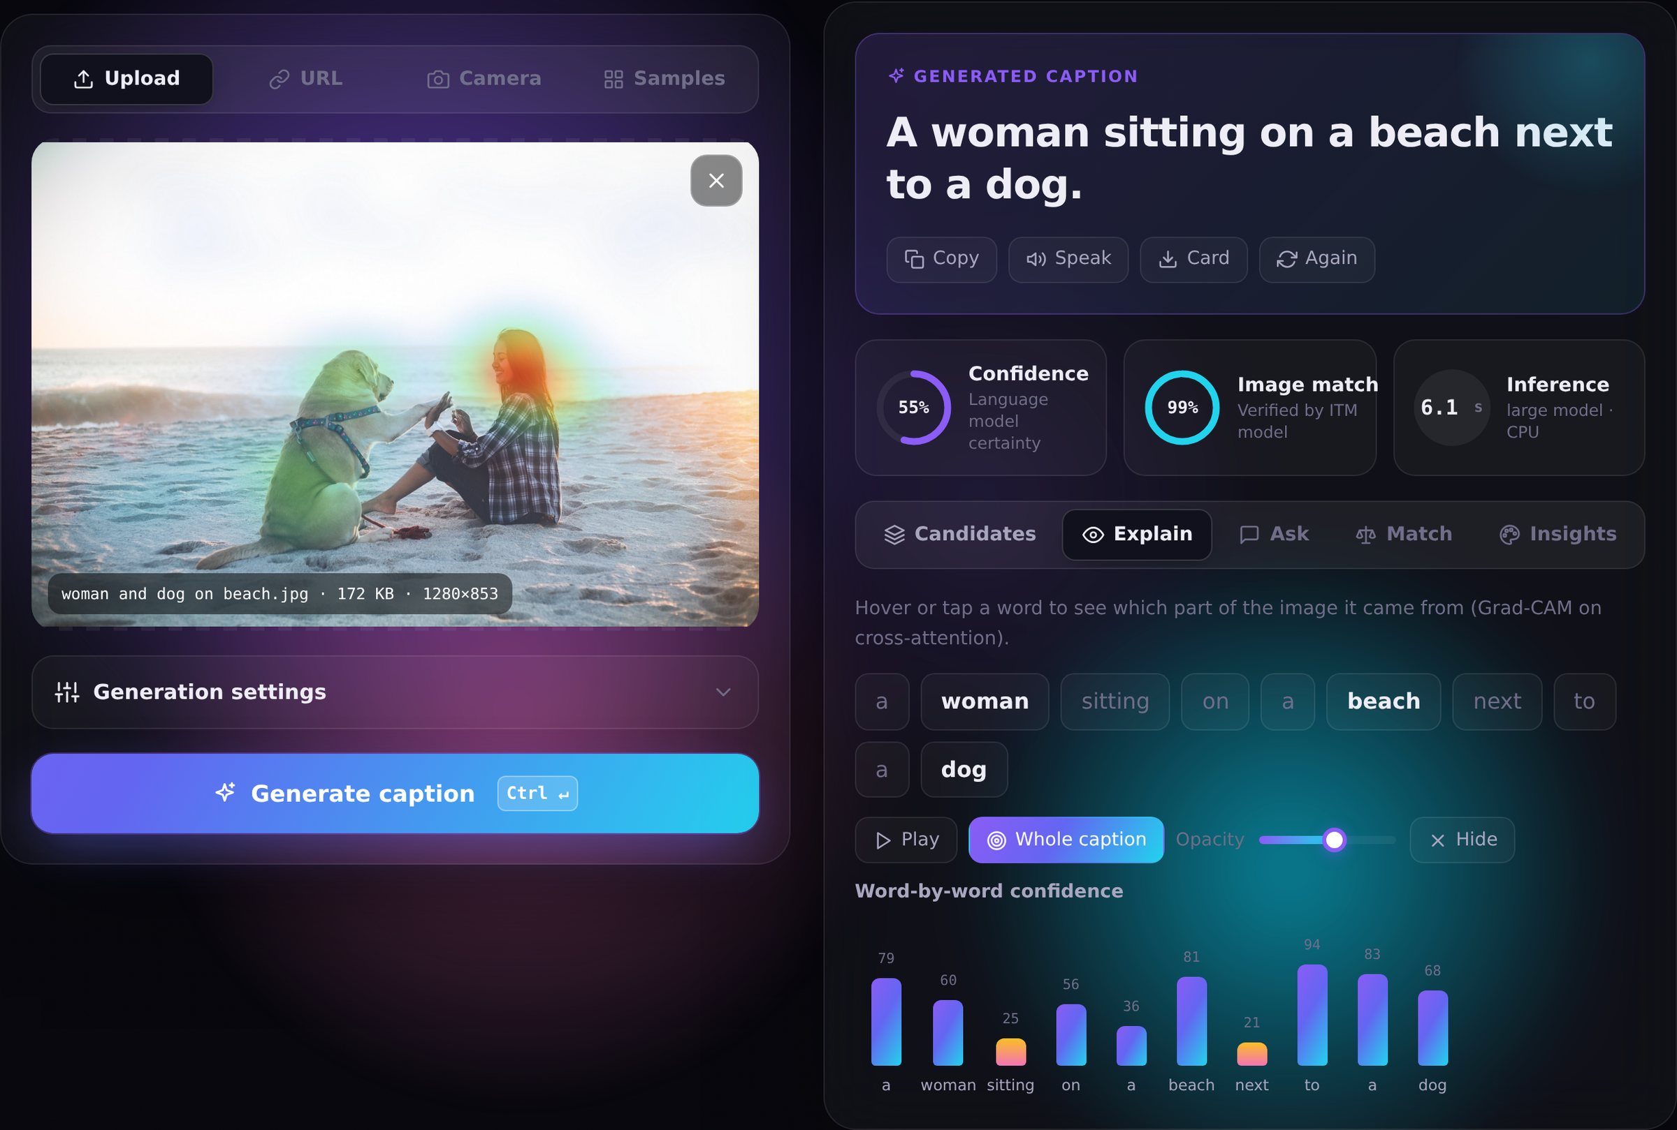
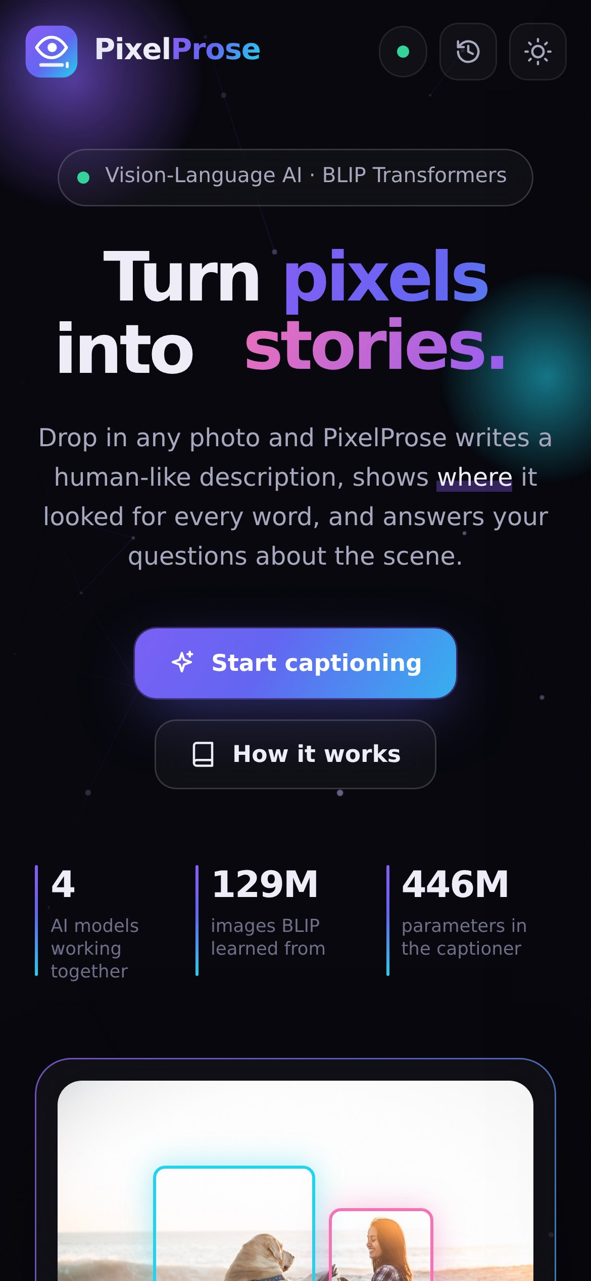
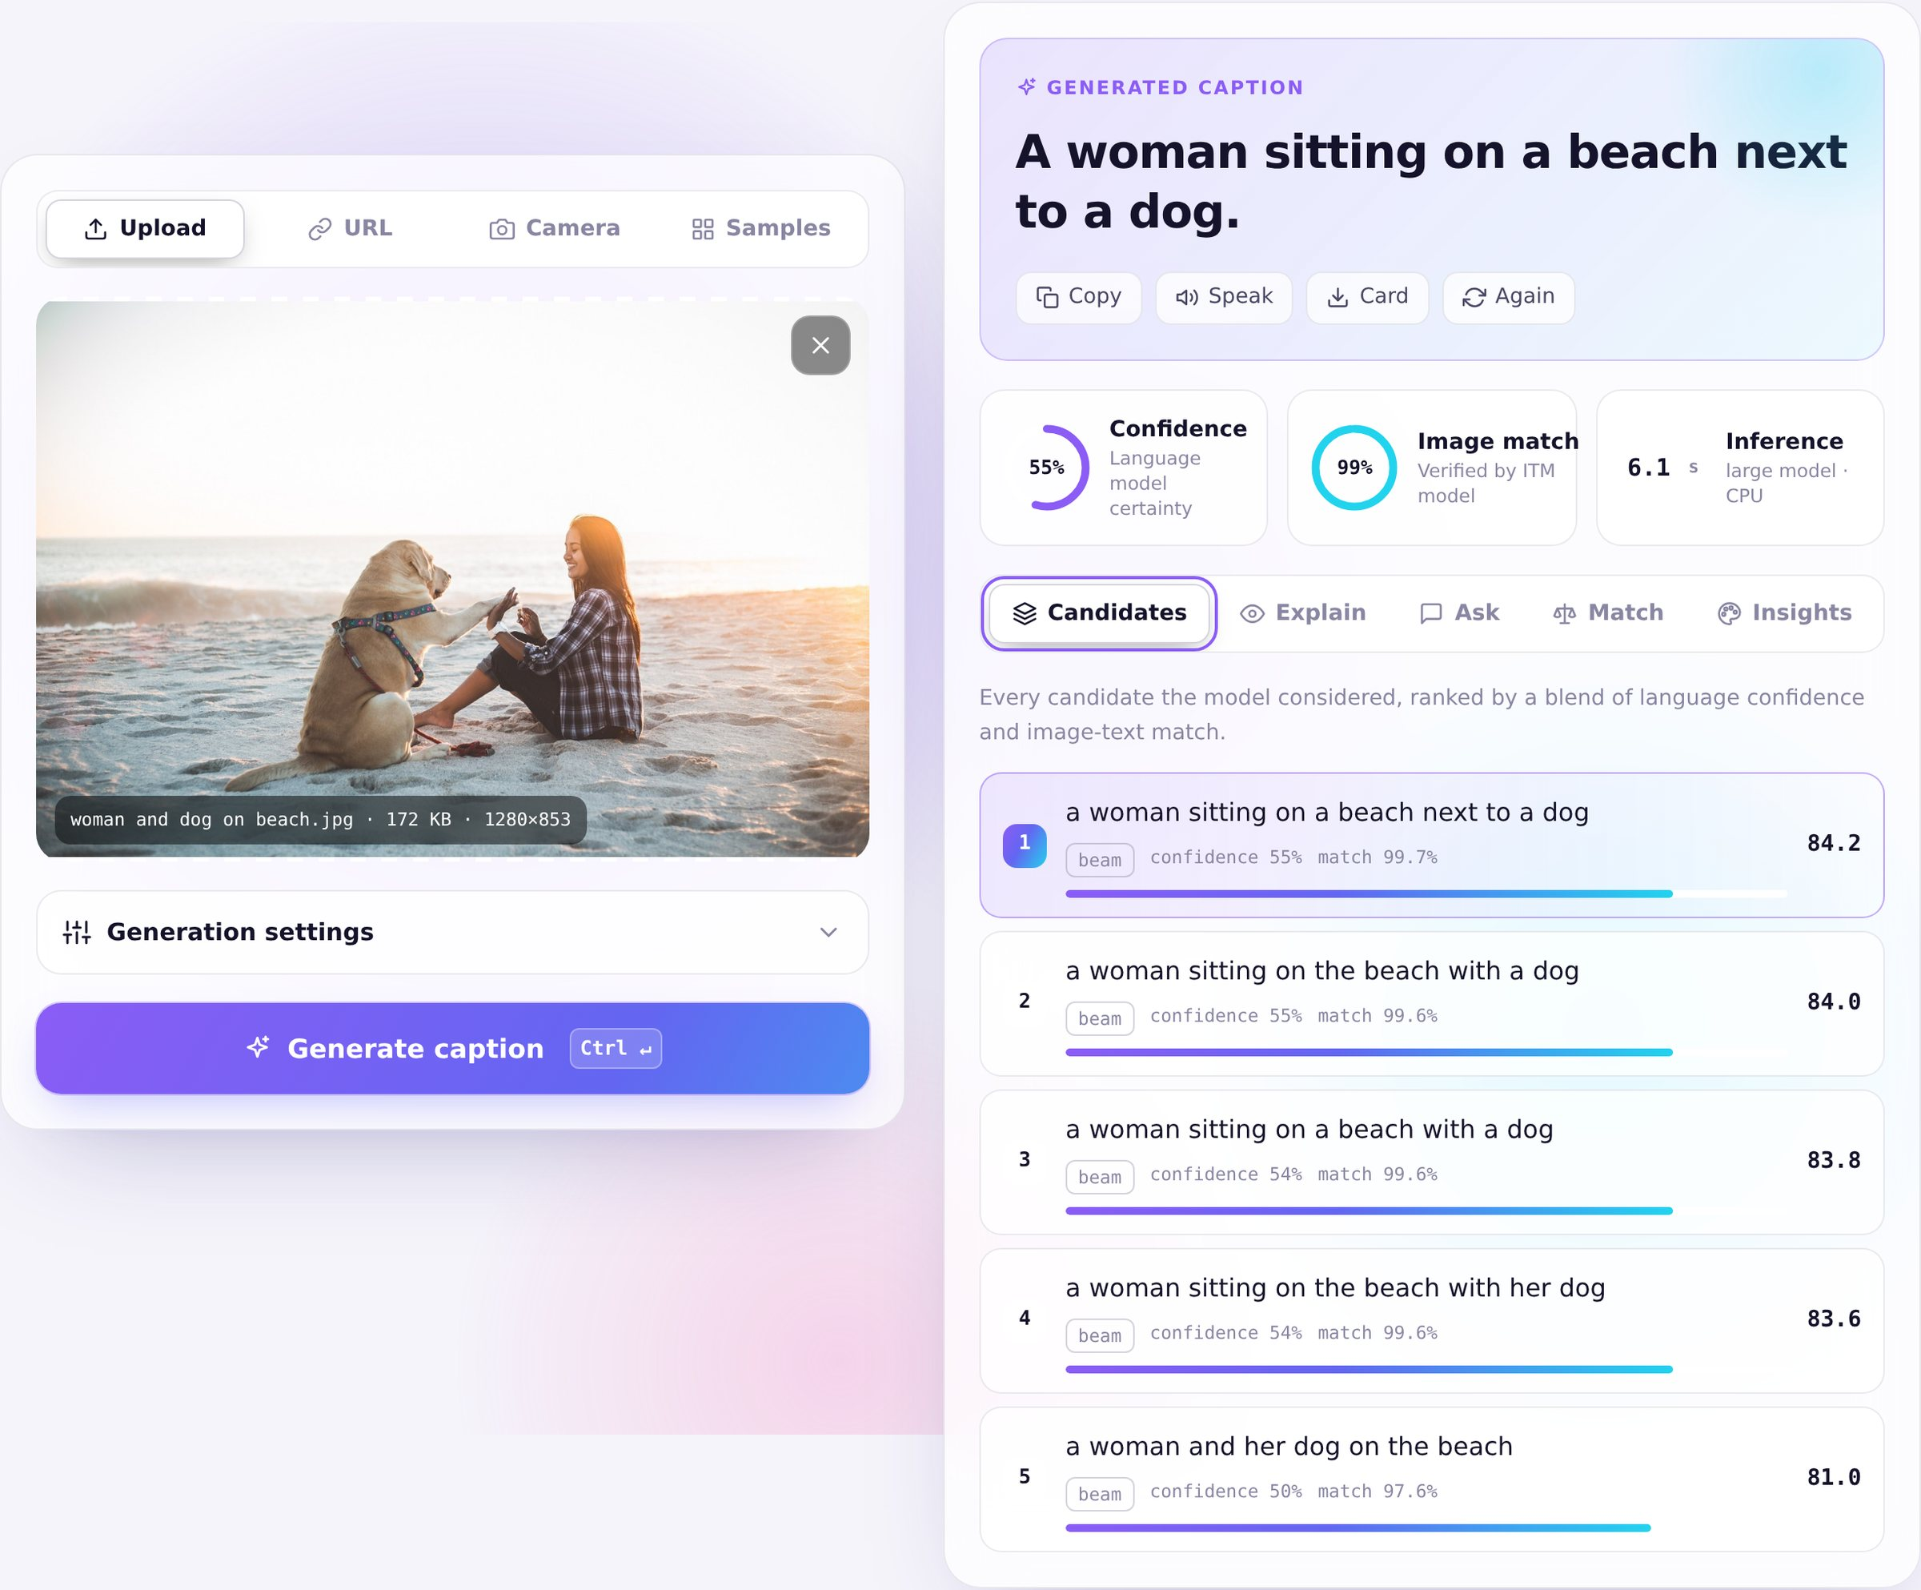
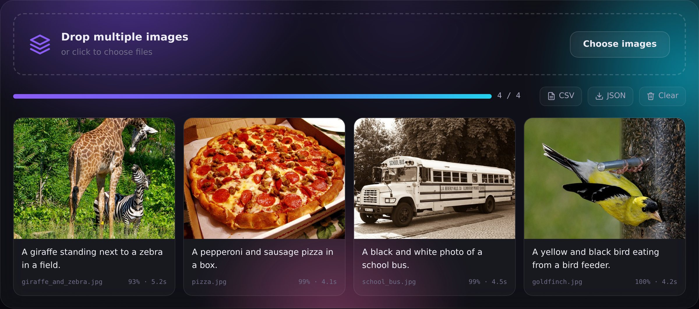
DESIGN & EXPERIENCE
Built to be a joy to use
Glassmorphism + animated aurora, dark & light themes
Scanning beam over the ViT's 24×24 patch grid while the AI works
Live pipeline checklist and neural-net loader
Word-by-word caption reveal, animated score rings
Responsive down to phones; reduced-motion support
Keyboard shortcuts, focus states, ARIA labels
PixelProse 11
Notes:
SPEAKER: Dhir Thakar (~50 s)
We treated the interface as seriously as the model. It's a glassmorphism design with dark and light themes, and it's fully responsive, so it even works on a phone.
Every wait is visualised: while the AI works, a scanning beam sweeps the image over a 24 by 24 grid, which is exactly how the Vision Transformer sees it, and a live checklist shows each stage of the pipeline.
We also respected accessibility: keyboard shortcuts, visible focus states, screen-reader labels and reduced-motion support for people who get motion sickness.
Now let's see it live.

Slide 12


Live demo
http://127.0.0.1:8000
1 Sample → Generate
2 Candidates
3 Explain heatmaps
4 Ask questions
5 Match descriptions
6 A fresh photo
7 Guided + fast mode
8 Speak & card
Notes:
SPEAKER: Dhir Thakar presents · Kartik Verma drives the laptop (~5 min)
Follow the run-sheet in docs/PRESENTATION_GUIDE.md, section 4:
1. Samples → people → "woman and dog on beach" → Generate. Point out the scanning 24×24 grid.
2. Read the caption and the 99.7% image match. Open Candidates and click the 2nd candidate.
3. Explain tab: hover "dog", then "woman", then "beach", then press Play. Pause and let the audience watch.
4. Ask: "what is the woman wearing?" and the chip "How many people are there?"
5. Match: "a cat sleeping on a sofa" vs "a woman playing with her dog".
6. Drag in a FRESH photo taken today from the desktop → Generate.
7. Settings: prefix "a painting of", Base model → Generate.
8. Speak, then download the Card. Optional: T for theme, H for history, the /docs tab.
If anything fails: switch to Base model, or go back to slides 4, 8 and 9 (they show real screenshots).

Slide 13
EVALUATION
Measured, not just claimed
Configuration | BLEU-4 | CIDEr-D | Match | sec
Base · greedy | 0.351 | 1.819 | 94% | 1.0
Large · greedy | 0.326 | 1.757 | 88% | 2.2
Large · beam 5 | 0.416 | 1.957 | 88% | 3.2
Balanced (default) | 0.408 | 1.945 | 92% | 3.9
Detailed (hybrid) | 0.399 | 1.913 | 97% | 5.6
What we learned
Beam search: +8% CIDEr-D over the baseline.
ITM re-ranking keeps that score and lifts image-match 88% → 92%: our default.
Detailed mode: 97% match with richer captions that short references under-reward.
44 images · 3 hand-written references each (132 total) · BLEU / ROUGE-L / CIDEr-D implemented from scratch & unit-tested · CPU, 4 cores · *default mode
PixelProse 13
Notes:
SPEAKER: Kushal Soni (~75 s)
To measure quality objectively we wrote three human reference captions for each of our 44 test images, 132 references in total. We compared five configurations with the standard captioning metrics: BLEU counts matching word sequences; ROUGE-L finds the longest common subsequence; CIDEr-D, the main COCO metric, weights informative words like "giraffe" higher than common words like "the". We implemented all three ourselves and unit-tested them.
Results (CIDEr-D): the base model with greedy decoding scores 1.82. Interestingly, the large model with greedy decoding is slightly lower at 1.76: a bigger model alone doesn't help if you decode naively. Beam search jumps to 1.96, a 8% gain.
Adding our ITM re-ranking on top of beam search keeps CIDEr-D essentially the same (1.94) but raises the image-match from 88% to 92%, so that's our default "Balanced" mode, at 3.9 seconds per image.
The Detailed mode reaches 97% image-match with longer, more specific captions, like "a bunch of red and white airplanes parked on an airport tarmac". Our short references don't contain those extra details, so n-gram metrics slightly penalise it. That's a known limitation of reference-based metrics.
Honesty note: 44 images is a small test set, so these numbers show trends rather than leaderboard scores, and the match score comes from the same model we re-rank with.

Slide 14



ENGINEERING
Three bugs that taught us the most
Silent config error
CPU thread contention
“arafed” artefacts
Matching model gave a correct caption a 2% match. The config used 8 attention heads instead of BLIP's 12: weights loaded fine, the maths was wrong.
In the browser a caption took >90 s instead of 5 s. PyTorch threads spin-wait; the browser's animations took one core and stalled all four.
BLIP-large sometimes invents words like “arafed” when decoding without context. We condition on its training prompt and clean the output.
2% → 99.6% match
>90 s → ~8 s
Clean captions
PixelProse 14
Notes:
SPEAKER: Kushal Soni (~70 s)
Three problems taught us the most.
One: when we first tested the matching model, it said a correct caption matched with only 2% probability. After debugging we found the configuration used 8 attention heads instead of BLIP's 12. The weight shapes are identical either way, so everything loaded without any error, but the maths was wrong. Fixing it brought the score to 99.6%, exactly the value in the official reference tests. Lesson: silent errors are the dangerous ones, so always validate against known outputs.
Two: in the browser, captioning sometimes took over 90 seconds instead of 5. PyTorch's threads spin-wait for each other, and when the browser's animations used one CPU core, all four threads stalled. Leaving one core free made it more than 10 times faster. We also pause decorative animations while the AI works.
Three: BLIP-large sometimes outputs nonsense words like "arafed". It learned them from noisy web alt-text. Conditioning on the prompt it was trained with ("a picture of"), plus a cleanup step, fixed it.

Slide 15




TECH STACK
What it's built with
PyTorch
Hugging Face Transformers
By the numbers
tensor maths & autograd
BLIP models & generation
4
~1.25 B
transformer models
parameters in total
FastAPI + Uvicorn
Pillow
8
22
REST API + OpenAPI docs
decoding, EXIF, palette
REST endpoints
features
44
35
HTML · CSS · JavaScript
pytest
sample images
automated tests
ES modules, Canvas, Web Speech
35 tests, models mocked
PixelProse 15
Notes:
SPEAKER: Kushal Soni (~40 s)
Our stack: Python, PyTorch and Hugging Face Transformers for the AI; FastAPI and Uvicorn for the server; Pillow for image processing; plain HTML, CSS and JavaScript for the interface, using the Canvas API for heatmaps and the Web Speech API for text-to-speech; and pytest for 35 automated tests. The neural networks are mocked in the tests, so the whole suite runs in about five seconds.
In total: four transformer models with about 1.25 billion parameters, eight REST endpoints and 22 features.

Slide 16






WHAT'S NEXT
Future scope
Indian languages
Bigger vision-language models
Hindi, Gujarati, Marathi captions via a translation model
BLIP-2 / Florence-2 for paragraph-length descriptions on GPU
Video captioning
Fine-tuning
Describe clips scene by scene
Adapt to Indian scenes and domain data (medical, retail)
On-device
Bias & safety audit
Quantised ONNX model inside a mobile app
Measure and reduce demographic bias in captions
PixelProse 16
Notes:
SPEAKER: Kushal Soni (~40 s)
Where next?
- Captions in Indian languages like Hindi, Gujarati and Marathi through a translation model.
- Larger vision-language models such as BLIP-2 or Florence-2 for paragraph-length descriptions when a GPU is available.
- Video captioning, scene by scene.
- Fine-tuning on Indian scenes and domain data, because most training data is Western.
- A quantised model running on-device in a mobile app.
- And a bias and safety audit of the captions.
HANDOVER: "Kartik will conclude."

Slide 17
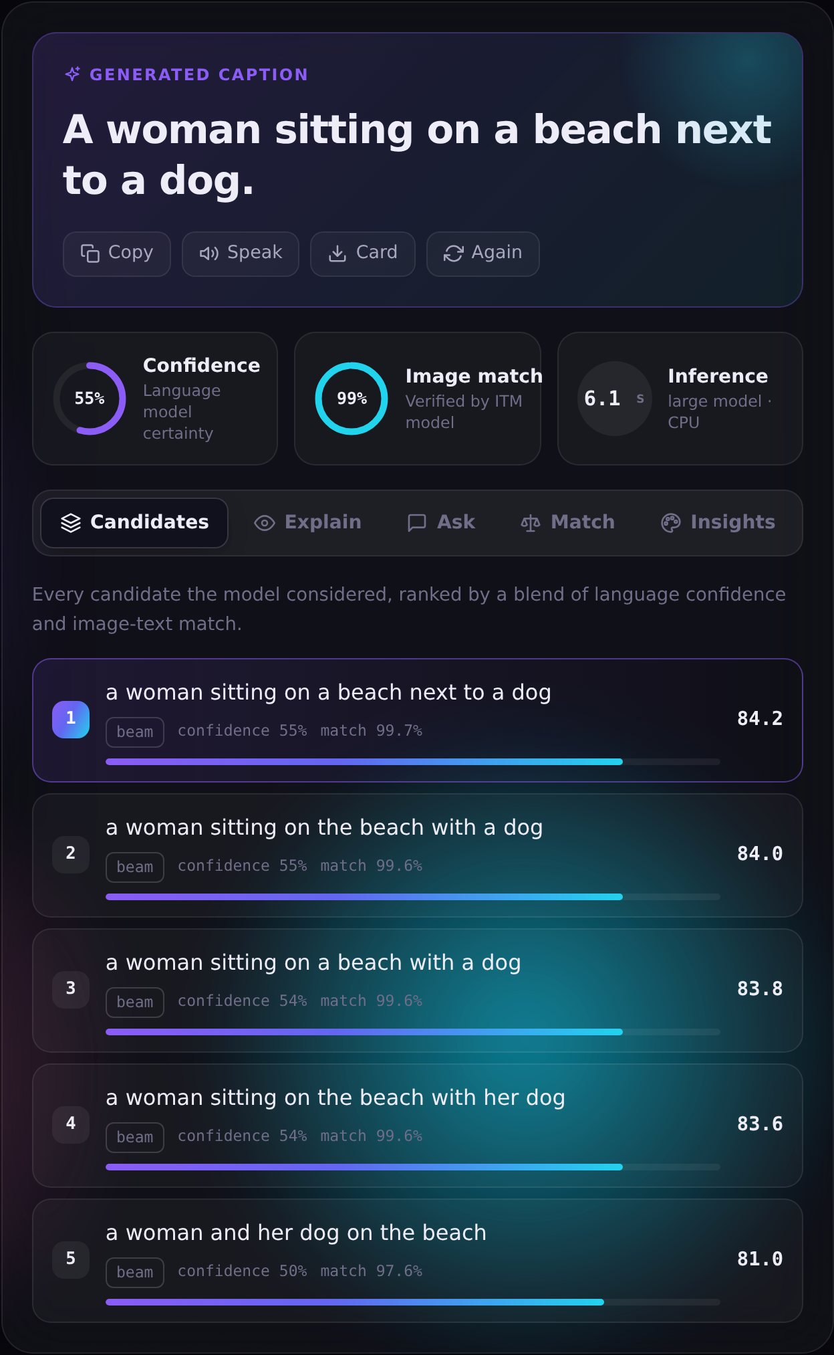
Thank you
Questions?
Accurate captions, verified by a second model
Word-level explanations with Grad-CAM
Visual Q&A and description matching
Runs offline on a laptop CPU
Kartik Verma
Dhir Thakar
Kushal Soni
Notes:
SPEAKER: Kartik Verma, then all three for questions
To conclude: PixelProse generates accurate captions, verifies them with a second model, explains them word by word, answers questions, and runs entirely on a laptop.
Thank you for your attention. We're happy to take questions.
Q&A prep: see docs/PRESENTATION_GUIDE.md section 5 (did you train it, CNN-LSTM vs transformers, attention, confidence, BLEU/CIDEr, why not GPT-4V, Grad-CAM, decoding strategies, limitations, speed, memory).

