Slide 1

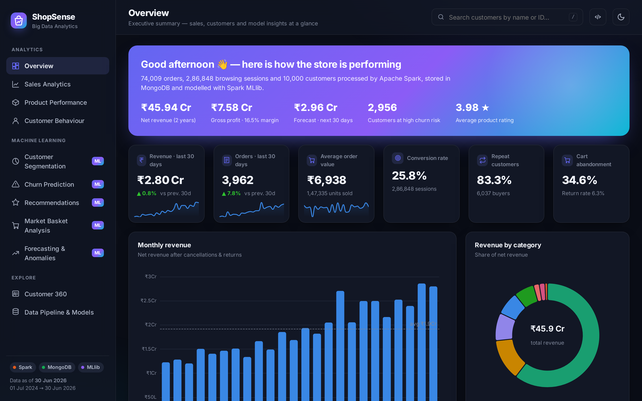

ShopSense
E-Commerce Sales & Customer Behaviour Analytics
using Big Data — Apache Spark · MongoDB · Machine Learning
Presented by
Kartik Verma · Kushal Soni · Dhir Thakar
Guide: <Guide Name>
LY Innovation-Based Major Project-B · Dept. of Computer Engineering
K. J. Somaiya Institute of Technology, Sion, Mumbai · 2026-27
Notes:
Introduce the team and the project title. ShopSense is an end-to-end Big Data platform: Apache Spark processes about 1.4 million e-commerce records, MongoDB stores the results, and six machine-learning models turn them into decisions shown on an interactive dashboard (screenshot on the right).

Slide 2
ROADMAP
Agenda
01
Problem & objectives
02
Literature & research gaps
03
Technology stack & architecture
04
Data pipeline & data quality
05
Machine-learning models & results
06
Live dashboard walkthrough
07
Business insights
08
Conclusion & future scope
ShopSense · Big Data Analytics | 2
Notes:
Walk through the structure of the talk: we start with the problem, then the design and the Big Data pipeline, then the six models with their results, a live demo of the dashboard, the business insights, and finally conclusions and future work.

Slide 3






PROBLEM STATEMENT
The problem: data-rich, insight-poor online retailers
Too big & too varied
Messy data
Orders, catalogues, profiles and 1 M+ click-stream events overwhelm spreadsheets and single servers.
Duplicates, "upi" vs " UPI ", missing cities and invalid quantities silently corrupt reports.
Fragmented tools
Reactive retention
Sales, funnel, segmentation and forecasts live in separate tools with no single customer view.
Valuable customers are noticed only after they have left, with no warning and no explanation.
Generic merchandising
No foresight
Everyone sees the same best-sellers; bundles are designed by intuition.
Plans ignore festive-sale effects; outages and bulk orders go unnoticed.
ShopSense · Big Data Analytics | 3
Notes:
Online retailers collect huge amounts of data but struggle to use it. Explain each of the six pain points. Our goal: one scalable Big Data system that ingests heterogeneous data, cleans it, derives analytics and ML insights with Spark, stores them in MongoDB and presents them in a decision-oriented dashboard.

Slide 4
WHAT WE SET OUT TO BUILD
Aim & objectives
Build an end-to-end platform that uses Apache Spark, MongoDB and machine learning to analyse e-commerce sales and customer behaviour and deliver predictive, explainable insights through an interactive dashboard.
Generate
Engineer
Analyse
Realistic 2-year dataset with seasonality, churn & dirty data
Bronze → silver → gold Spark pipeline with a data-quality report
KPIs, geo, funnels, sessions & cohort retention (Spark SQL)
Store
Predict
Deliver
Query-shaped MongoDB documents written in parallel
Segments, churn, recommendations, bundles, forecast, anomalies
REST API + 11-page dashboard, simulator & CSV export
ShopSense · Big Data Analytics | 4
Notes:
Read the aim, then the six objectives as verbs: generate, engineer, analyse, store, predict and deliver. Each maps to a module of the code and a chapter of the report.

Slide 5
VOLUME · VARIETY · VELOCITY
Why is this a Big Data problem?
1.35 M
74,348
10,000
315 MB
click-stream events (JSON-lines, 24 monthly files)
orders with 1.45 lakh line items
customers across 28 Indian cities
raw data per run (medium scale); 790 MB at large scale
Volume
≈1.4 million records per run; scales to 3.4 M+ events without code changes.
Variety
Structured CSV tables + semi-structured JSON logs + product catalogue with nested fields.
Velocity
Every visit produces 4–7 events; daily batch runs, with a streaming path (Kafka) as future work.
ShopSense · Big Data Analytics | 5
Notes:
Justify the Big Data tools with the 3 Vs. The dataset is generated by our own behaviour-driven simulator: realistic personas, Indian sale festivals, churn and deliberately dirty records. The same code scales from small to large data sizes.

Slide 6
WHAT EXISTS · WHAT IS MISSING
Literature review & research gaps
Key references (25 reviewed)
Gap → how ShopSense addresses it
Spark / RDD — Zaharia et al. 2012, 2016
In-memory distributed processing
Isolated solutions → One pipeline feeds all models + Customer 360
MLlib — Meng et al. 2016
Scalable ML pipelines
Temporal leakage in churn → Strict observation / label windows
RFM + k-means — Chen et al. 2012
Customer segmentation
Explicit-rating assumption → Implicit views, carts & purchases
Churn benchmarks — Verbeke et al. 2012
Classifier comparison
Implicit ALS — Hu, Koren & Volinsky 2008
Recommendations from clicks
Data quality ignored → Measured cleaning with a DQ report
FP-Growth — Han et al. 2000
Frequent itemsets
Naïve forecasts & alarms → Sale-calendar features, robust residual z-score
Prophet — Taylor & Letham 2018
Holiday-aware forecasting
MAD outliers — Leys et al. 2013
Robust anomaly detection
Metrics, not actions → Playbooks, explanations, simulator, CSV export
ShopSense · Big Data Analytics | 6
Notes:
Summarise the literature: Spark and MLlib for distributed processing and ML, RFM segmentation, churn benchmarking, implicit ALS, FP-Growth, Prophet and robust outlier detection. Then explain the six research gaps and how our system addresses each one.

Slide 7





PYTHON + SPARK + MONGODB + MACHINE LEARNING
Technology stack
Python 3.11
Apache Spark 3.5
Spark MLlib
Pipeline, ML & API code
PySpark DataFrames, Spark SQL
K-Means · LR · RF · GBT · ALS · FP-Growth
MongoDB 8
FastAPI
ECharts + JS
Document store, aggregation pipelines
29 REST endpoints + Swagger docs
11-page responsive dashboard
ShopSense · Big Data Analytics | 7
Notes:
Everything is open source. Spark does distributed ETL and machine learning, MongoDB is the serving database, FastAPI exposes a REST API and the dashboard is plain JavaScript with Apache ECharts. It runs on a normal laptop with Java 17 and Python 3.11.

Slide 8
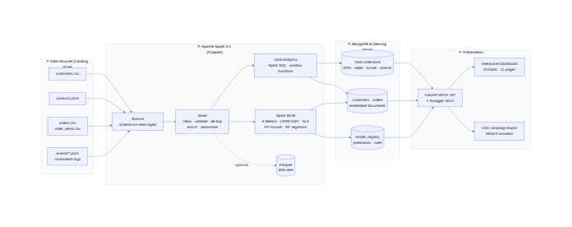
BATCH PROCESSING LAYER + LOW-LATENCY SERVING LAYER
System architecture
1 Sources
CSV + JSON-lines landing zone
2 Spark
bronze → silver → gold, MLlib
3 MongoDB
query-shaped gold documents
4 Serving
FastAPI + dashboard
ShopSense · Big Data Analytics | 8
Notes:
Four layers. Raw files land on disk. Spark does all heavy work: ingestion, cleaning, aggregation and model training. Results are written in parallel into MongoDB as small query-shaped documents, so the API and dashboard never touch raw data and answer in milliseconds. This batch/serving split is how large e-commerce analytics platforms are built.

Slide 9
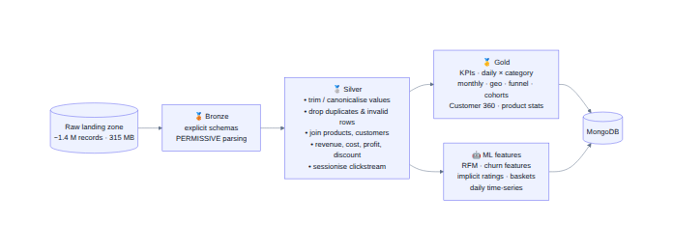
MEDALLION ARCHITECTURE
Spark pipeline & data quality
Run on a 4-core laptop (medium scale)
Dataset | Raw | Clean | Fixed
Customers | 10,033 | 10,000 | 33 dup · 107 cities
Orders | 74,348 | 74,052 | 296 dup · 1,518 payments
Order items | 1,45,368 | 1,45,160 | 208 invalid qty
Events | 13,51,601 | 13,47,800 | 2,685 dup · 3,362 casing
Total: 6.7 min for ≈1.4 M records · every stage logged to MongoDB
ShopSense · Big Data Analytics | 9
Notes:
Bronze reads raw files with explicit schemas; silver standardises values, removes duplicates and invalid rows, joins products and customers, computes revenue and profit and sessionises the click-stream; gold computes analytics. The table shows the data-quality report: every injected problem is caught and counted. On the right: stage timings. The whole run takes under 7 minutes.

Slide 10



INTELLIGENCE LAYER
Six machine-learning models (Spark MLlib)
Segmentation
Churn prediction
Recommendations
RFM + K-Means
LR vs RF vs GBT
Implicit-feedback ALS
k = 5 · silhouette 0.375
AUC 0.955 · precision 93.5%
HitRate@10 0.18 · 1.8× baseline
Market basket
Forecasting
Anomaly detection
FP-Growth
LR trend + RF seasonality
Robust z-score (MAD)
281 rules · lift up to 135×
best daily MAPE 20.78% · weekly 6.78%
4/4 planted events · 0 false alarms
ShopSense · Big Data Analytics | 10
Notes:
Overview of the six models and their headline results; the next slides go into each. All models are trained inside the Spark pipeline and their metrics are stored in a model_registry collection in MongoDB.

Slide 11
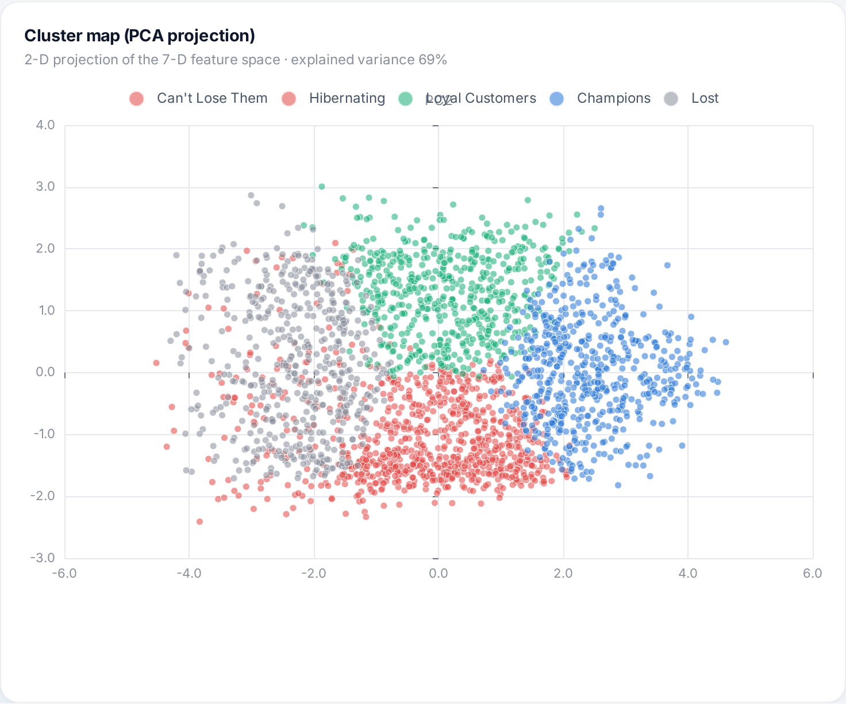
RFM + K-MEANS
Customer segmentation: who are our customers?
Segment | Customers | Avg orders | Revenue
Champions | 1,394 | 30.1 | 71.58%
Can't Lose Them | 1,541 | 7.9 | 15.21%
Loyal Customers | 1,406 | 6.4 | 11.97%
Lost | 1,223 | 1.7 | 0.85%
Hibernating | 473 | 1.9 | 0.4%
23% of buyers → 72% of revenue
Champions dominate revenue; “Can’t Lose Them” (high value, silent ≈1 year) are the prime VIP win-back target. k chosen by silhouette over k = 3…8; clusters named automatically from centroids with a marketing playbook.
ShopSense · Big Data Analytics | 11
Notes:
Seven RFM-style features (log-transformed and standardised) are clustered with K-Means for k from 3 to 8; k = 5 has the best silhouette. Clusters are named automatically from their centroids. The PCA map shows clear separation. Key insight: Champions are about a quarter of buyers but 72% of revenue.

Slide 12
LEAK-FREE, TIME-BASED DESIGN
Churn prediction: who will stop buying?
Features: only data before cutoff (2026-04-02) → Label: no order in the next 90 days → 57.17% churned
Top churn drivers (Random Forest)
Days since last visit
20.5%
Sessions in last 30 days
19.6%
Sessions in last 90 days
14.2%
Days since last order
9.5%
Spend in last 90 days
8.9%
Orders in last 90 days
8.3%
2,956 high-risk customers · ₹8.37 Cr annual revenue at risk
ShopSense · Big Data Analytics | 12
Notes:
Churn = no successful order in the next 90 days. Features come only from data before the cutoff date, so there is no leakage. Three models were trained on 80% of customers and tested on 20%; Random Forest wins with AUC 0.955 and 93.5% precision. The strongest predictors are click-stream engagement features, which shows the value of processing log data.

Slide 13
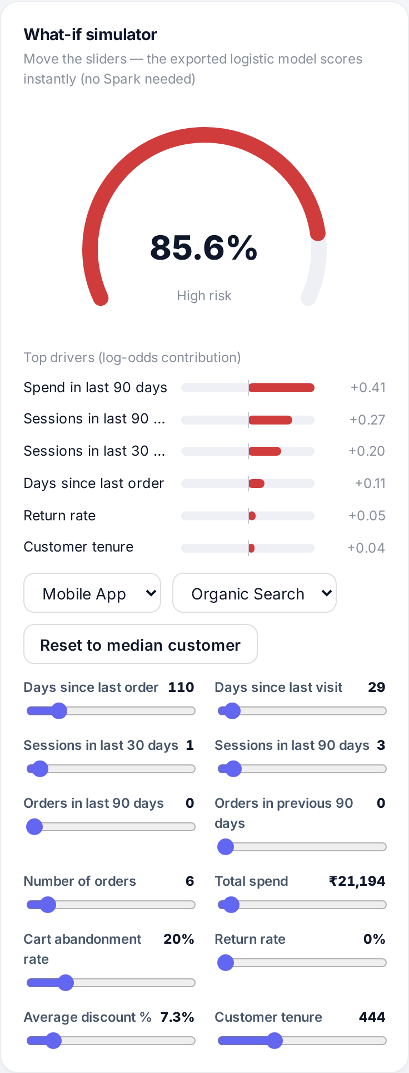
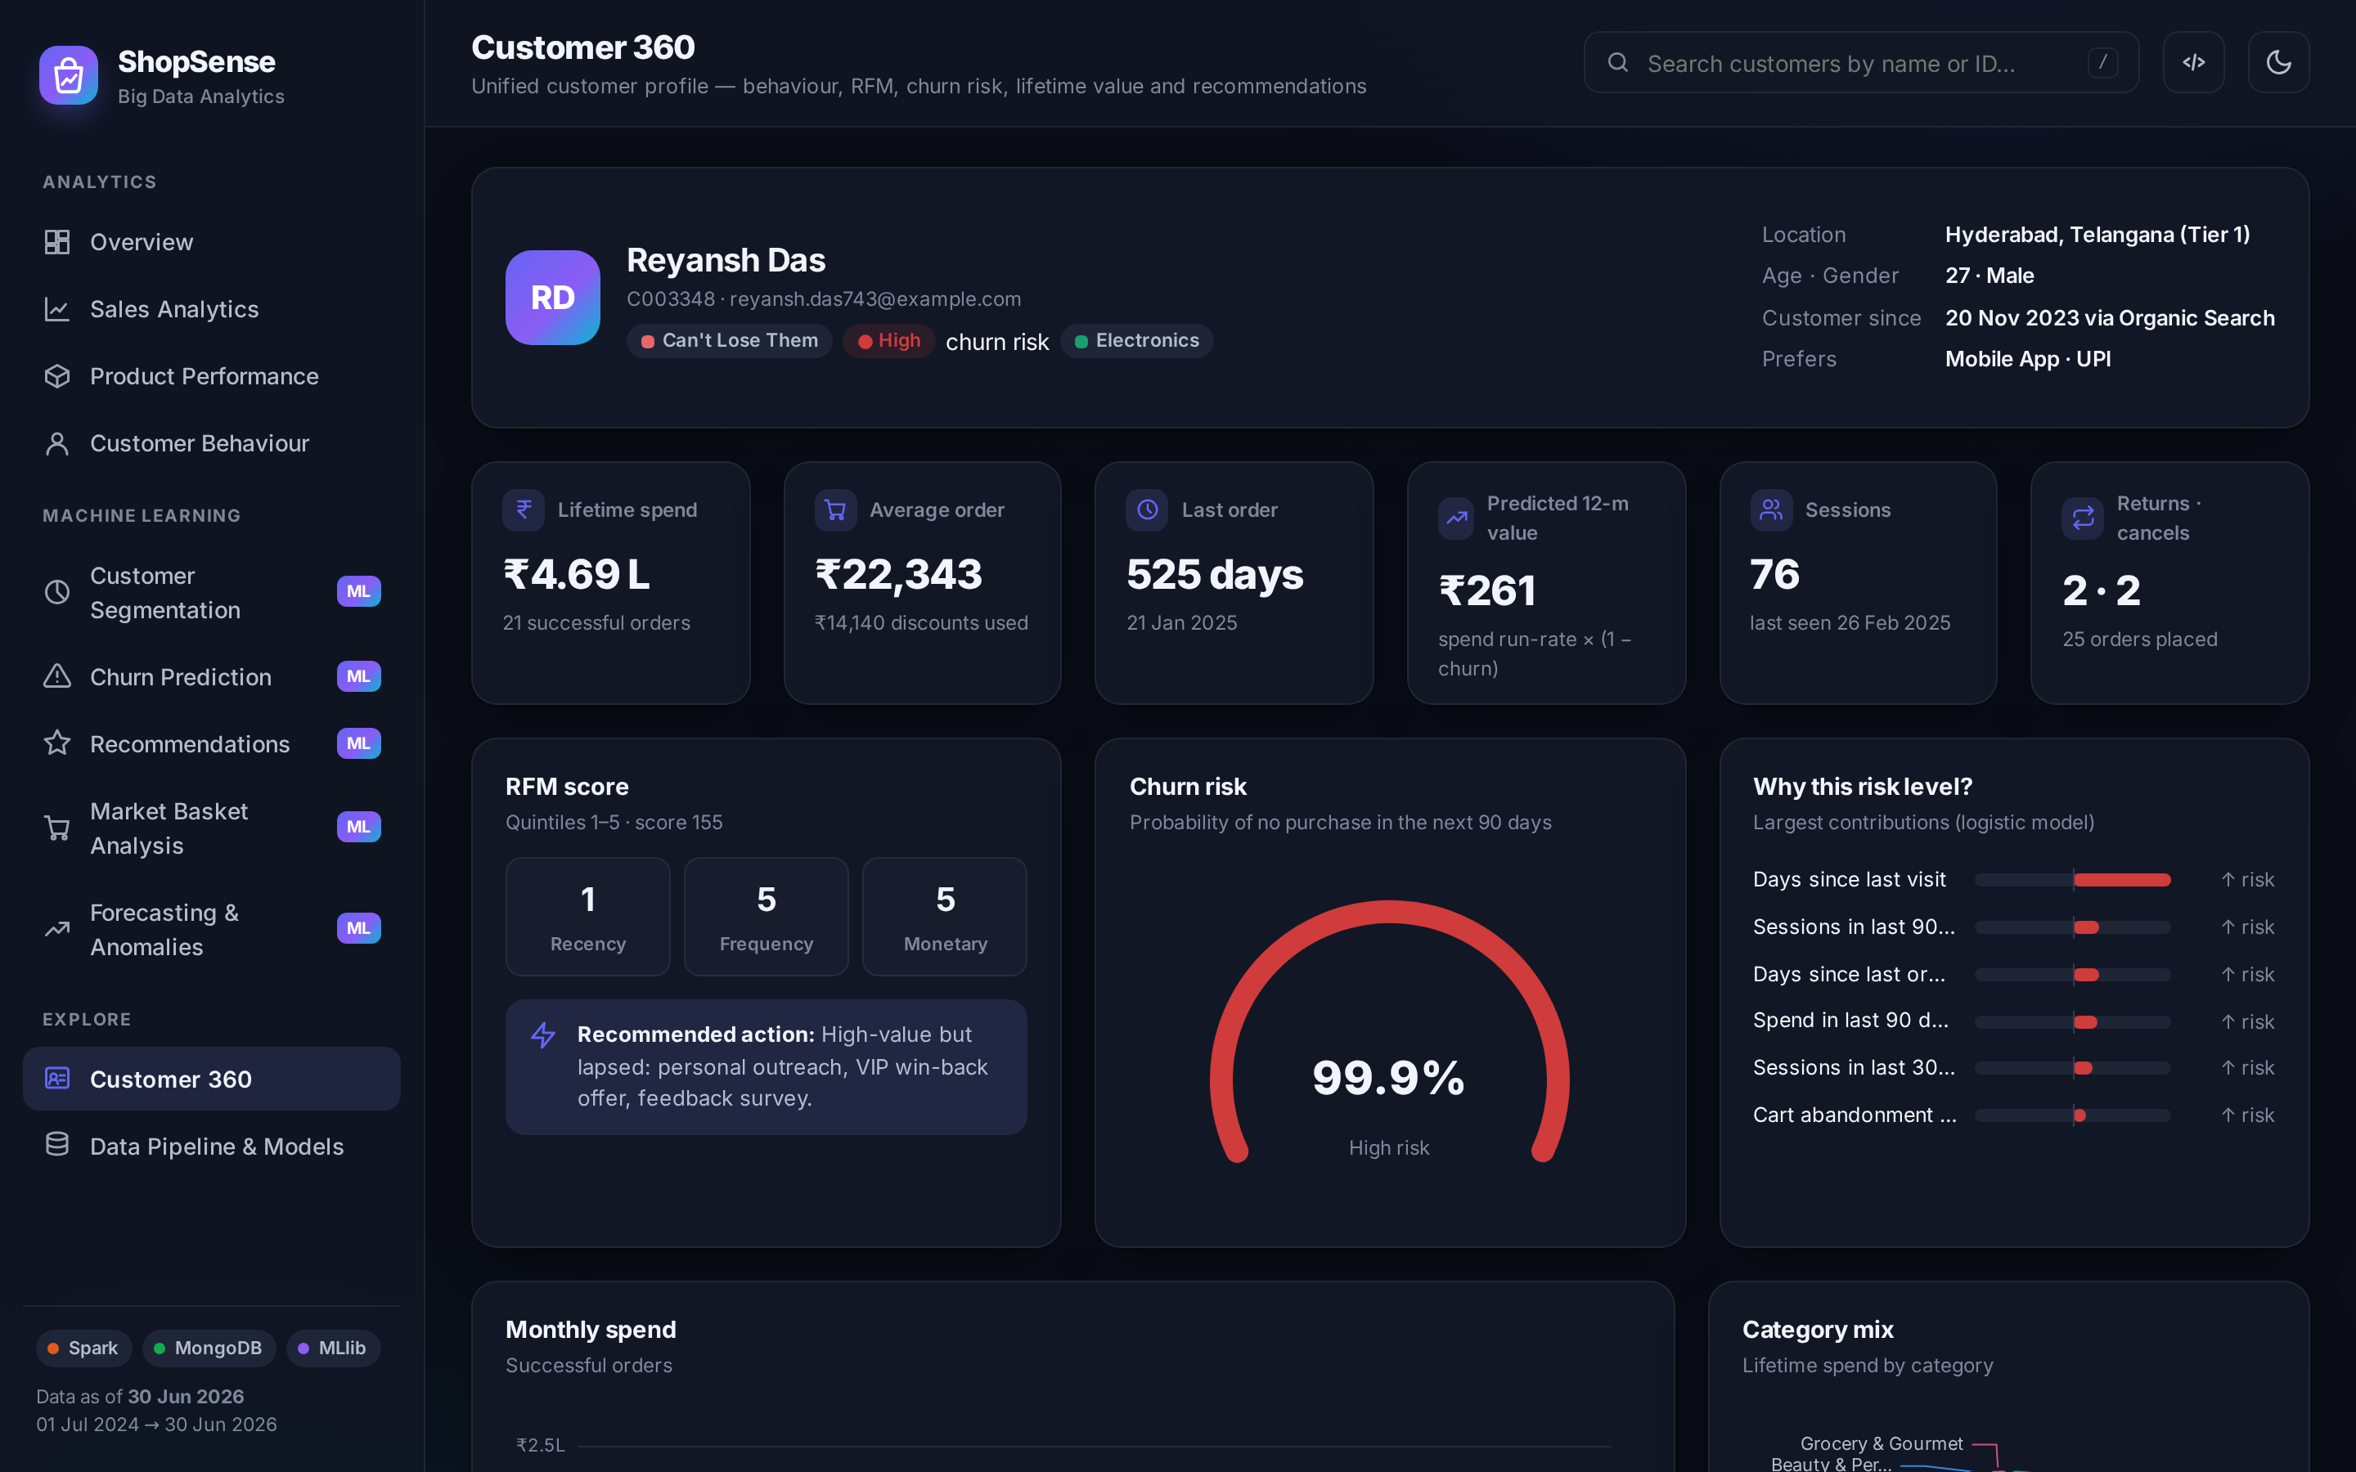
EXPLAINABLE & ACTIONABLE: FROM PREDICTION TO DECISION
What-if simulator & Customer 360
Logistic model exported to MongoDB → API scores in ~1 ms without Spark
Per-feature log-odds contributions explain every score
Win-back list sorted by predicted 12-month value, exported as CSV
ShopSense · Big Data Analytics | 13
Notes:
Predictions must be actionable. The what-if simulator lets a marketer move sliders, for example days since last visit, and see the churn probability and its drivers change instantly. Customer 360 combines profile, RFM score, churn gauge with explanation, orders and recommendations for one customer.

Slide 14
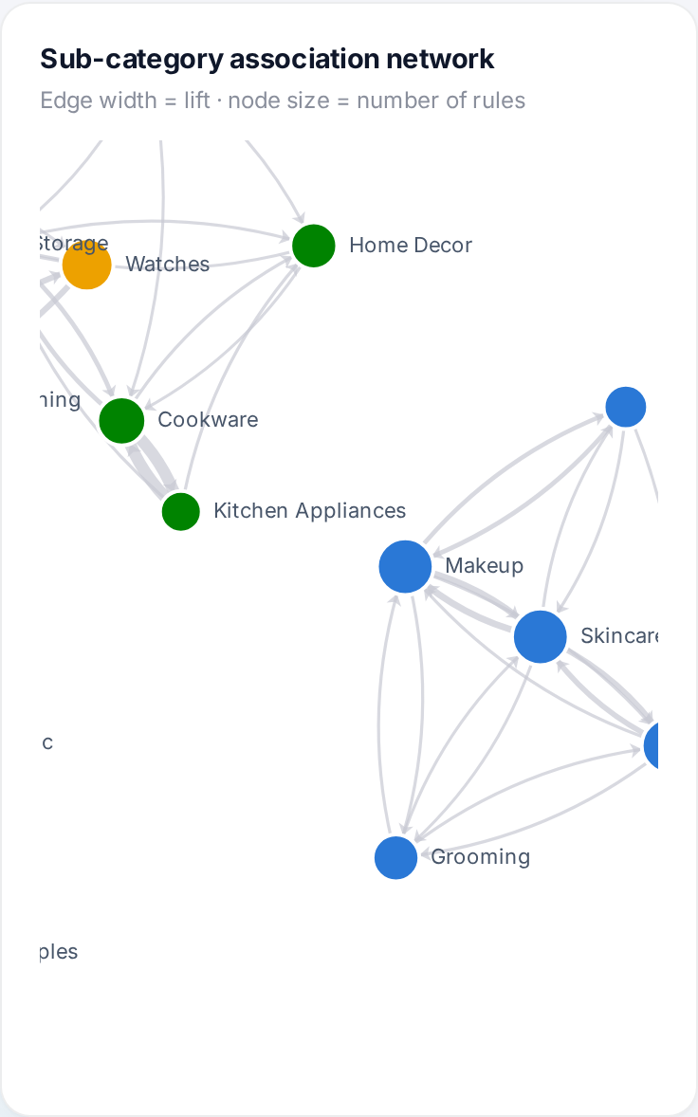
ALS COLLABORATIVE FILTERING · FP-GROWTH
Recommendations & market-basket analysis
Cookware → Kitchen Appliances lift 10.5 · conf 41%
Non-Fiction → Fiction lift 8.5 · conf 26%
Toys → Baby Care lift 7.9 · conf 30%
1.8× more hits than recommending best-sellers (rank 64, λ=1, α=5, grid-searched)
ShopSense · Big Data Analytics | 14
Notes:
ALS learns latent factors from implicit signals (views, carts, wishlists, purchases). Evaluation hides each customer’s last purchase: ALS finds it in the Top-10 1.8 times more often than a popularity recommender. FP-Growth mines association rules; the network shows categories bought together, for example cookware with kitchen appliances, which drives bundle offers.

Slide 15
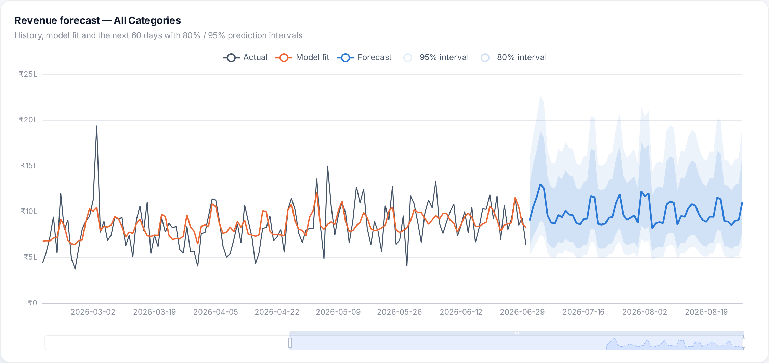
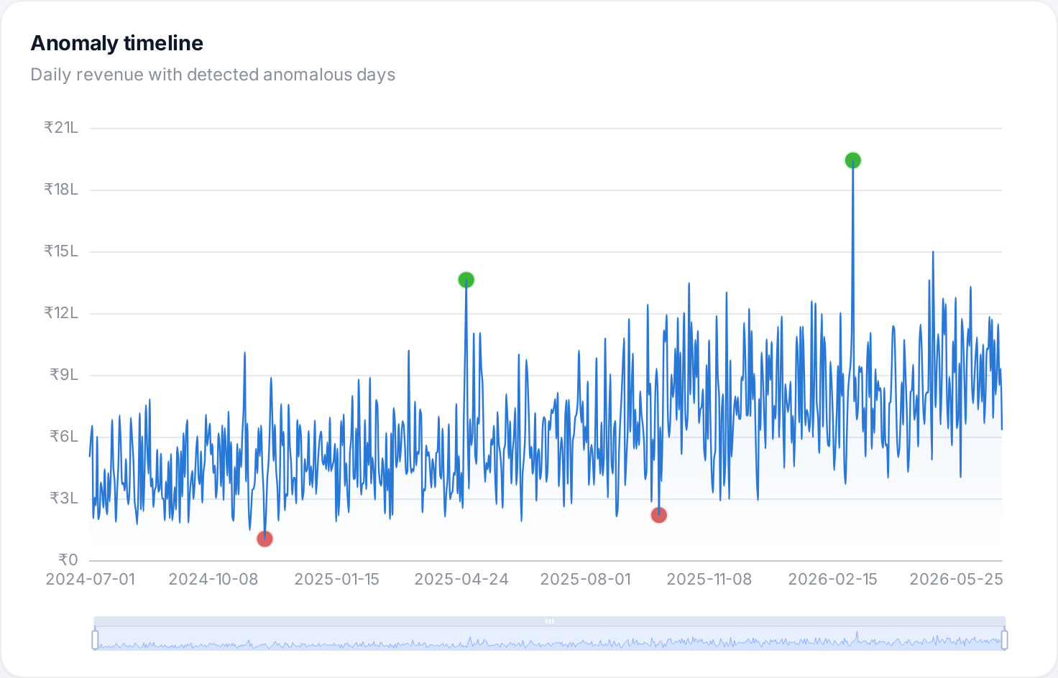
WHAT COMES NEXT · WHAT WAS UNUSUAL
Forecasting & anomaly detection
Model | Daily MAPE | Weekly
Hybrid (ours) | 20.78% | 6.78%
Calendar Linear Regression | 22.72% | 7.56%
Seasonal Naive | 24.72% | 6.31%
28-day Moving Average | 21.91% | 14.42%
4 / 4
planted anomalies found, 0 false alarms
Gateway outage · viral flash sale · downtime · bulk order. Residual robust z-score ignores festivals that the model already expects.
ShopSense · Big Data Analytics | 15
Notes:
The forecaster combines a linear trend with a random-forest seasonality model that knows weekdays, salary days and the planned sale calendar, with smearing bias correction and 80/95% intervals. It beats three baselines on daily error. Daily revenue is noisy because a few laptop orders dominate some days; on weekly totals the error is about 7%. Anomaly detection uses the same model: all four planted events were found with no false alarms.

Slide 16
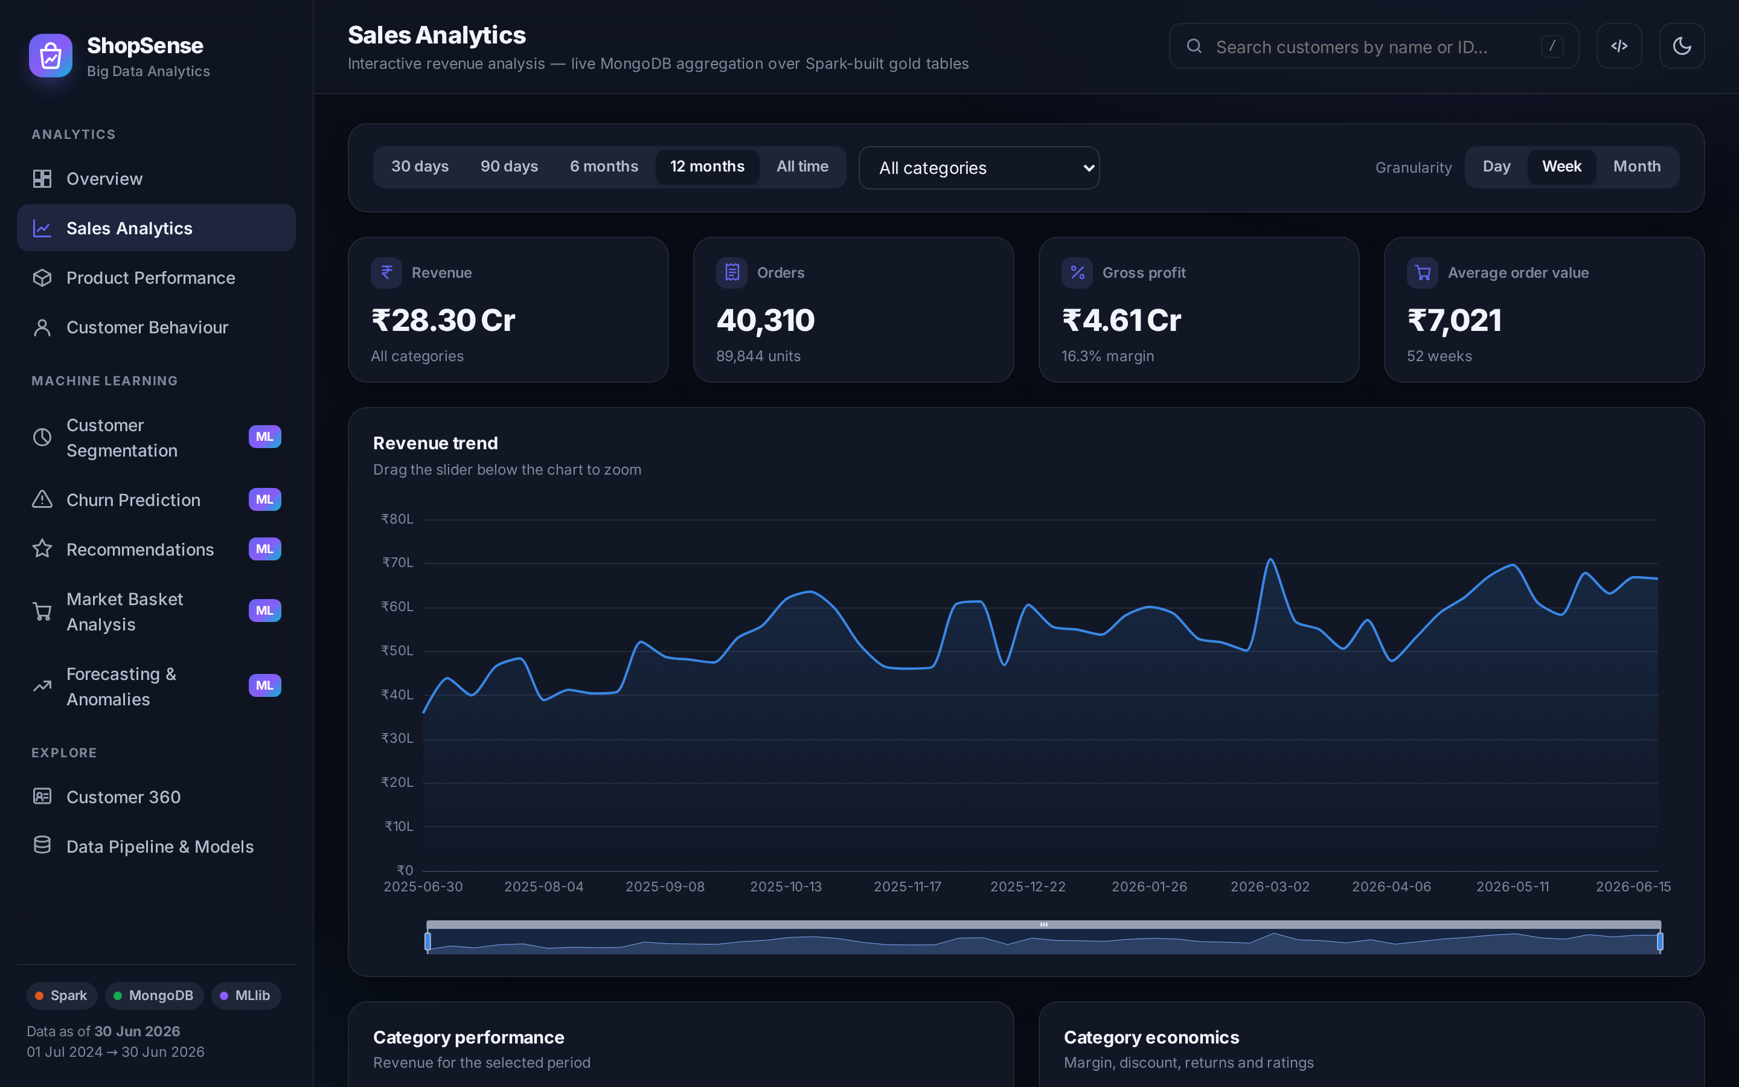
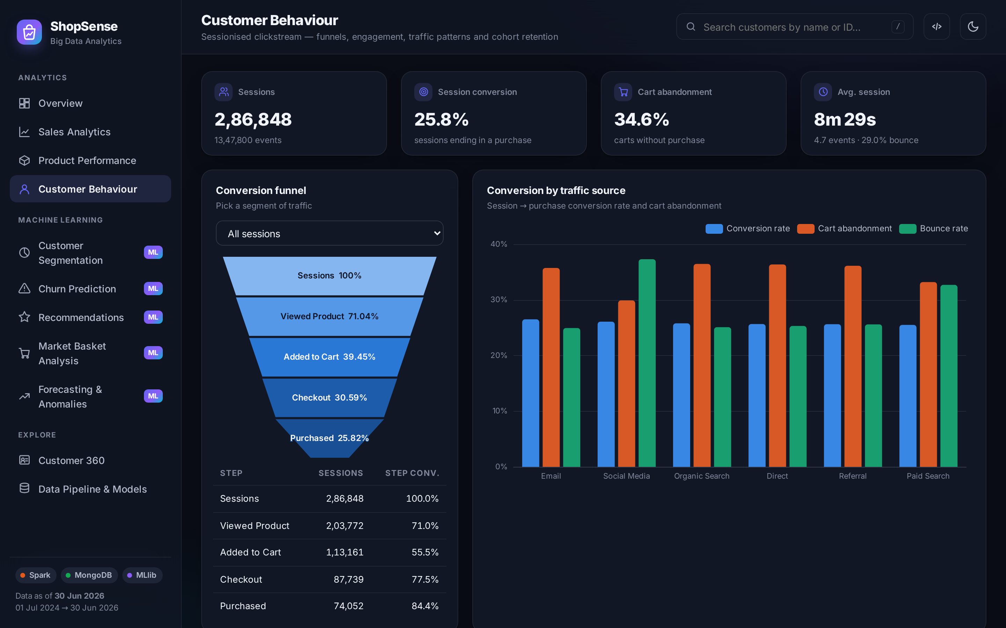
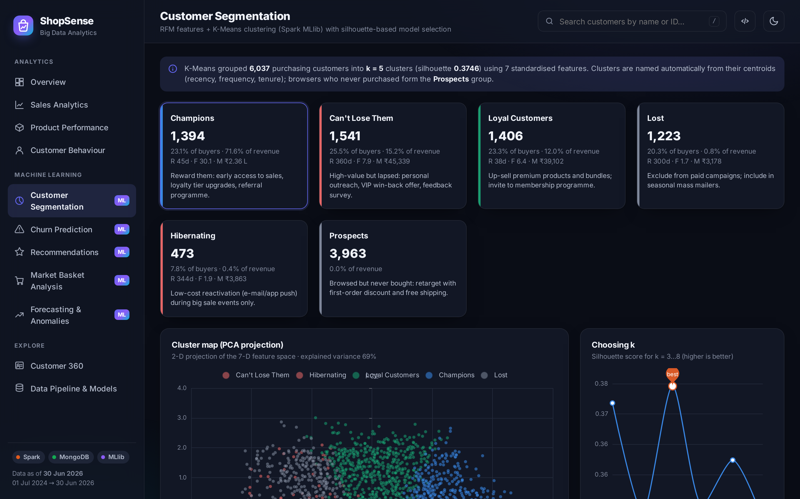
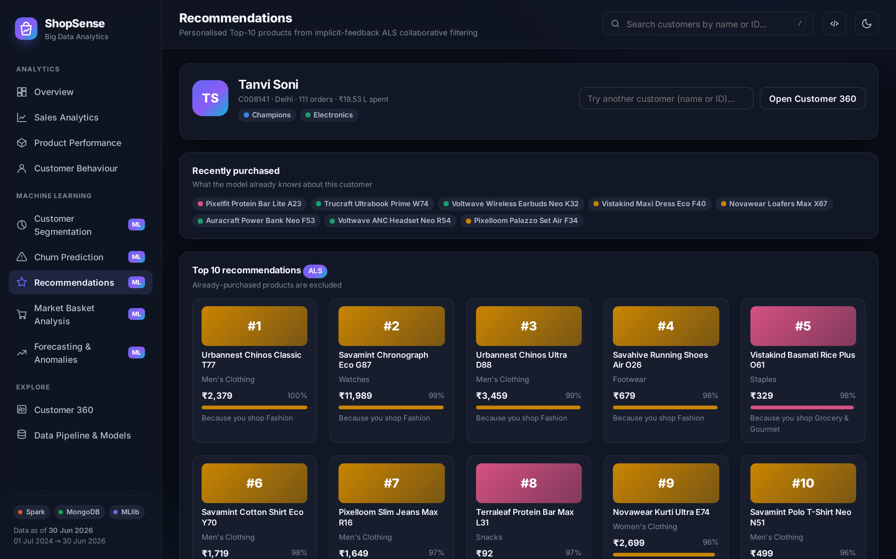
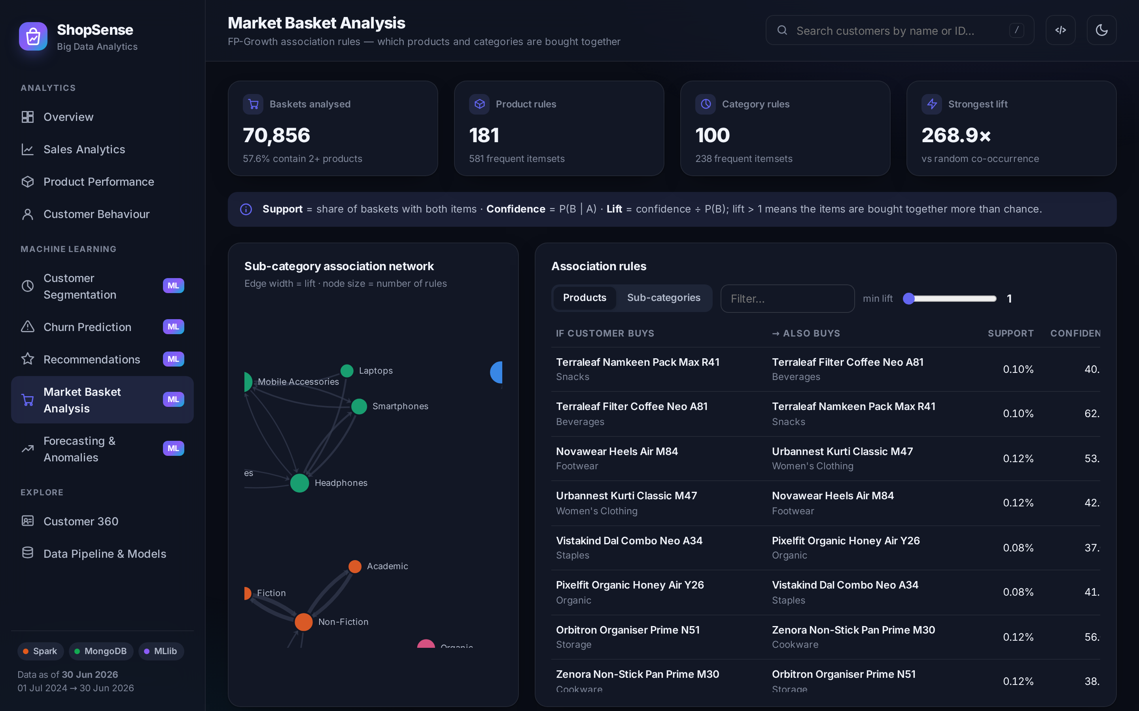
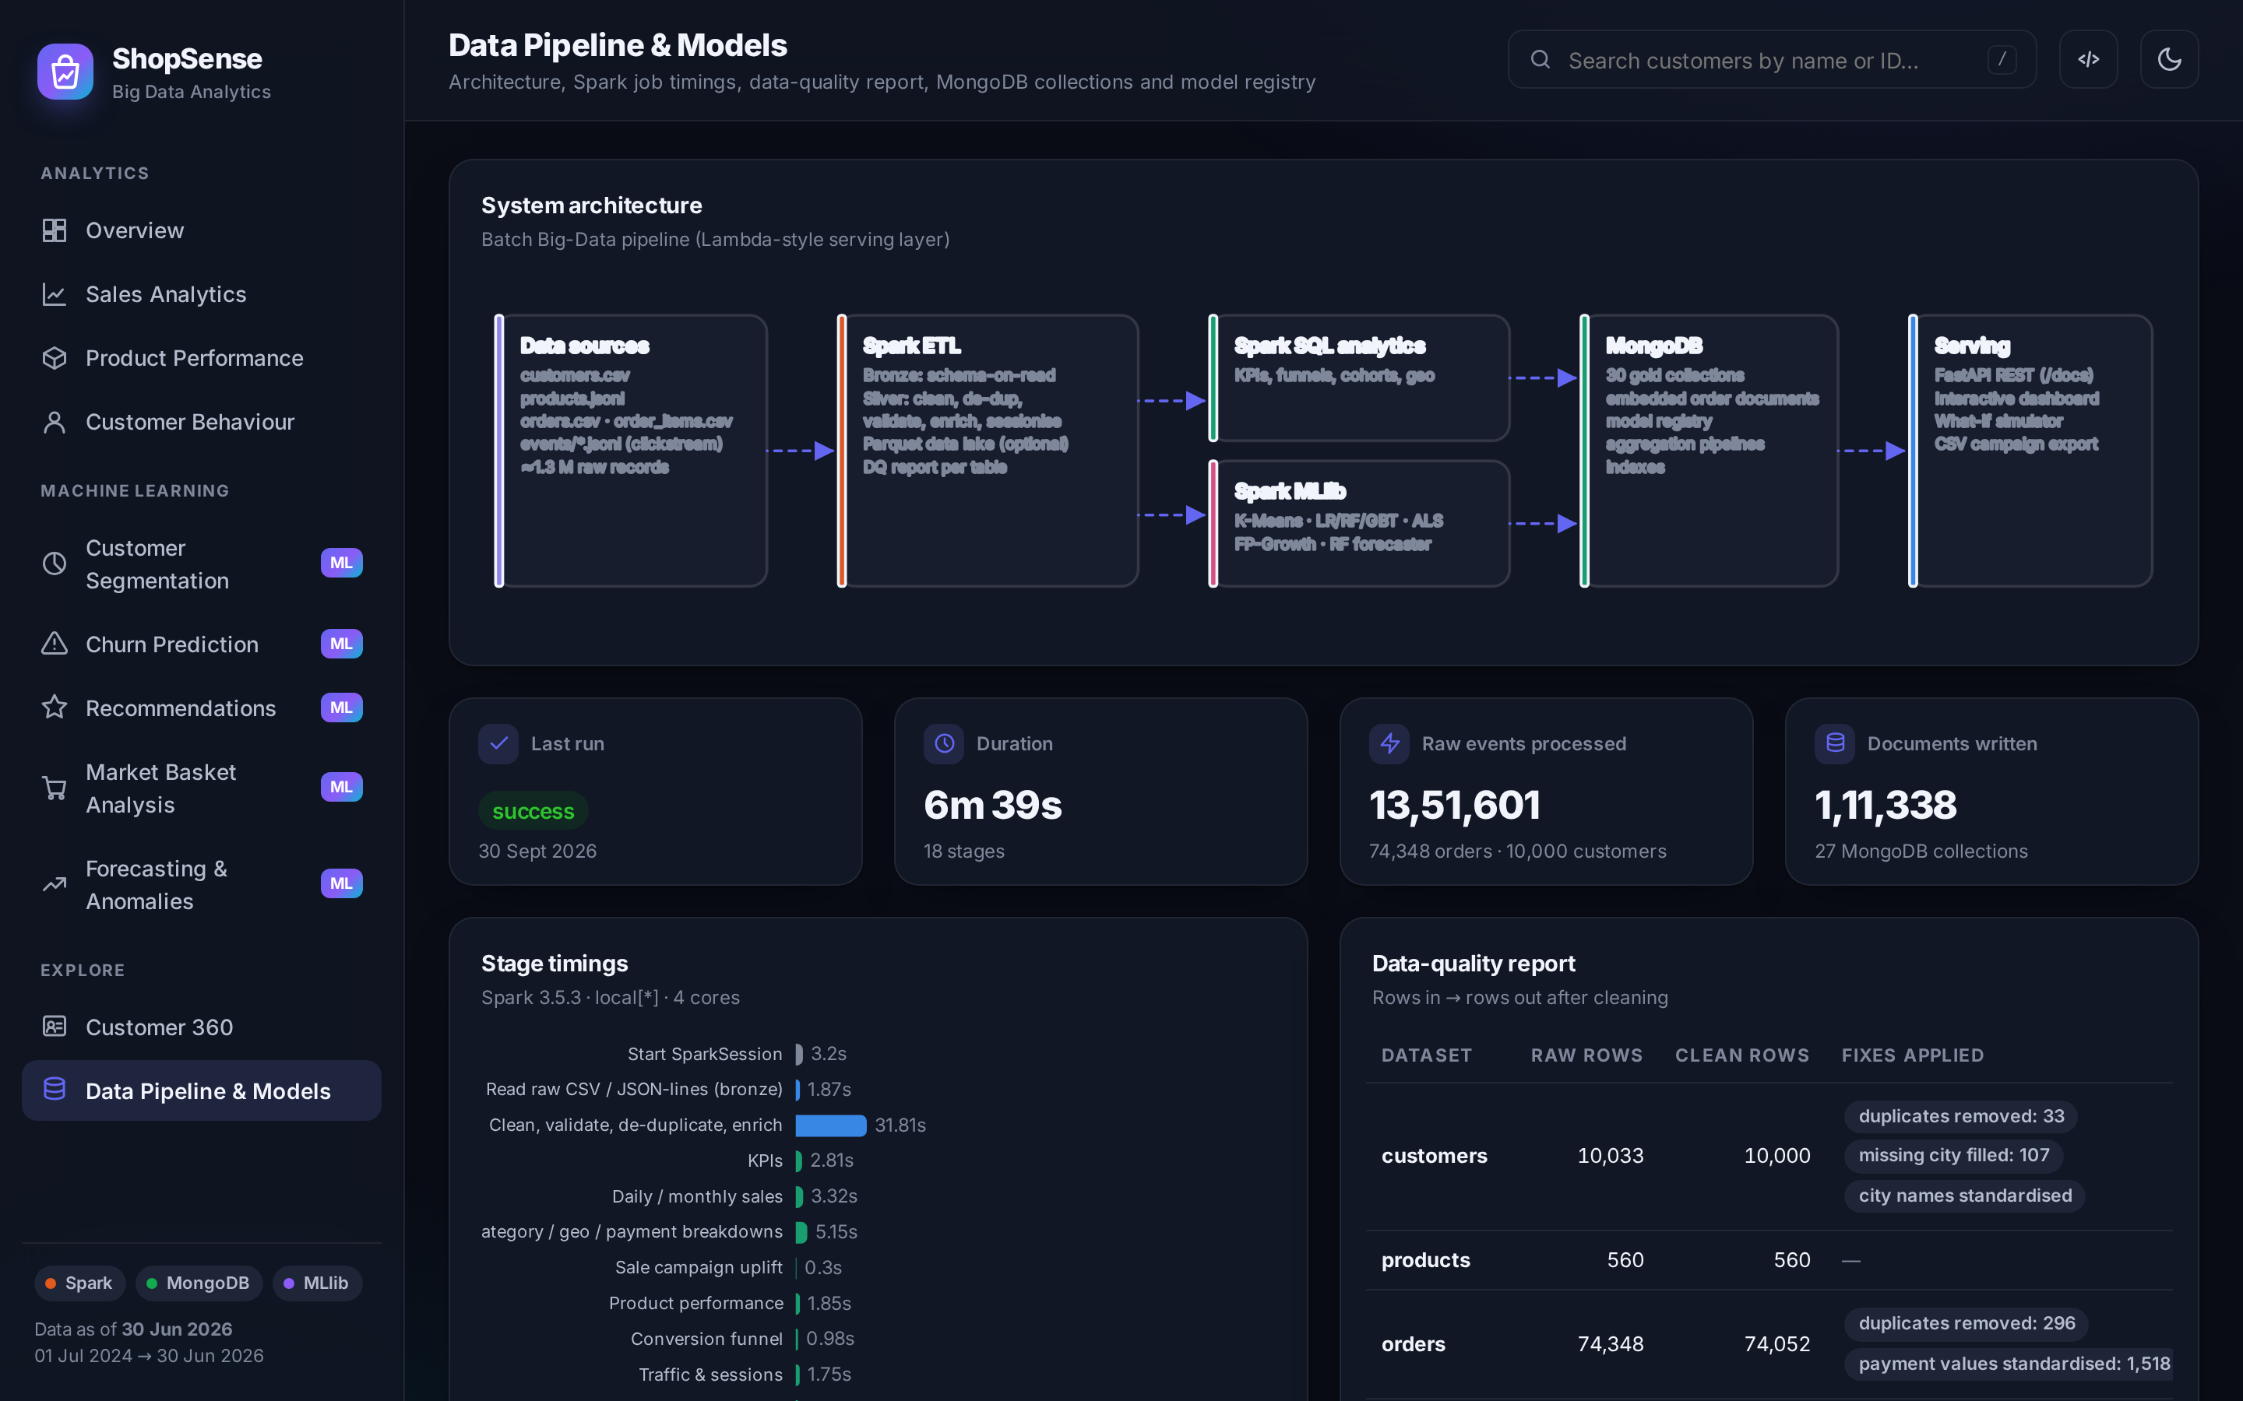
DEMO
Live dashboard: 11 interactive pages
Sales analytics
Customer behaviour
Segmentation
Recommendations
Market basket
Pipeline & models
python run_dashboard.py → http://127.0.0.1:8000 · Swagger API docs at /docs
ShopSense · Big Data Analytics | 16
Notes:
Switch to the live demo here. Suggested flow: Overview KPIs, then Sales with a 90-day filter on Fashion, then the Behaviour funnel by device, Segmentation cards, Churn simulator (move the "days since last visit" slider), Recommendations for a customer, the Market basket network, the Forecast page and finally the Pipeline page showing the data-quality report.

Slide 17
DATA → DECISIONS
Business insights discovered
+117%
7.37%
60%
orders during Big Festive Sale
Cash-on-Delivery cancellation rate
of revenue from Electronics
but only +22–30% revenue: discounts eat the uplift
≈2× prepaid methods: nudge COD users to UPI
at only 7% margin: cross-sell Fashion & Beauty (36–40%)
34.56%
#1
₹8.37 Cr
cart abandonment
churn signal = days since last visit
annual revenue at risk
largest funnel drop is view → cart: recommendations matter
click-stream beats purchase history for early warning
2,956 high-risk customers exported for win-back
ShopSense · Big Data Analytics | 17
Notes:
These insights come straight from the dashboard. Emphasise that each insight leads to a concrete action: rethink discount depth, reduce COD, cross-sell high-margin categories, improve product pages, monitor engagement for churn, and run a targeted win-back campaign.

Slide 18
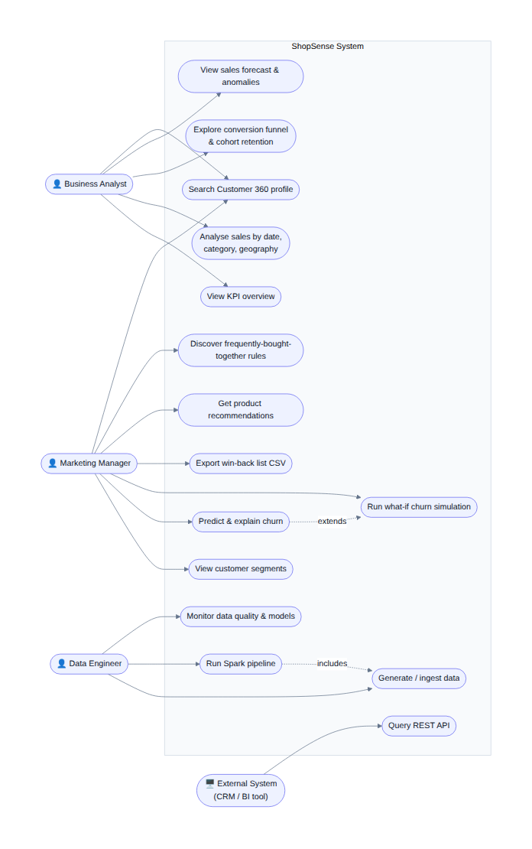
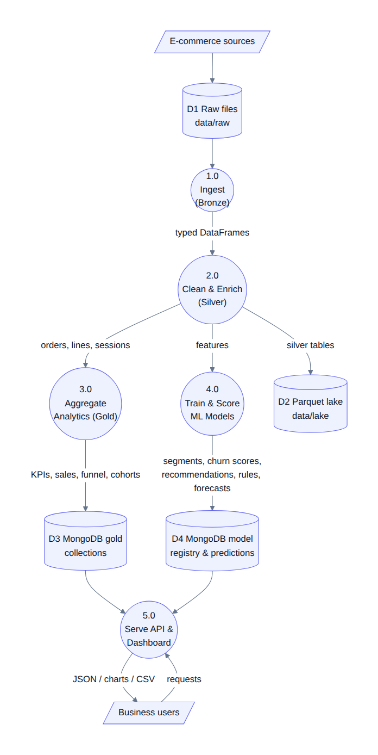
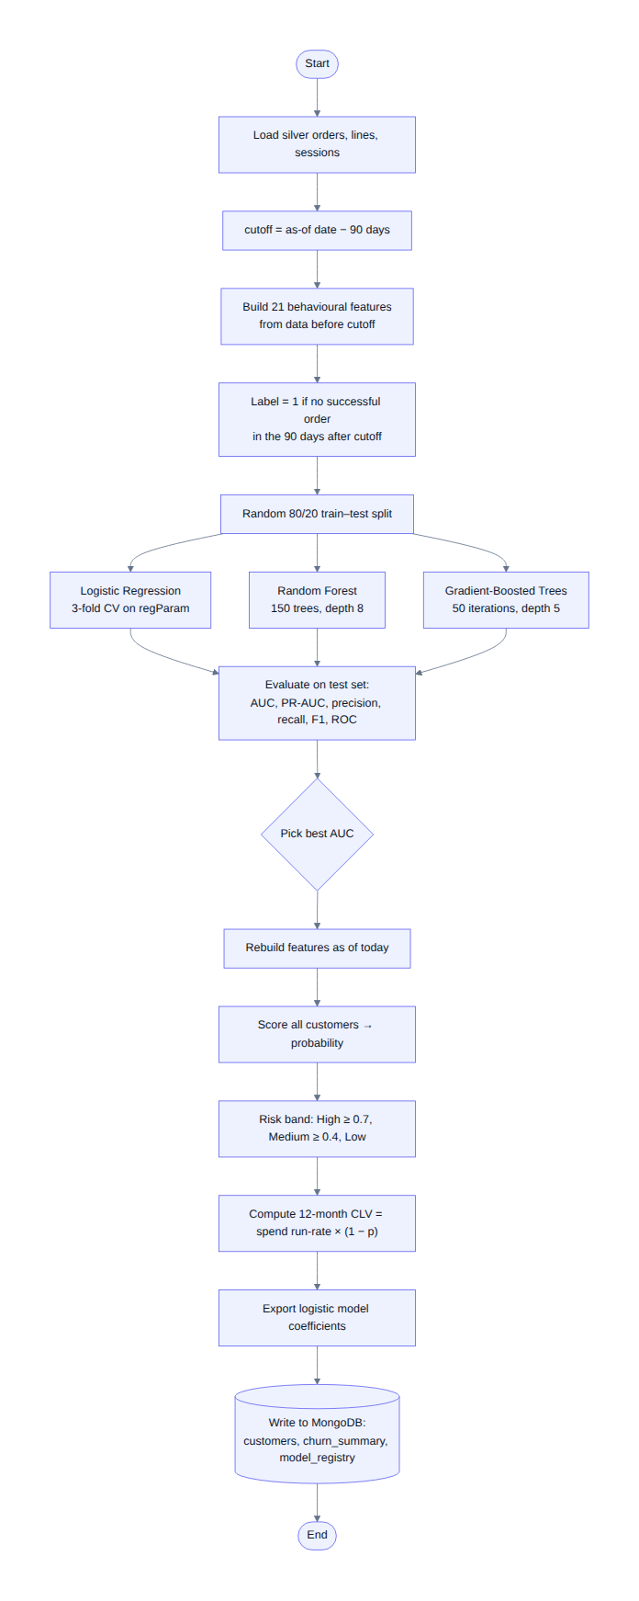
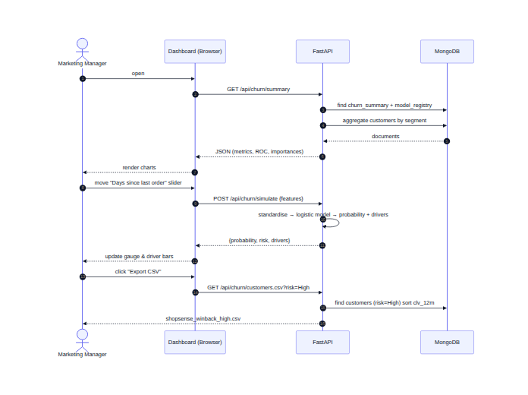
ANALYSIS & DESIGN
Design: UML & data-flow diagrams
Use-case
Sequence (dashboard)
DFD level 1
Activity (churn)
ShopSense · Big Data Analytics | 18
Notes:
The report contains the full set: use-case, two sequence diagrams, two state diagrams, activity, class, DFD levels 0 and 1, ER model of MongoDB collections and the deployment diagram. All are generated from text (Mermaid) stored in the repository.

Slide 19
WRAPPING UP
Conclusion & future scope
What we achieved
Future scope
End-to-end Spark → MongoDB → dashboard platform
≈1.4 M records processed in under 7 minutes on a laptop
6 MLlib models: churn AUC 0.955, ALS 1.8× baseline, 4/4 anomalies
Explainable, actionable outputs: playbooks, simulator, CSV export
100% open source, reproducible, documented and tested
Real-time streaming with Kafka + Structured Streaming
Cluster deployment (YARN/Kubernetes, Delta Lake, Atlas)
Survival & uplift models, sequence-aware recommenders
Review sentiment analytics with NLP
MLOps: Airflow scheduling, MLflow tracking, drift monitoring
Natural-language analytics assistant
Big Data tools from the curriculum, applied end-to-end to a real business problem.
ShopSense · Big Data Analytics | 19
Notes:
Summarise the achievements and the value: affordable, explainable analytics for online retailers. Then the future scope: real-time streaming, cluster deployment, advanced models, sentiment analysis, MLOps and a conversational analytics assistant.

Slide 20
Thank you!
Questions & discussion
Kartik Verma
Kushal Soni
Dhir Thakar
Guide: <Guide Name> · Department of Computer Engineering, K. J. Somaiya Institute of Technology
github.com/Interior-Gardener/BDA
Notes:
Thank the guide and the examiners, and invite questions. Likely questions: why MongoDB rather than MySQL (flexible nested documents, embedding, fast single-document reads); why synthetic data (privacy, reproducibility, known ground truth for validation); how it scales (change SPARK_MASTER to a cluster); why Random Forest won (non-linear interactions between engagement features).

