Slide 1

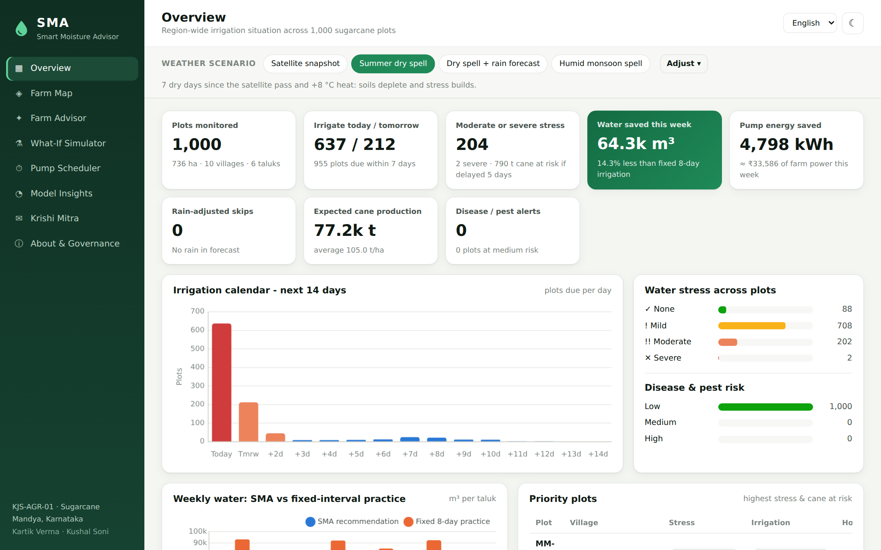
SMA
Smart Moisture Advisor
AI-driven irrigation advisory for sugarcane - when to irrigate, how long, how much fertiliser, and what is at stake if you wait.
Presented by
Kartik Verma · Kushal Soni
Use case KJS-AGR-01 · K J Somaiya Institute of Technology × KIAAR × Godavari Biorefineries
Notes:
[Kartik] Good morning, Professor. We are Kartik Verma and Kushal Soni. Our project is SMA, the Smart Moisture Advisor. It is our solution to use case KJS-AGR-01, an irrigation advisory system for sugarcane.
In one line: SMA takes satellite, soil and weather data for every geofenced plot and tells the farmer when to irrigate, how long to run the pump, how much fertiliser to give, and what they lose if they wait. It speaks the farmer's own language.
We will cover the problem, our data and machine-learning approach, a live demo of the web platform, the results, and what comes next.

Slide 2






Irrigation today is guesswork
Sugarcane is one of India's thirstiest crops, and most irrigation decisions come from habit, not data
18-25k
Water wastage
Yield loss
Over-irrigation drains aquifers and canals
Delayed irrigation → moisture stress
sugarcane farmers in the GBL / KIAAR network
1,500-2,500 mm
Wasted electricity
Nutrient losses
Pumps run hours longer than needed
Fertiliser leaches with excess water
water needed by one sugarcane crop (FAO)
1000s
Higher costs
No visibility
Water, power and fertiliser all add up
Factories cannot see field stress early
scattered plots - impossible to monitor by hand
SMA · Smart Moisture Advisor | Kartik Verma · Kushal Soni | 2
Notes:
[Kartik] The problem statement from KIAAR and Godavari Biorefineries is simple. Between 18 and 25 thousand farmers grow sugarcane in this network. One sugarcane crop needs 1,500 to 2,500 millimetres of water, and today farmers decide when to irrigate from experience.
That leads to two opposite mistakes. Over-irrigation wastes water, electricity and fertiliser. Delayed irrigation causes moisture stress and lost yield. With thousands of scattered plots, no field team can watch every farm.
So the question we set out to answer was: can we give every plot its own scientific irrigation decision, automatically, every day?

Slide 3








SMA answers four questions for every plot
From satellite pixels to a one-line instruction a farmer can act on
When should I irrigate?
How long do I run the pump?
How much fertiliser?
What if I wait?
Next-irrigation date with uncertainty, rain-adjusted
Depth → water volume → pump hours by method
Stage-wise NPK split into urea, 12-61-0, MOP
Yield loss curve for 0-14 days of delay
Data
7 ML models
Decision engine
Advisory
›
›
›
NDVI · LAI · soil moisture
pH · organic C · weather
Random Forest &
Gradient Boosting
Rain adjustment · fertigation
pump scheduling
EN · ಕನ್ನಡ · हिंदी · मराठी
web · chatbot · SMS
SMA · Smart Moisture Advisor | Kartik Verma · Kushal Soni | 3
Notes:
[Kartik] SMA answers four practical questions for every plot. When should I irrigate? How long should the pump run? How much fertiliser should I apply this week? And what will it cost me if I wait?
The pipeline underneath is shown at the bottom. Satellite and soil data go into seven machine-learning models. A decision engine adds rain adjustment, fertigation rules and pump scheduling. The output is a plain-language advisory in English, Kannada, Hindi or Marathi.

Slide 4
The dataset: 1,000 geofenced plots in Mandya
Satellite and soil features per plot, but no irrigation logs or yield records
1,000
736 ha
6
10
plots
area
taluks
villages
Features used
NDVI
LAI
Soil moisture
Soil pH
Organic carbon
Rainfall
Temperature
Humidity
Plot polygon
What our data audit found
No target labels: nothing says when a plot was irrigated or what it yielded
6 NDVI gaps (cloud) → filled with the village median
Area, district and sampling method are constant → dropped
Temperature, humidity and rainfall correlated up to r = −0.94
SMA · Smart Moisture Advisor | Kartik Verma · Kushal Soni | 4
Notes:
[Kartik] The dataset has 1,000 geofenced sugarcane plots across 6 taluks and 10 villages of Mandya district. For each plot we get NDVI, leaf area index, soil moisture, pH, organic carbon, rainfall, temperature, humidity and the plot boundary polygon.
Before modelling we audited the data. The most important finding: there are no labels. Nothing tells us when a plot was irrigated or what it yielded, so plain supervised learning is impossible. We also found 6 NDVI values missing because of cloud, which we filled with the village median. Three columns are constant, and the weather variables are strongly correlated with each other. The chart shows NDVI is fairly normal, centred around 0.58.

Slide 5




No labels? We taught the models agronomy
Physics-informed machine learning: science creates the labels, trees learn the fast surrogate
1,000 real plots
Why not just use the formula?
Observed satellite, soil and climate features
Real field labels (irrigation logs, yields) can replace the synthetic ones with zero code changes: npm run train
Ensembles give uncertainty (± days) and feature importance
Robust to noisy, missing and correlated sensor data
× 12 seasonal scenarios
Crop age 0-365 days, heat waves, dry spells, rain forecasts → 12,000 rows
Agronomy labels
FAO-56 water balance (ET₀, Kc, root depth, TAW/RAW) + FAO-33 yield response (Ky = 1.2)
+ field noise
Key agronomy in one line
Realistic sensor & weather error so models cannot memorise the formula
Days to irrigate = (RAW − current depletion + effective rain) ÷ crop water use
Tree ensembles
RAW = readily available water in the root zone, ETc = Kc × ET₀ (Hargreaves).
Train on 800 plots, test on 200 unseen plots (no leakage)
SMA · Smart Moisture Advisor | Kartik Verma · Kushal Soni | 5
Notes:
[Kartik] This is the key idea of the project. Since there are no labels, we used agronomic science to create them. This approach is called physics-informed machine learning.
We took every real plot and generated 12 seasonal scenarios: different crop ages, heat waves, dry spells and rain forecasts. That gives 12,000 training rows. For each row we computed the ground truth with FAO-56, the international standard for crop water balance, and FAO-33 for how yield responds to water stress. Then we added realistic noise, so the models learn patterns and not just the formula.
Why not use the formula directly? Three reasons. First, when KIAAR provides real irrigation logs, we retrain on real labels with one command and no code changes. Second, the ensembles give us uncertainty and explanations. Third, they cope better with noisy and missing sensor data.
We split train and test by plot, so the model is always tested on plots it has never seen.

Slide 6



Seven models, all beating their baselines
Evaluated on 200 plots never seen during training
Water-stress probability
87.8%
accuracy · F1 0.82
logistic baseline 83.5%
Disease & pest risk
87.3%
accuracy · F1 0.76
logistic baseline 82.0%
Runs natively in Node.js
Trees exported to JSON. 23 automated tests prove the JavaScript predictions match scikit-learn exactly. All 1,000 plots scored in < 0.3 s.
SMA · Smart Moisture Advisor | Kartik Verma · Kushal Soni | 6
Notes:
[Kartik] Here are the results on 200 plots the models never saw. The chart compares R-squared of our models, in green, against a linear-regression baseline, in grey. Every model clearly beats its baseline. The biggest gains are for irrigation depth and yield loss, which are strongly non-linear. That is exactly why we chose tree ensembles.
Next irrigation date: R-squared 0.96, an average error of 0.7 days. The two classifiers, water stress and disease risk, reach about 87 to 88 percent accuracy, and most of their errors are between neighbouring classes such as mild versus moderate.
One engineering point: we export the trained trees to JSON and run them natively in Node.js. Automated tests confirm the JavaScript gives exactly the same predictions as Python. The whole region is scored in under a third of a second.

Slide 7


All 11 models from the use case - implemented
Plus one extra: unsupervised management zones
Next irrigation date
Irrigation duration
Crop water requirement
Random Forest + uncertainty
GBM depth → pump hours
GBM regressor (ETc)
Water stress probability
Rainfall-adjusted advice
Yield loss from delay
RF 4-class probabilities
Forecast input + counterfactual
GBM with delay as input
Pump scheduling
Fertigation
Disease & stress forecast
WSPT optimisation
Stage-wise NPK engine
RF risk classifier + rules
Yield prediction
Farmer advisory (LLM-ready)
Management zones ★
GBM regressor (t/ha)
4 languages, voice, chatbot
K-Means clustering
SMA · Smart Moisture Advisor | Kartik Verma · Kushal Soni | 7
Notes:
[Kartik] The use-case document lists eleven AI models. This slide maps each one to what we built. Seven are machine-learning models. Pump scheduling is an optimisation algorithm. Fertigation and advisory generation are decision engines on top of the model outputs.
For the LLM-based advisory, we deliberately used templates in four languages for now. Every sentence is predictable and auditable, and the same structured output can be handed to an LLM later. We also added management zones, which group similar plots so agronomists can plan by zone.
Now Kushal will show you the platform.

Slide 8
Live demo · Region-wide dashboard
Scenario "Summer dry spell": 7 dry days since the satellite pass, +8 °C
637
plots must irrigate today
204
plots under moderate or severe stress
790 t
of cane at risk if irrigation slips 5 days
4 presets
switch weather scenarios live in the demo
SMA · Smart Moisture Advisor | Kartik Verma · Kushal Soni | 8
Notes:
[Kushal] This is the SMA web platform. It is built with Node.js and runs entirely on a laptop. On the overview page, the supervisor sees the whole region at a glance.
We selected the "Summer dry spell" scenario: seven dry days after the satellite pass and eight degrees hotter. The models now say 637 plots must irrigate today and 212 tomorrow. 204 plots are under moderate or severe stress, and about 790 tonnes of cane are at risk if irrigation slips by five days.
The irrigation calendar shows the water demand for the next 14 days, which helps the factory and the electricity department plan. At the top, these weather presets let us change conditions live. I will use them in the demo.
[DEMO: click "Satellite snapshot", then "Summer dry spell", and point at the KPI cards changing.]

Slide 9
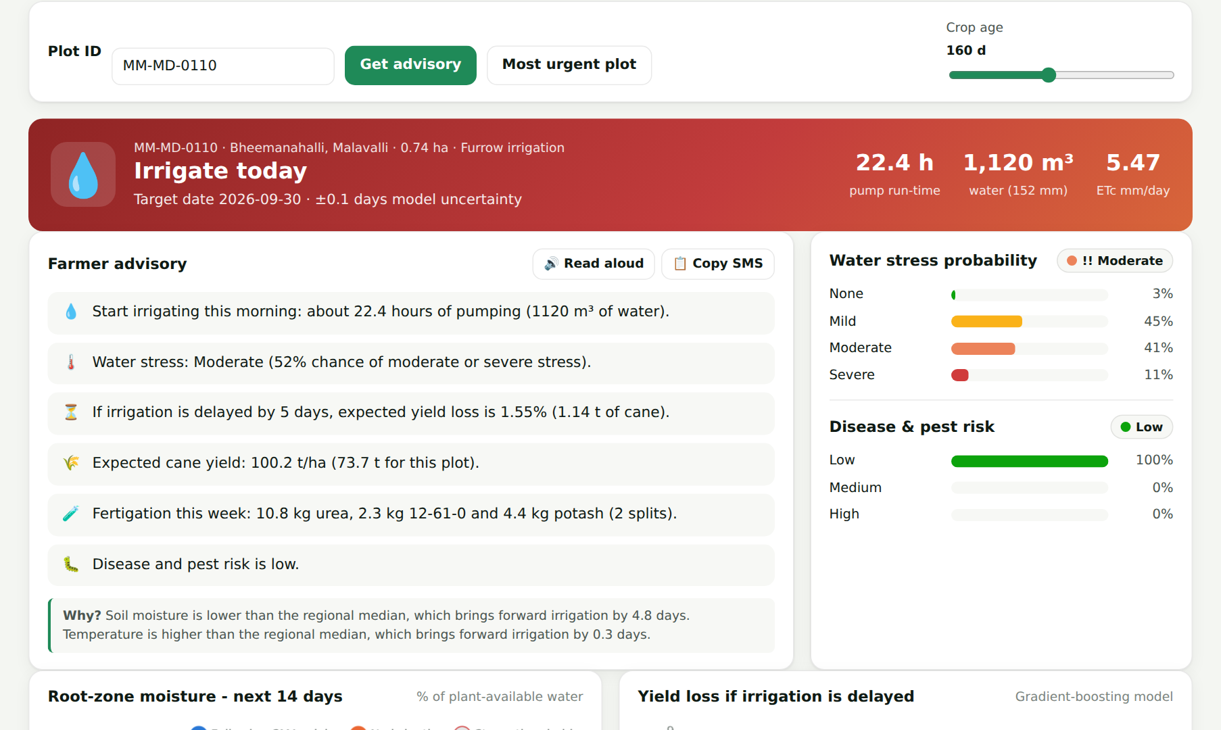
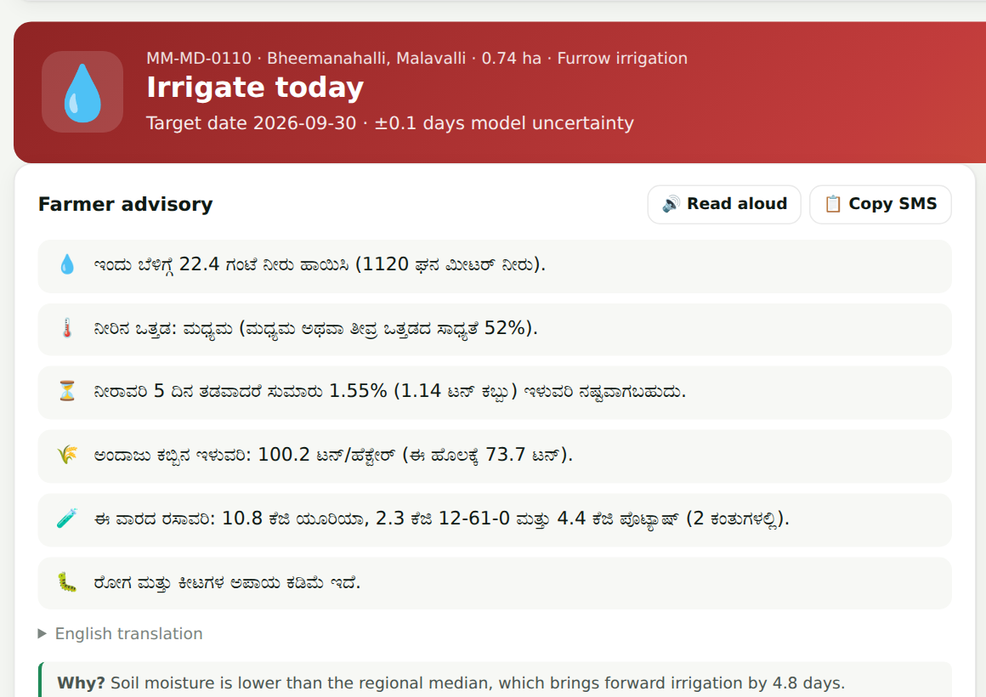




Plot-level advisory a farmer can act on
Plot MM-MD-0110 · Bheemanahalli, Malavalli
English · ಕನ್ನಡ · हिंदी · मराठी
Read aloud for low-literacy users
"Why this advice?" explanations
Accept / override → retraining data
SMA · Smart Moisture Advisor | Kartik Verma · Kushal Soni | 9
Notes:
[Kushal] Clicking any plot opens the Farm Advisor. For plot MM-MD-0110 the banner says: irrigate today, about 22 hours of pumping, 1,120 cubic metres of water.
Below that is the farmer advisory. The same content appears in Kannada, Hindi or Marathi, and it can be read aloud or copied as an SMS or WhatsApp message. On the right are the probabilities. We show the full distribution, not just a label, so the farmer sees how confident the model is.
Further down are the 14-day root-zone moisture projection, the yield-loss curve if irrigation is delayed, the fertigation plan and a "Why this advice?" panel. For example, it says soil moisture is the main reason irrigation came 4.8 days earlier.
Finally, farmers and supervisors can accept or override the advice. Every override is logged as training data. This is the human-in-the-loop design the use case asks for.
[DEMO: switch language to Kannada, press Read aloud, scroll to the charts, click Accept.]

Slide 10

Rain-aware: skip pumping when rain is coming
Same dry spell, but the forecast now shows 40 mm of rain in 3 days
Without forecast
With 40 mm forecast
Plots told to irrigate today
637
0
How it works
Plots postponed because of rain
0
894
Forecast rain is a model input, so the Random Forest learns how much of it reaches the root zone
SMA also predicts a "no-rain" counterfactual; if rain moves the date, the advice becomes "skip"
Plug in the IMD / weather API forecast and this runs daily for all plots
Water to pump this week
387k m³
62k m³
Rain used instead of pumping
-
218k m³
SMA · Smart Moisture Advisor | Kartik Verma · Kushal Soni | 10
Notes:
[Kushal] This is my favourite part of the demo. We keep the same dry spell, but the forecast now shows 40 millimetres of rain in the next three days.
Immediately, the 637 "irrigate today" alerts drop to zero. 894 plots are told to skip, because the rain will do the job. Water to pump this week falls from 387 thousand cubic metres to 62 thousand. About 218 thousand cubic metres of rainwater is used instead of pumped groundwater.
Technically, forecast rain is an input to the model. We also run a "no-rain" counterfactual prediction. If the rain moves the irrigation date, the advice changes to "skip". In production, this input would come from the IMD forecast API every day.
[DEMO: click "Dry spell + rain forecast" and show the KPI cards.]

Slide 11
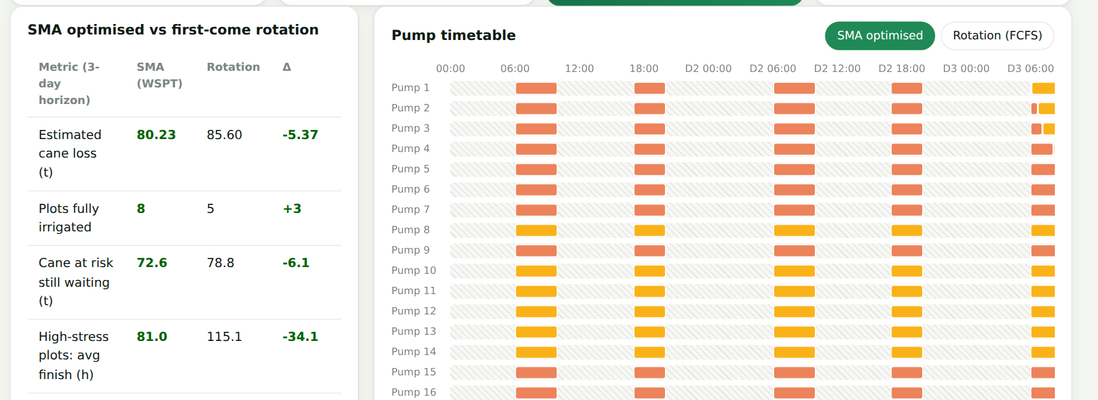
Pump scheduling under limited 3-phase power
Village Hosur · 2 power windows (7 h/day) · 20 pumps per feeder · 3-day horizon
5.4 t
cane loss avoided vs a first-come rotation
7 / 14
high-stress plots served (rotation: 2 / 14)
Algorithm: Weighted Shortest Processing Time (Smith's rule)
81 h vs 115 h
Priority = cane at risk (from the yield-loss model) ÷ pumping hours. Plots are packed into the power windows without exceeding the feeder limit. Pumps pause when power goes off and resume in the next window.
average finish time for high-stress plots
SMA · Smart Moisture Advisor | Kartik Verma · Kushal Soni | 11
Notes:
[Kushal] Knowing who needs water is not enough. In Karnataka, farm pumps get three-phase power only for about seven hours a day, and a feeder can only run a limited number of pumps at once. So who should pump first?
We treat it as a scheduling problem. Each plot is a job. Its weight is the tonnes of cane at risk, predicted by our yield-loss model, and its length is the pumping time. We order jobs by weight divided by length. This is the Weighted Shortest Processing Time rule, or Smith's rule, which is optimal for minimising weighted completion time on one machine. Then we pack the jobs into the power windows.
For Hosur village over three days, compared with a first-come rotation, the optimised plan avoids about 5.4 tonnes of cane loss. It serves 7 of the 14 high-stress plots instead of 2, and finishes them 34 hours earlier on average. The Gantt chart shows the actual pump timetable.
[DEMO: open Pump Scheduler, click Optimise, toggle between "SMA optimised" and "Rotation".]

Slide 12




Estimated impact across the 1,000 plots
Model estimates vs farmers' fixed practice (≈70 mm every 8 days), satellite-snapshot conditions
38%
56%
12.9k kWh
172k m³
less irrigation water with furrow irrigation
less water when combined with drip
pump energy saved per week
water saved per week, about 69 Olympic pools
Beyond water: earlier stress and disease alerts, rain-aware postponement, fair pump timetables, and a 14-day water demand forecast the sugar factory can plan with.
SMA · Smart Moisture Advisor | Kartik Verma · Kushal Soni | 12
Notes:
[Kushal] What could this mean at scale? Under normal satellite conditions, the recommended schedule uses about 38 percent less water than the fixed practice of roughly 70 millimetres every 8 days. With drip irrigation the saving rises to about 56 percent. Across these 1,000 plots that is about 172 thousand cubic metres of water and 12,900 kilowatt-hours of pump energy every week.
Please note these are model estimates against a documented baseline, not field-measured results. Validating them in the field is the first item on our roadmap.
Beyond water, SMA gives early stress and disease alerts, fair pump timetables, and a 14-day water-demand forecast the factory can plan with.

Slide 13






Responsible, explainable, human-in-the-loop
Designed around the governance section of the use case
Privacy (DPDP)
Explainability
Human in the loop
Anonymised plot IDs only; no farmer names or phone numbers stored; minimal feedback log
Per-feature "why" vs regional median, probability bars, ± days uncertainty
Accept / override on every advisory; overrides become retraining data
Fair evaluation
Security
Honest limits
Tested on unseen plots across all 6 taluks; zones expose soil / climate differences
Input validation and clamping on every API; no secrets in code; small attack surface
Labels are agronomy-derived until real KIAAR data arrives, and we say so in the app
SMA · Smart Moisture Advisor | Kartik Verma · Kushal Soni | 13
Notes:
[Kushal] The use case puts strong emphasis on responsible AI, so we designed for it from day one. For privacy, plots are addressed only by anonymised IDs and we store no personal data. For explainability, every advice shows why, with probabilities and uncertainty. For human-in-the-loop, farmers and agronomists can override any recommendation, and those overrides become retraining data.
We evaluated on unseen plots across all taluks. The API validates and clamps every input. And we are honest about the limits: until real field data arrives, our labels come from agronomy, and the app states this openly.

Slide 14




Architecture & tech stack
Offline-first, one command to run: npm install && npm start
Data
›
Training (Python)
›
Backend (Node.js)
›
Frontend
IrrigationAdvisory
Dataset.csv
1,000 plots + polygons
pandas · scikit-learn
FAO-56 / FAO-33 labels
→ models/*.json
Express REST API
tree inference · advisory
scheduler · i18n · chat
Vanilla JS SPA
Chart.js · Leaflet maps
light / dark, mobile
REST API (integrates with STEPS / mobile apps)
Quality
GET /api/farms
GET /api/farms/:id?lang=kn
23 automated tests (models, engine, API)
Python ↔ JavaScript prediction parity verified
1,000 plots scored in < 0.3 s on a laptop
Retrain on real data: npm run train
POST /api/predict
POST /api/schedule
GET /api/insights
GET /api/models
POST /api/chat
POST /api/feedback
SMA · Smart Moisture Advisor | Kartik Verma · Kushal Soni | 14
Notes:
[Kartik] A quick look at the architecture. Python and scikit-learn are used only for training. The trained trees are exported to JSON, so at runtime everything is Node.js with Express. There is no Python dependency and no external service. The frontend is a lightweight single-page app with Chart.js and Leaflet maps.
Everything is exposed as a REST API, so the STEPS platform or a mobile app could use the same advisories. We have 23 automated tests, including tests that prove the JavaScript and Python predictions are identical.

Slide 15




Limitations & roadmap
What a real deployment with KIAAR and GBL would add
IoT soil sensors + real irrigation logs
Current limitations
retrain the same pipeline on ground truth
Labels come from FAO agronomy, not field records
Crop age is estimated (STEPS has the real planting dates)
One satellite snapshot; no daily time series yet
Translations are templates and need native-speaker review
Savings are estimates until validated in the field
IMD forecast & Sentinel-2 feeds
daily automatic updates for every plot
LLM + WhatsApp / IVR advisory
free-form questions in local languages
Mobile app + STEPS integration
field staff and farmers on one platform
Smart pump control
auto-start pumps inside the optimised windows
SMA · Smart Moisture Advisor | Kartik Verma · Kushal Soni | 15
Notes:
[Kartik] We want to be upfront about the limitations. Our labels come from agronomy, not field records. Crop age is estimated, because the real planting dates live in the STEPS platform. We have one satellite snapshot rather than a time series. The translations should be reviewed by native speakers.
The roadmap follows from this. First, connect IoT soil sensors and real irrigation logs, and retrain the same pipeline on ground truth. Second, add daily weather and Sentinel-2 feeds. Third, add an LLM on top of our structured output for WhatsApp and voice advisories. Then a mobile app, STEPS integration and, finally, automatic pump control inside the optimised windows.

Slide 16
Thank you
Run the demo
npm install
npm start
→ http://localhost:3000
Right water, right time, right plot.
Questions welcome - we would love to try SMA on real KIAAR field data.
Kartik Verma · Kushal Soni
Use case KJS-AGR-01 · K J Somaiya Institute of Technology
Notes:
[Both] Thank you for listening. SMA is about giving every sugarcane plot the right water, at the right time. We would be happy to take questions, and we would love the chance to test SMA on real KIAAR field data.
[Keep the app open on the Overview page for questions.]

