Slide 1



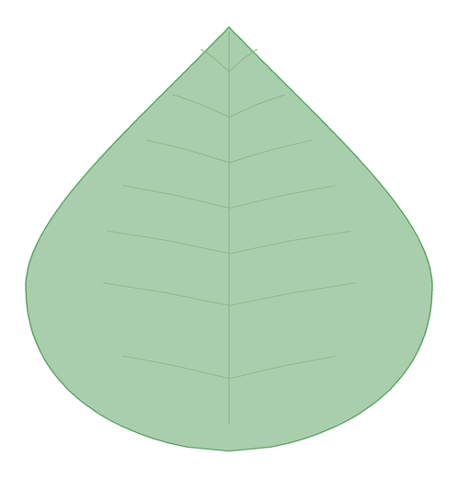


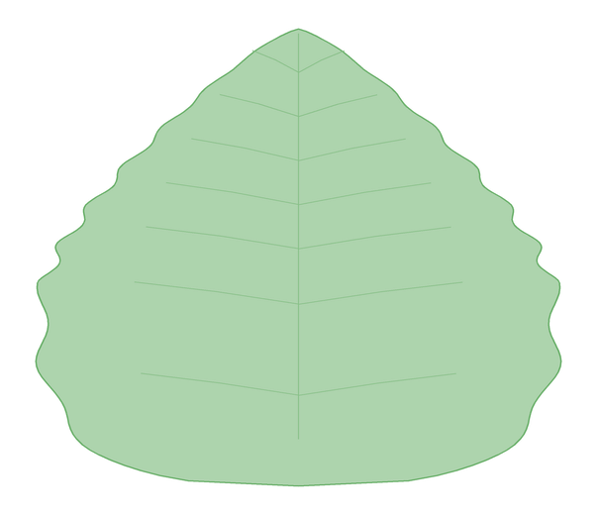
TEAM
LOGO
SMART INDIA HACKATHON 2025
VANASPATI
IMAGE 1
Hero render — the garden seen from above
replace with the AI image (prompt 1)
A virtual herbal garden in which every plant is grown from its botany — never downloaded.
Problem Statement ID – « Problem Statement ID »
Problem Statement Title- Development of a Virtual Herbal Garden (AYUSH)
Theme- « MedTech / BioTech / HealthTech »
PS Category- Software
Team ID- « Team ID »
25
AYUSH species
6
themed beds
6
guided tours
0
downloaded assets
Team Name (Registered on portal)- « Team Name »
Every silhouette is drawn by the same leaf-profile function that grows the 3D plants.
Twenty-five species. Not one downloaded model, texture or photograph.
VANASPATI · Virtual Herbal Garden
@SIH Idea submission- Template
1
Notes:
Vanaspati is a virtual herbal garden for the AYUSH problem statement. The one line to remember: every plant is generated at run time from its botanical description, so there is no 3D model, texture or photograph anywhere in the project. Fill in the amber fields from the SIH portal before submitting.

Slide 2
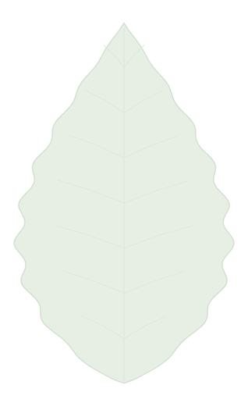
TEAM
LOGO
VANASPATI — A GARDEN THAT GROWS ITSELF
Idea title
Proposed Solution (Describe your Idea/Solution/Prototype)
IMAGE 2
Plant viewer with labelled part hotspots
replace with the AI image (prompt 2)
Every plant is grown at run time from its botanical description.
Thirty lines of botany become a plant — morphology, phyllotaxy, flowers and all.
Detailed explanation of the proposed solution
▪ 25 AYUSH species in 6 themed beds, with 6 guided tours and 4 botanical plates each
▪ One PlantModelSpec per species drives the 3D model, the 2D plate and the search index
▪ Compendium per plant: rasa, guna, virya, vipaka, parts used, preparations, cultivation, cautions
How it addresses the problem
▪ Walk the garden, orbit any specimen, tap a hotspot to see where the medicine sits
▪ Weighted search over names, symptoms and Sanskrit synonyms, with six filter facets
▪ Bookmarks, autosaving notes, narration, share and a study sheet — offline after first load
TULSI, AS THE APP STORES IT
model: {
archetype: 'herb', height: 0.62,
stem: { square: true }, // Lamiaceae
leaf: { shape: 'ovate',
arrangement: 'opposite',
serration: 0.55 },
flower: { form: 'spike', petals: 5 },
}
Innovation and uniqueness of the solution
▪ Botany is the model: a square stem makes a mint, 9–19 leaflets make a neem frond
▪ Seeded growth — the same species grows identically on every device, every time
▪ A new plant costs ~30 lines of data, not a week in Blender
The garden, the specimen plate and the search index all read this one object. Nothing else is stored.
VANASPATI · Virtual Herbal Garden
@SIH Idea submission- Template
2
Notes:
Lead with the spec card on the right: that object is the whole plant. The 3D geometry, the 2D botanical plate and the search index are all derived from it, which is why adding a species is data entry rather than 3D modelling.

Slide 3

TEAM
LOGO
TECHNICAL APPROACH
How the garden is built, and what builds it
Technologies to be used (e.g. programming languages, frameworks, hardware)
React 19
TypeScript
Vite 8
three.js r185
React Three Fiber
drei
Custom GLSL (wind + venation)
Tailwind CSS v4
Zustand + localStorage
React Router 7
Web Speech API
No backend · static hosting
Methodology and process for implementation (Flow Charts/Images/ working prototype)
Botanical spec
shape · phyllotaxy · branching
Archetype skeleton
herb · shrub · tree · climber
Leaf profile + phyllotaxy
golden angle, parametric blade
Flowers · fruit · rhizome
spike · umbel · panicle · pod
Merge to ≤6 geometries
one per material
One wind + vein shader
shared program → GPU
≤ 6 geometries per plant
merged by material — not hundreds of meshes
IMAGE 3
Wireframe leaf resolving into a shaded one
replace with the AI image (prompt 3)
~2,600 grass tufts in 2 draw calls
instanced lawn and bed undergrowth
~60k triangles, built in under 100 ms
light preset; nothing fetched from a CDN
Leaf budget: an up-front axis census thins the whole plant evenly instead of spending every leaf on the first limb. Detail auto-detected from CPU cores, device memory and pointer type; three presets in Settings.
VANASPATI · Virtual Herbal Garden
@SIH Idea submission- Template
3
Notes:
The pipeline runs left to right and is the whole system: a spec becomes a skeleton, the skeleton is clothed by the leaf profile function, and everything merges into at most six geometries sharing one shader. That is why twenty-five distinct species cost about sixty thousand triangles.

Slide 4

TEAM
LOGO
FEASIBILITY AND VIABILITY
Built already, and built to survive a low-end phone
Analysis of the feasibility of the idea
Working build, not a mock-up
25 species live today across ~9,700 lines of TypeScript
No backend, no asset pipeline
deploys to any static host; SPA routes survive a hard refresh
Runs on a 4-core phone
quality auto-detected, leaf budget keeps geometry in bounds
Offline after first load
no network calls; narration comes from the browser
Potential challenges and risks
Strategies for overcoming these challenges
Low-end GPUs and thermal throttling
Leaf budget + axis census, three quality presets, capped pixel ratio, instanced planting
Botanical and clinical accuracy
Ayurvedic Pharmacopoeia conventions, IUCN statuses, per-plant precautions, "not medical advice"
Speech voices vary between browsers
The narration control disables itself rather than failing silently
Expectation of photoreal plants
A deliberate trade — a stylised plant that is correct teaches better than a pretty one that is not
Scaling beyond twenty-five species
Data-driven: ~30 lines per plant, with no artist and no asset budget in the loop
Viability: hosting is a static bundle, content grows by data entry, and every plant page carries its own contraindications — the project can scale to hundreds of species without changing a line of the renderer.
VANASPATI · Virtual Herbal Garden
@SIH Idea submission- Template
4
Notes:
Feasibility is not theoretical: the prototype exists and runs. The risk table is the honest version - the two that matter to a jury are device performance, answered by the leaf budget and quality presets, and botanical authority, answered by following the Ayurvedic Pharmacopoeia and IUCN.

Slide 5

TEAM
LOGO
IMPACT AND BENEFITS
A garden that costs no plant to teach with
Potential impact on the target audience
AYUSH & pharmacy students
identify a species by its structure, not by a caption
School & college classrooms
a whole botanical garden inside a browser tab
Home growers
soil, spacing, water and harvest month for every plant
Practitioners & eco-tourists
classical preparations, cautions, conservation status
25 species
6 themed beds
6 guided tours
4 plates each
6 languages
0 assets downloaded
Benefits of the solution (social, economic, environmental, etc.)
IMAGE 4
Students exploring the garden on a tablet
replace with the AI image (prompt 4)
SOCIAL
▪ Names in Sanskrit, Hindi, Tamil, Telugu, Bengali, Marathi and English
▪ Spoken descriptions for low-vision and low-literacy learners
▪ Free and offline-capable — it reaches low-bandwidth districts
▪ Works on a shared classroom tablet: no login, no account, nothing leaves the device
ECONOMIC
▪ No 3D artists, no photo licensing, no server bills
▪ A new species is ~30 lines of data, added in an afternoon
▪ Deploys to any free static host; no GPU farm, no CDN
▪ One codebase serves phone, tablet and classroom projector
ENVIRONMENTAL
▪ Teaches critically endangered species without picking one
▪ A whole tour on guggulu: the medicinal part is the part that kills the plant
▪ Conservation status printed on every plant card
▪ Six themed beds map each medicine back to its habitat and region
VANASPATI · Virtual Herbal Garden
@SIH Idea submission- Template
5
Notes:
The conservation point is the strongest one in the room: for guggulu the medicinal part is the resin, and taking it kills the plant. A virtual garden is the only way a class of forty can study a critically endangered species without harming a single specimen.

Slide 6
TEAM
LOGO
RESEARCH AND REFERENCES
Where the botany, the pharmacology and the rendering come from
Details / Links of the reference and research work
BOTANICAL, AYURVEDIC & CONSERVATION
RENDERING, WEB & PERFORMANCE
Ayurvedic Pharmacopoeia of India
rasa, guna, virya, vipaka and doshic action conventions
three.js documentation and examples
geometry, materials, instancing · threejs.org
Ministry of AYUSH
system definitions and terminology · ayush.gov.in
React Three Fiber + drei
declarative scene graph · r3f.docs.pmnd.rs
National Medicinal Plants Board / e-Charak
cultivation, trade and species lists · nmpb.nic.in
GPU Gems 3, ch. 16
vegetation procedural animation and shading
IUCN Red List of Threatened Species
conservation status per species · iucnredlist.org
Vogel's model of phyllotaxis
the golden angle used to place leaves
Standard Indian field floras
morphology, habitat and regional distribution
React 19 · Vite 8 · Tailwind v4 · Zustand
framework and tooling documentation
PROTOTYPE
Live build: « deployment URL » Source: « repository URL »
Runs in any modern browser · no install, no login, no backend · 25 species available offline after the first visit.
QR
to the
prototype
VANASPATI · Virtual Herbal Garden
@SIH Idea submission- Template
6
Notes:
Two kinds of source: the botany and pharmacology, which come from the Ayurvedic Pharmacopoeia, AYUSH and IUCN, and the rendering techniques, which come from three.js and the vegetation-shading literature. Replace the amber URLs and drop a real QR code over the placeholder.

