Slide 1

Internship Oscar Veldman
At VI Company

Slide 2
Table of contents
Evaluation of my work
Result of my work
Contribution to the company
Evaluation of my personal learning goals
Evaluation of my competences
Additional information

Slide 3





Evaluation of my work
Interview
Requirements
Design
Creating UML diagrams
Programming
Test plan
Testing
Demo

Slide 4
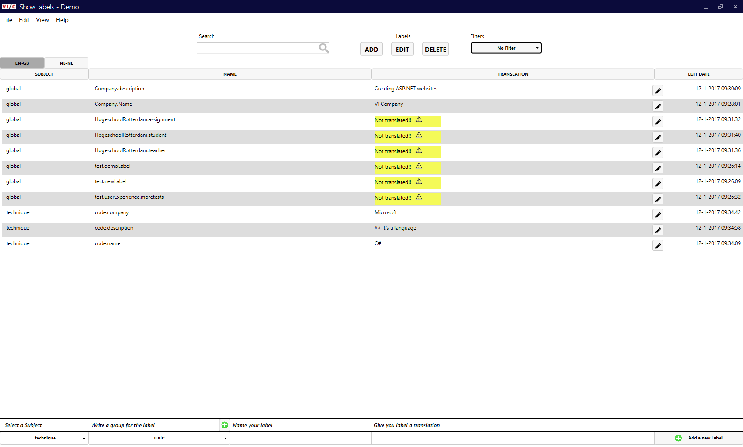
Result - Program

Slide 5
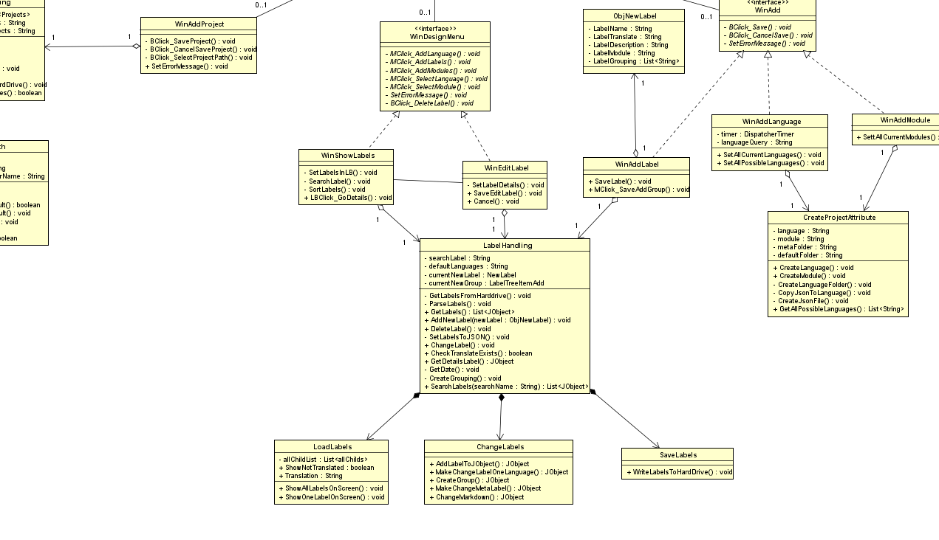
Result - UML

Slide 6
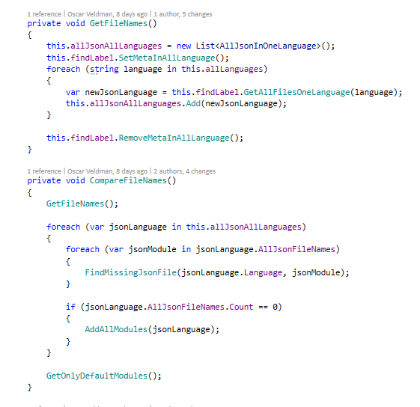
Result - code

Slide 7
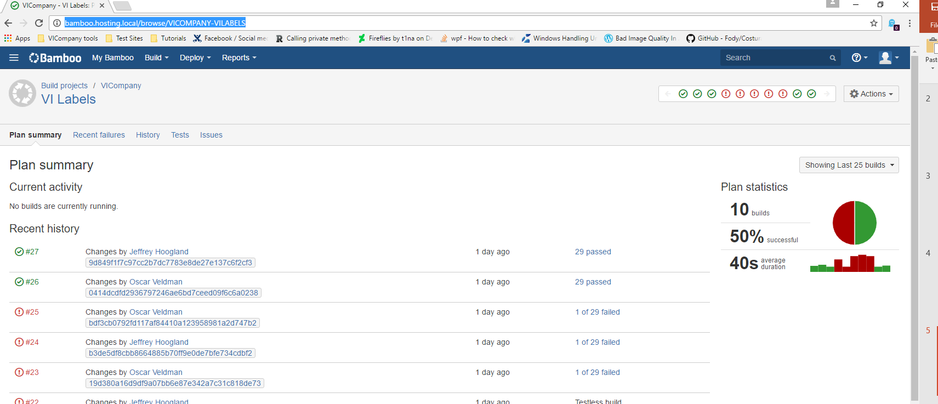
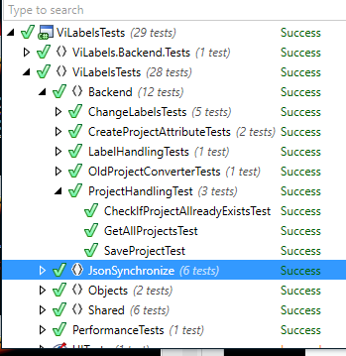
Result - Test

Slide 8
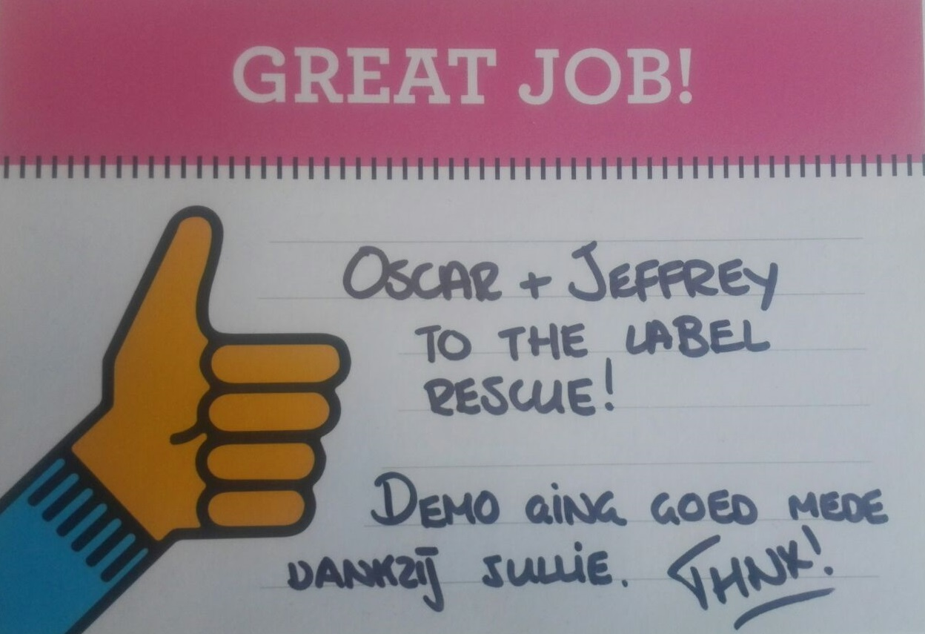
Contribution to the company
Process translation labels automatic
Console application
New program to edit labels

Slide 9
personal learning goals
In the end of my internship I know where I’m good at programming and what I like about it.
In the end of my internship I know the rules of the company.
In the end of my internship I can programming clean and good per the rules of VI Company.
In the end of my internship I can write good and automatic tests.
In the end of my internship I can work well with version control.
In the end of my internship I can write good and readable rapport .

Slide 10
Competences - Manage
You can work with a pre-established and approved intern plan (including planning) and justify any deviations.

Slide 11
Competences - Analyse
You can analyze an assignment based on a research question. You use methods and technique that exists. Also, you can run a requirement analyze for a part of the software system with multiple stake holders. You must consider with the high-quality standards.
You can create specification from the analyzing.
You can create acceptation test from the analyzing.

Slide 12
Competences - advice
You can explain and good advice about new processes, software, and/or new technique. He can explain this clear and understandable.

Slide 13
Competences - Design
You can create a design for a software system and you can combine them with exists part and libraries; Also, you use with design qualities;
You can validate your design with the specifications from the design

Slide 14
Competences - Realize
You can create software with the requirements from the assignments and with the high quality as in software engineering.
Tests: 1. You use of unit, integration, and system tests 2. You create all the test automatic

Slide 15
Competences – skills
You can see which company culture is visible in your internship and you can tell which feature is has.
You can determine which company feature has your intern company.
You can work and adjust to company with the methods, rules, and procedures and you can reflect your activities
You can work independently agreed (commitment, motivation, respect, etc.) and perform shows progress and any issues proactively.

Slide 16
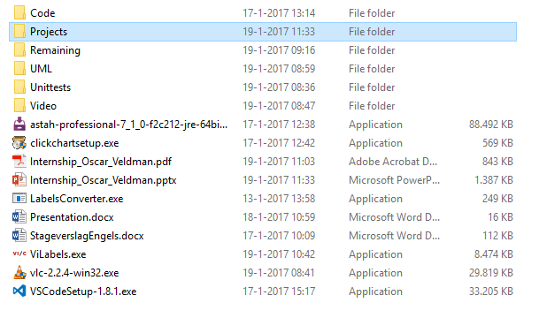
Additional information

Slide 17
The end
Any questions or comments?

