Slide 1

The Aerobatic Contest Registration System available at www.iacusn.org/acrs/ is a complete registration system for regional and the national aerobatic contests.
This presentation reviews many of the features of ACRS with screen shots and commentary.
ACRS has been used for the IAC National Aerobatic Championship for the past two years (2007, 2008). It was used for the Green Mountain, Kathy Jaffe, Ohio, East Coast, and Wildwood regional contests in 2008.
There are over 170 members registered with ACRS as of 12/30/2008, representing ¼ to 1/3 of active competitors.

Slide 2
Contest Selection and Configuration
Pilot and Volunteer Registration
Registration Management
Account Management

Slide 3
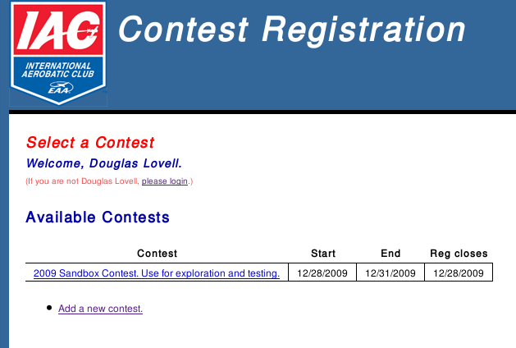
ACRS allows any number of contests. They appear in order of start date. Contests disappear from the list after the end date. The contest data remains in the database and may be accessed for historical purposes.
Any registered member can add a contest.

Slide 4
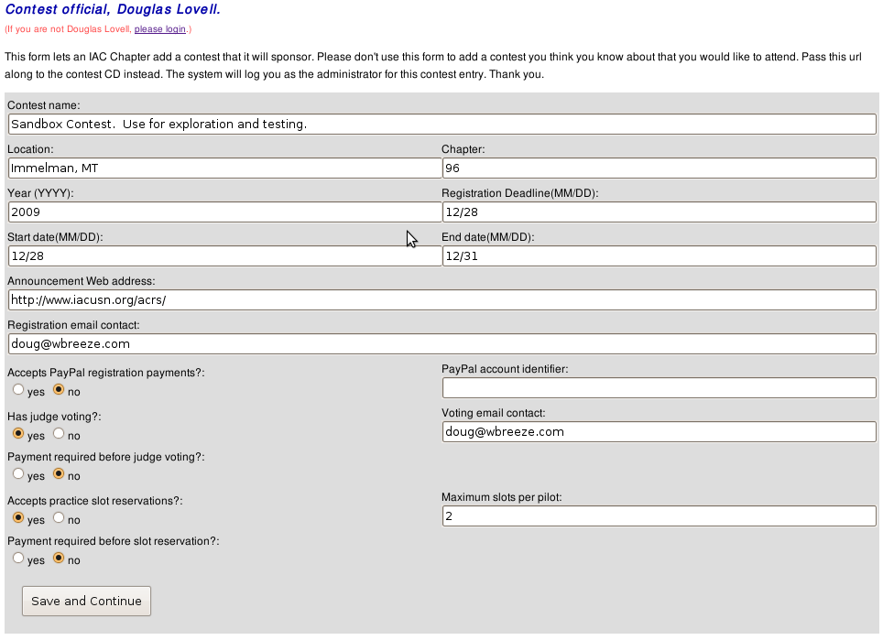
The add contest form requests that the Contest Director at least be aware of hosting contest registration on ACRS.
Optional contest registration features include PayPal payments, judge voting, and practice sessions.

Slide 5
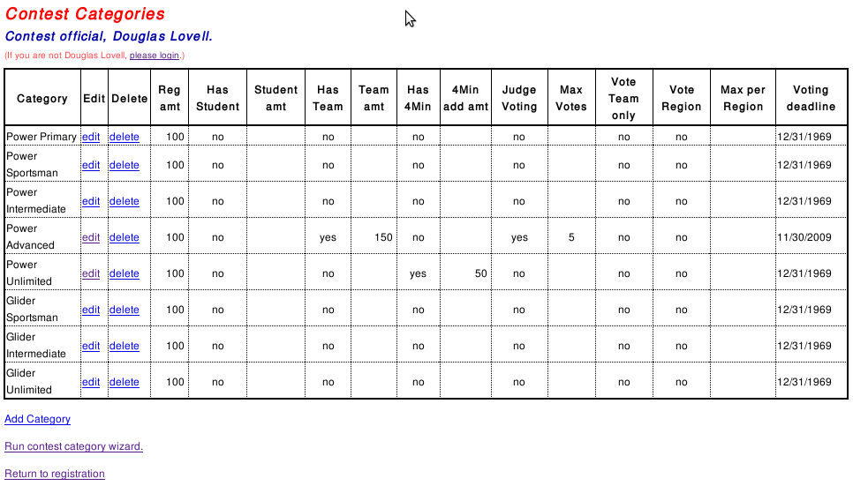
A contest creation wizard produces the list of categories hosted by the contest. This table shows the features elected for each category.

Slide 6
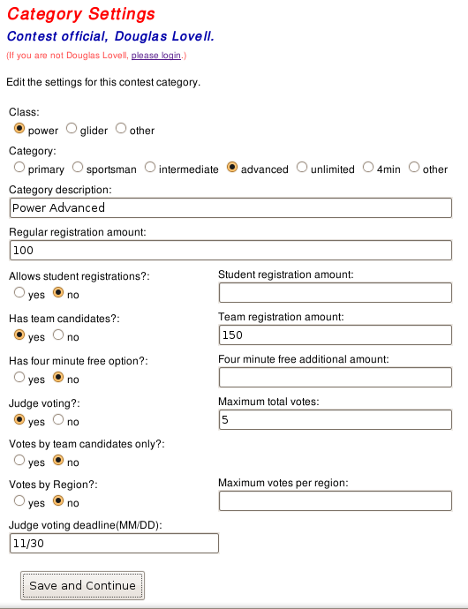
Each category may have selected registration features:
Registration amount
Student registration
Team registration and amount
Four minute free
Judge voting
Team only voting
Judge voting by region

Slide 7
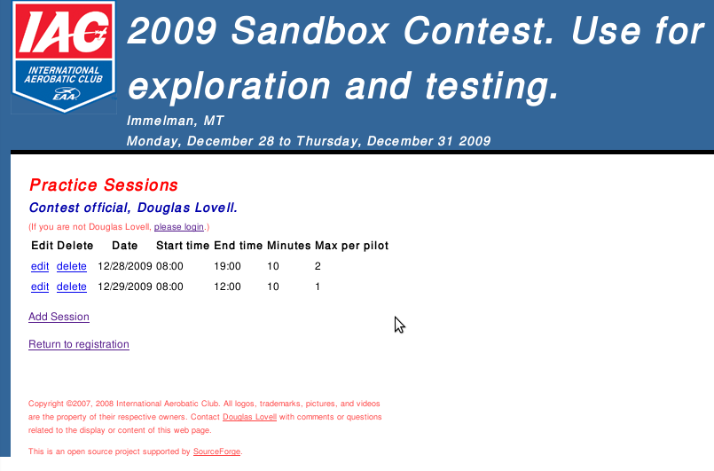
A contest may have zero or more practice sessions.
If enabled, registered pilots will have the option of reserving in advance some number of practice slots.
The box master will have the ACRS practice list report.

Slide 8
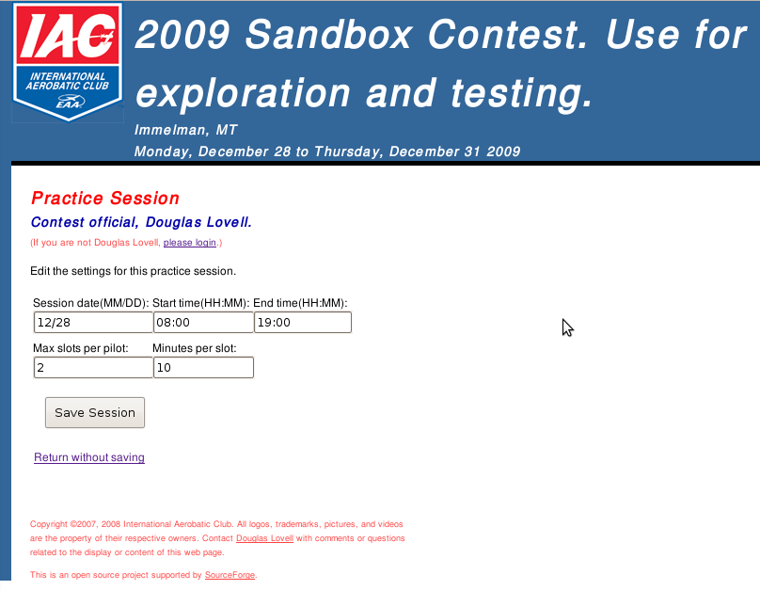
A practice session has date, start time, and end time. The CD sets the amount of practice time allocated per slot and the maximum number of slots that a pilot may reserve in each session.

Slide 9
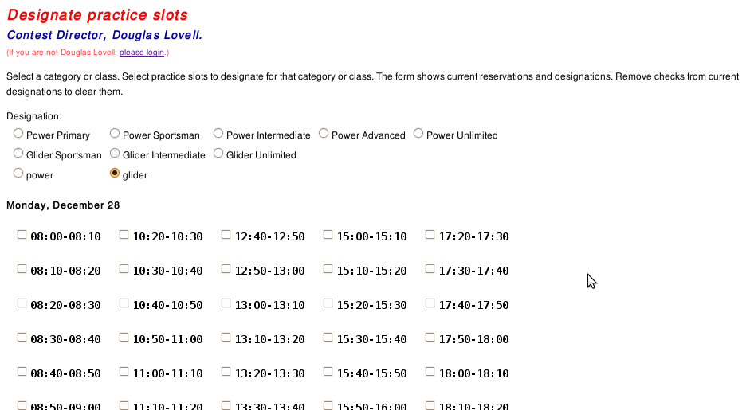
The CD can designate selected slots for power or glider pilots, or for a specific category. Those sessions will appear reserved to pilots not registered for the designated category or class.

Slide 10
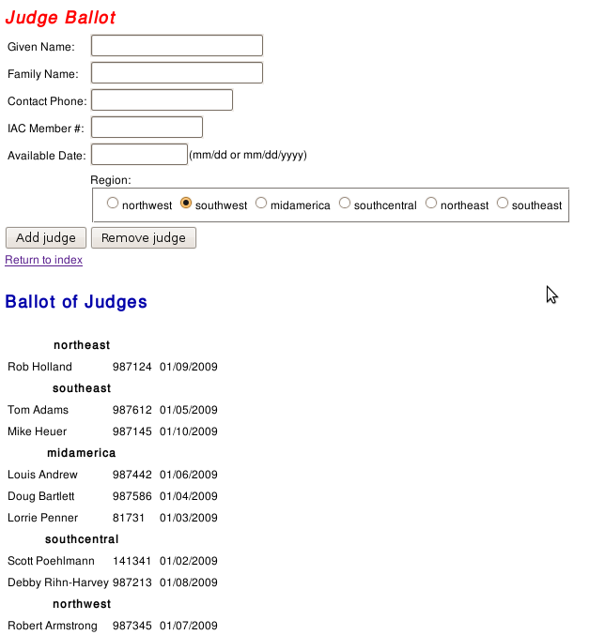
A contest that has judge voting must have a ballot. This screen allows the CD to create the list of judges on the ballot.

Slide 11
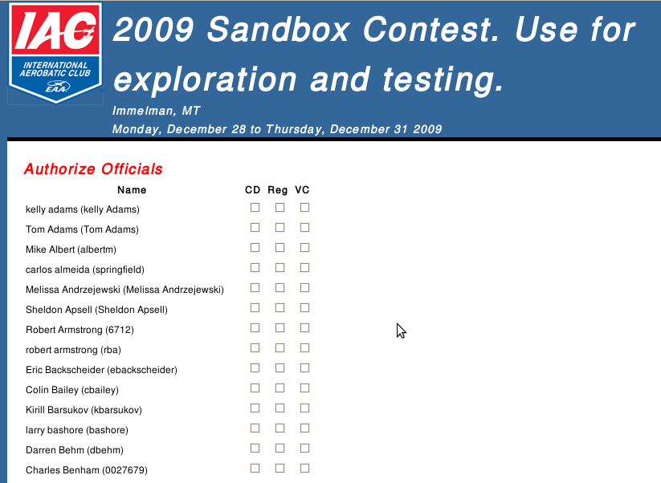
The CD designates people who may have access to contest reports and configuration. There are four levels of access.
- Registrant can edit their own registration information.
- VC can view volunteer reports
- Registrar can view registration, payment, and volunteer reports.
- CD can view all reports and edit the contest parameters.

Slide 12
Contest Selection and Configuration
Pilot and Volunteer Registration
Registration Management
Account Management

Slide 13
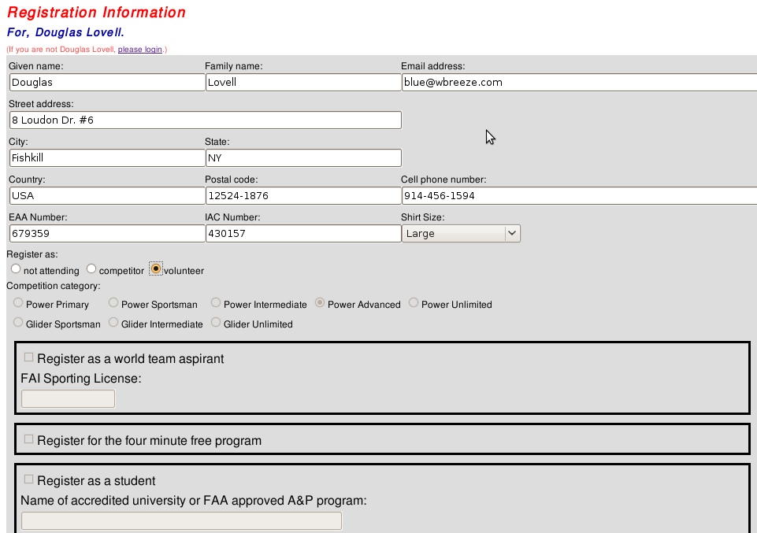
ACRS copies registration information from the most recent contest. Registrants do not have to re-enter this information for every contest.
Note that the category related items are disabled for a volunteer.
A registrant can withdraw by changing their status to “not attending.”

Slide 14
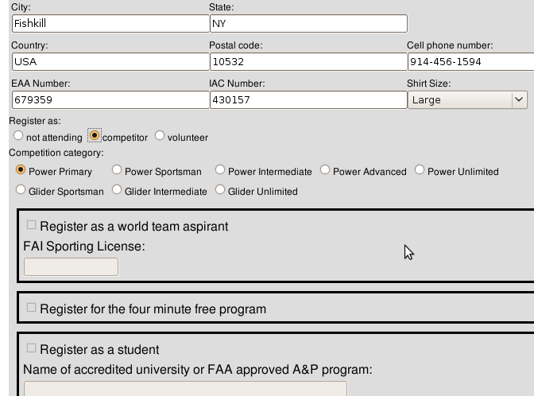
This registrant has changed status to “competitor.” The list of competition categories includes only categories configured for the contest.
As a competitor, this registrant can select a competition category.
Note that team, four minute, and student registrations are not available for Power-Primary registrants at this contest and are not enabled.

Slide 15
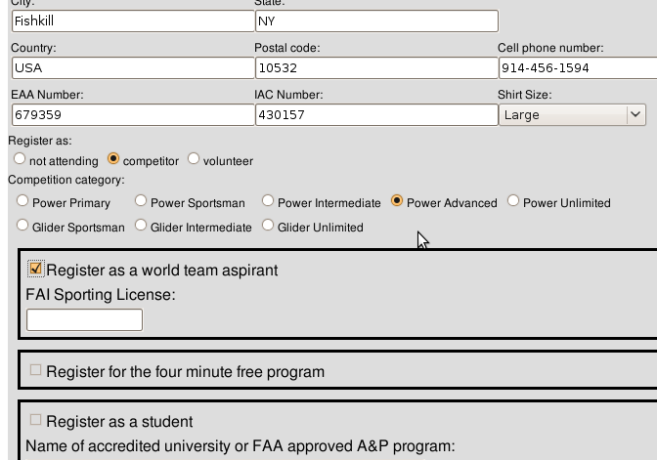
The Power Advanced category for this contest has optional team registration.

Slide 16
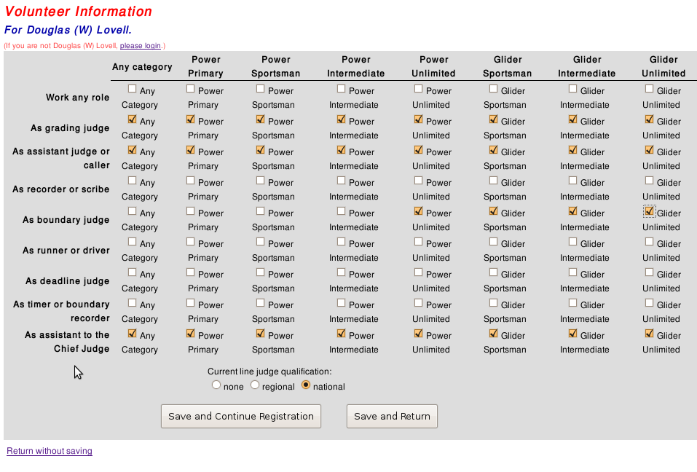
The volunteer preferences screen enables selection of any combination of category and position.
Note that a competitor's selected category does not appear.

Slide 17
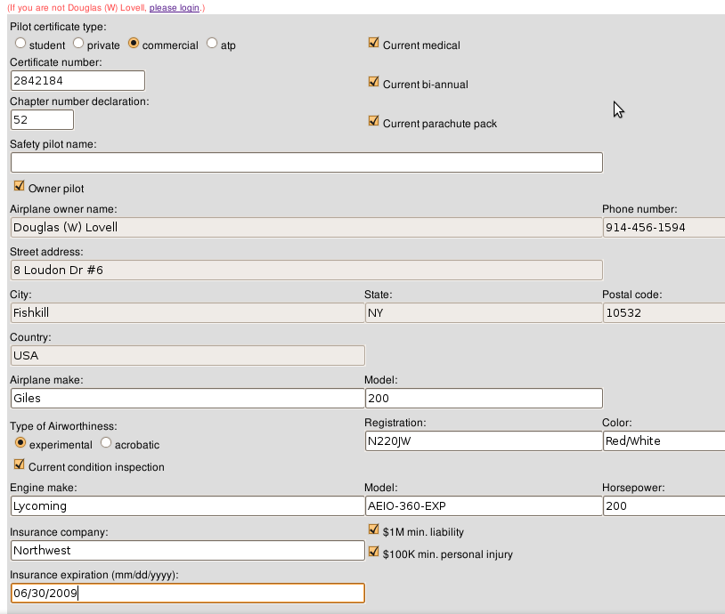
ACRS copies flying information from the registrant's most recent registration.
It copies owner fields when the pilot checks the “Owner pilot” box and disables those fields.
Clearing the “Owner pilot” checkbox enables the owner information fields for editing.

Slide 18
Contest Selection and Configuration
Pilot and Volunteer Registration
Registration Management
Account Management

Slide 19
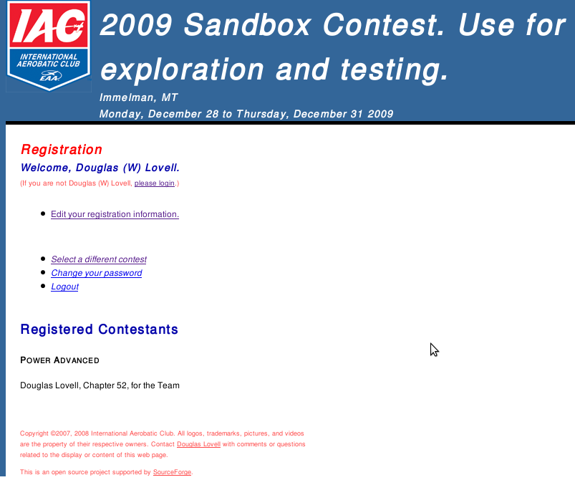
The registration menu for a new, unregistered competitor has only one registration related action. The action starts the series of screens that take pilot, volunteer, airplane information, and payment (if enabled for payment).
The remaining options enable contest selection, password change, and logout (for public machines).

Slide 20
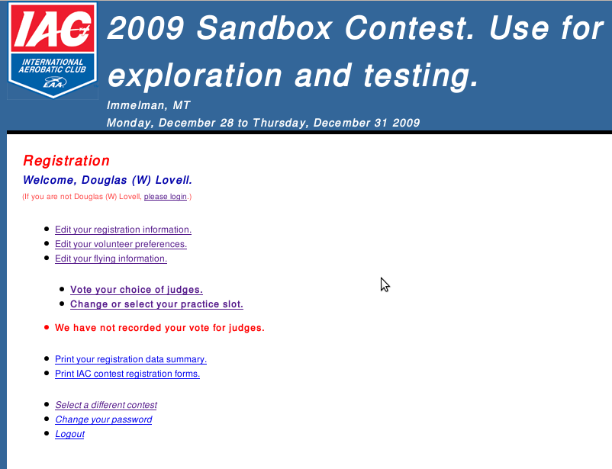
A registered pilot sees more options for editing registration, volunteer, and flying information.
A contest with judge voting will show a voting action when the registrant has not yet voted.
A contest that has practice slots will show an action to edit practice slot selection.
Warnings appear when the registrant has not yet provided required information.
A registrant can print their registration forms for backup and comfort.

Slide 21
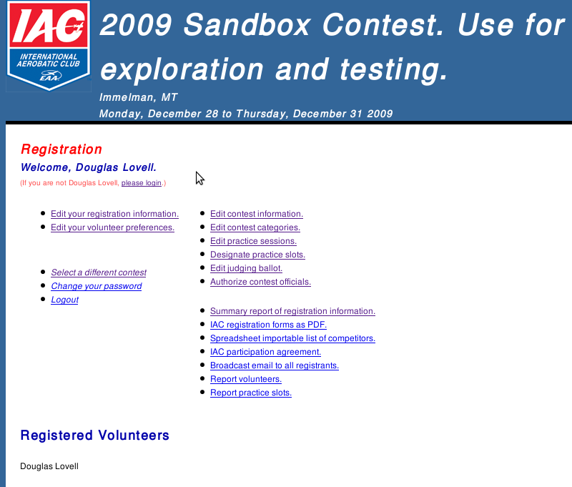
A contest official sees an additional column of actions.
The CD has contest configuration options.
The CD, Registrar, and VC have a number of full and summary reports and actions available, including the PDF with complete IAC registration forms for all registrants.

Slide 22
Contest Selection and Configuration
Pilot and Volunteer Registration
Registration Management
Account Management

Slide 23
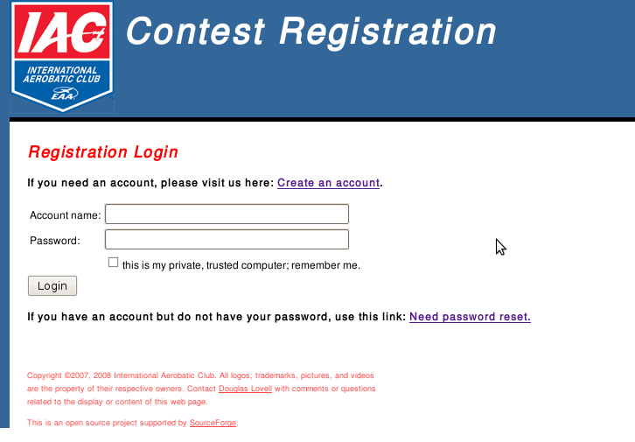
Account login requires a password and may be remembered as a cookie. All except the account login, creation, and reset screens require the established session or stored account cookie.

Slide 24
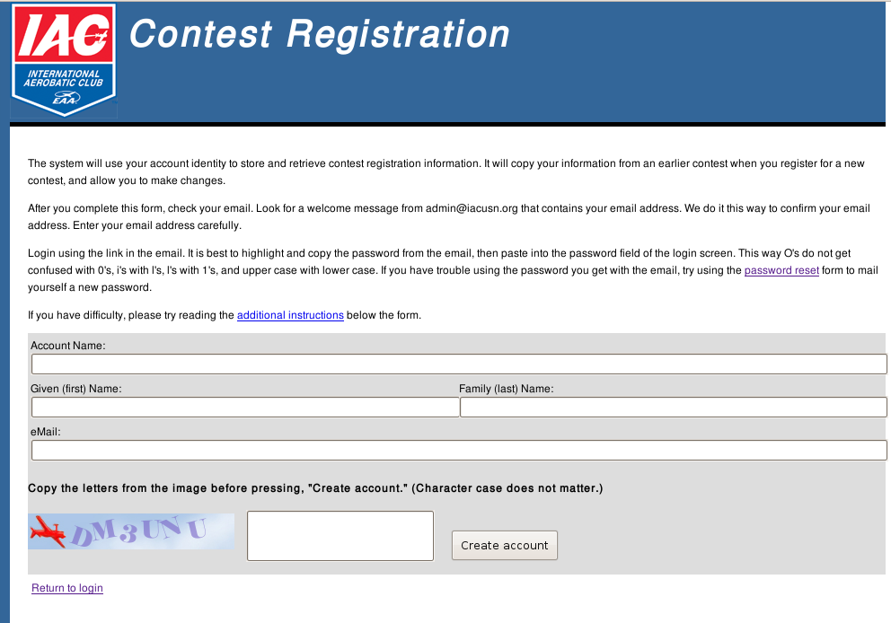
Registration requires an account name, display name, and email address. ACRS mails an activation link and initial password to validate the email address.
The anti-robot Turing test appears on this screen and the password reset to prevent spamming robots from attempting to create an account. All other screens require an authorized user.
All fields on all screens are length limited for input. All user supplied data copied to SQL queries is processed to prevent SQL insertion attacks.

Slide 25
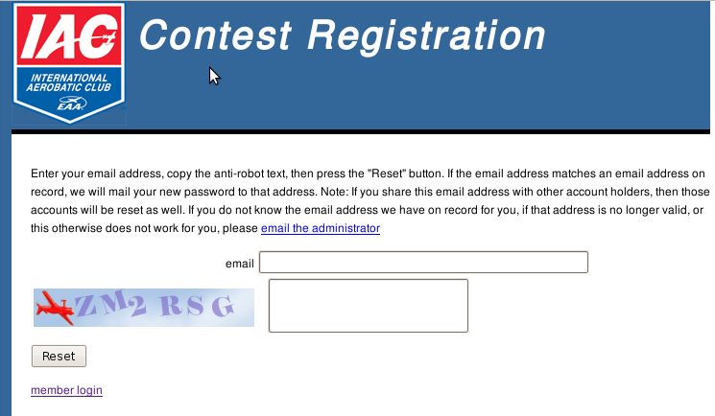
It is very easy to reset the password with the email address. The anti-robot feature prevents denial of service attackers from stressing the email server.

Slide 26
The Aerobatic Contest Registration System hosted at www.iacusn.org/acrs/ provides a complete, robust registration system for regional and the national aerobatic contests.
The International Aerobatic Club (IAC) owns copyright to all of the source code for ACRS. The code is open source licensed under the Apache License V.2.0.
ACRS is hosted open source by SourceForge The project URL is http://sourceforge.net/projects/acrs/

