Slide 1
Observing of data sharing contracts
Observing Data Transactions (Data sharing contracts)
Was the contract agreed upon?
Was the data made available?
Did the data sharing happen?
…
Control plane
Data Provenance
Traceability
Knowing where the data comes from
Lineage of data
Tracing how Data is accessed and used
Who has accessed which data
Data plane
Value added services
Billing, charging, notarisation, etc.
Services
In the scope of Data space concepts
In the scope of Use case implementations
Notes:
Updated image based on discussions on May 5:
Figure 1 Distinguishing observability of data-sharing contracts Observability vs Data Provenance vs Traceability

Slide 2
Data Space Governance Authority
Data Space Governance rules
for participation management
Data Space Participant
Business processes and rules for data sharing governance
Data space participants and/or any observing 3rd party
Technical Implementation
Covered in this paper
Not covered in this
edition of the paper
Notes:
Updated image based on the conversation on March 4 workshop
Figure 2 More than technical elements are needed to enable Observability, Data Provenance and Traceability

Slide 3
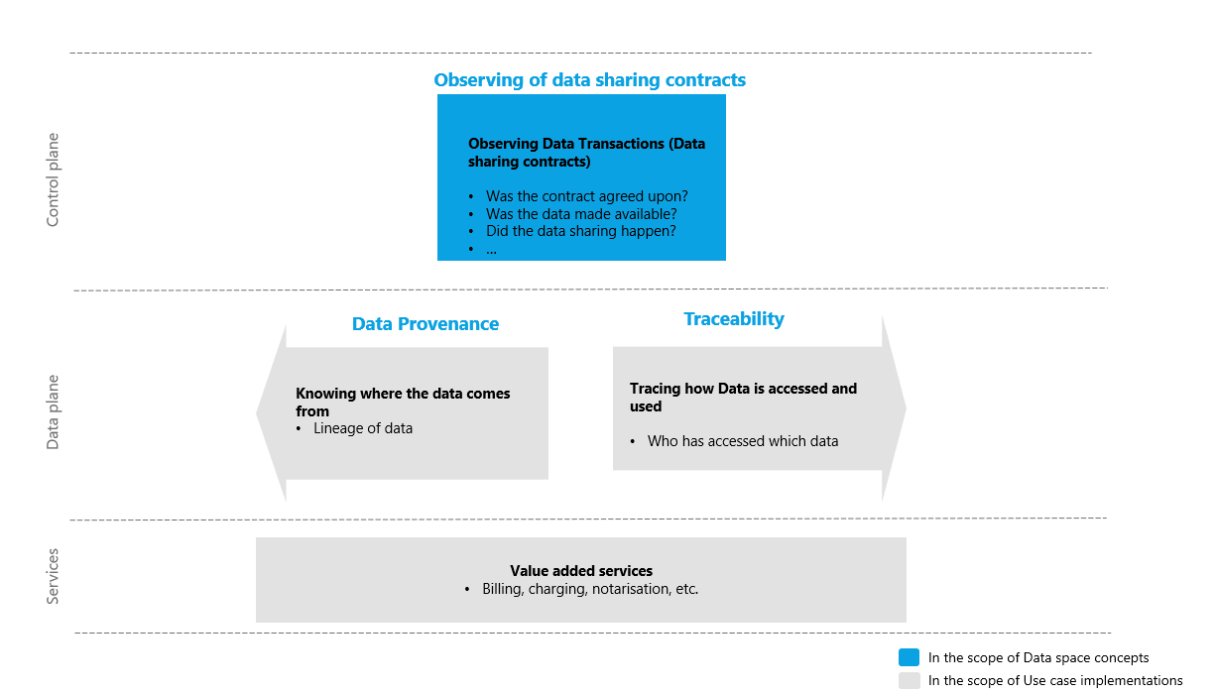
We aim at the Observability of Data sharing contracts, not end-to-end observability in data ecosystems

Slide 4
Observability requires more than technical elements
Rules and Processes are needed more than technical elements

Slide 5
Contract Offer may include
A term: that requires the use of an observation service to observe the Contract Negotiation and/or the Transfer Process
List of acceptable Observers proposed by the Provider
Claims and evidence on established Data Sharing Contracts for Observability (DSCOs) with the proposed Observers

