Slide 1
Power Up Research Software Development with Github Copilot
Amanda Tan
CLASS Program Manager
Internet 2
Ananya Ravipati
Lead Cloud Engineer
Internet 2
Tim Manik
Cloud Solutions Architect
Internet 2

Slide 2
Agenda
Introduction (coding companion primer)
Overview of Github Copilot
Hands-on Lab part 1
Break
Hands-on Lab part 2
Hands-on Lab part 3
Takeaways and closing remarks

Slide 3
Introduction
What is a coding companion?
Why use a coding companion for research software development?
Notes:
What is a coding companion?
A coding companion is a tool, typically software-based, that aids developers in writing, debugging, and optimizing code. These companions can be integrated development environment (IDE) extensions, standalone applications, or AI-driven assistants. They offer various functionalities such as code suggestions, error detection, automated testing, and documentation generation.
Why use a coding companion for research software development?
- Using a coding companion for research software development enhances efficiency by providing code suggestions, error detection, and debugging tools, allowing researchers to focus more on their scientific work rather than coding issues.
It ensures code quality and consistency through linting, formatting, and adherence to best practices. The companion aids in maintaining detailed documentation and version control, crucial for reproducibility. It facilitates interdisciplinary collaboration by making code more understandable and maintainable for diverse teams. Additionally, it supports rapid prototyping and testing of new ideas, speeding up the research and development process.

Slide 4



Introduction
What are the different coding companions?
Github Copilot
Amazon Codewhisperer
Gemini Code Assist
Notes:
Github Copilot
Developed by Microsoft
Programming languages supported: “GitHub Copilot provides suggestions for numerous languages and a wide variety of frameworks, but works especially well for Python, JavaScript, TypeScript, Ruby, Go, C# and C++” https://docs.github.com/en/copilot/using-github-copilot/using-github-copilot-code-suggestions-in-your-editor
Pricing tiers: Individual, Business, Enterprise https://github.com/features/copilot#pricing
Strengths: LLM is based on GPT3.
Limitations:
Amazon Codewhisperer
Developed by Amazon
Programming languages supported: Java, Python, JavaScript, TypeScript, C#, Go, PHP, Rust, Kotlin, SQL, JSON (AWS CloudFormation), YAML (AWS CloudFormation), HCL (Terraform), CDK (Typescript, Python), Ruby, C++, C, Shell, Scala https://docs.aws.amazon.com/codewhisperer/latest/userguide/language-ide-support.html
Pricing tiers: Individual (free), Professional https://docs.aws.amazon.com/codewhisperer/latest/userguide/billing.html
Strengths: Trained on Amazon internal code. Good at AWS specific code
Gemini Code Assist
Developed by Google
Programming languages supported: Bash, C, C++, C#, Dart, Go, GoogleSQL, Java, JavaScript, Kotlin, Lua, MatLab, PHP, Python, R, Ruby, Rust, Scala, SQL, Swift, TypeScript, YAML https://cloud.google.com/gemini/docs/codeassist/supported-languages
Pricing tiers: Gemini Code Assist https://cloud.google.com/products/gemini/pricing
Strengths: Supports many natural languages for query/prompting.

Slide 5
Overview of GitHub Copilot
Main features of GitHub Copilot
AI-based suggestions in real-time
Chat interface
CLI support
Suggest summary for pull request (GitHub Copilot Enterprise)
Search through your codebase (GitHub Copilot Enterprise)

Slide 6
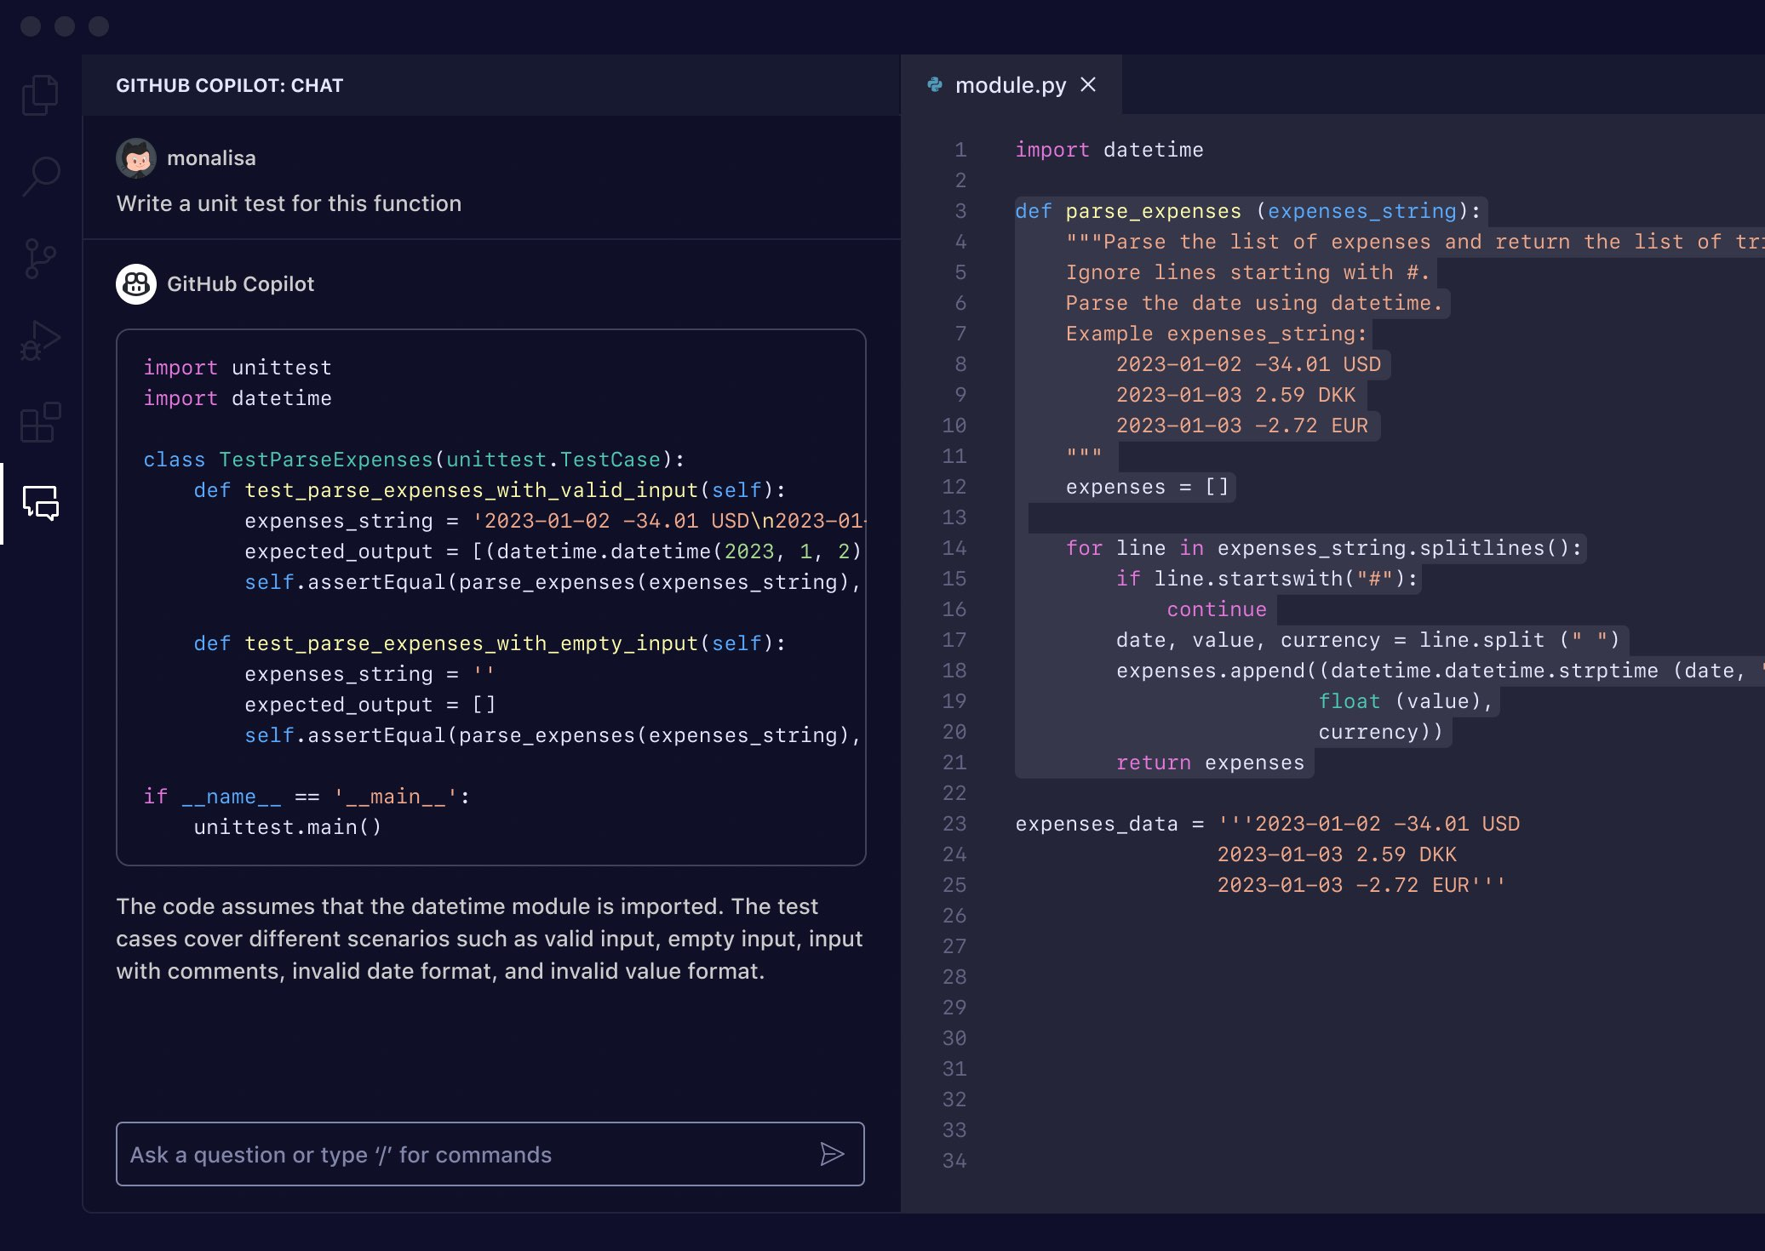
Overview of GitHub Copilot
GitHub Copilot chat features
Answering coding questions
Explaining code and suggesting improvements
Proposing code fixes
Planning coding tasks

Slide 7
Hands-on Lab (pre-reqs)
Visual Studio Code
Conda
GitHub account
GitHub Copilot
GitHub Copilot Visual Studio Extension

Slide 8
Hands-on Lab (part 1)
Working with large datasets on AWS
Working with Jupyter Notebooks
Using Github Copilot to import libraries and analyze datasets

Slide 9
Hands-on Lab (part 2)
Using Copilot to develop code
Using Copilot to explain code
Using Copilot to document code

Slide 10
Hands-on Lab (part 3)
Choose your own adventure
Continue analyzing current data set
Analyze a new dataset

