Slide 1
Disco

Slide 2
Overview
Goals
Methodology
Target Selection
Probe Selection
Running Measurements
CBG

Slide 3
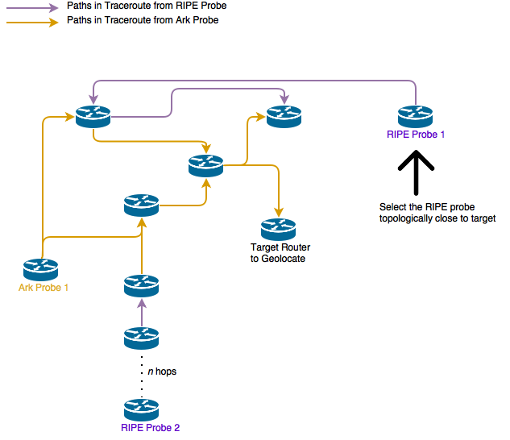
Use Routing Topology
Create a graph database from traceroute data
Select Atlas probes that are topologically near the target

