Slide 1


PROGESS LOG
Edited by
Loek Ehren
Mike Schatorjé
Simone Francesconi
Herm Lecluse
Rick van Osch

Slide 2
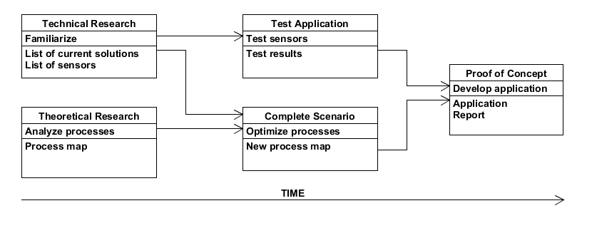



The project

Slide 3
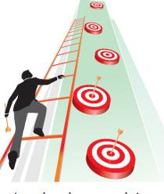
What did we want to achieve?
Start with features for our application -> Route calculation
Documenting research results in report
Make 3D model of demo container for minor exhibition
Submit it to get materials

Slide 4


How did we do it?
Online research regarding Google API
Heavy Typing…
Sketchup

Slide 5
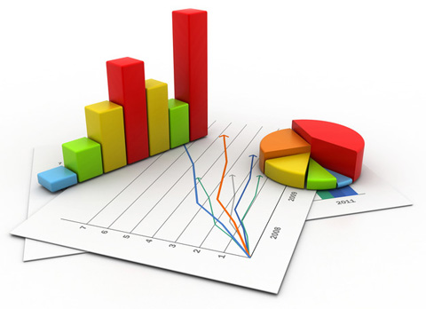
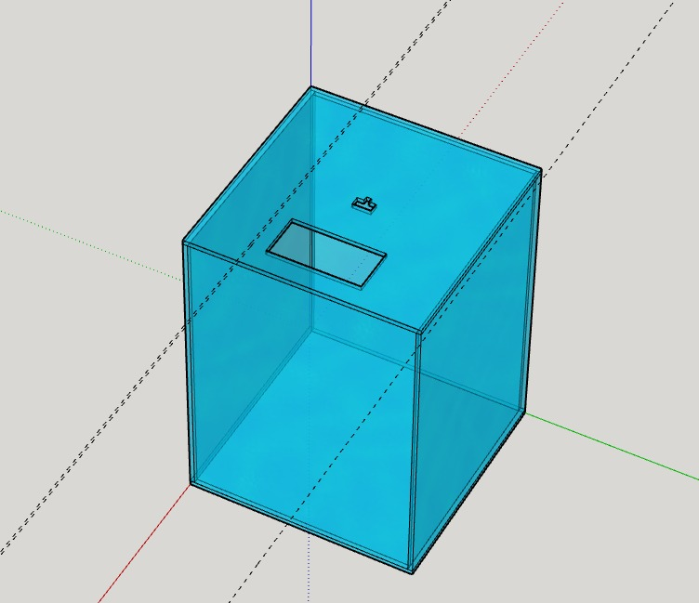
What were the results?
Knowledge about Google API
Started on research report
3D Model of prototype container

Slide 6
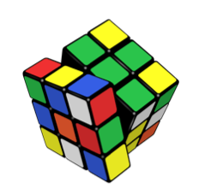
What were the problems?
Not much time due to Easter

Slide 7
What were the lessons learned?

Slide 8
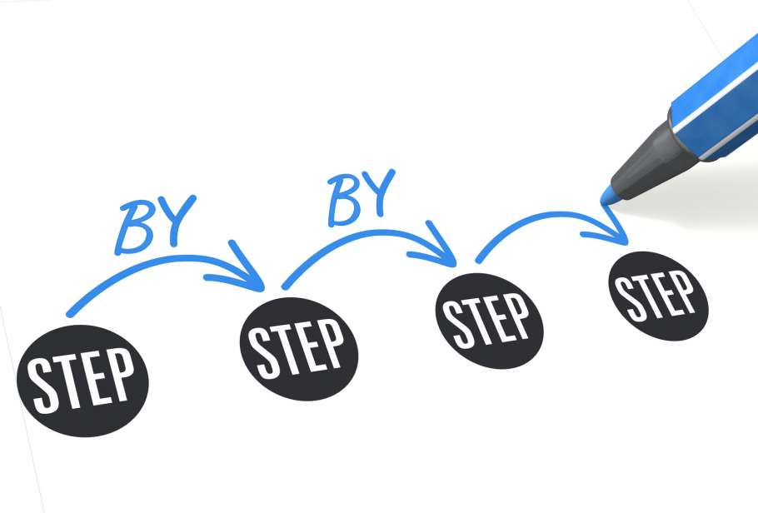
What do we want to achieve?
Continue with report
Start design phase of prototype

Slide 9

How we are going to do it?
Start designing and implementing prototype
Continue writing in report

Slide 10
Any Question?
Thanks for your attention!

