Slide 1


PROGESS LOG
Edited by
Loek Ehren
Mike Schatorjé
Simone Francesconi
Herm Lecluse
Rick van Osch

Slide 2
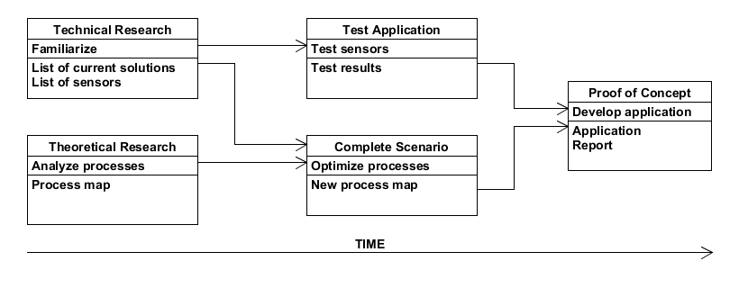


The project

Slide 3

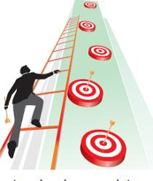
What did we want to achieve?
Continue with report
Evaluate process map
Exam 9th Tuesday
Continue with the exhibition video and look at other video making tools
Continue on prototype

Slide 4



How did we do it?
Divided work
Solidworks
A day at the workshop with Gijs
More programming

Slide 5
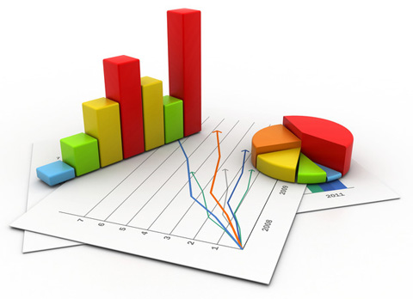
What were the results?
Exhibition container modelled, materials found
Laser cutting next week
Mock-ups implemented
Missing functionalities for necessary for front end

Slide 6
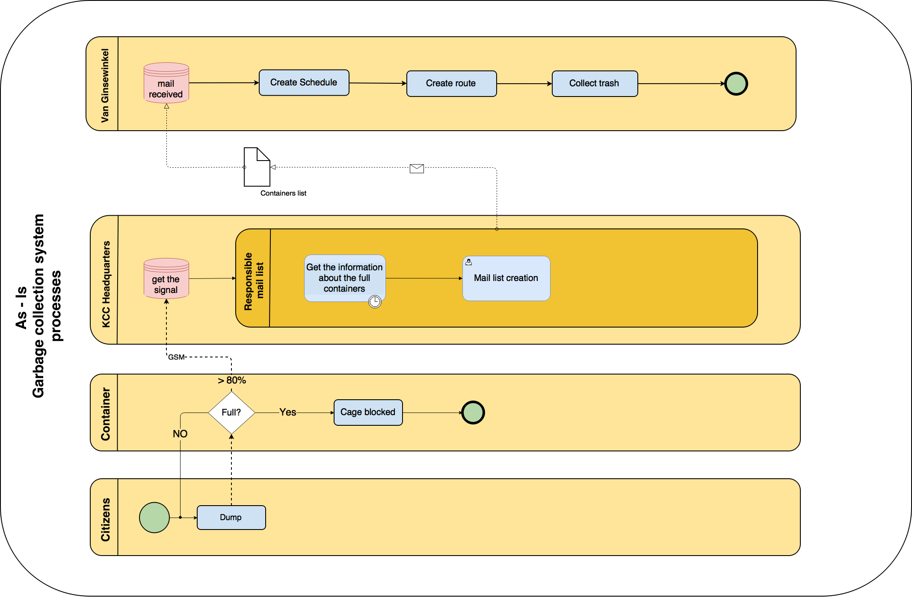

Slide 7
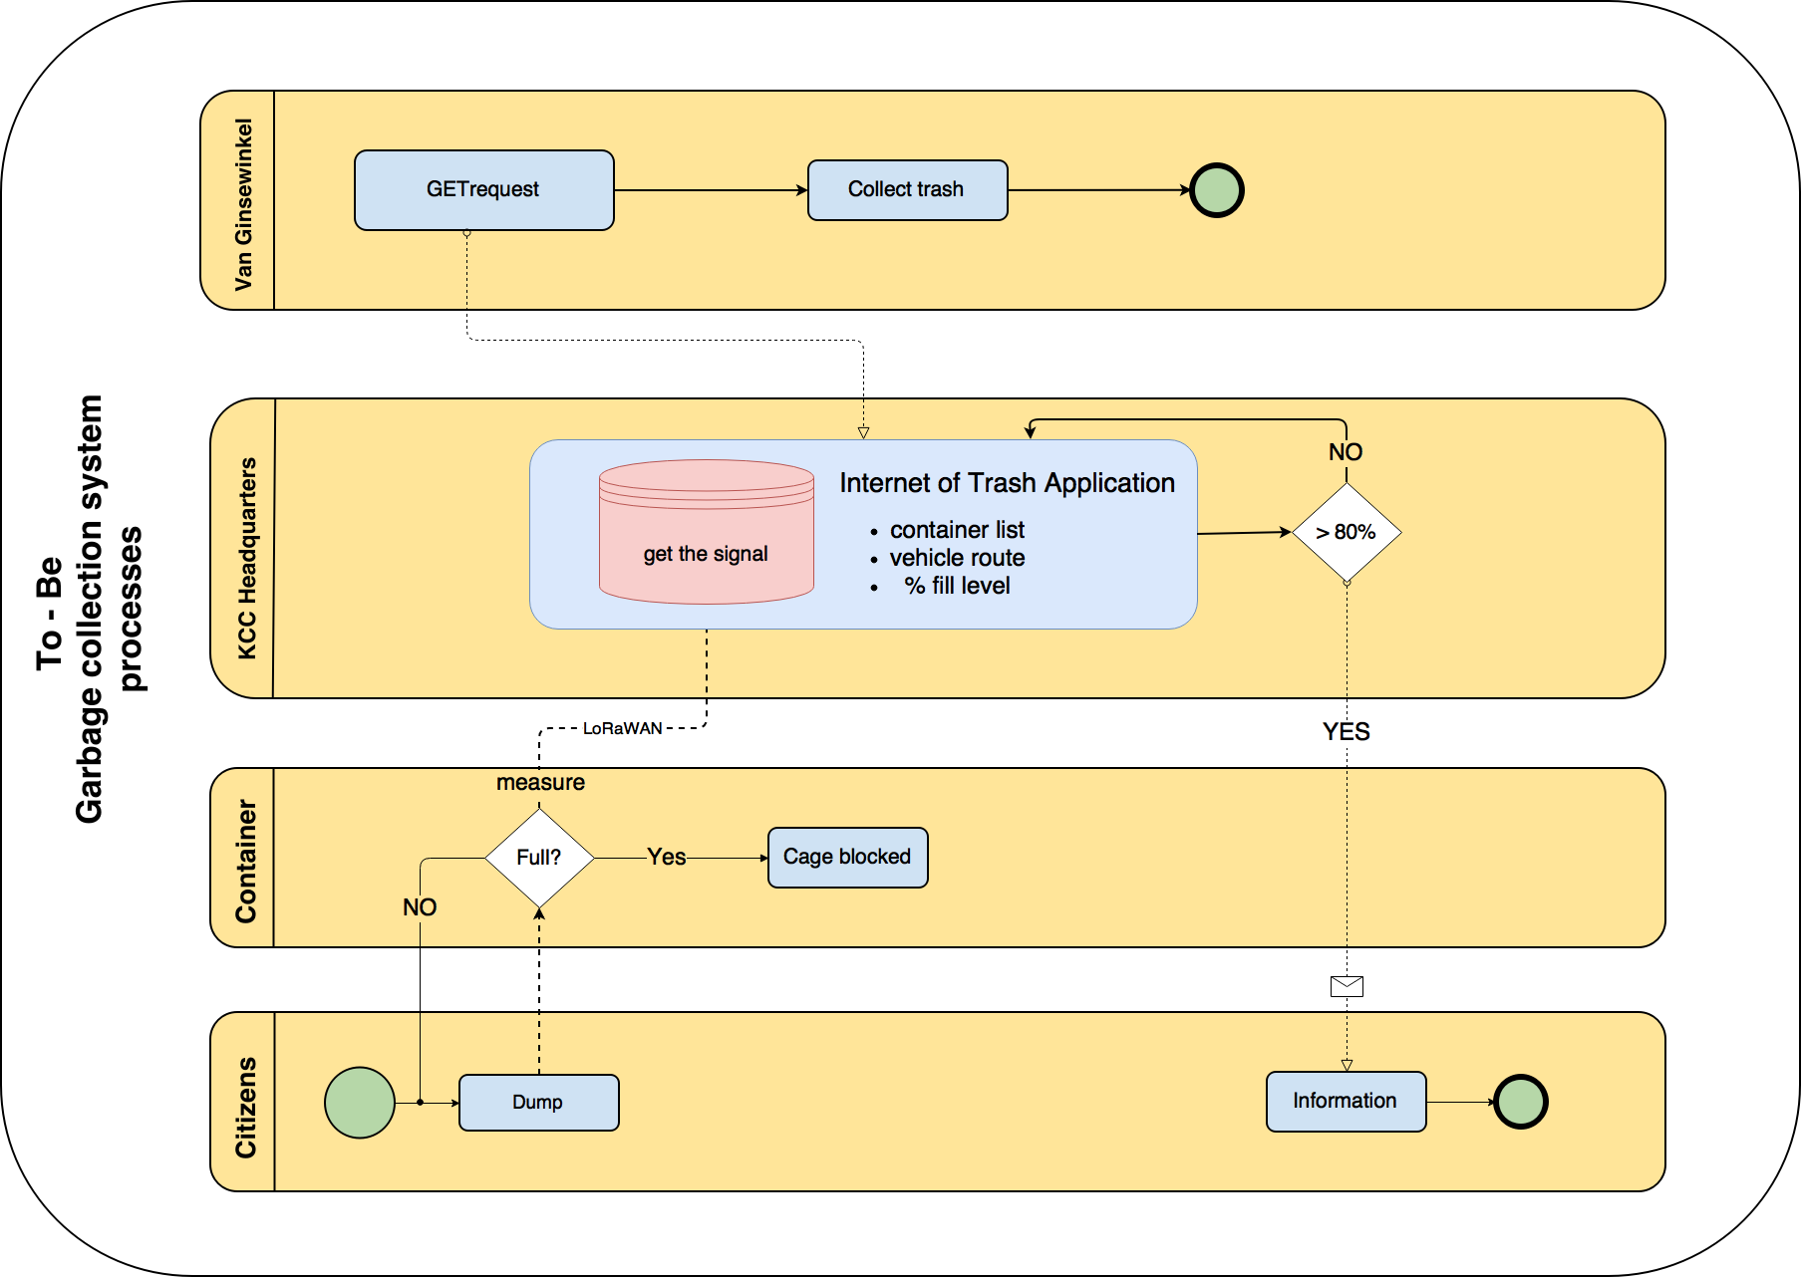

Slide 8
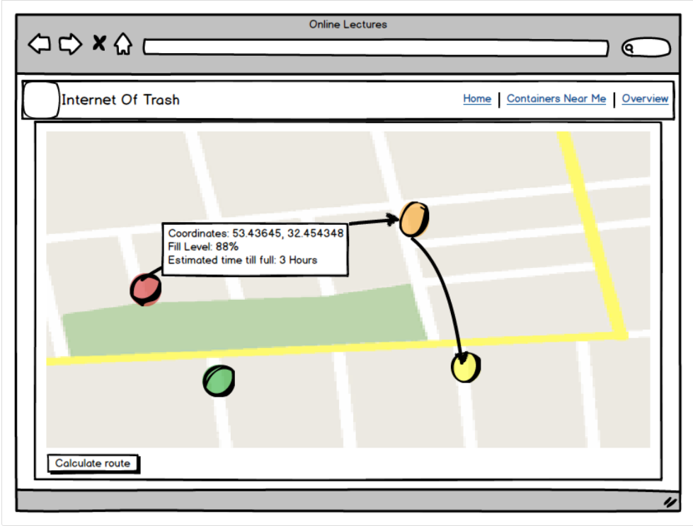
Results

Slide 9
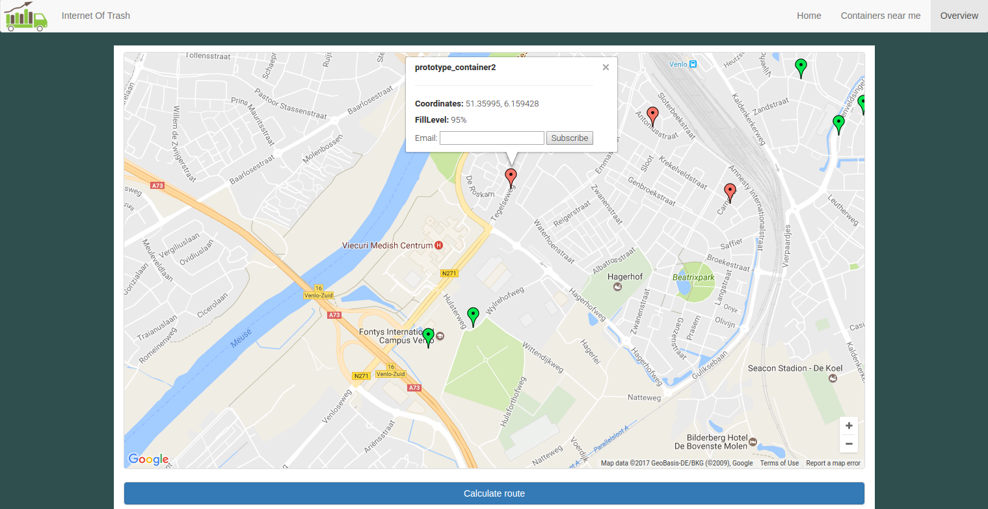
Results

Slide 10
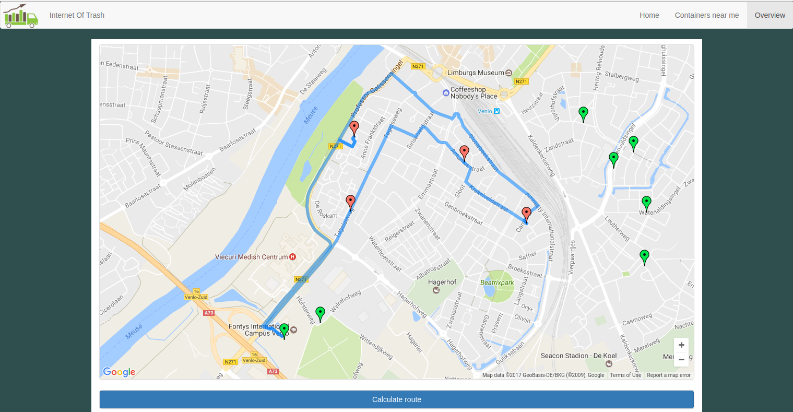
Results

Slide 11
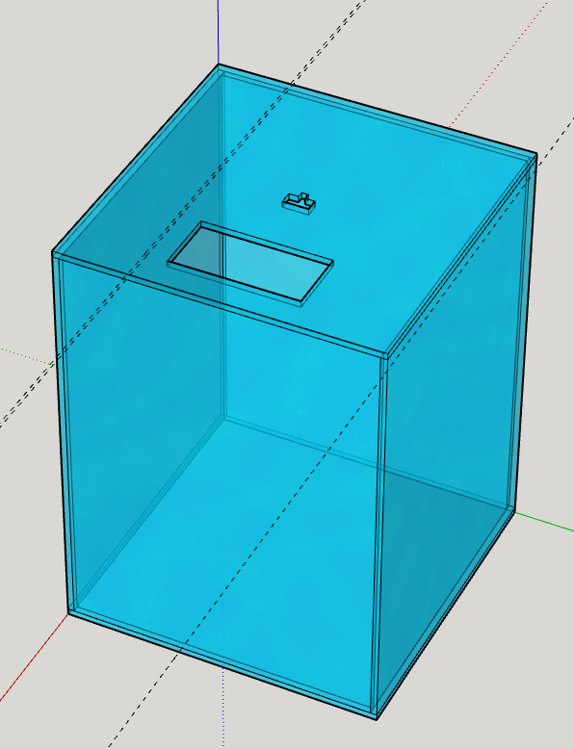
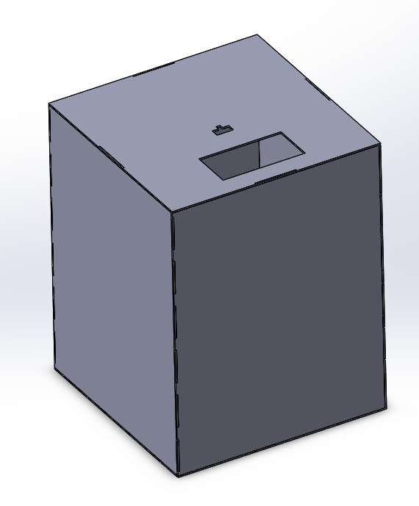
Results

Slide 12
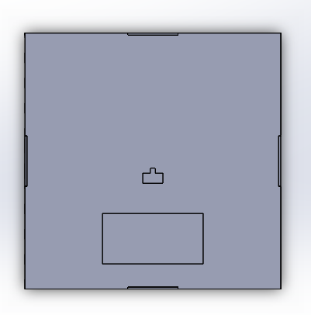
Results

Slide 13

Results

Slide 14
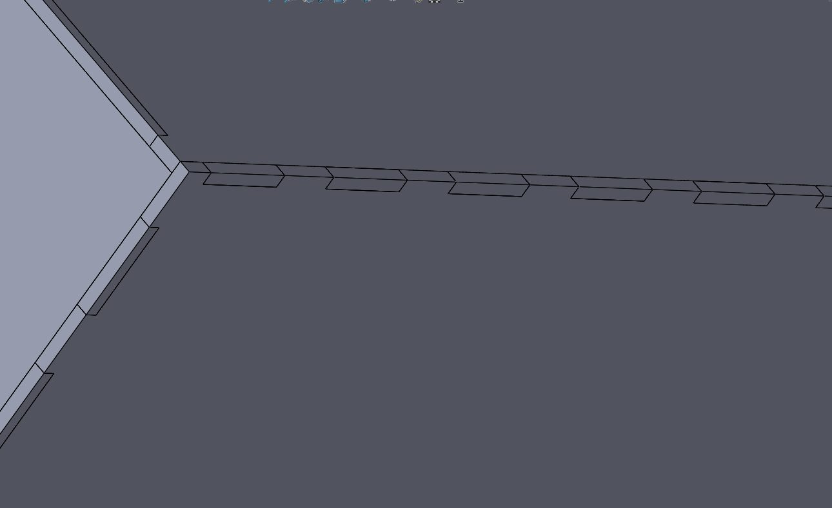
Results

Slide 15
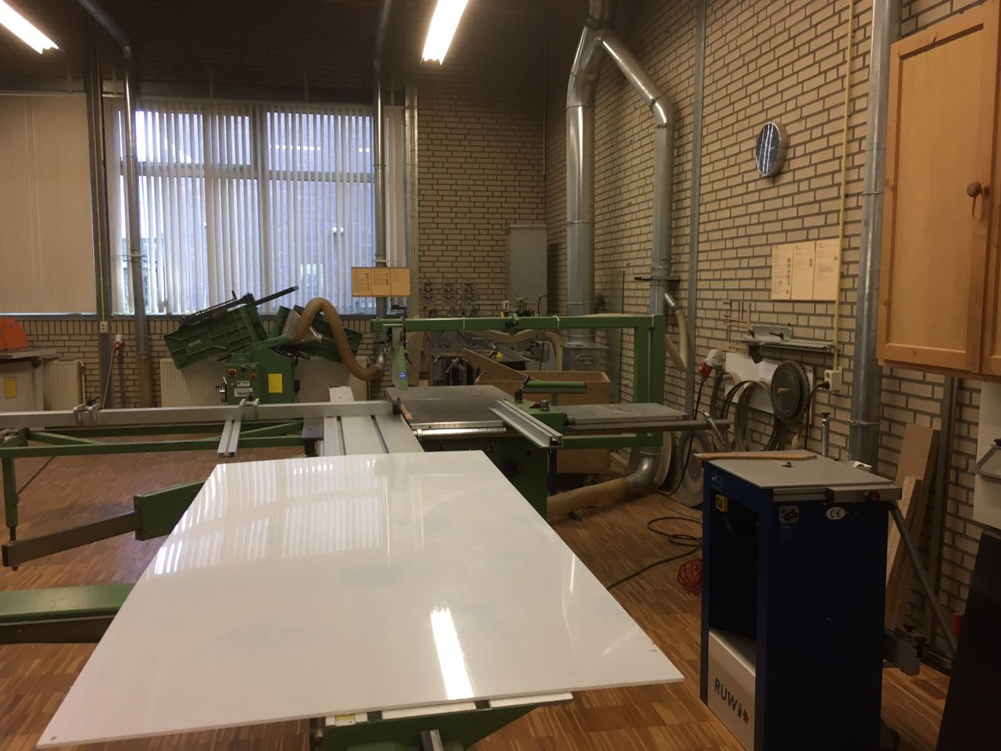
Results

Slide 16
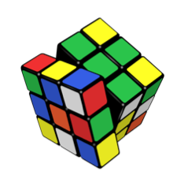
What were the problems?
Test on Tuesday
Solid “works”
Laser cutter rather busy
Wrong acrylic sheet thickness

Slide 17
What were the lessons learned?
Getting a 3D model right the first time is rather difficult
Workshop has the right materials, if you know where to look

Slide 18
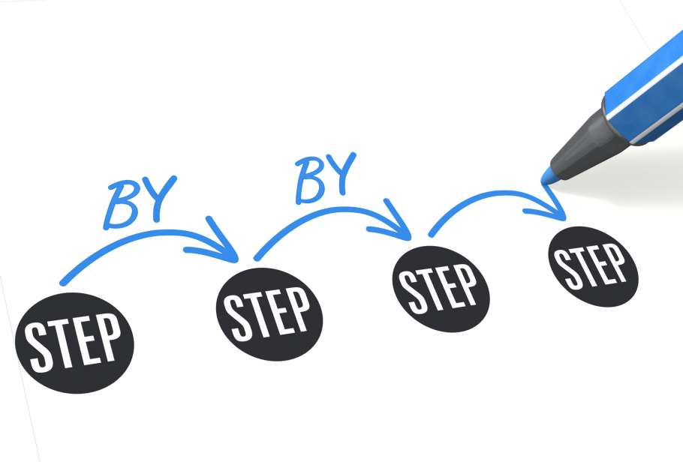
What do we want to achieve?
Laser cut and assemble the exhibition demo container
Add more functionality to front and back end
Arrange another meeting with
Leo Jacobs

Slide 19
Any Question?
Thanks for your attention!

