Slide 1


PROGESS LOG
Edited by
Loek Ehren
Mike Schatorjé
Simone Francesconi
Herm Lecluse
Rick van Osch

Slide 2
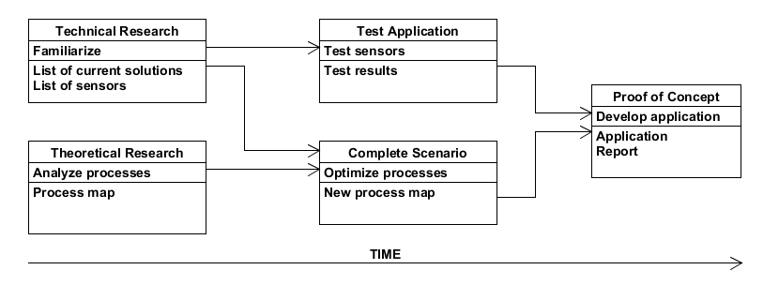


The project

Slide 3


What did we want to achieve?
Cost analysis and differences among the 2 systems
Implement hardware + software in the box
Create a small case for all the electronics
Button functionality

Slide 4

How did we do it?
Divided work
Gathering more information from Leo Jacobs
Implement & test scenarios with the box and our software

Slide 5

What were the results?
Secondary process of the GCS and its cost
Implenting costs of our system
A physical Box + hardware + software = working™ product
Poster

Slide 6
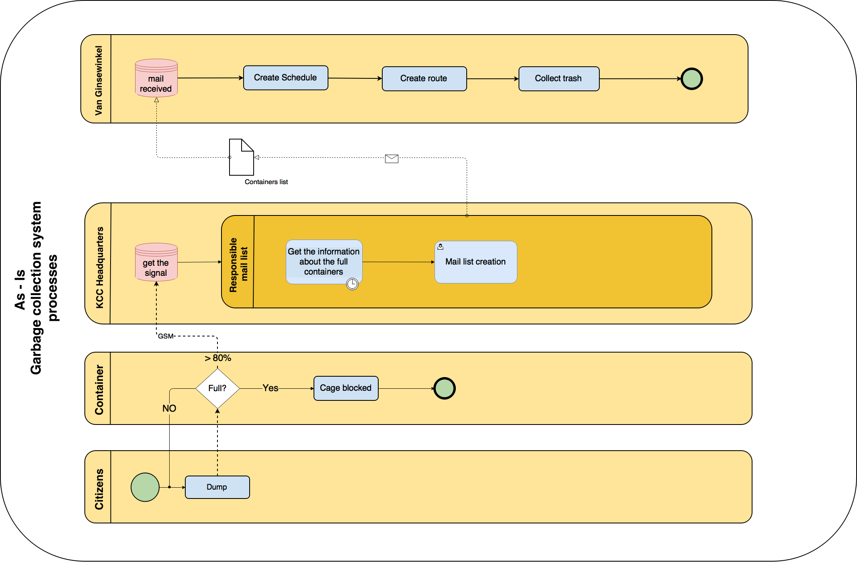

Slide 7
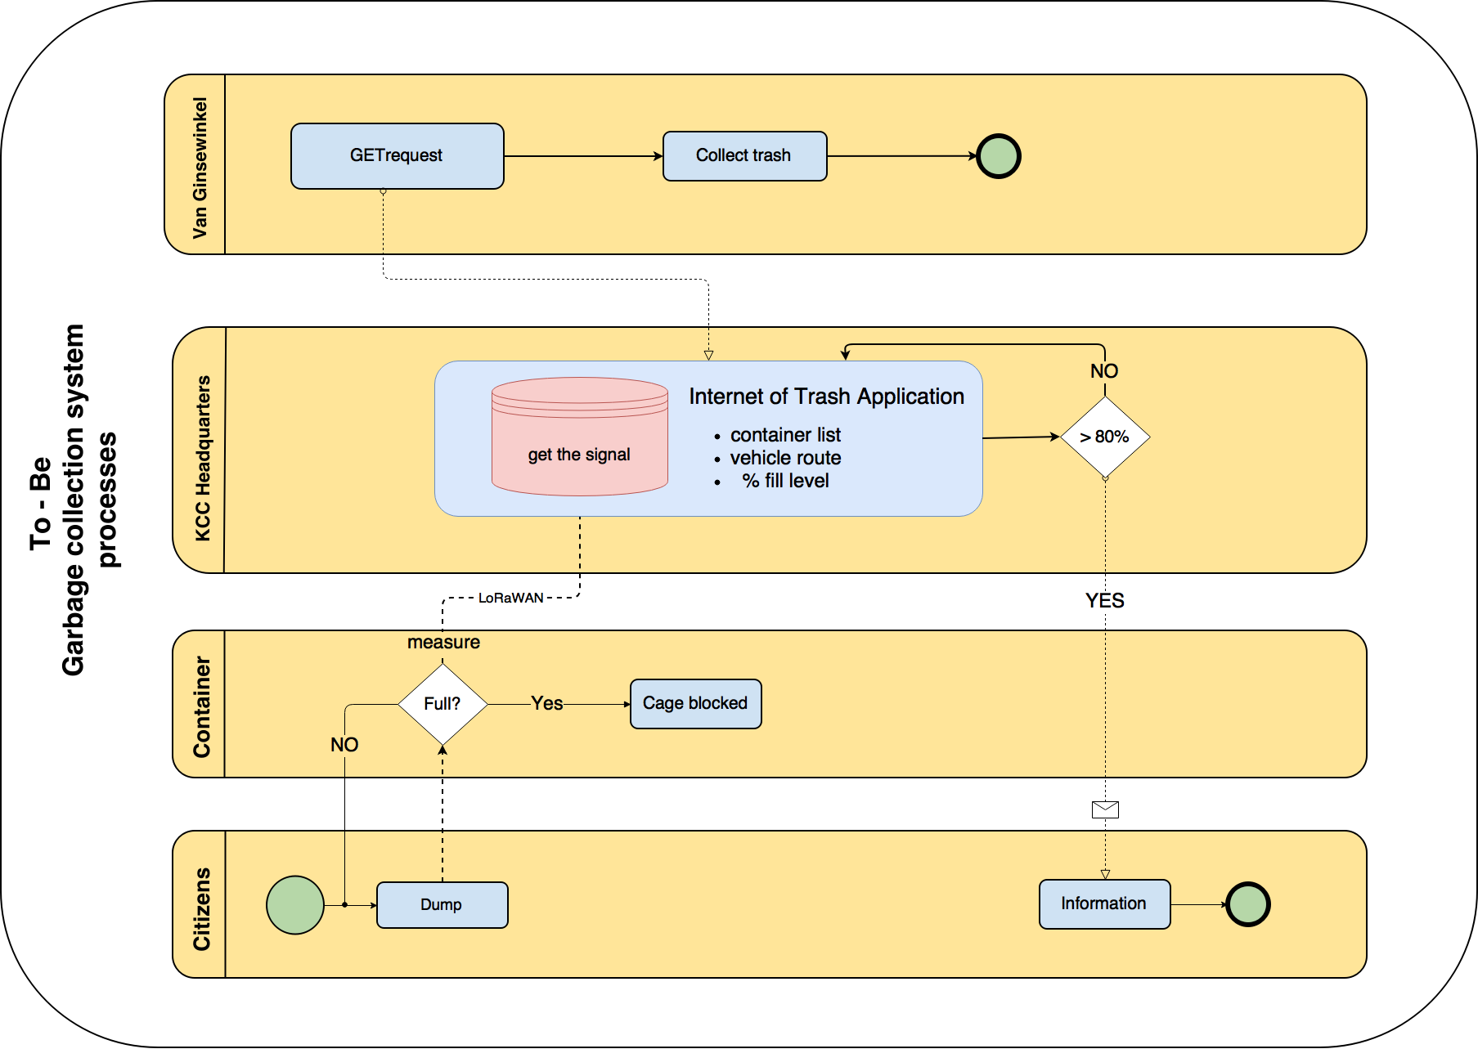

Slide 8
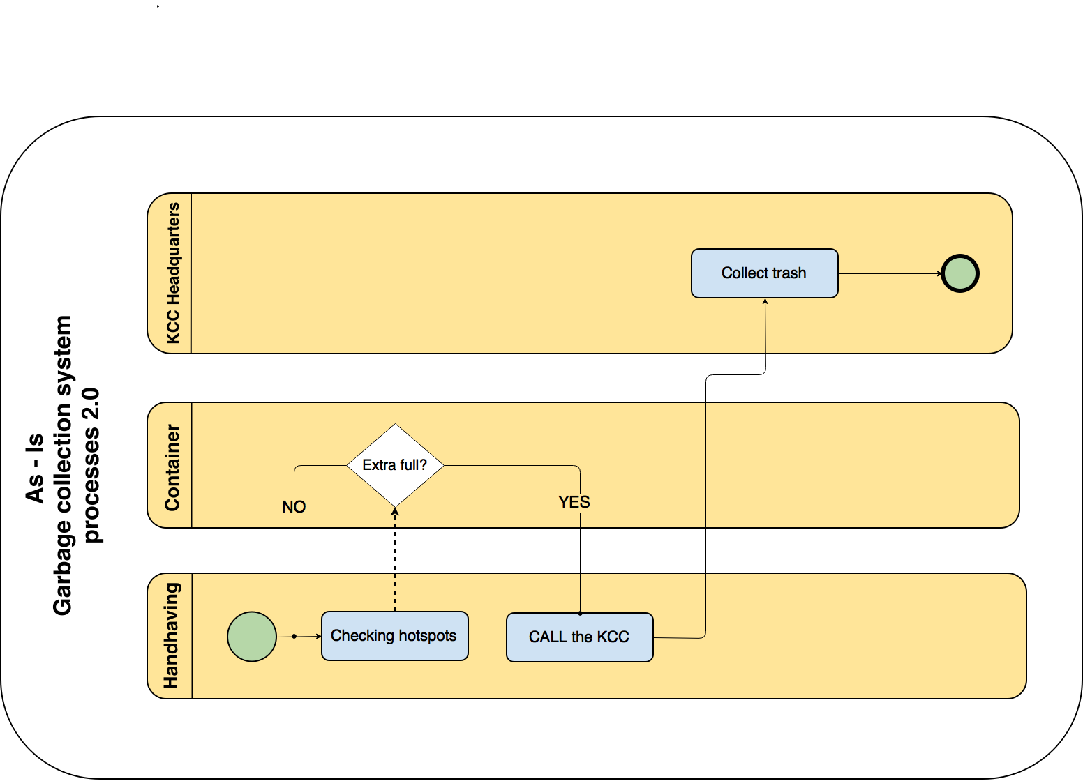

Slide 9
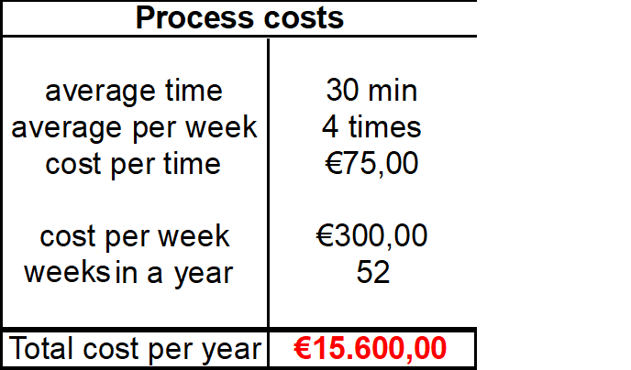
Process cost
Truck costs (i.e. fuel)
Truck driver
‘Handhaving’

Slide 10
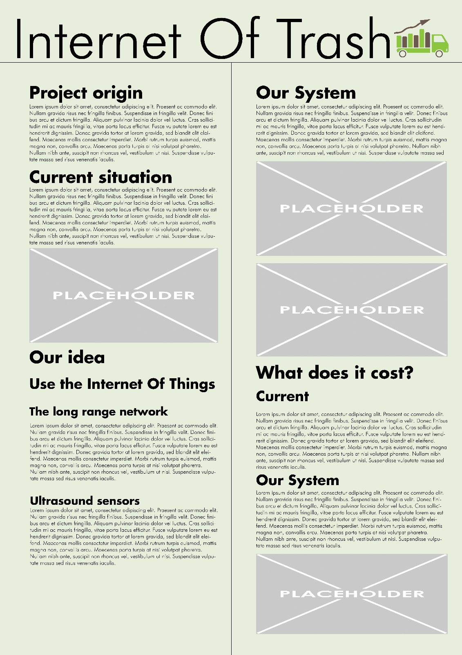
Results

Slide 11
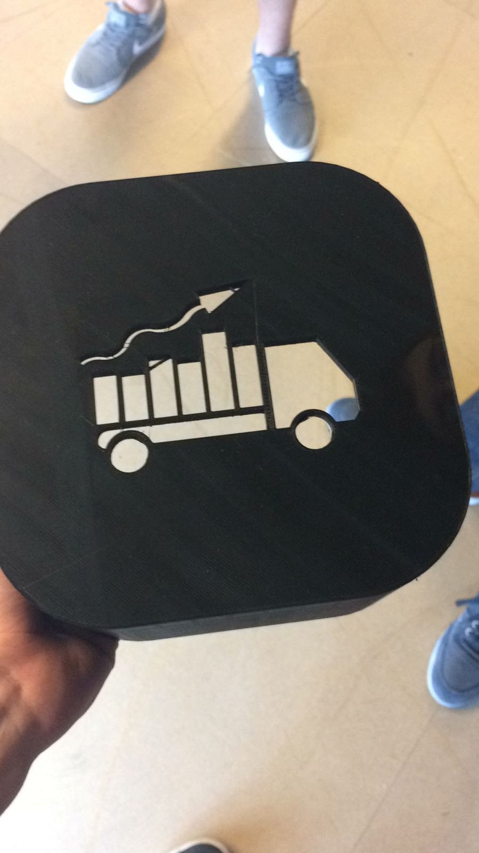
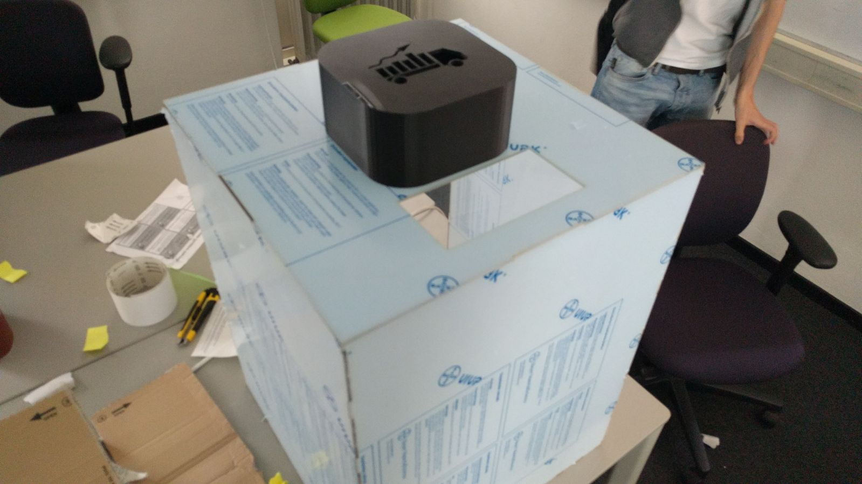
Results

Slide 12
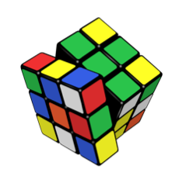
What were the problems?
3D print took a long time (24.5h)
Ascension day

Slide 13
What were the lessons learned?
3D printing takes time!
Only two weeks left → time to finish

Slide 14
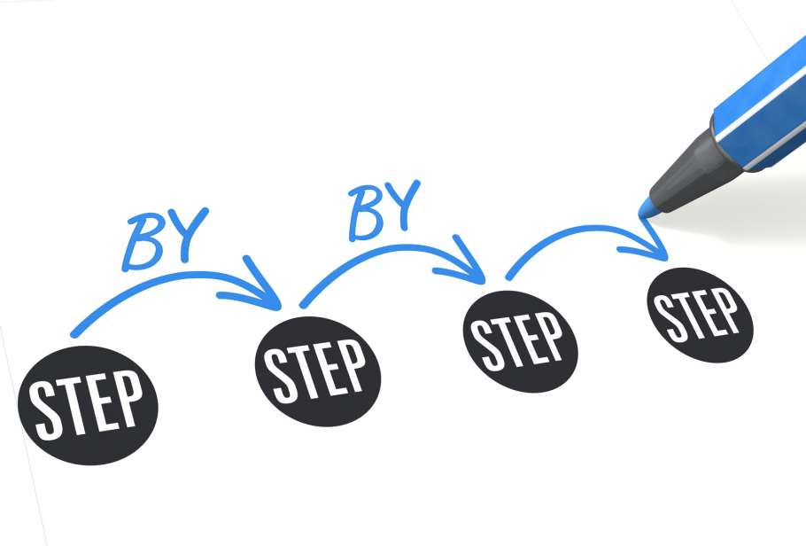
What do we want to achieve?
Poster
Presentation
Report
Finishing touches

Slide 15
Any Question?
Thanks for your attention!

