Slide 1


PROGESS LOG
Edited by
Loek Ehren
Mike Schatorjé
Simone Francesconi
Herm Lecluse
Rick van Osch

Slide 2
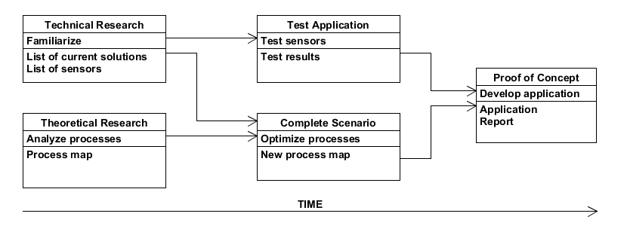


The project

Slide 3


What did we want to achieve?
Start designing prototype application and if feasible start implementation
Work on documentation
Evaluate the process map
Start on Exhibition video

Slide 4


How did we do it?
Divided work
Various diagrams
Used applications like Umlet & GoAnimate
Draw.io

Slide 5
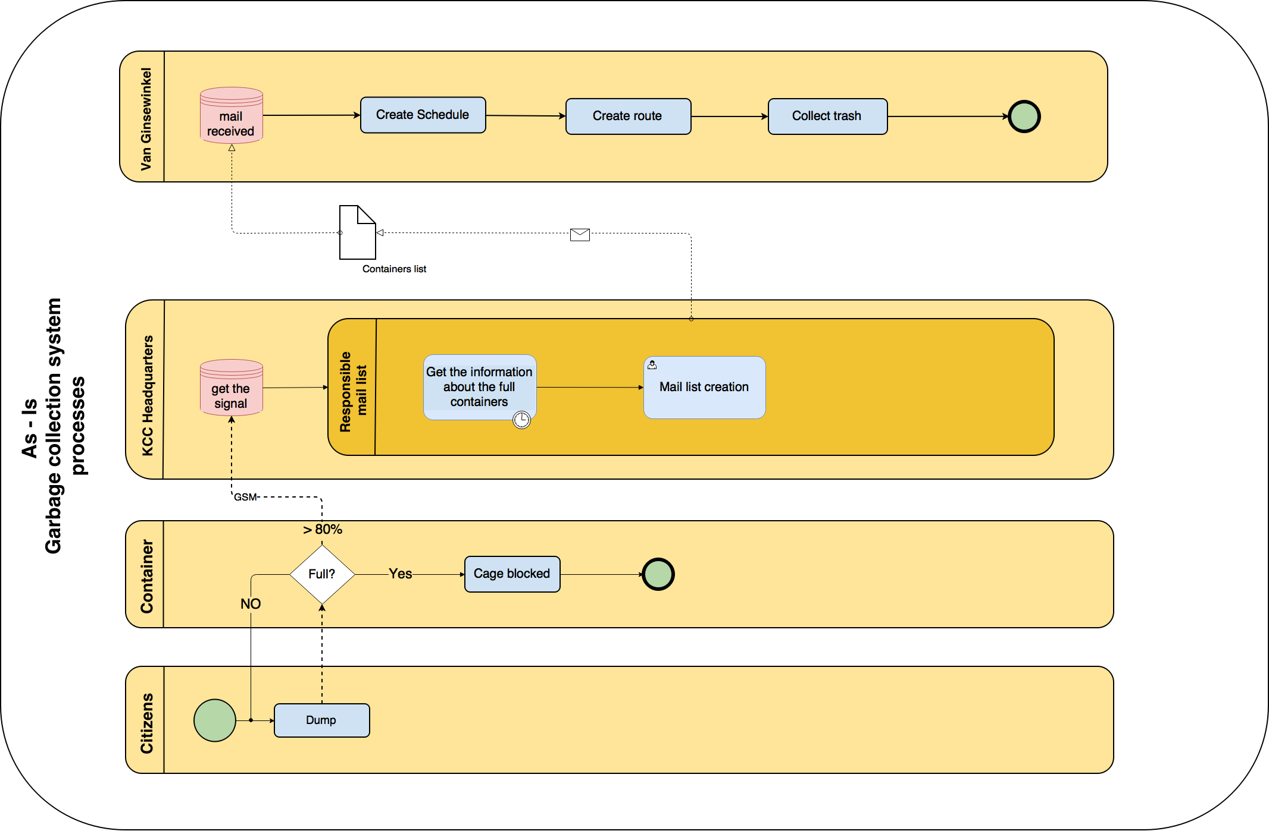

Slide 6

What were the results?
Finished design and started implementation
Use cases
Mockups
DB Design
Activity diagram
Critical process points

Slide 7
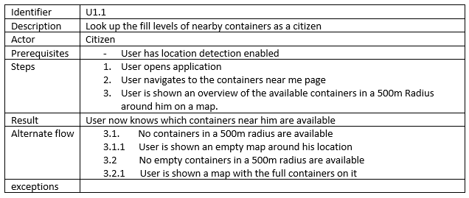
Results

Slide 8
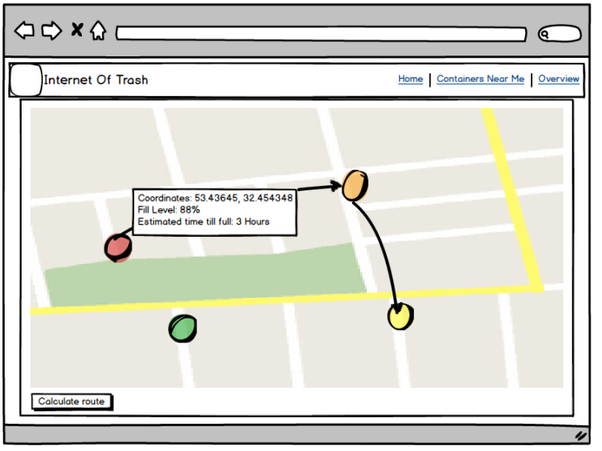
Results

Slide 9
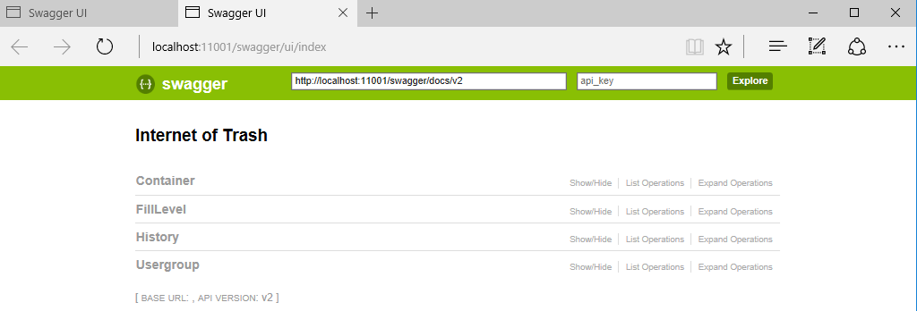
Results

Slide 10
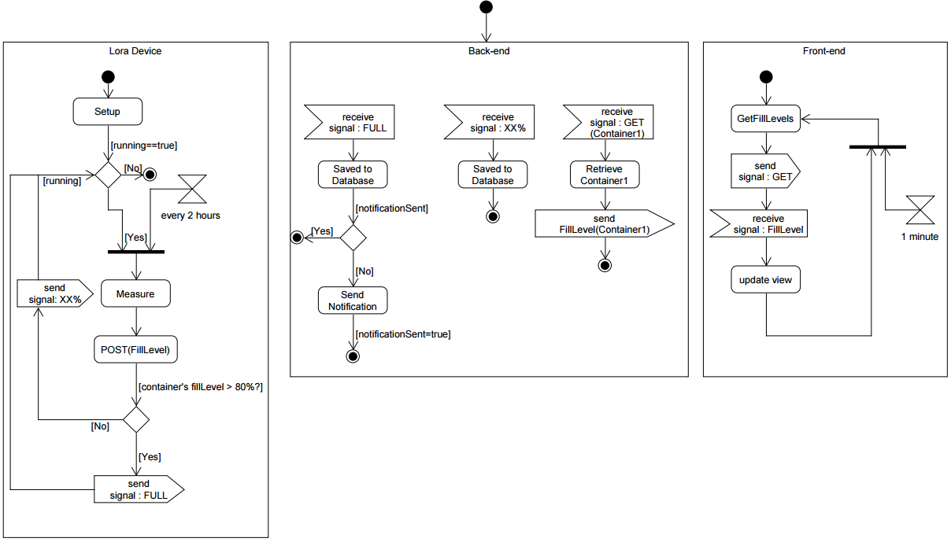
Results

Slide 11
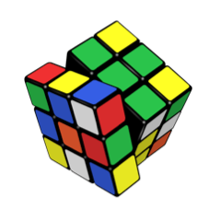
What were the problems?
Again: time!
Custom objects in NoSQL database
Gmail Security
Limitiations on free software

Slide 12


What were the lessons learned?
RTFM
Scope creep
Integrating Google Maps API in Javascript
SMTP in C#

Slide 13
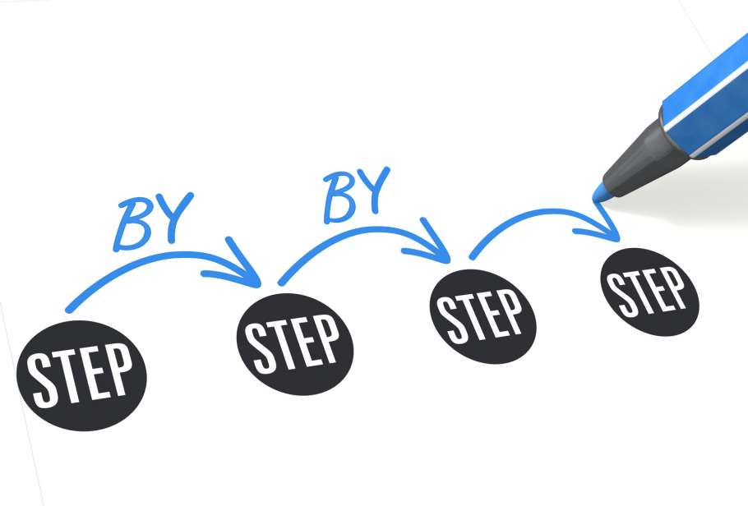
What do we want to achieve?
Continue with report
Evaluate process map
Exam 9th Tuesday
Continue with the exhibition video and look at other video making tools
Continue on prototype

Slide 14
Any Question?
Thanks for your attention!

