Slide 1
We Care
A complete Mental HealthCare solution

Slide 2
Problems:
Awareness about mental health disorders is very low often leading to it being ignored as a disease.
Lack of an easy self diagnosis process.
Hard to find help and knowledge about meetings of people going through same problems.
No Appealing and immersive solution to take care of your mental health

Slide 3
Solution:
An all in one platform offering immersive experience for maintaining mental health, networking with people going through similar problems, educating people about the problems.
Learn
Share
Overcome

Slide 4
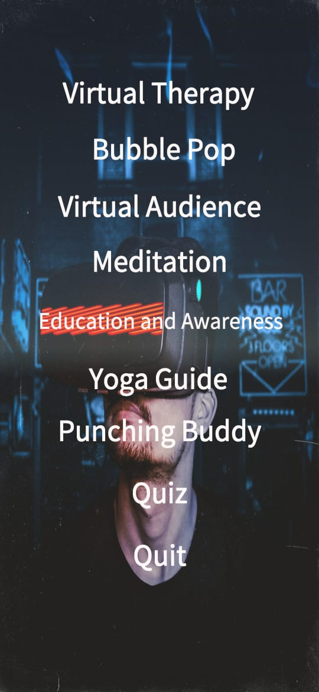
The Product:

Slide 5
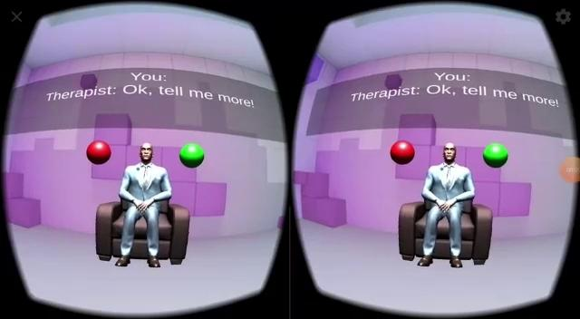
VIRTUAL THERAPY

Slide 6
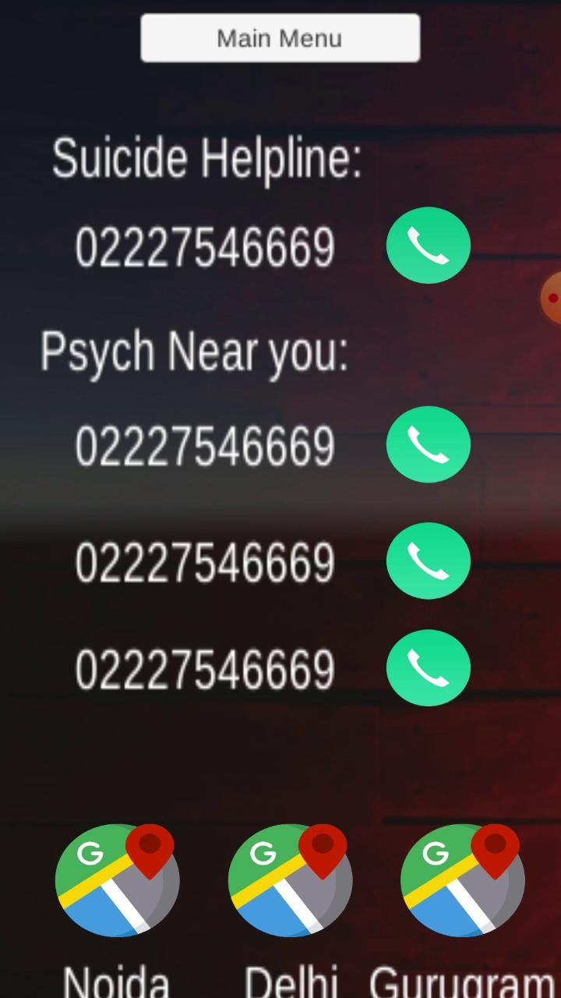
HELPLINE

Slide 7
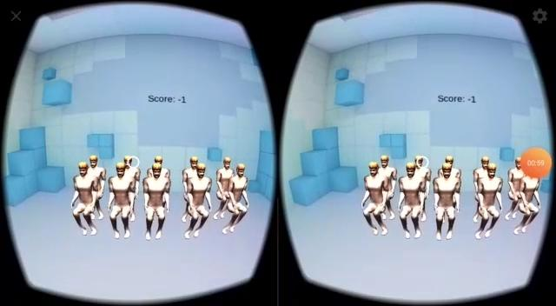
VIRTUAL AUDIENCE

Slide 8
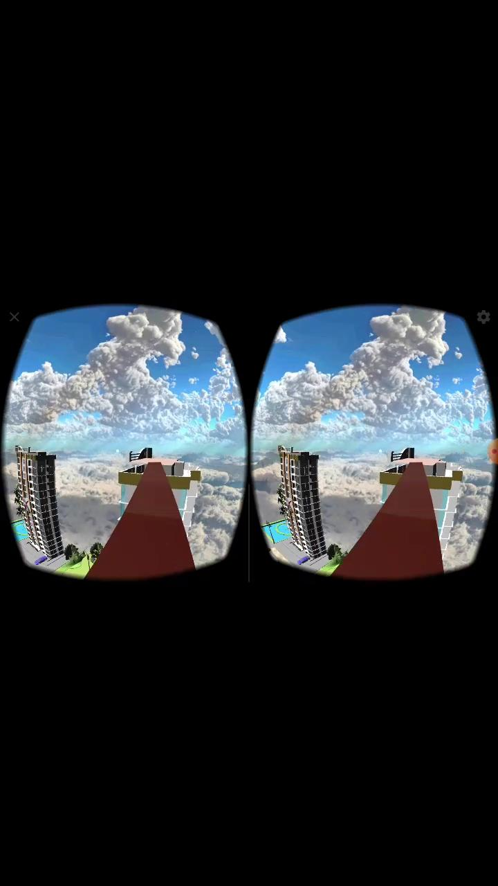
PHOBIA

Slide 9

MEDITATION

Slide 10
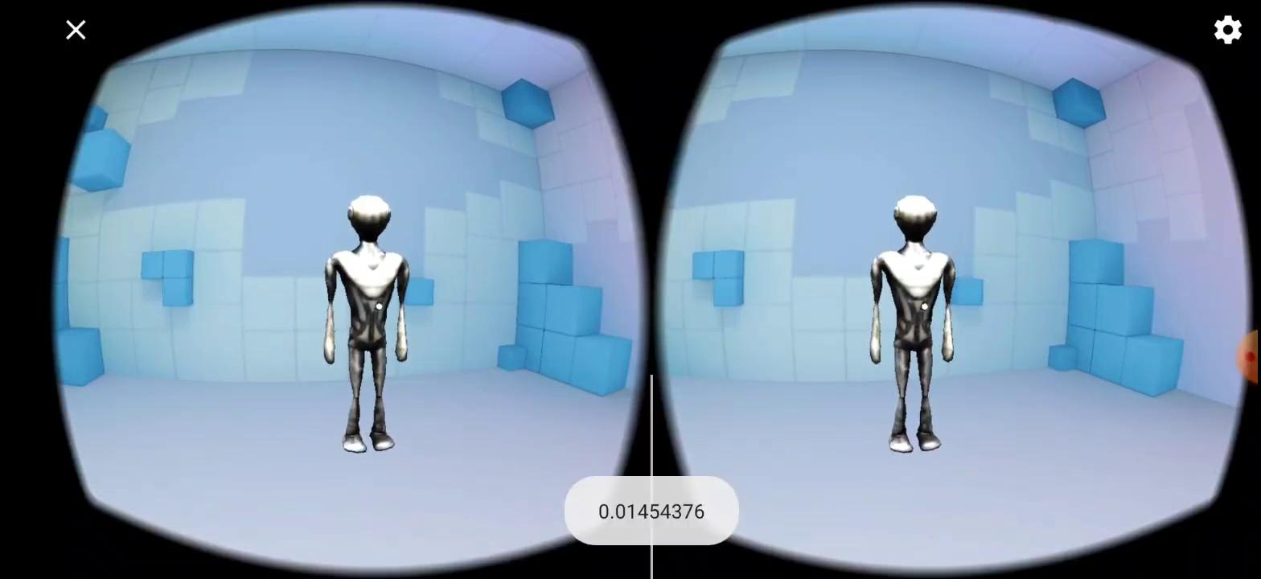
Anger Management

Slide 11
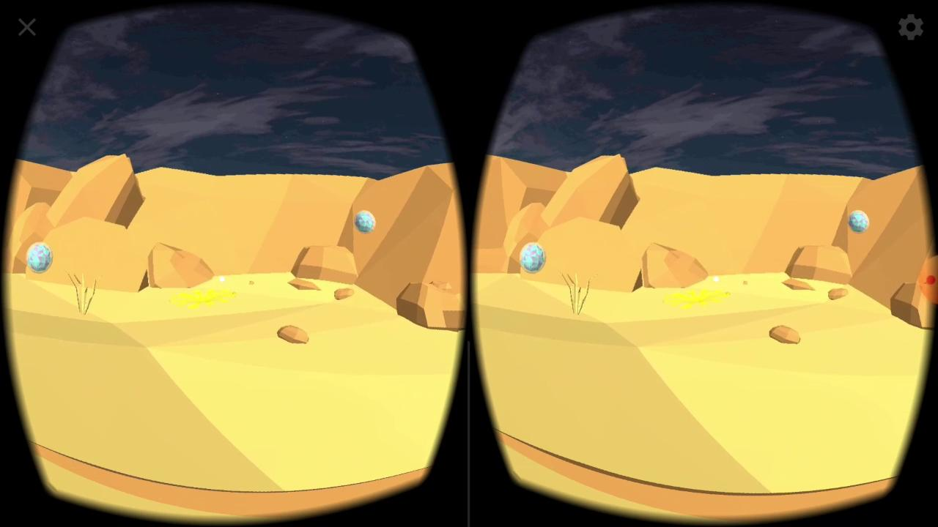
STRESS BUSTER

Slide 12
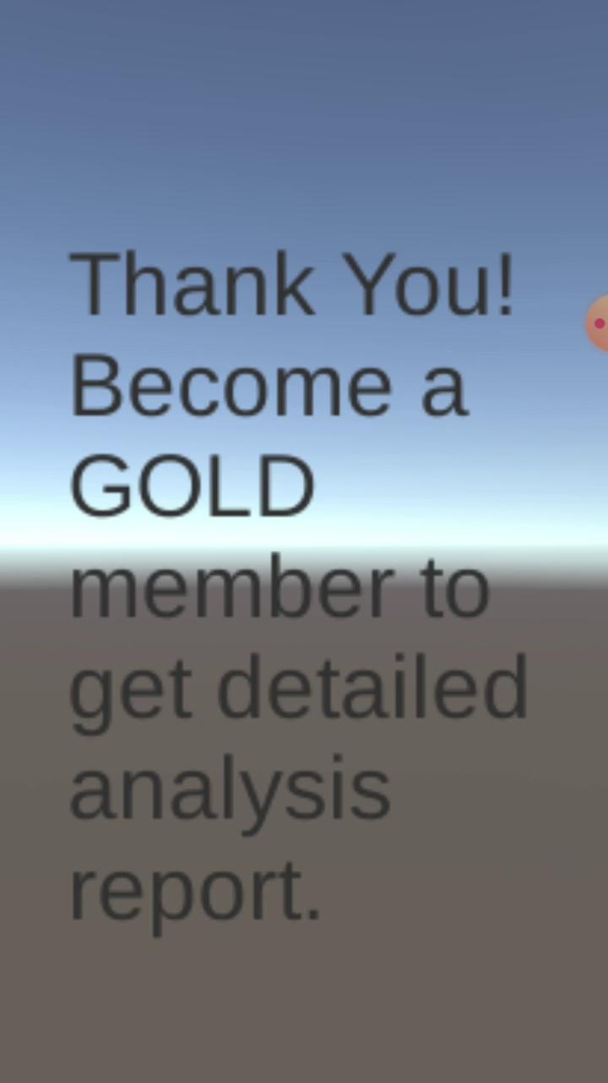
PERSONALITY QUIZ

Slide 13
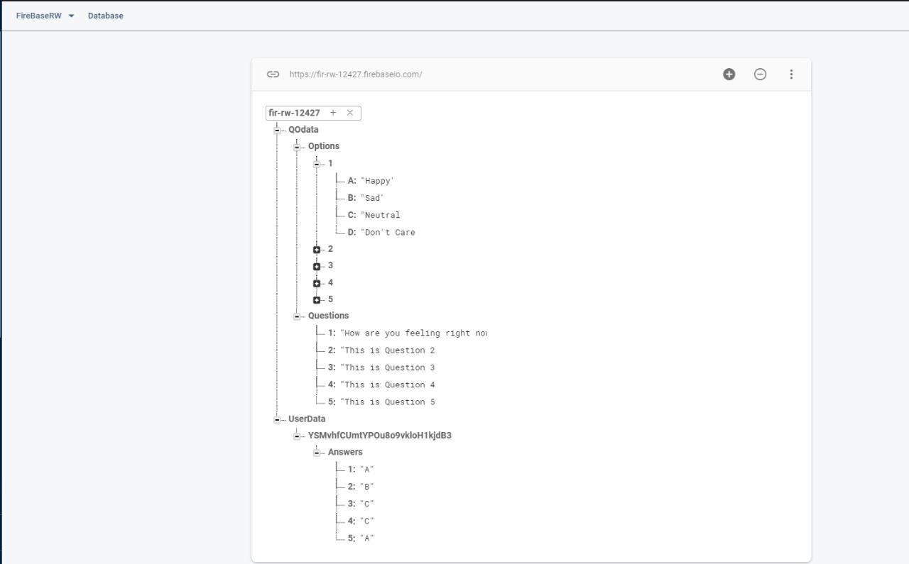
DATABASE

Slide 14
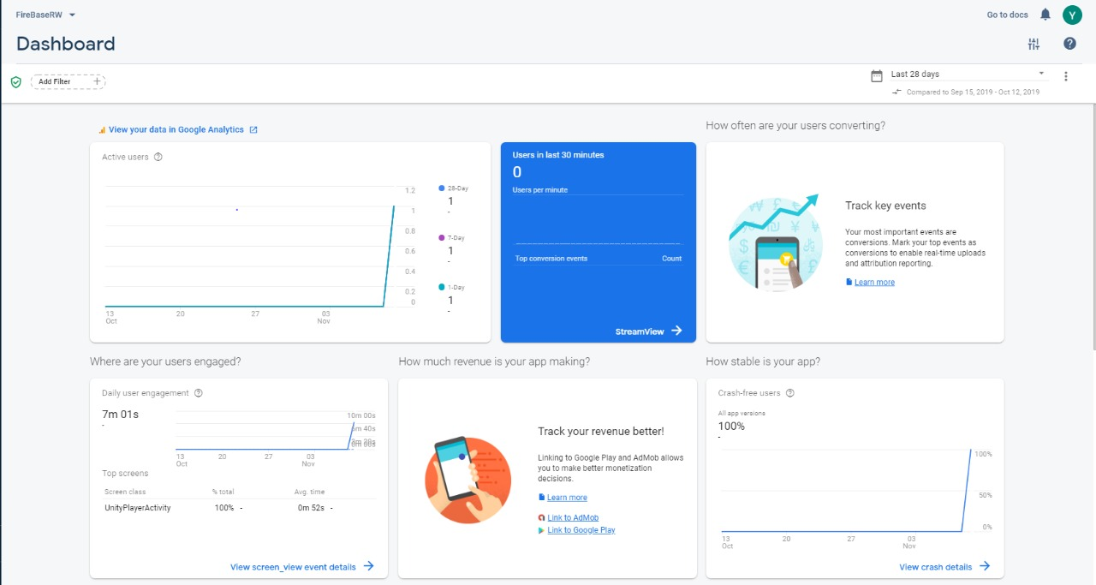
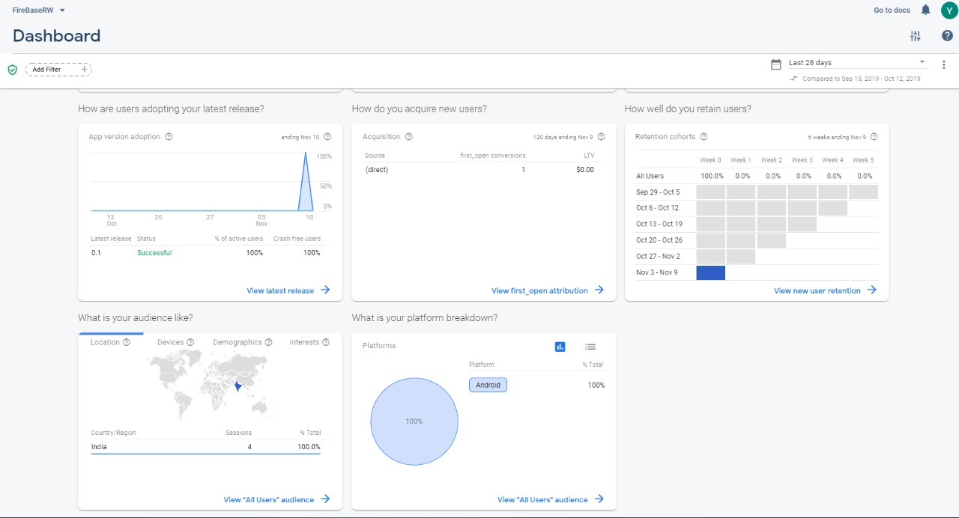
MEETUPS AND TARGET AUDIENCE

Slide 15
Business Model:
Psychiatric Subscription
Freemium Features
Cooperate angle (HR activities)
Meetups organisation
Paid Psych recommendations

Slide 16
Competition:
Only provide Audio experience:
Calm!!
HeadSpace
Provide with a social angle and Audio experience:
Sanvello
Youper

Slide 17
Competitive Advantage:
All in One solution
Immersive audio and visual experience
Customer Engagement is high.
Will be first to market with an AR/VR solution to mental health problem.
VR headsets work on the most basic smartphones and start from 150-/- hence a very cheap solution.

Slide 18
FUTURE WORK:
UI and UX improvements.
Better high quality models.
Partnership with doctors and therapists.
Personalized experience based on time spent and personality.
Payment Setup for premium services.
Partnership with NGOs to organize targeted workshop.
More mental health problem coverage

