Slide 1


Slide 2
TEAM DETAILS
Team Name: Nazarick
Member 1 : Prakhar Mathur
Member 2 : Shaurya Vardhan Singh
Member 3 : Piyush Bhargav

Slide 3
Sanidhya
"feeling to be together"

Slide 4
Theme Selected : Early Harvest Programme - Digital India
Problem Statements:
Lack of an efficient platform for Lost and Found Children
Lack of connectivity between general public and authorities
Lack of digitised official documents
Solution:
Sanidhya, a national portal app which connects general public to authorities to help reunite missing children and their families with the help of facial recognition and real-time location.

Slide 5
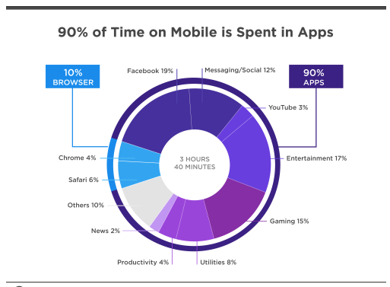
Why mobile app?
-To enhance citizen participation
-90% of user time is spent in Apps

Slide 6
Structure
Let’s start by discussing the different types of users this app will have:
Authorities : Police , Child Care Services, NGOs
General Public
Also, the app contains 4 major sections:
Missing - Modification Access to authorities
Found – Modification Access to authorities
Public – Access to all
Profile – Logged in user

Slide 7
Features:
Authentication
Registration: The user will have to fill the necessary details, along with an option which
which classifies the user either into authority or general public.
Login: Registered user will have to provide their username/email with their password.
Login is successful if the user is registered and the password is correct.
Field validation is applied in both registration and login.

Slide 8
2. Connect general public with authorities (Police, Child Care Services, NGOs ) : Public Section
Whenever a User reports a missing child, that report will be added to the database and the ‘Public Section’ of the App would be updated, and an alert would be send to the nearby authorities.
This eliminates the time consuming process of visiting the concerned authorities and reporting the missing child.

Slide 9
3. Connecting Users with the help of Geo-Location
When a user posts a missing child report in the public section, the app search for the users in nearby area and notifies them.
If a user finds the missing child, he can send an alert to the concerned user and the authorities.

Slide 10
4. Facial Recognition
Using facial recognition software, a user can upload a photo of the missing child using the camera feature of the app which will search the database containing information of missing children.
If it finds a match, the near by and the concerned authorities will be alerted, and they will recieve the user’s current location and all the necessary information, so that authorities can further contact him.

Slide 11
5. Digitisation of records
Whenever an authority reports a missing child, that report will be added to the database and the ‘Missing Section’ of the App would be updated.
This way, all the official records of missing children are saved online on a single platform.
Therefore, allowing the authorities to access, maintain and update the records in an efficient manner.

Slide 12
6. Found Section
This will contain the records of children which are found by the authorities, but are not yet reported.
7. Profile Section
Display all the user details.
Provide the user with an option to edit the details.

Slide 13
Future Production and Implementation
As this project is build under the Early Harvest Programme in Digital India Initiative, it is a non-profit application.
For future production, this project has to be approved by the Indian Government and respective rights should be given in order to connect all the authorities and general public.
Develop a User-friendly Interface.

Slide 14
Thank you

