Slide 1



YOUR healthcare Solution
CURA

Slide 2

OUR BIG IDEA
Our team, Brute Forces, is developing an online application to help health-conscious people, to keep a track of their medicines, allergies and alert them if they consume a similar product that might cause allergies so that they remain pink of their health.

Slide 3



Core functionalities
Medicines
Food analysis
Allergy Prediction
User can add the medicines, he/She is allergic with.
Salts of these medicines will be extracted using web scraping.
At any time user can fetch probability of getting allergic from that medicine.
User can add the food items, he/She is allergic with.
Food ingredients of these items will be extracted using an API.
At any time user can fetch probability of getting allergic from that food item.
Person A experiences food allergies.
The user logs their food consumption for a week in our app.
We analyzed the user data using Apriori Algorithm to find frequent sets.
This information is represented graphically and thus user can make an informed decision.

Slide 4
Some innovations we are trying to come up with
Preventive healthcare by using Data mining, web and analytics technologies, accurately to analyze the food ingredients and to predict if which ingredients can cause allergy.
Initiative to live a healthy lifestyle if someone has them, using technology. Managing health using technology and bringing smart lifestyle to the general mass.
Our project is in sync with the Digital India scheme and promotes the idea “technology for good”.

Slide 5
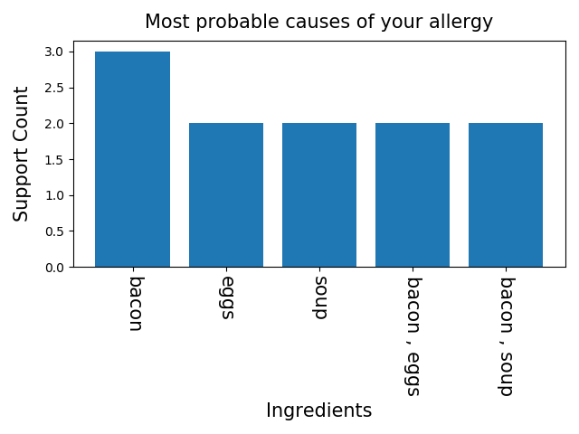
Technologies we are using
Data Mining
Firebase
Python
HTML, CSS
Frontend Library: REACT
Backend: Node.js
Fig. Data Visualization

Slide 6

Thank you

