Slide 1

PROBLEM
RUMOR IS AN IMPORTANT FORM OF SOCIAL COMMUNICATIONS,
AND SPREAD OF RUMORS PLAYS A SIGNIFICANT ROLE IN A VARIETY OF HUMAN AFFAIRS.

Slide 2

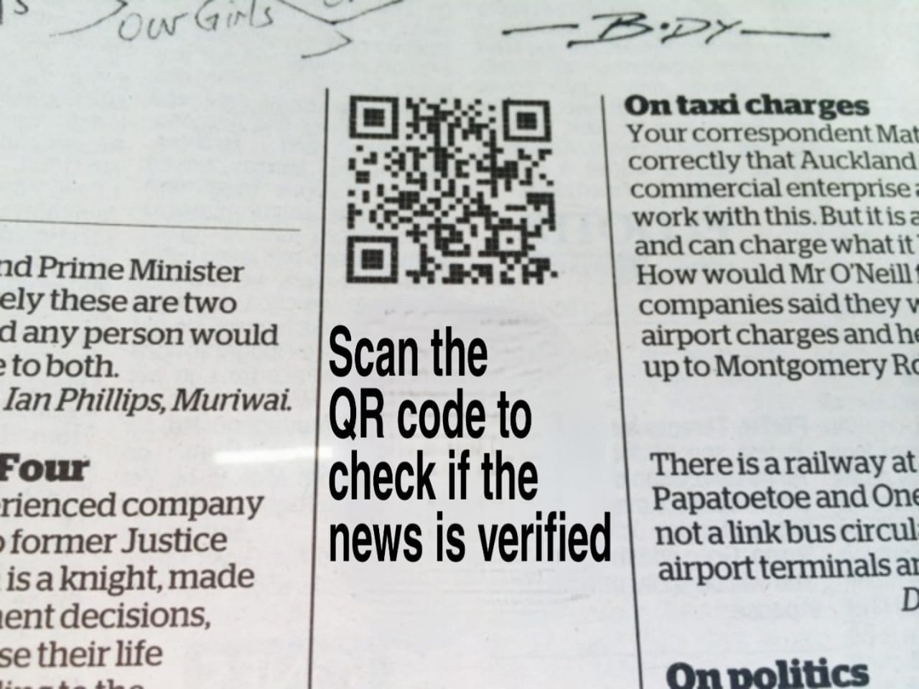

SOLUTION
OFFICIAL.COM
ONE SINGLE WEBSITE THAT ENSURES
THE SHARED NEWS IS VERIFIED

