Slide 1


DaanCorona
Ek Nayi Soch

Slide 2
In the wake of COVID-19, how would stationery stores, electrical shops, restaurants, laundromats, and salons manage to pay their owners and employees during this ‘zero-business’ period? Wouldn’t these markets be in low supply post COVID-19?

Slide 3
Problem/s you are solving
In the wake of the COVID-19 pandemic, the United Nations Conference on Trade and Development has predicted a likely world recession and developing countries like India will be the worst hit. While the incomes of all Indians will get disturbed, small businesses in the consumer-facing service industry will suffer the most during the lockdown period.
This includes various stores - General (Kiraana), retail, stationery, etc. and other service-based businesses - electricians, dhobi, plumbers, theatres, gyms, and the list goes on. These people with no current income source and minimal savings find it hard to afford basic necessities. Their businesses, after sustaining these hefty losses, might even shut down permanently. In a market with demand and supply issues, how do these even survive past the pandemic?

Slide 4
Problem/s you are solving
This ‘zero-business’ period has serious consequences for these people and businesses. With 62% of the economy’s Gross Value Addition being attributed to the service and retail industry, the economy can’t retain its liquidity and purchasing power if this industry fails. How can we help these people and businesses out? Why would a citizen donate their hard-earned money, if there are no returns?

Slide 5
Solution
DaanCorona is the solution to all these problems. The Idea of DaanCorona is simple. It is a seamless online platform for buying coupons from India's largely undigitized small & medium businesses.
To help out these non-essential local businesses with liquid capital, consumers can buy a gift card now and redeem it later, when the circumstances have reasonably improved.
Finally, a better alternative to donations! It’s not a donation. It’s an advanced payment.

Slide 6
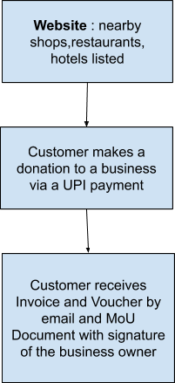
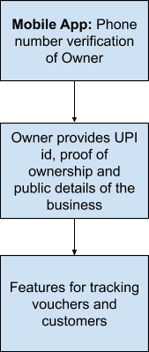
Solution
Customers Businesses

Slide 7
Solution
I. Backend REST API
The backend API is built using python's framework Django taking advantage of the Django Rest Framework. This api fetches data from a sqlite database.
Both the Android App as well as the Website use endpoints from this api for all applications ranging from user authentication using JWT to database get/post requests.
II. Webapp Frontend
The website frontend is based on React.js framework, which enables real time functionality and is integrated with Django based backend.
The website along with the backend API are temporarily hosted at http://daancorona.herokuapp.com.

Slide 8
Solution
III. Android app
The mobile app is built using Android Studio, the official Integrated Development Environment for developing mobile apps for the Android Operating System. It uses Java as the programming language and XML as the markup language.
The app utilizes Google Maps API and several other libraries for an enhanced user interface.
The android app can be downloaded from https://drive.google.com/file/d/1nzdGZ49lWjrKlN22euUYufqrzGbEJ7b1/view

Slide 9
Solution
Who is our target audience?
It is non-essential services and retailers
Non-Grocery Stores
Hotels
Restaurants
Gyms
Malls

Slide 10

Innovation you bring in
Legally binding MoU contract, forces businesses to pay back the customer
All businesses are verified before registering on the platform
Businesses can go from zero to accepting money in just a few minutes
100+ Payment Methods Supported

Slide 11
Future Aspects
With approval of the Government, we could link owner app logins to their Aadhar number to verify their identity and eliminate counterfeit accounts
Reach customers and businesses nationwide, through outreach channels
Switch to a more robust hosting so as to handle sufficient traffic
Extend the product to an App and Website for both the customers and the business owners

