Slide 1



COVID – 19 MPSS
CORONA VIRUS MONITORING, PREVENTION & SAFEGUARDING SYSTEM
PROPOSED BY: AVINASH SHARMA (EAGLE EYE GROUP - 2000)

Slide 2
COVID – 19 MPSS MONITORING – MOVEMENT TRACKING & GEOFENCING, PREVENTION – PAST CONTACT TRACES, SAFEGUARD – GEOFENCING Corona Virus (COVID-19) has already been declared as a global pandemic by the WHO and also the only effective solution for preventing it spread is SOCIAL DISTANCING. Also, another very important component of getting out of this fatal problem is ensuring a proper flow of information, avoiding the spread of any fake news and thus ensuring a proper mental status of the citizens by keeping up their spirits high.
PROPOSED BY: AVINASH SHARMA (EAGLE EYE GROUP - 2000)

Slide 3
Problem/s you are solving
1) No effective system for Monitoring of People’s Movement around compulsory quarantine-(Houses/Buildings)- with the small number of cases it is easy to impose a forced quarantine on the already detected/suspected cases, but god forbid if the cases increase, it would be difficult to physically monitor of the quarantine is being followed or not.
2) Monitoring of People’s Movement around Lockdown Areas - Apart from imposing forces there's no other way out at the moment to check if the main purpose of lockdown (i.e restricted movement of people) is being really followed and also the system lags a proper channel to monitor the same at the central level.
3) Unable/Difficulties in Tracing past contacts of Confirmed Cases.
PROPOSED BY: AVINASH SHARMA (EAGLE EYE GROUP - 2000)

Slide 4
Solution
Considering it to be a global problem our solutions if implemented can prove to be really useful by TRACING THE CONTACTS with any diseased person and at the same time ensuring effective quarantine on already detected cases.
Solution Technologies/Titles: Geofencing, Movement Tracking. Contact Tracing
Geofencing Technology allows us to bound geolocation areas using digital system to track the movements around these areas.
Using Movement Tracking Algorithms, system can track the live status of people movements help in finding gatherings quickly.
Contact Tracing algorithm track the meet points of particular user with infected person using their location history.
PROPOSED BY: AVINASH SHARMA (EAGLE EYE GROUP - 2000)

Slide 5
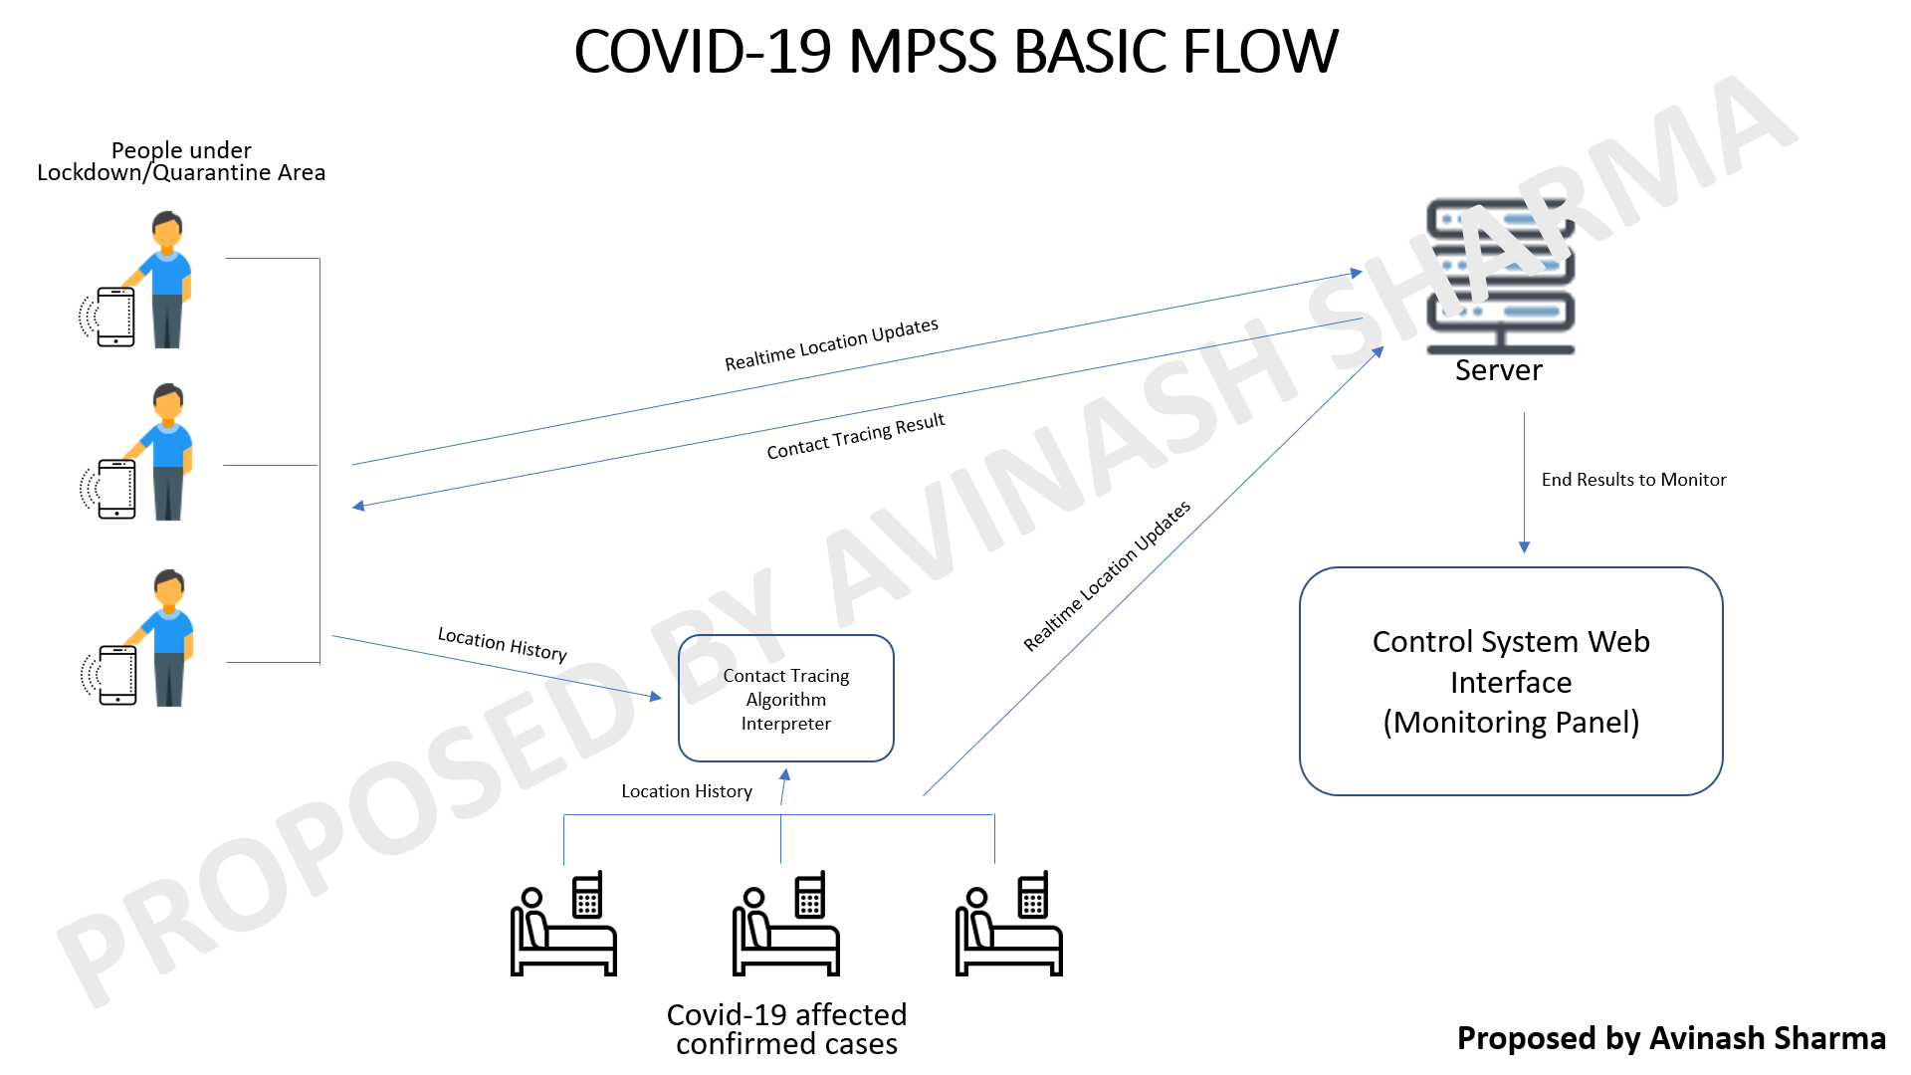
BASIC FLOW:

Slide 6
Innovation
A Single platform to monitor large areas from control centre/one place. A lot COVID-19 proposal calls are asking to companies for the submission of Movement Tracking Solution. Here it is with revolutionary Technologies.
How we implement it
Tracking Data will be collected from Mobile Application and End results will be generated on Web Platform under Control Team. We will provide the complete flow and system synopsis with prototype.
PROPOSED BY: AVINASH SHARMA (EAGLE EYE GROUP - 2000)

Slide 7
Problem We solved:
Cases of people regularly breaking the boundaries of lockdown/quarantine areas can be monitored easily.
Cases of leaving hospitals/quarantine places without informing to authorities can be monitored and easily trackable.
Gathering can be easily trackable.
People can trace their contacts with confirmed patient in past, helps to easily find the people who has the possibility of infection.
PROPOSED BY: AVINASH SHARMA (EAGLE EYE GROUP - 2000)

Slide 8
Future Aspects
1. The can be integrated for any monitoring problem like Vehicle Tracking, Patrolling Monitoring etc.
2. We are going to integrate the hardware based signaling enable hardware device to transfer location and other details like speed of vehicle etc.
3. It can also be used for prisoners to track and monitor their movement around prison.
4. We are developing it for security & monitoring problems.
5. Its contact tracing feature can be used in any communication disease.
PROPOSED BY: AVINASH SHARMA (EAGLE EYE GROUP - 2000)

