Slide 1


HackIT
AI based Digital scanning system

Slide 2
Stay home, stay safe

Slide 3
Problem/s you are solving
1) For most people covid19 scanning is not possible.
2) In India many people are facing problem in the eyes, so even digital scanning might be a problem.

Slide 4
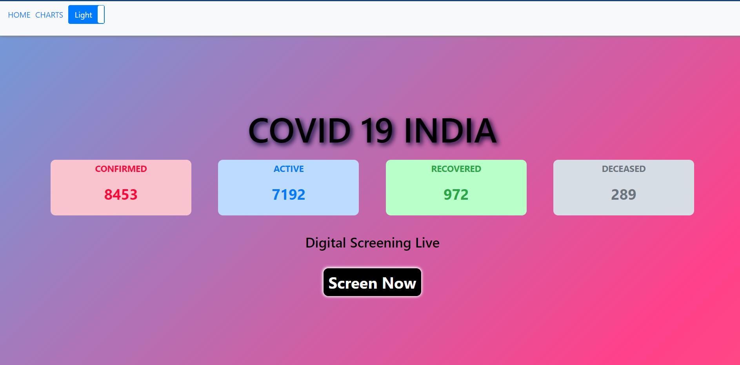
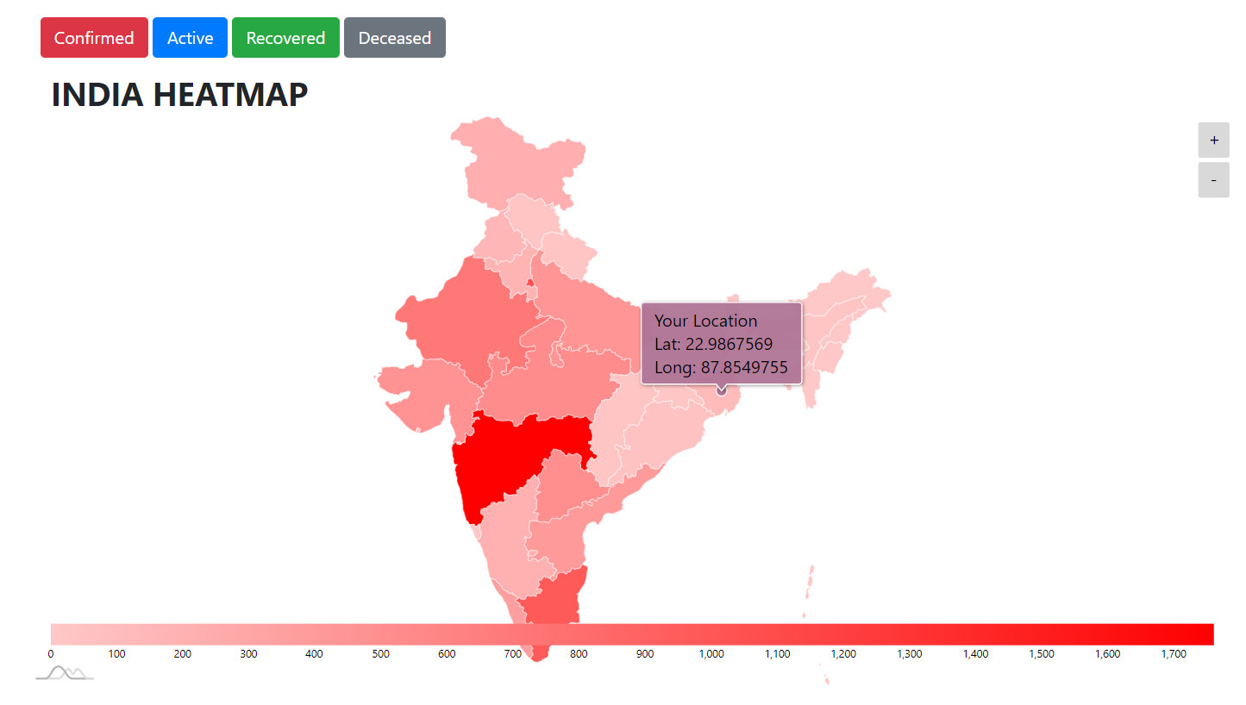
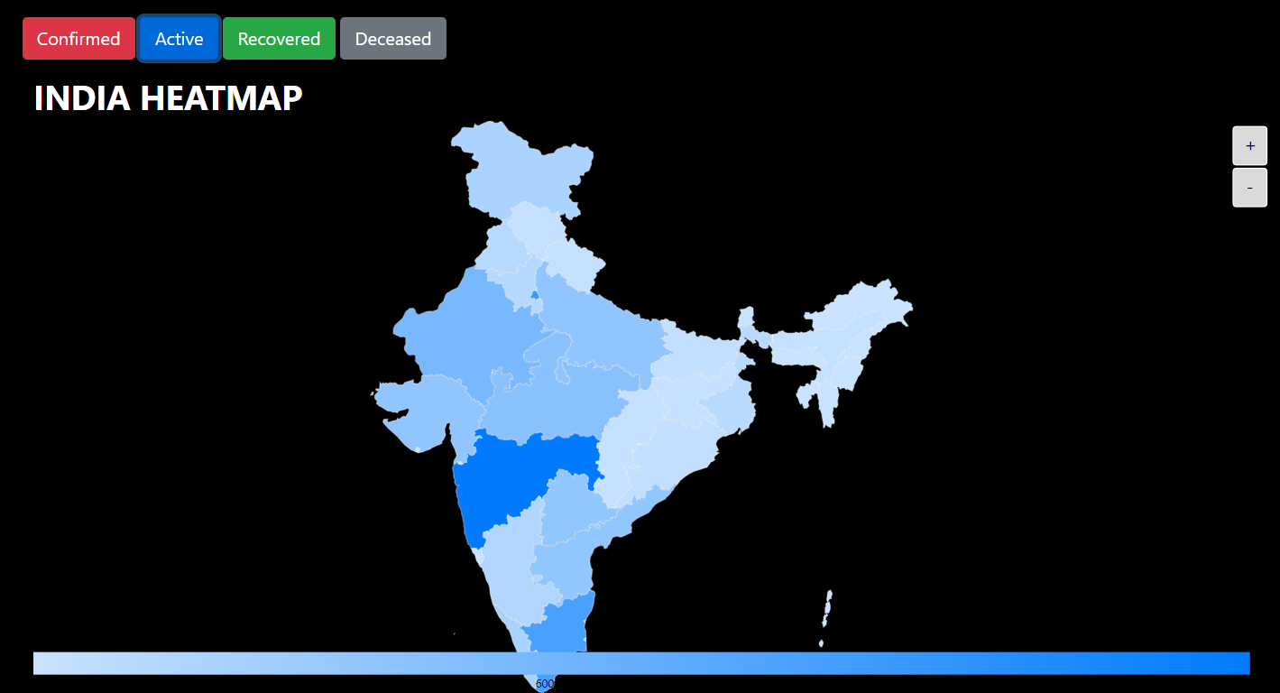
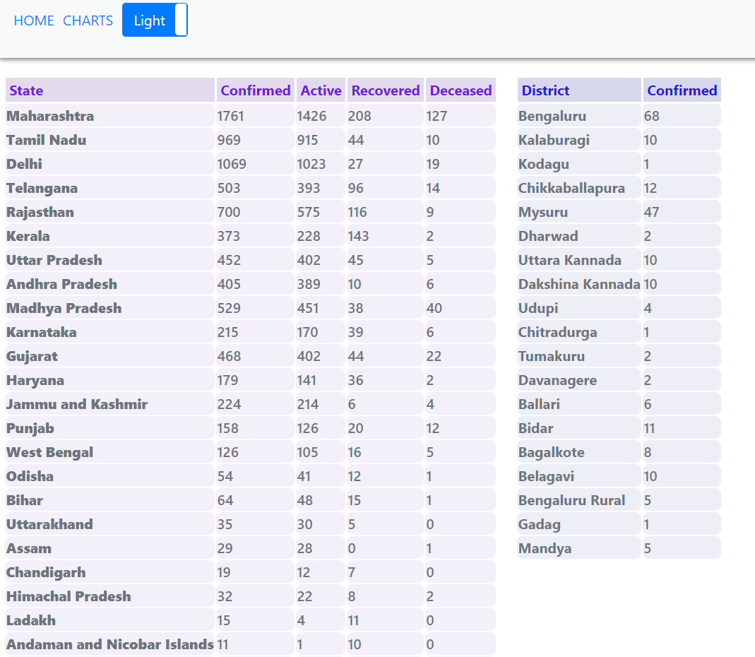

Slide 5
Solution
1) We provide an online digital covid19 scanner based on the guidelines of WHO.
2) So, the digital scanner also has voice functionality enabled.
3) Statistics and Screening all in one website.

Slide 6
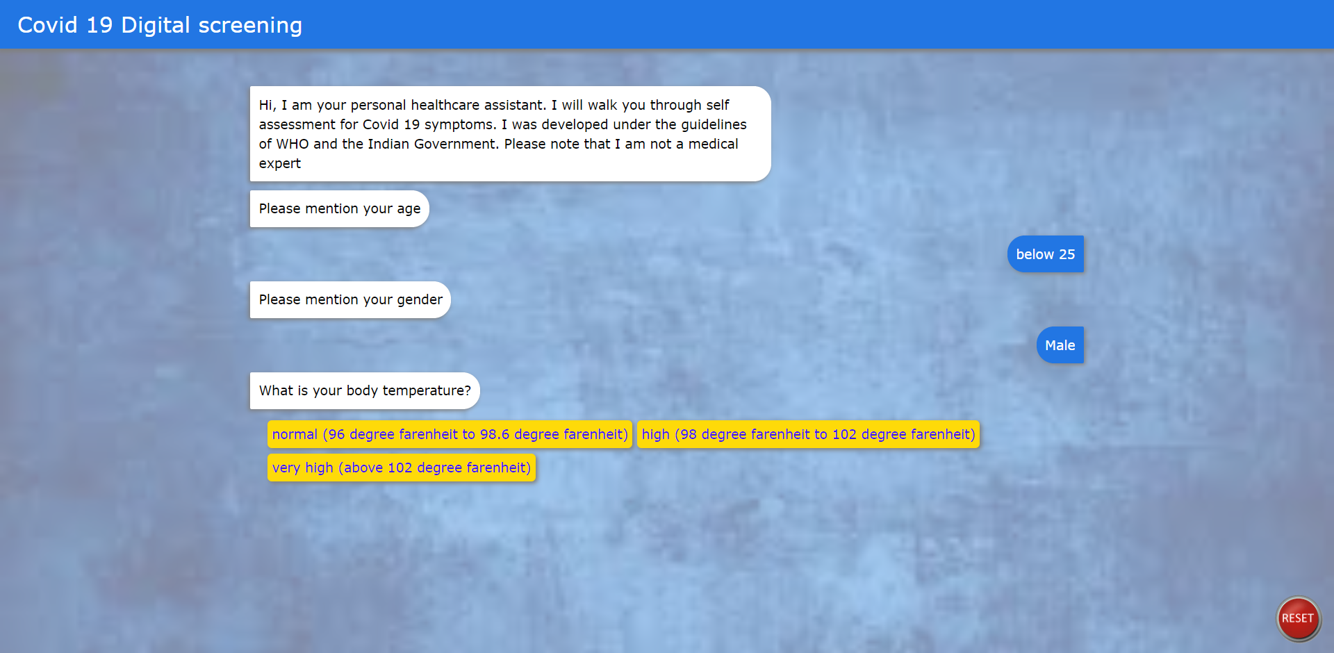

Slide 7
Innovation you bring in
We have an AI based Digital scanner which can be used by users. It has been trained according to the guidelines by WHO.

Slide 8
Future Aspects
You can already see your location on the heatmap. In the future we intend to serve users with live location, so that they come to know how far they are from the nearest covid.

