Slide 1
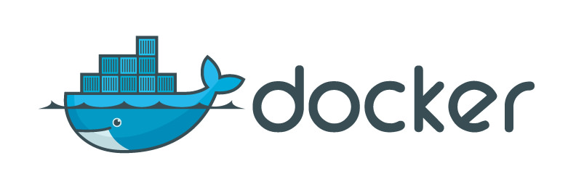
Presented by :
Shivansh Srivastava
Jasmeet Saran

Slide 2
Agenda
What is Docker?
Why Docker ?
Docker Architecture
Basic Docker Commands
Demo

Slide 3
What is Docker ?

Slide 4
Docker : 😎
Docker is an open platform for developing, shipping, and running applications.
Docker allows you to package an application with all of its dependencies into a standardized unit for software development known as Container.

Slide 5
Now What are Containers ? 😢
It is a standardized unit of Software.
A container image is a lightweight, stand-alone, executable package of a piece of software that includes everything needed to run it: code, runtime, system tools, system libraries, settings.
Available for all standard platforms.

Slide 6
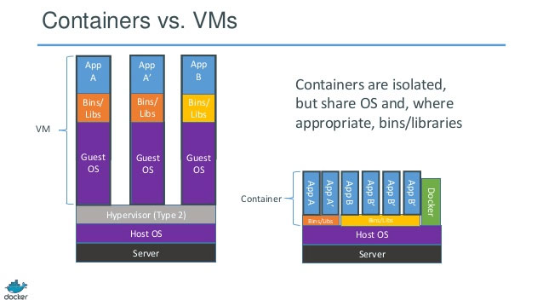
Docker VS Virtual Machines 😠
Do you know about Virtual Machines ?

Slide 7
When it all started ?
Solomon Hykes (@solomonstre)
dotCloud (now Docker Inc)
260k public repositories on hub.docker.com
Docker joins the "Open Container Initiative", June 2015
Recently got converted into the Moby Project
List of Open Source Tools provided by Docker

Slide 8
Why Docker ?

Slide 9
Docker is Aweeeee-some ! ! ! Because ...
Fast (deployment, migration, restarts)
Secure
Lightweight (save disk & CPU)
Open Source
Portable software
Microservices and integrations (APIs)
Simplify DevOps
Version control capabilities

Slide 10
Docker Architecture

Slide 11
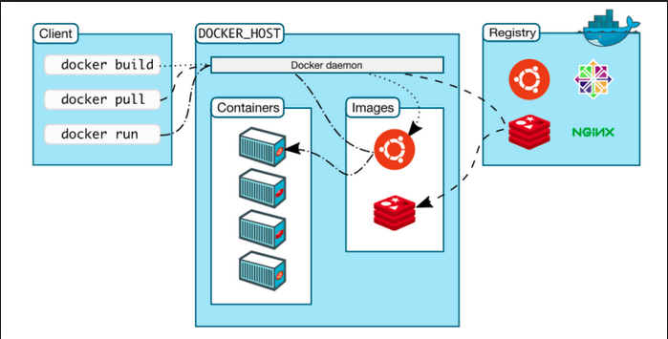
This is what it looks like ...

Slide 12
Docker components
(Docker) client
daemon
engine
machine
compose
swarm

Slide 13
Docker client
It is the primary user interface to Docker. It accepts commands from the user and communicates back and forth with a Docker daemon.

Slide 14
Docker Daemon :
It runs on a host machine. The user does not directly interact with the daemon, but instead through the Docker client with the RESTful api or sockets.

Slide 15
Docker engine:
A Client with a Daemon as also as the docker-compose tool. Usually referred simply as "docker".

Slide 16
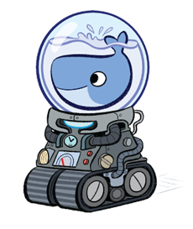
Docker machine :
A tool which makes it really easy to create
Docker hosts on your computer, on cloud
providers and inside your own data center.
It creates servers, installs Docker on them,
then configures the Docker client to talk to them.
Required for Mac, Windows users.

Slide 17
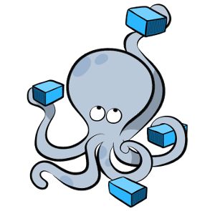
Docker-compose
A tool for defining and running complex applications with Docker (eg a multi-container application) with a single file.

Slide 18
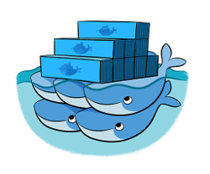
Docker-Swarm :
A native clustering tool for Docker. Swarm pools together several Docker hosts and exposes them as a single virtual Docker host.
It scale up to multiple hosts.

Slide 19
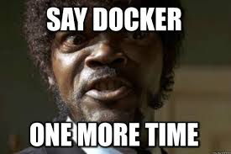
Don’t you feel like Samuel Right now ? 😁

Slide 20
Basic Docker
Commands

Slide 21
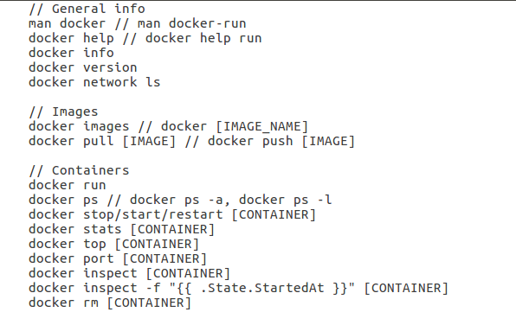
Some Basic Docker Commands:

Slide 22
DEMO

Slide 23
Docker examples
SSH into a container
Build an image
Running the Container
Pushing an image

Slide 24

SSH into a container

Slide 25
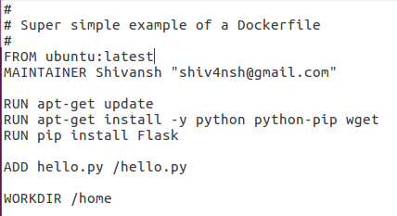
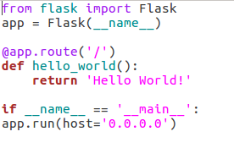

Build an Image
Dockerfile
hello.py
Using Command :

Slide 26

Running the container
Command :
Result :

Slide 27
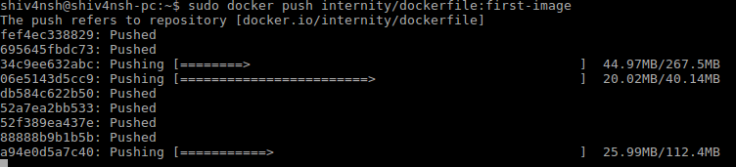
Pushing the Docker Image
Tag the image:
Push the image:

Slide 28
Resources :
Awesome Docker (list of Docker resources & projects)
Docker cheat sheet
Docker in Practice, The Docker Book (books)
Docker aliases/shortcuts
Docker case studies

Slide 29
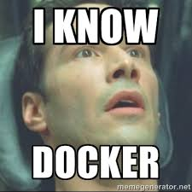
Do you feel like Neo now ?

Slide 30

😉

Slide 31
References:
Docker Documentation
Theodorosploumis presentation.
You can find full code and presentation here: https://github.com/InternityFoundation/IOT-NCR-Docker-Meetup

