Slide 1
Applications Of DAC
Meenakshi Goyal
Nikita Narwal
Jyotiprasad Patil
Harshit Goel

Slide 2
The Skyline problem

Slide 3
A skyline is a collection of rectangular strips. A rectangular strip is represented as a pair (left, ht) where left is x coordinate of left side of strip and ht is height of strip.

Slide 4
Approach
A Simple Solution is to initialize skyline or result as empty, then one by one add buildings to skyline. A building is added by first finding the overlapping strip(s). If there are no overlapping strips, the new building adds new strip(s). If overlapping strip is found, then height of the existing strip may increase. Time complexity of this solution is O(n2).
We can find Skyline in Θ(nLogn) time using Divide and Conquer. The idea is similar to Merge Sort, divide the given set of buildings in two subsets. Recursively construct skyline for two halves and finally merge the two skylines.

Slide 5
How to merge two skylines
The idea is similar to merge of merge sort, start from first strips of two skylines, compare x coordinates. Pick the strip with smaller x coordinate and add it to result. The height of added strip is considered as maximum of current heights from skyline1 and skyline2.

Slide 6
Given n rectangular buildings in a 2-dimensional city, computes the skyline of these buildings, eliminating hidden lines. The main task is to view buildings from a side and remove all sections that are not visible.
All buildings share common bottom and every building is represented by triplet (left, ht, right)
‘left’: is x coordinate of left side (or wall).
‘right’: is x coordinate of right side
‘ht’: is height of building.

Slide 7
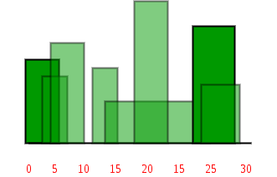
Example
Input: Array of buildings
{(1, 11, 5),(2, 6, 7),(3, 13,9), (12, 7, 16), (14, 3, 25),
(19, 18, 22), (23, 13, 29), (24, 4, 28) }
Building.

Slide 8
When only one building
Consider following as another example when there is only one
building
Input: {(1, 11, 5)}
Output: (1, 11), (5, 0)

Slide 9
Maximum Subarray Sum
Using
Divide & Conquer Algorithm

Slide 10
This algorithm is used to find the sum of subarray of numbers which has the largest sum.
1) Divide the given array in two halves
2) Return the maximum of following three
….a) Maximum subarray sum in left half (Make a recursive call)
….b) Maximum subarray sum in right half (Make a recursive call)
….c) Maximum subarray sum such that the subarray crosses the midpoint

Slide 11
How to find the Sum?
Step-1 Find the maximum sum starting from mid point and ending at some point on left of mid,
Step-2 Then find the maximum sum starting from mid + 1 and ending with sum point on right of mid + 1.
Step-3 Finally, combine the two and return.

Slide 12
The first two cases where the subarray is entirely on right or on the left
we can solve them recursively by calling the function to calculate the maximum sum subarray on both the parts.
max_sum_subarray(array, low, high){
if (high == low) // only one element in an array{
return array[high]}
mid = (high+low)/2
max_sum_subarray(array, low, mid)
max_sum_subarray(array, mid+1, high)
}

Slide 13
we will now make a function called max_crossing_subarray to calculate the maximum sum of the subarray crossing the middle element and then call it inside the max_sum_subarray function.
mid = (high+low)/2;
maximum_sum_left_subarray = max_sum_subarray(array, low, mid)
maximum_sum_right_subarray = max_sum_subarray(array, mid+1, high)
maximum_sum_crossing_subarray = max_crossing_subarray(array, low, mid, high);
// returning the maximum among the above three numbers
return maximum(maximum_sum_left_subarray,Maximum_sum_right_subarray,
maximum_sum_crossing_subarray);

Slide 14
Now the max_crossing_subarray function for left array.
max_crossing_subarray(int ar[], int low, int mid, int high){
left_sum = -infinity
sum = 0
for (i=mid downto low) {
sum = sum+ar[i]
if (sum>left_sum)
left_sum = sum
}

Slide 15
Now the max_crossing_subarray function for right array.
int rightSum = Integer.MIN_VALUE;
sum = 0;
for (i=mid+1; i<=high; i++) {
sum=sum+ar[i];
if (sum>rightSum)
rightSum = sum;}
return (leftSum+rightSum);

Slide 16
Tiling And Fast Exponentiaton

Slide 17
Fast Exponentiation
Suppose that we need to compute the value of a to the power of n for some reasonably large n. Such problems occur in primality testing for cryptography.
The simplest algorithm performs n-l multiplications, by computing axaxa…xa. However we can do better by observing that n =n/2+n/2. If n is even then a^n = (a^n/2)^2 or if n is odd then a^n = a(a^n/2)2.

Slide 18
In either case we have halved the size of our exponent at the cost of at most two multiplications, so O(logn) multiplications suffice to compute the final value.
Function power(a,n)
if (n = 0) return (1)
X = power(a,[n/2])
If (n is even) then return(x^2)

Slide 19
Function power(a,n)
if (n = 0) return (1)
X = power(a,[n/2])
If (n is even) then return(x^2)
else return(a x X^2)

Slide 20
Tiling Problem
Given a n by n board where n is of form 2^{k} where k >= 1 (Basically n is a power of 2 with minimum value as 2). The board has one missing cell (of size 1 x 1). Fill the board using L shaped tiles. A L shaped tile is a 2 x 2 square with one cell of size 1×1 missing.

Slide 21
// n is size of given square, p is location of missing cell
Tile(int n, Point p)
1) Base case: n = 2, A 2 x 2 square with one cell missing is nothing
but a tile and can be filled with a single tile.
2) Place a L shaped tile at the center such that it does not cover
the n/2 * n/2 subsquare that has a missing square. Now all four
subsquares of size n/2 x n/2 have a missing cell (a cell that doesn’t
need to be filled). See figure 2 below.

Slide 22
Solve the problem recursively for following four. Let p1, p2, p3 and
p4 be positions of the 4 missing cells in 4 squares.
a) Tile(n/2, p1)
b) Tile(n/2, p2)
c) Tile(n/2, p3)
d) Tile(n/2, p3)

Slide 23
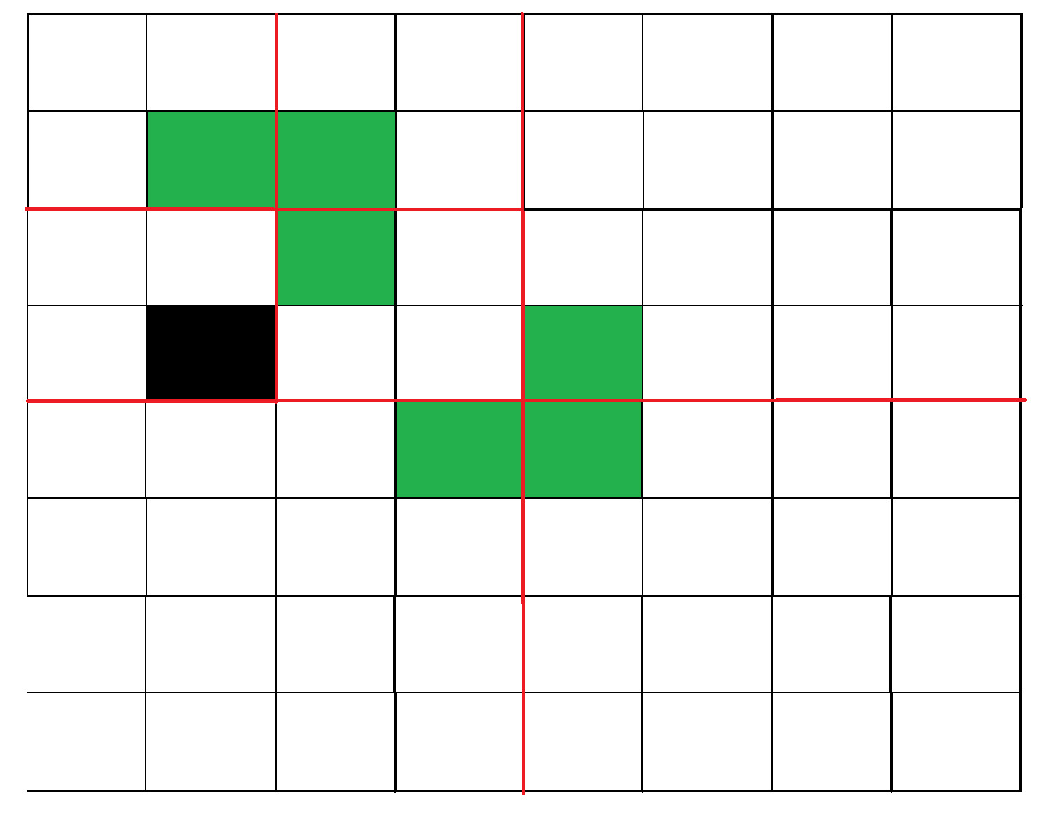
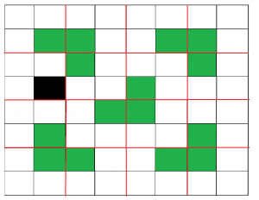
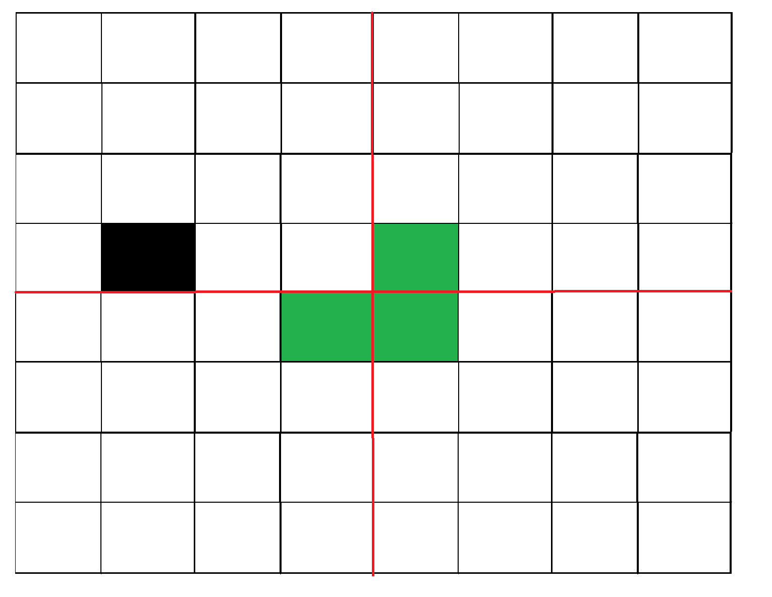

Slide 24
Recurrence relation for above recursive algorithm can be written as below. C is a constant.
T(n) = 4T(n/2) + C
The above recursion can be solved using Master Method and time complexity is O(n2)

Slide 25
Comb Sort
Comb Sort is mainly an improvement over Bubble Sort.
Bubble sort always compares adjacent values. So all inversions are removed one by one.
Comb Sort improves on Bubble Sort by using gap of size more than 1. The gap starts with a large value and shrinks by a factor of 1.3 in every iteration until it reaches the value 1. Thus Comb Sort removes more than one inversions couts with one swap and performs better than Bubble Sort.
The shrink factor has been empirically found to be 1.3 (by testing Combsort on over 200,000 random lists)
Although, it works better than Bubble Sort on average, worst case remains O(n2).

Slide 26
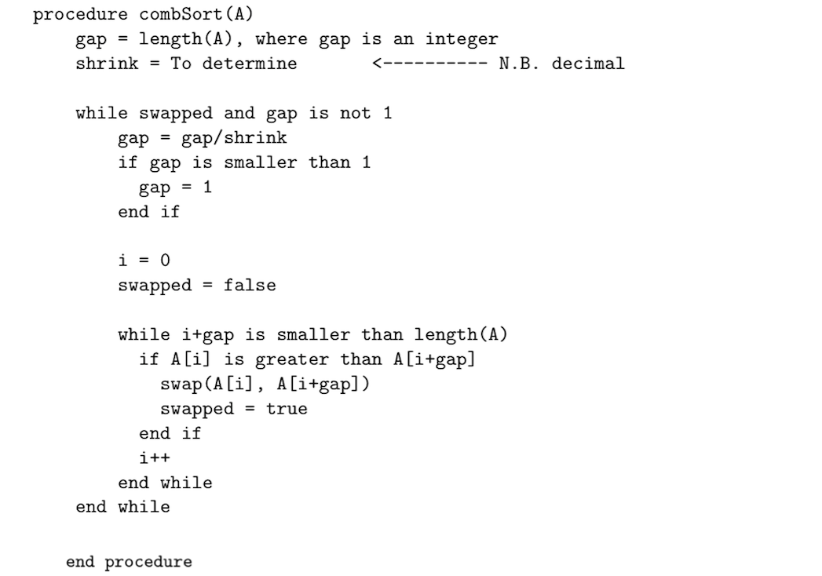
Algo For Comb Sort

Slide 27
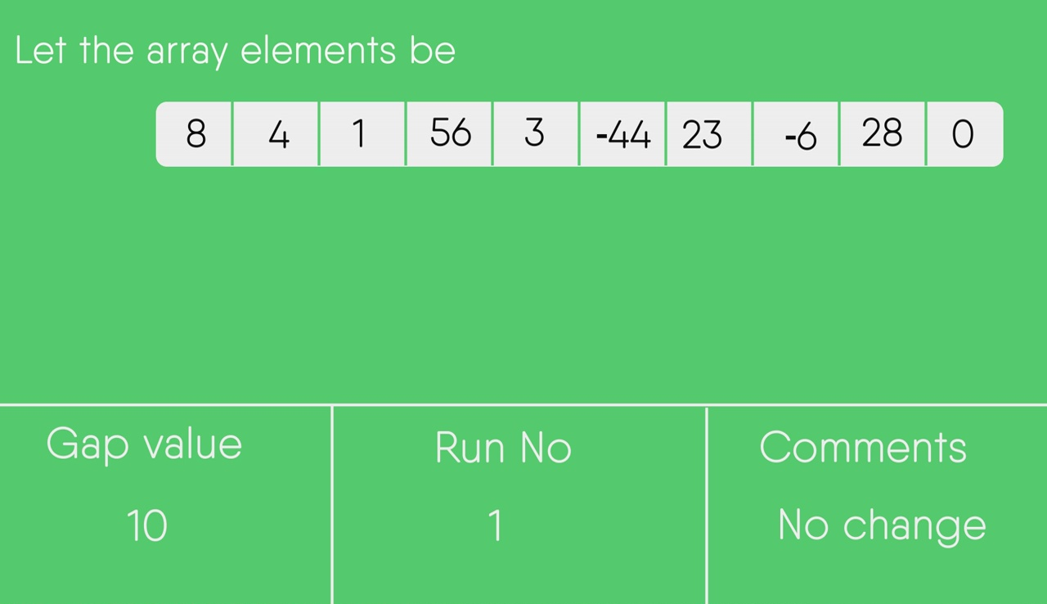
How To Apply Comb Sort

Slide 28
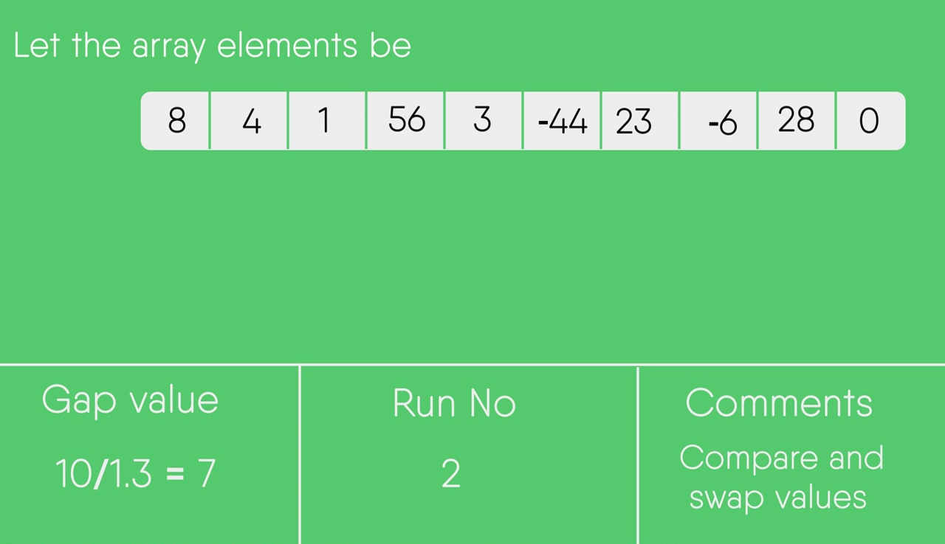

Slide 29
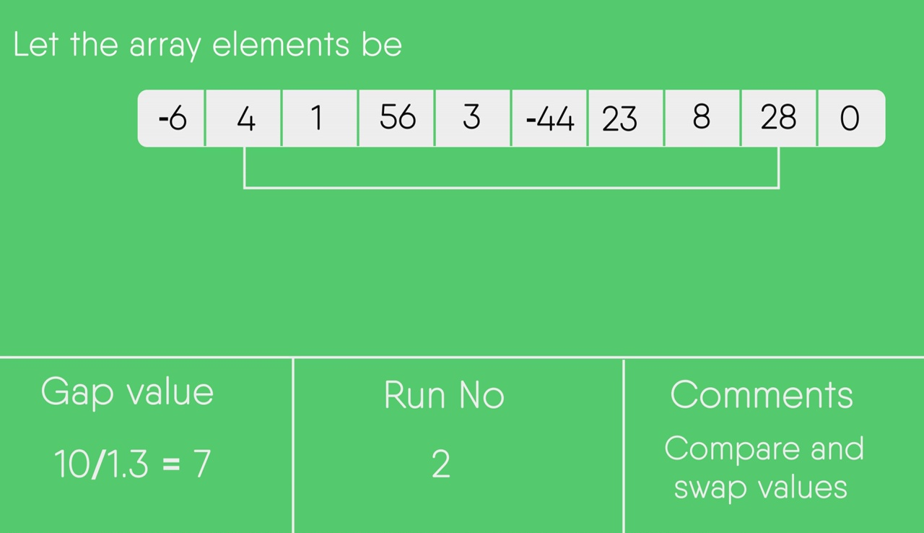

Slide 30
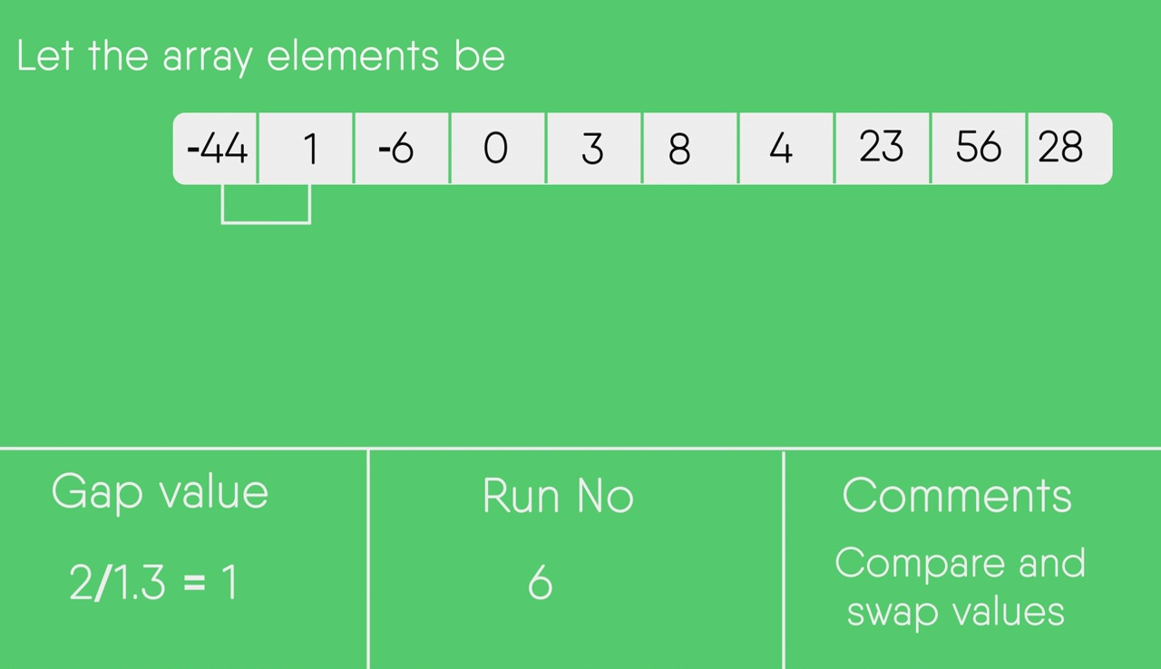

Slide 31
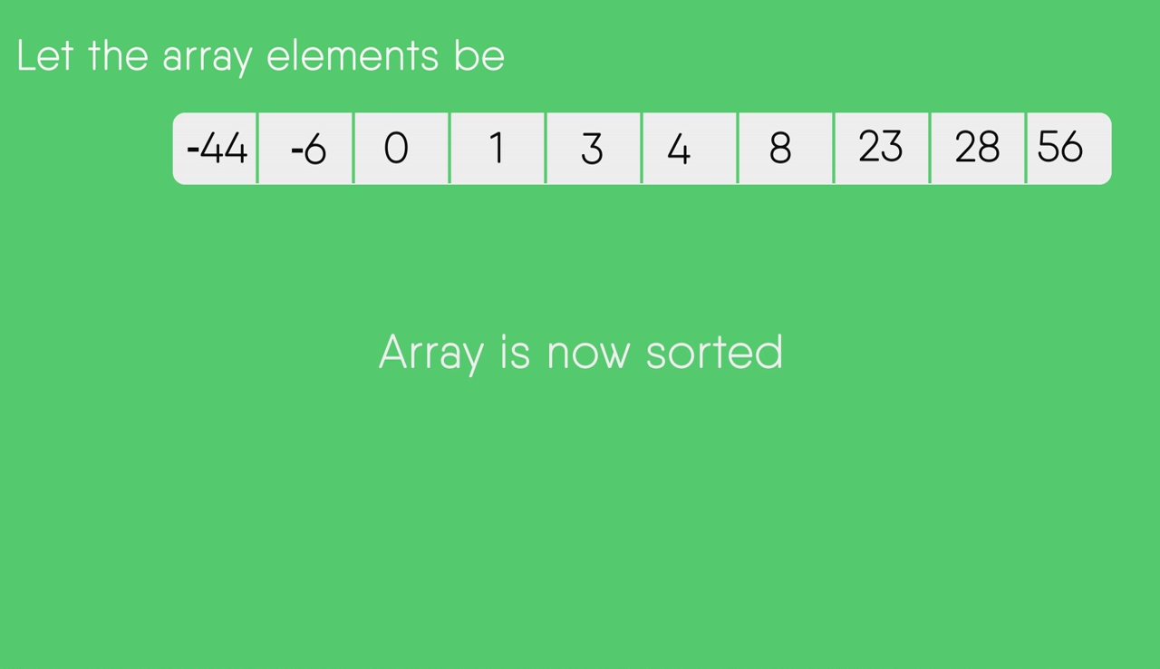

Slide 32
Conclusion
So this is how we can improve Bubble Sort, its worth mentioning that the name changes to Comb Sort. If compared all the three ways of Sorting, below is the result:
Plain Bubble Sort : Comparison – 72 , Swap – 20
Optimized Bubble Sort : Comparison – 44 , Swap – 20
Comb Sort : Comparison – 45 , Swap – 12
This proves that organized randomness helps and we can employ Comb Sort in place of bubble sort to get things faster.

Slide 33
Pro’s And Con’s Of DCA
Divide and Conquer strategy uses recursion that makes it a little slower and if a little error occurs in the code the program may enter into an infinite loop.
Usage of explicit stacks may make use of extra space.
If performing a recursion for no. times greater than the stack in the CPU than the system may crash
.
Solves difficult problems with ease.
Algorithms designed under Divide and Conquer strategy does not require any modification as they inhibit parallelism and can easily be processed by parallel processing systems.
It makes efficient use of memory cache this happens so because that problems when divided gets so small that they can be easily solved in the cache itself.

