Slide 1


Pitch-Deck Presentation

Slide 2
Ms Nyna - The Grievance Redresser

Slide 3
TEAM DETAILS
Team Name | PY_WARRIORS
Member 1 Name | Saikat Ghosh
Member 2 Name | Srishti Maurya
Member 3 Name | Harshit Mishra
Member 4 Name | N/A
THEME SELECTED
Digital India(e-kranti-Electronic Delivery of Services)

Slide 4
OUR PROJECT
Voice-based Customer Grievance Redressal System using Google Action, a google-assistance based app.
Better option when compared to Chatbots and IVR Systems.
Hassle free way.
Feed the required details easily by ‘typing in’ or ‘speaking’. This will uniquely identify each user’s complaint.
This will allow the user to easily register the complaint and the complaint will be seamlessly forwarded to the desired department for redressal.
After the successful registration of the complaint, the user will receive a confirmation on their email respectively including the reference number. This will uniquely identify each user’s complaint.

Slide 5
Our Entities
Customers
CRM
Companies

Slide 6
PROCEDURE
INVOCATION: We can invocate the grievance redressal action by saying the phrase: “Talk to Ms. Nyna”.
ACCESS NAME: This command invokes the google action, followed by the permission to access the users name. yes user is supposed answer with ‘yes’ for granting the permission or with ‘no’ for denial.
MOBILE NUMBER: The next intent is to ask the user to input the mobile number. After the successful input, Ms. Nyna asks for a confirmation for the entered phone number, whether is correct or you want to edit. For this user can respond with ‘yes’ and proceed further or with ‘no’ and edit the phone number.
COMPLAINT REGISTRATION: Further to this, Ms. Nyna asks the user to input the grievance. By chance, if you miss some details, this action gives you a chance by asking if you still want to add some more information, where user can say yes or no as per their requirement.
Finally Ms. Nyna replies with a closing note and stores the information in the Firebase database(we are still working on it) and this database can be accessed only after authentication by the admins.

Slide 7
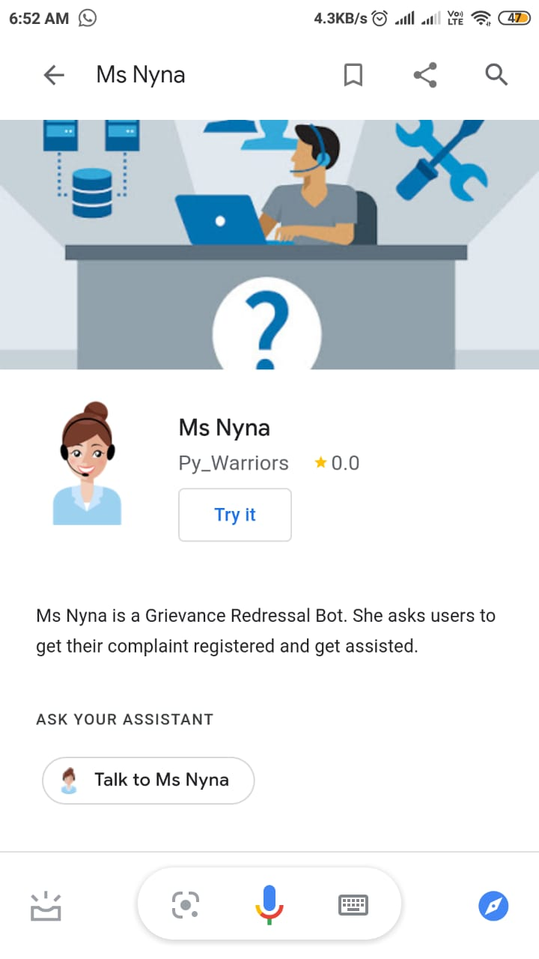
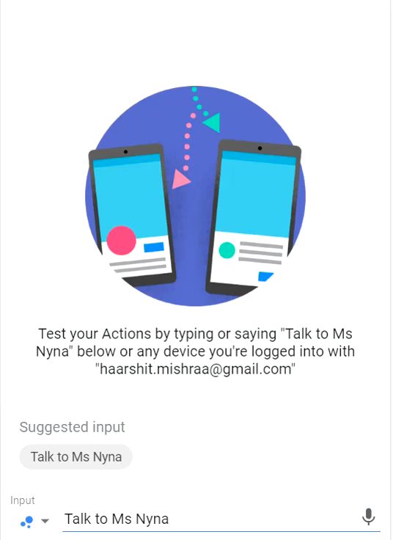

ADDITIONAL DOCUMENTS FOR SOLUTION
This section contains a screenshot and a video of the working of the whole program on a Simulator.

Slide 8
COMPETITORS
Strengths
1. Direct support to the customer
2. Hassle free registration of complaint
3. Availability of android on wide variety of platforms make it more feasible
Weaknesses
1. Cannot completely replace the existing modes of communication, viz. IVR and email.
2. Internet connectivity is a strong requirement.
3. Restricted by the availability of Google assistant application or android device.
Opportunities
1. Devices like Google home and personal Assistants like google home make it more approachable that IVR and emailing services
2. Minimum efforts and maximum reach. With minor changes we can use the Action for various companies.
Threats
1. IVR systems and Emailing services are being widely used
2. IVR systems do not depend on Internet availability and have wider scope than this Google Action.

Slide 9
WHAT INNOVATION/CREATION ARE YOU BRINGING ?
With the advent of voice-based personal assistants (Google Home, Alexa) and smart home devices, people have started using it at a large scale to get their things done. Therefore, why not we also upgrade our existing complaint redressal system to these VUI (Voice User Interface) platforms.
We chose Google as its initial platform because Google Assistant is available on all android based devices and customer can use Google Home to do the same.
This will allow the customers to log their complaint without any hassle of going through various navigating option over the call.
This will target all the existing customers of a company to register any types of complaint related to any department.
And finally, we are adding a short in making our glorious India more digital.

