Slide 1


Face Recognition System for Crime Detection
“A smart surveillance system that knows every face”
Presented by Perceptron_3038

Slide 2
Pitch Deck
“A smart surveillance system that knows every face”
Our product is based on real time identification of people with real streaming, based on a person's database. To be able to identify and recognise criminals and similar activities.

Slide 3
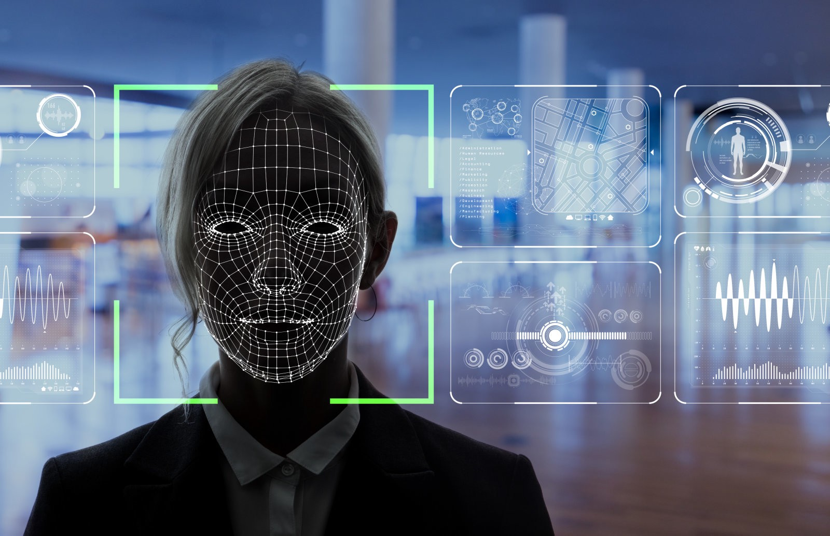

Slide 4
THE PROBLEM STATEMENT :
Build a face recognition analytics system for law enforcement
agencies

Slide 5
OUR AIM
What do we want to build ?
To develop an accurate face recognition analytics system that would assure maximum accuracy and traits at the time of a criminal trial.

Slide 6
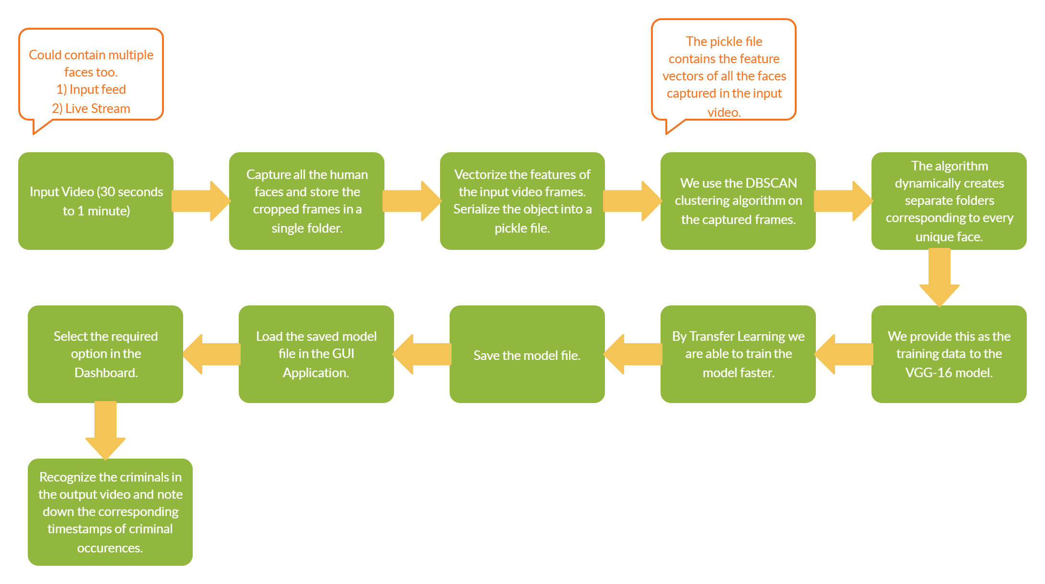

Slide 7
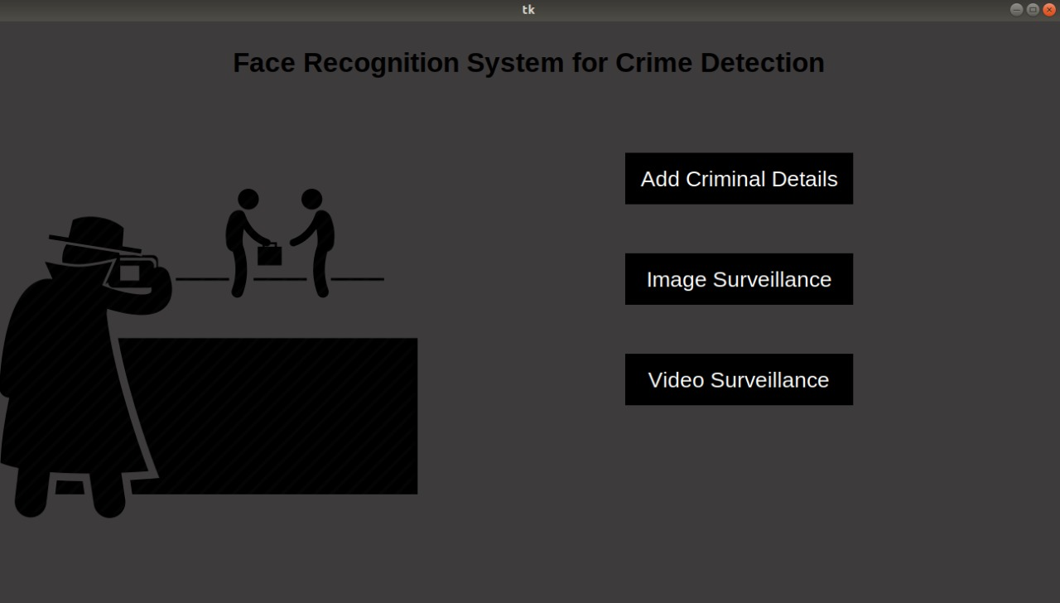
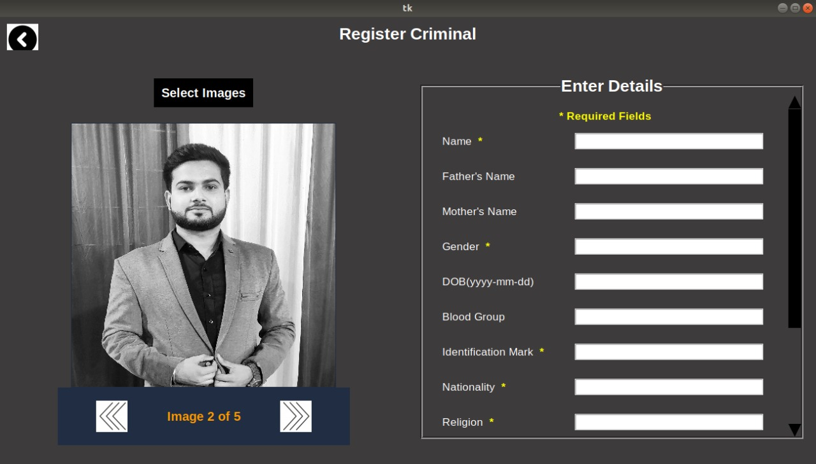
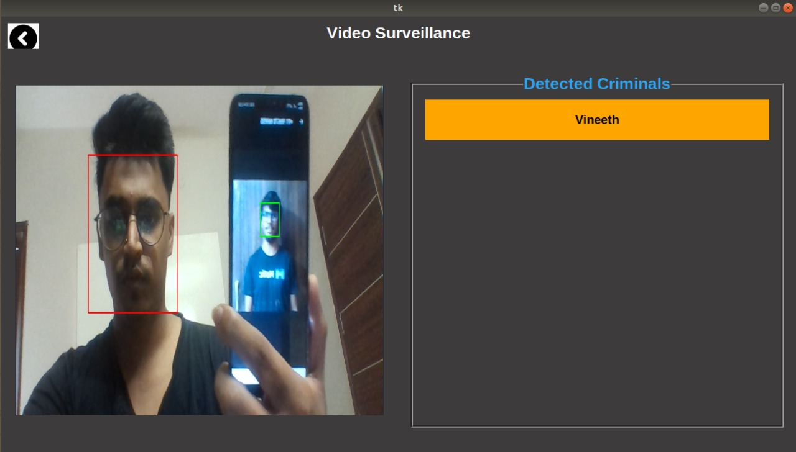
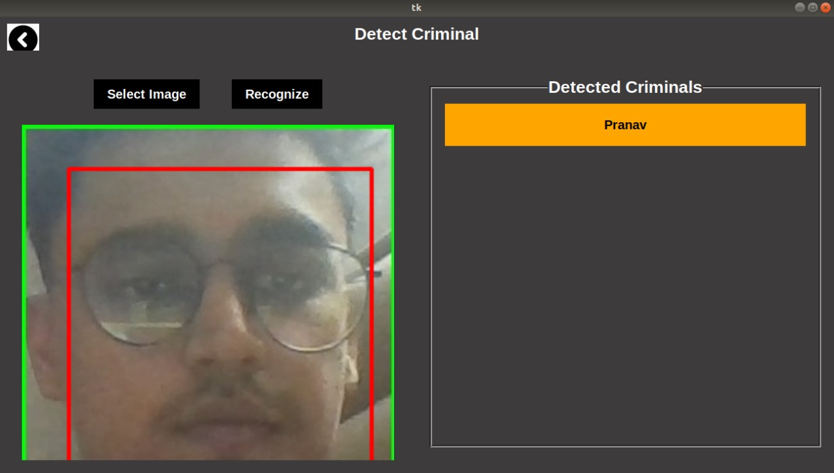

Slide 8




Technology Stack
What is inside the box?

Slide 9
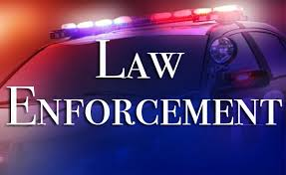

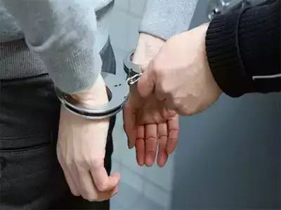
LAW ENFORCEMENT AGENCIES
To ensure the accurate identification and detection of a criminal, saving time and resources.
WHERE CAN YOU USE THIS ?
CRIME BRANCHES
To ensure that a proper database is kept and maintained with all the records.
Endless Possibilities...
GENERAL SECURITY PURPOSES
To ensure the general safety of customers from common crimes like theft, etc.

Slide 10
Thank you

