Slide 1


Face Recognition System for Crime Detection
“A smart surveillance system that knows every face”
Presented by Perceptron_3038

Slide 2
Pitch Deck
“A smart surveillance system that knows every face”
Our product is based on real time identification of people with real streaming, based on a person's database. To be able to identify and recognise criminals and similar activities.

Slide 3
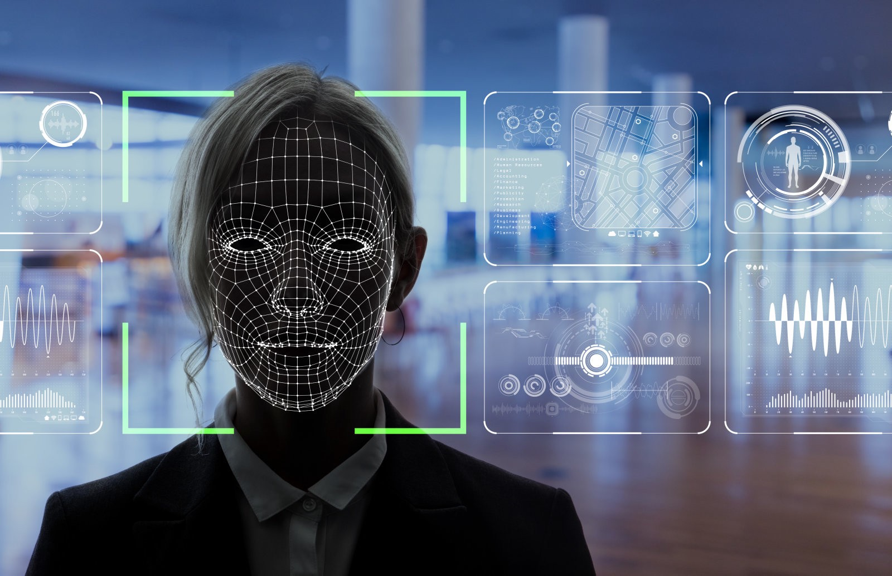

Slide 4
THE PROBLEM STATEMENT :
Build a face recognition analytics system for law enforcement
agencies

Slide 5
PROBLEM DESCRIPTION :
The security of India is becoming ever more critical in this new world. There is an expectation of a slew of organized crime activities that may attempt to cripple our law enforcement and defense agencies. In such a scenario, technology becomes of paramount importance.
One aspect of the use of technology in law enforcement is video analytics, and video analytics has various components. One of the components is to identify patterns across different videos.

Slide 6
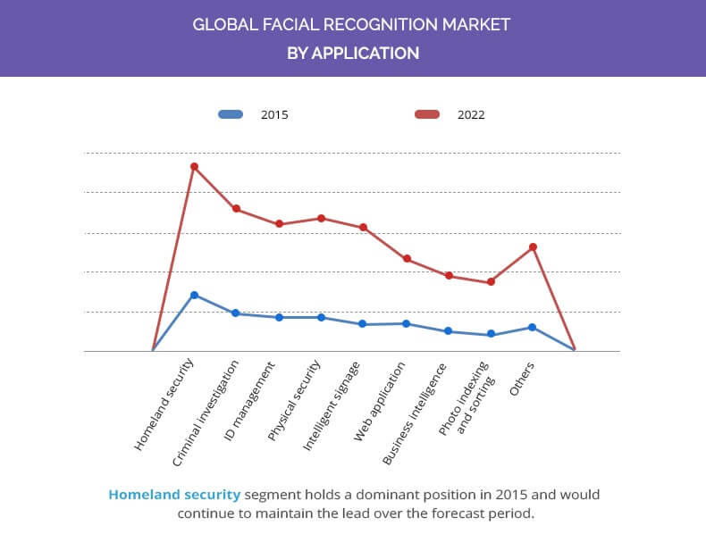
STATISTICS

Slide 7
4
20%
IN 5 CASES ARE WRONGLY IDENTIFIED INNOCENT PEOPLE
MATCHES ARE IDENTIFIABLY CORRECT

Slide 8
OUR AIM
What do we want to build ?
To develop an accurate face recognition analytics system that would assure maximum accuracy and traits at the time of a criminal trial.

Slide 9




FEATURES
Crime Detection
Maximum Accuracy
Recognizes Facial Features
Detects other criminal traits as well

Slide 10
Methodology
We intend to use state of the art deep learning based face recognition modules and methods, eventually helping in crime detection and identification.
Our software identifies the facial features of a person in a particular frame and detects if the person's profile is matching with that of an identified criminal or not.
The software mainly uses the VGG 16 model.
VGG16 is a convolutional neural network model proposed by K. Simonyan and A. Zisserman in the paper “Very Deep Convolutional Networks for Large-Scale Image Recognition”. The model achieves 92.7% top-5 test accuracy in ImageNet, which is a dataset of over 14 million images belonging to 1000 classes.

Slide 11



Python
Technology Stack
Opencv
What is inside the box?
VGG 16

Slide 12
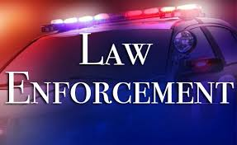

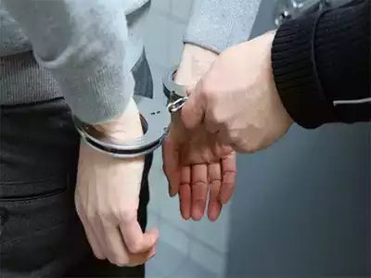
LAW ENFORCEMENT AGENCIES
To ensure the accurate identification and detection of a criminal, saving time and resources.
WHERE CAN YOU USE THIS ?
CRIME BRANCHES
To ensure that a proper database is kept and maintained with all the records.
Endless Possibilities...
GENERAL SECURITY PURPOSES
To ensure the general safety of customers from common crimes like theft, etc.

Slide 13
Our Plan for the future?
How do we plan to help the world?
UNDERSTAND REQUIREMENTS
BUILD CUSTOMISED SOLUTIONS
PROVIDE SUPPORT TO CLIENT

Slide 14
" WE BELIEVE IN KEEPING EVERYONE SAFE "
Just as strongly as we believe in our product that would help change the figures of the crimes occurring and the cases being solved successfully every year, in the times to come...
So “detection” made easy and available for everyone out there.

Slide 15
Thank you

