Slide 1

CONVERSE
An Interactive Voice Response (IVR) solution made to disseminate reliable information to the masses using NLP and crowdsourcing methods
Team Name: TALK AI TO ME
Theme: Information Dissemination

Slide 2
Problem
Due to the COVID-19 pandemic, there is a rise of a lot of panic and confusion amongst the public. People want to know the precautionary steps, symptoms and other relevant news regarding this pandemic but are often misguided with fake news or rumors instead. Elderly individuals or people who aren't well-versed with using technology are exploited the most. There is a need for a source of information for such people which is easily accessible, scalable and reliable.

Slide 3
Solution
CONVERSE A one-stop Interactive Voice Response (IVR) solution (made using NLP models) hosted on an actual phone number (like Alexa but on a phone call) to disseminate reliable news, stats, and safety measures to the public so as to curb confusion and rumors amongst the masses along with features to aid the users in this time of crisis.

Slide 4
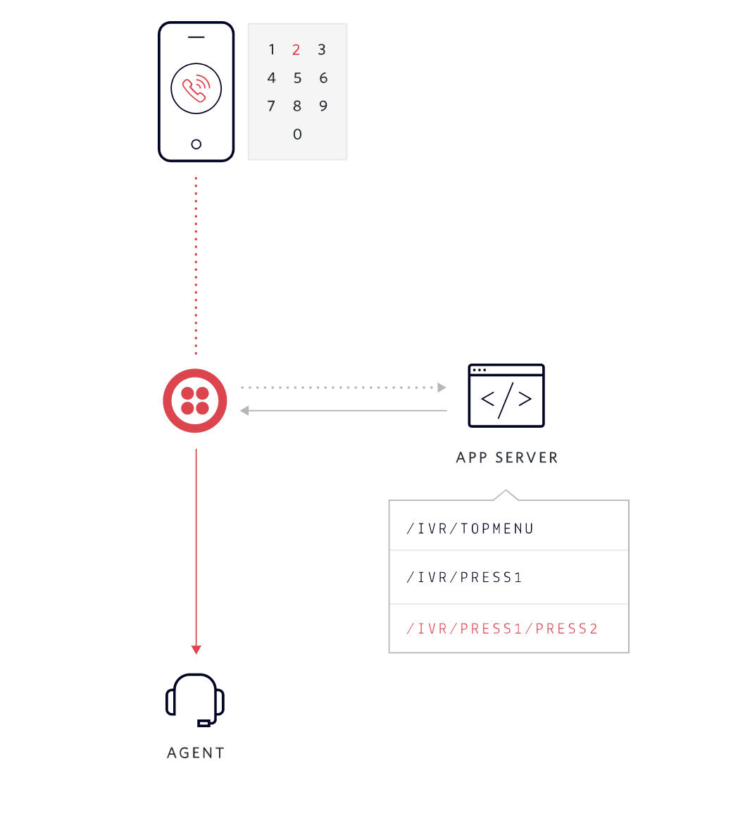
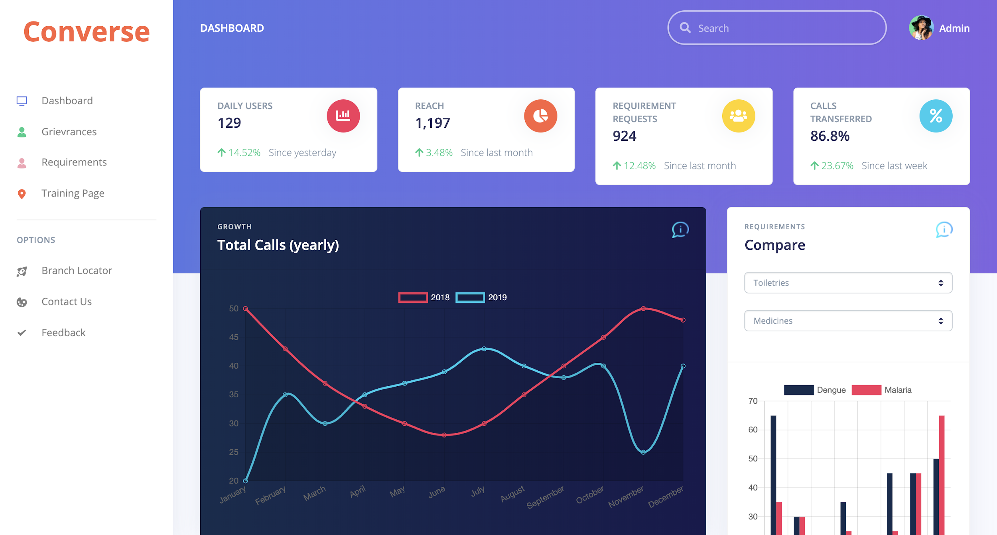
Solution (UI Wireframe)
(Interactive Voice Response system)
(Admin Dashboard)

Slide 5
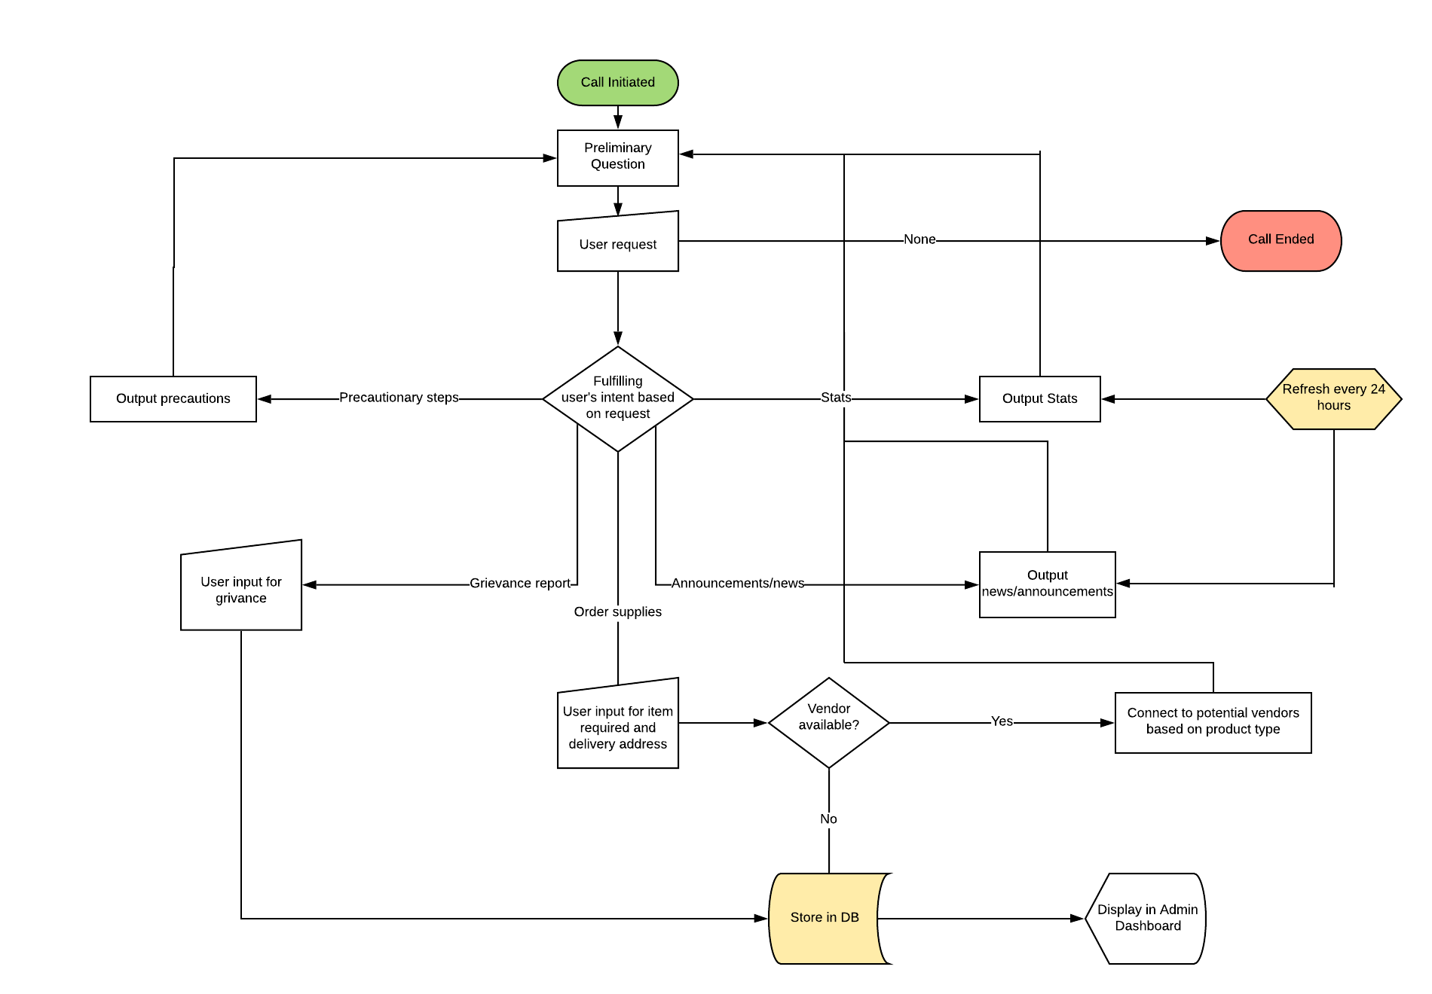

Slide 6
Pros
Reachability is the biggest plus point here as people who aren’t well-versed with technology can also use it due to it’s dial-and-talk capability
Highly scalable with no hardware dependencies and easy to deploy software
Monitor the needs of the public from kilometers away using crowdsourcing methodology
Collect grievance reports from different areas and display it on the dashboard for a better analysis of the current situation
Bridges the gap between the supply-and-demand chain by connecting potential customers directly to vendors
Can be immediately deployed which is currently the need of the hour for our nation as well as for the whole world.

Slide 7
Pros
Act as a front-line tool for helpline call centers so they can cater to the more prioritized clients
This helps the elderly and the tech illiterate population to readily keep upto date with reliable information regarding this ongoing pandemic and protect themselves better
Government’s public announcements will have a better reach towards the public with this application

Slide 8
Tech Stack
Firebase (real-time DB)
Twilio API (IVR + Autopilot)
Amazon Polly (for Hindi lang support)
BeautifulSoup
Python
Flask
HTML/CSS
Javascript
Bootstrap

Slide 9
Future Prospects
Built-in Hindi language support with better accuracy
Supporting a much wider range of essentials for orders
A dedicated platform for vendor registration

