Slide 1
2102 Covid-19 Spread Heatmap plots
Team : TruthRevealed
[ Members- Abhishek ]

Slide 2
Tools used
Data preparation
Python notebook
Dashboard
Html/Css
Javascript
Mapbox API

Slide 3
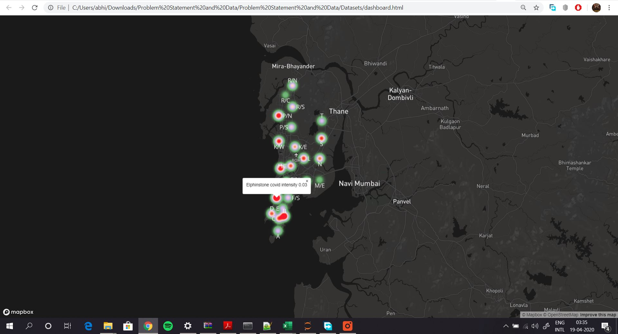

Slide 4
What more?
Dashboard can be used for other geographic locations
Can be made dynamic and real-time as a web app
Important data points can be highlighted on the plot
Filter on data points such as intensity, city etc

Slide 5
Thank you Questions?

