Slide 1
JDBC
By: Vaishali Varshney
Contact: vaishalivarshney98@gmail.com

Slide 2
Discussions
What?
Why?
Architecture of JDBC
Types of JDBC driver available
Steps to connect to DB
Types of Statement
Difference

Slide 3
What is JDBC?
JDBC acronym of Java Database Connectivity is an API that executes SQL statements.
API : Application Programming Interface which includes packages consists of classes and interface required for implementing database operations.
It is present in the “java.sql” package.

Slide 4
Why we need JDBC?
Difference between ODBC(Open Database Connectivity) and JDBC : Like ODBC is also an interface for accessing a database. However, ODBC isn’t appropriate for direct use for java applications.
ODBC uses C interface, so it can’t be used with java directly.
JDBC is used only for connectivity with java allows database application to run on different platforms and interact with different DBMS.

Slide 5
For ex. Consider a scenario where you have to develop an application for an airlines company that maintains the record for daily transactions. You will install SQL Server as an RDBMS, design the airlines database and ask the airlines personnel to use it. Will the database alone be of any use to the airlines personnel?
The answer will be negative.
Therefore you need to develop an application that communicates with the database to perform the following task:
Store and update data
Retrieve the data.

Slide 6
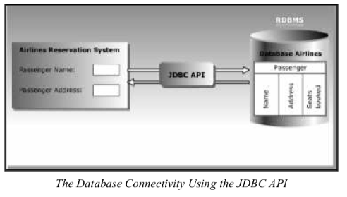
Airlines reservation system interacts with Airlines database.

Slide 7
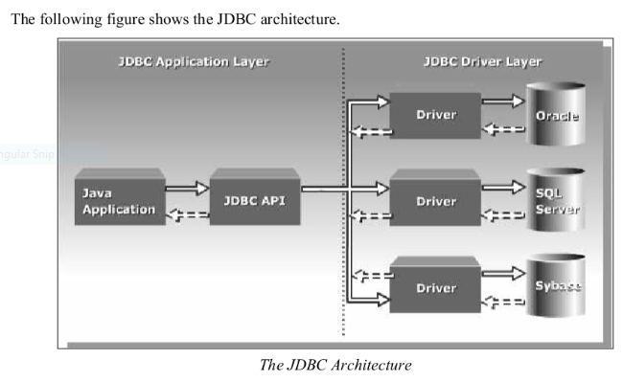
Architecture of Database

Slide 8
Java Application layer: Signifies a java application that uses a JDBC API to interact with the JDBC drivers. A JDBC driver is the software that a java application uses to access a database.
JDBC driver layer: Acts as a interface between a java application and a database. A driver sends the request of a java application to the database.

Slide 9
Identifying the types of JDBC Drivers.
You need to use JDBC drivers to convert queries into a form that a particular database can interpret.
JDBC supports following type of drivers:
JDBC-ODBC Bridge Driver
Native-API Driver
Network Protocol Driver
Native Protocol Driver

Slide 10
JDBC-ODBC Driver
Also called type-1 driver.
Converts the JDBC method calls into the ODBC- function calls
JDBC-ODBC bridge driver enables a java application to use any database that supports the ODBC driver.
The java application cannot interact directly with the ODBC Driver. This bridge works as an interface between both of them.

Slide 11
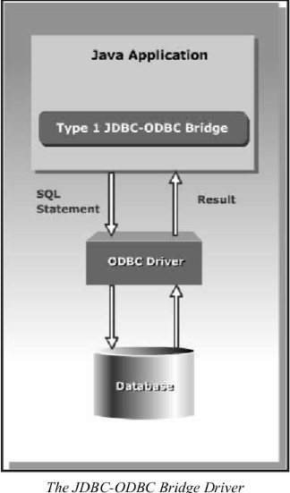

Slide 12
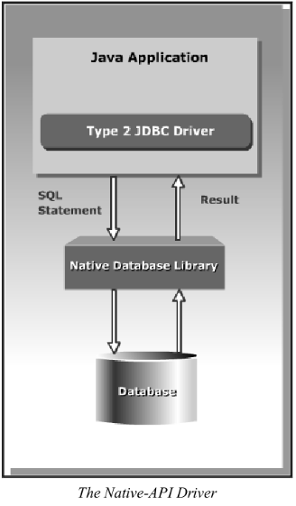
The Native API Driver
Also called type-2 driver.
Uses local native libraries provided by the database vendors to access the database.
It doesn’t have any ODBC intermediate layer.
Used for network based applications.

Slide 13
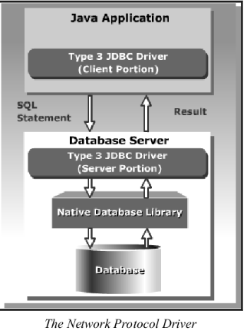
The Network Protocol Driver
Also called type-3 driver.
Consists of client and server portions.
The client portion contains java functions, and the server portion contains java and native methods.

Slide 14
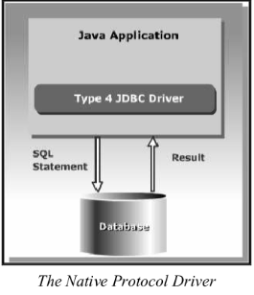
The Native Protocol Driver
Also called Type-4 Driver
Java driver that interacts with the database directly using a vendor specific network protocol.

Slide 15
Classes and Interfaces used:
The DriverManager Class: Loads the driver for the database.
The Driver interface: represents the database driver.
The Connection interface: Enables you to establish the connection between a java application and a database.
The Statement interface: enables you to execute the SQL statements.
The ResultSet Interface: represents the information retrieved from the database.
The SQLException class: Provides information about exceptions that occur while interacting with databases.

Slide 16
Steps to Connect:
Define the connection URL.
Established the connection.
Create the statement object.
Execute a query.
Process the results.
Close the connection.

Slide 17

Loading and Register to the database.
You can load and register a driver by:
Using the forName() method of java.lang.Class class.
Using the registerDriver() static method of the DriverManager Class.
Using the forName() method:
This method loads the JDBC Driver and registers the driver.

Slide 18
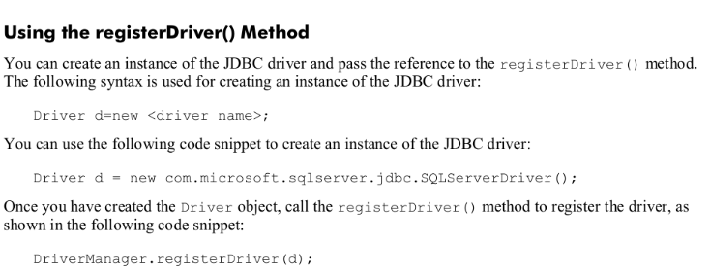
Using the registerDriver() method:

Slide 19
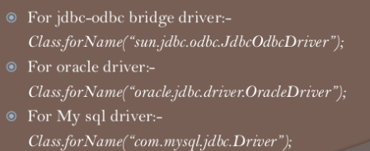
If you are having any other datbase, you can use:

Slide 20
Steps to Connect: 2. Established the Connection:
Connection con=DriverManager.getConnection(“url”,”username”,”pass”);

Slide 21
Steps to connect: 3. Create a Statement Object
Statement stmt=con.createStatement();

Slide 22
Steps to connect: 4. Execute the query:
For the Select query:
String sql=“SELECT * from EMP”;
Stmt.executeQuery(sql);
For the Insert/Update query:
String sql=“INSERT into Emp values(47,”TEDDY”);
Stmt.executeUpdate(sql);

Slide 23
Steps to Connect: 5. Process the Result
ResultSet rs= stmt.executeQuery(sql);
While(rs.next())
{
System.out.println(rs.getInt(id));
System.out.println(rs.getString(name));
}

Slide 24
Steps to Connect: 6.Close the connection.
It release all the resources that the connection is holding.
stmt.close();
con.close();

Slide 25
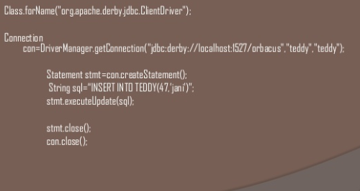
Overview:

Slide 26
Types of Statement:
There are three types of statement available in statement class:
Statement
Prepared Statement
Callable Statement

Slide 27
Types of statement: 1. Statement
This represents a simple sql/mysql statement.
Statement stmt=con.createStatement();

Slide 28
Types of statement: 2. Prepared statement:
This reperesent precompiled sql statement which allows improved performance. It allows to execute the query multiple times and we can set the values according to our need.
PreparedStatement pstmt=con.preparestatement();

Slide 29
Types of statement available: 3. Callable statement:
This allows the access of stored procedures, that are stored on the database.
CallableStatement csmt=con.prepareCall();

Slide 30
Difference between executeQuery()and executeUpdate()
executeQuery():
This method is used to execute the SQL statements which retrieves some data from the database.
This method is used to only select variables.
executeUpdate()
This method is used to execute the sql statements which update or modify the database.
This method is used to execute only non-select query like insert, update and delete(DML), create and alter too.

Slide 31
Thank you☺

