Slide 1

Time Management
Mastering Your Schedule, Achieving Your Goals
Presented By: Pardha Sai Muddana (23221A4233)

Slide 2
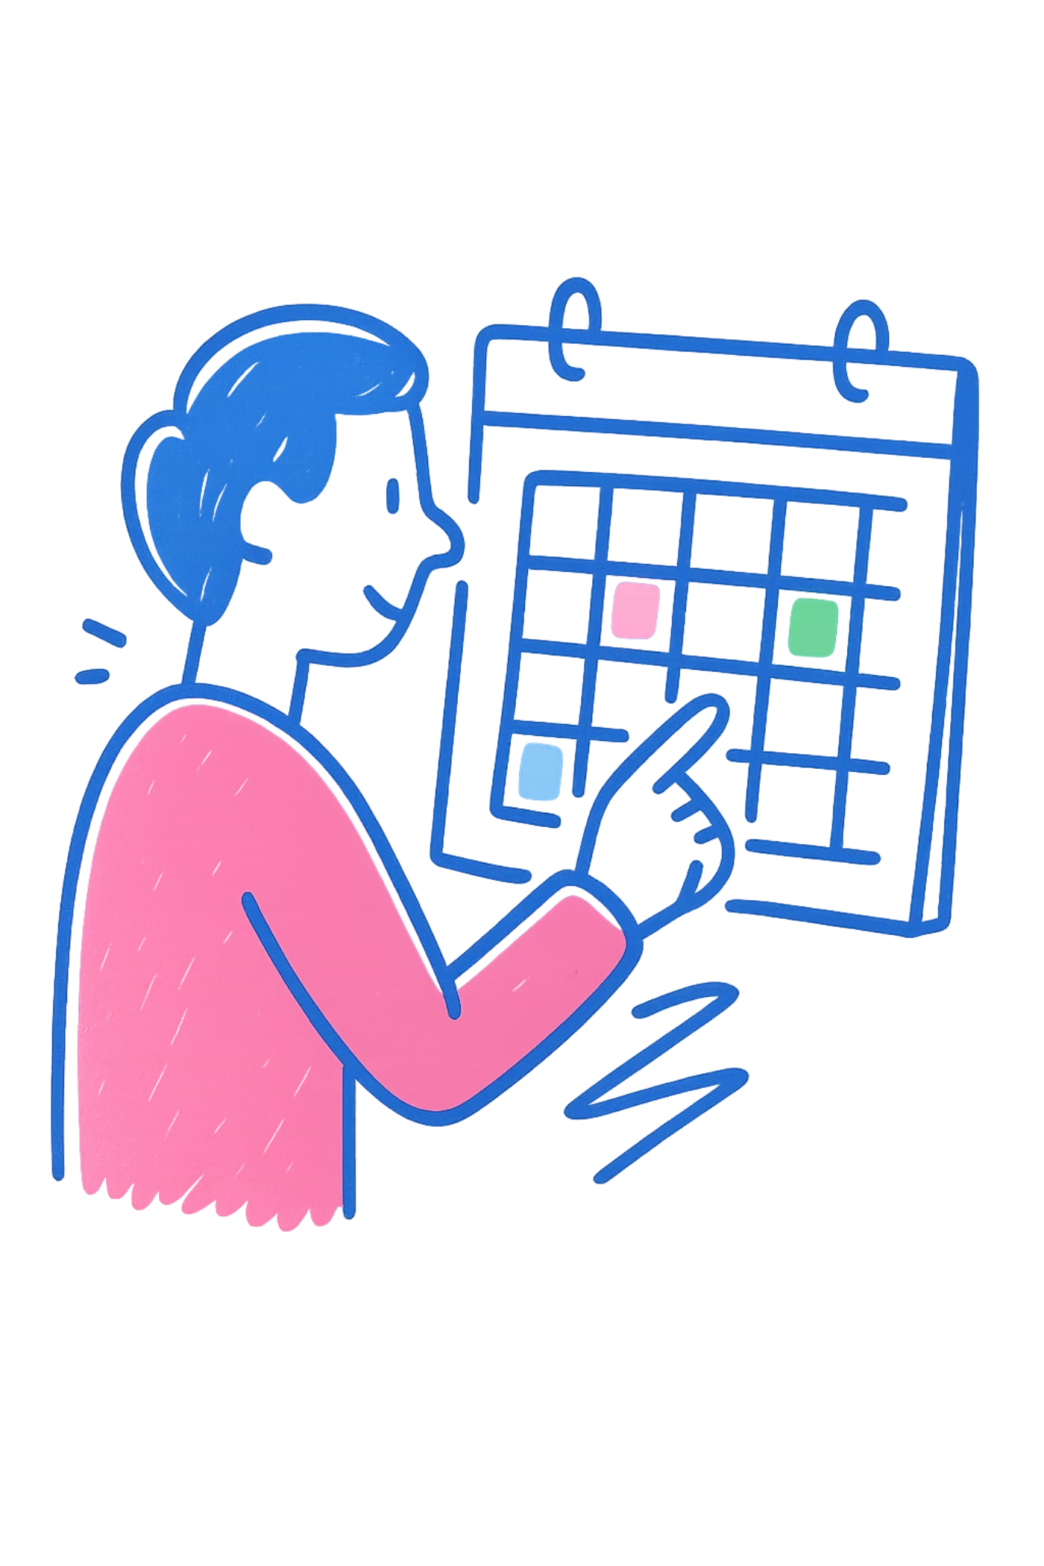

What is Time Management?
Planning
Prioritizing
Organizing tasks and activities to maximize productivity
Focusing on what matters most to achieve your goals
Executing
Completing tasks efficiently within allocated time frames

Slide 3

Why Time Management Matters for Students
Better Grades
Complete assignments on time with quality work instead of rushing at the last minute
Less Stress
Avoid the anxiety of looming deadlines and last-minute cramming sessions
Work-Life Balance
Find time for classes, studying, social activities, and self-care without burnout
Career Readiness
Develop skills employers value: organization, reliability, and meeting deadlines

Slide 4
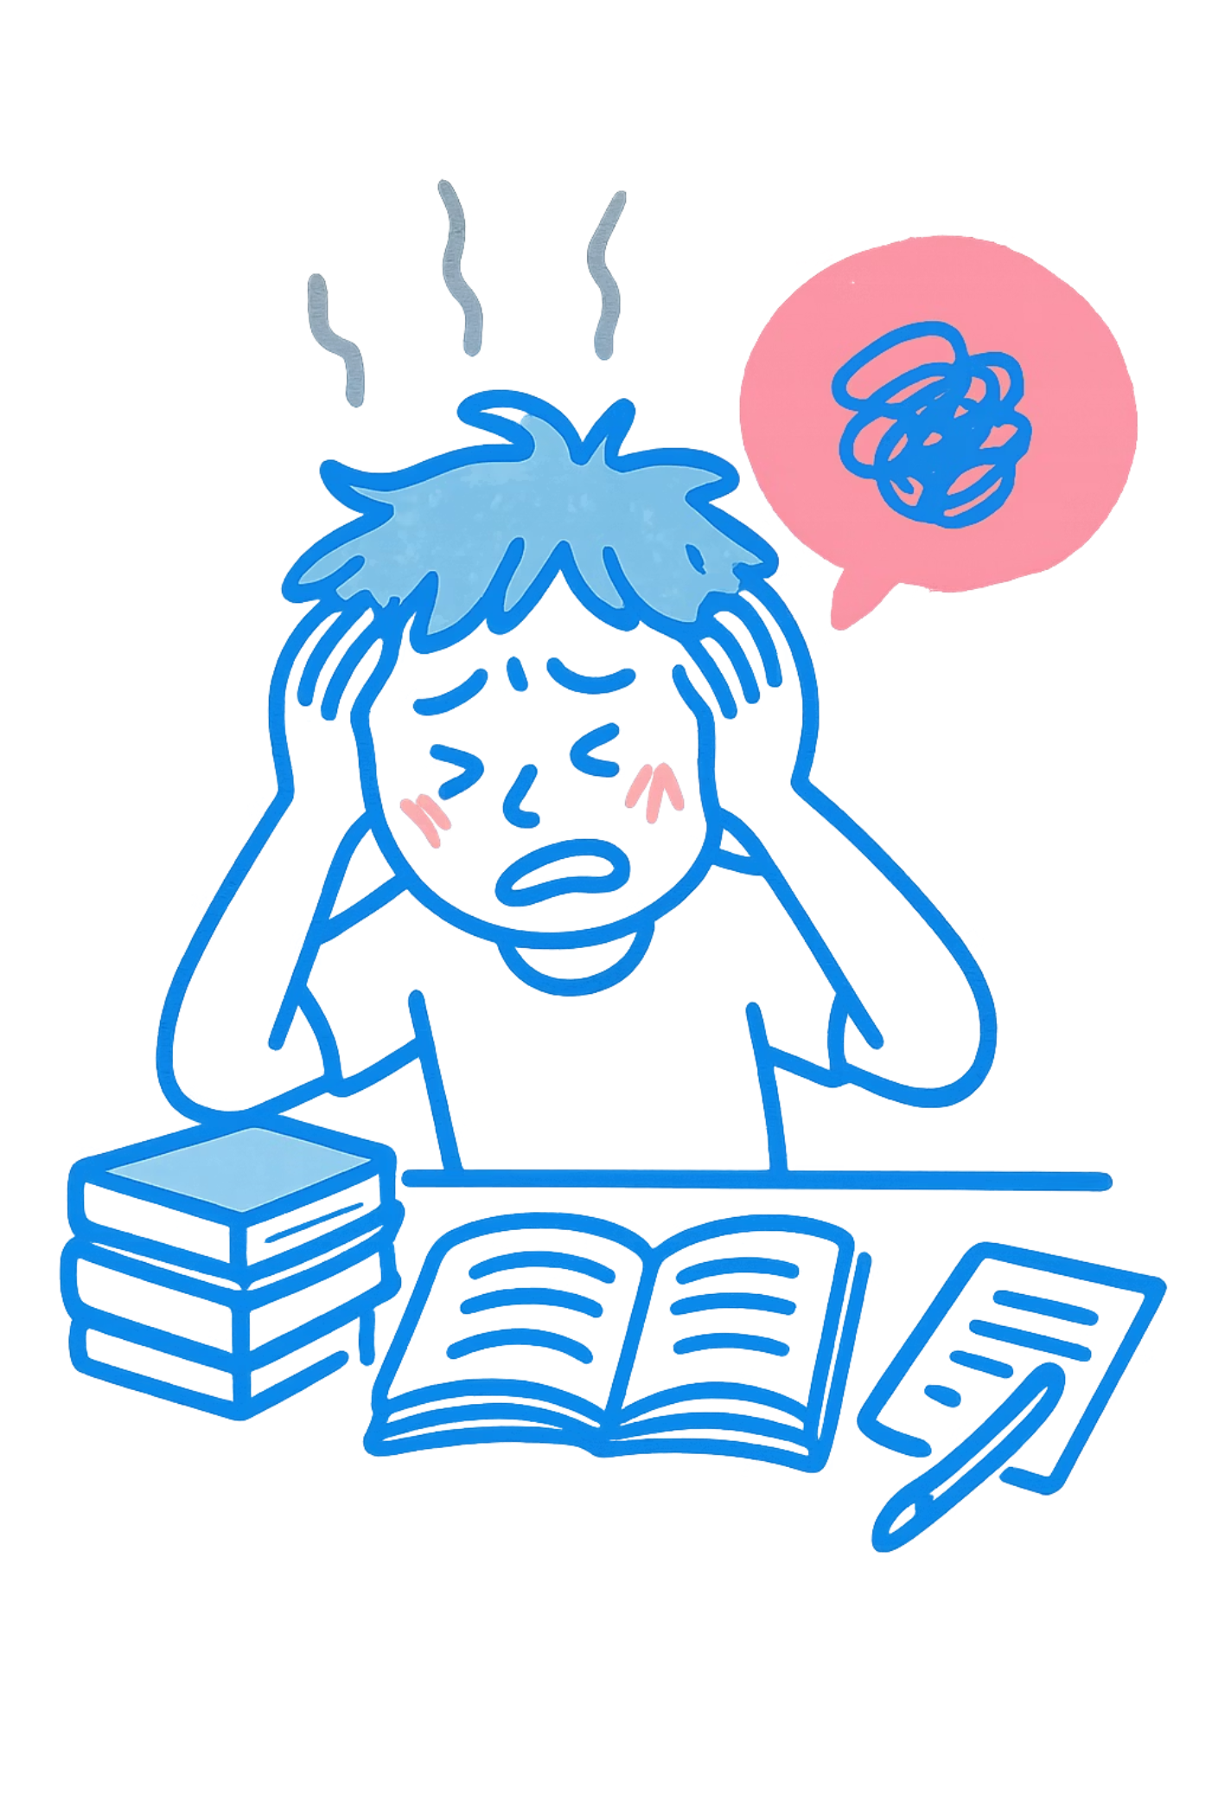
Common Time Management Problems
Procrastination
Delaying important tasks until the last minute, leading to rushed work and increased stress
Distractions
Social media, phone notifications, and environmental factors pulling focus away from priorities
Poor Planning
Lack of structure or unclear priorities causing wasted time and missed opportunities

Slide 5
Effective Time Management Techniques
To-Do Lists
Prioritization
Write down daily tasks to visualize workload and track progress throughout the day
Use the Eisenhower Matrix to separate urgent vs. important tasks and focus accordingly
Pomodoro Technique
Time Blocking
Work in focused 25-minute intervals with 5-minute breaks to maintain concentration
Schedule specific blocks for different activities to create structure and routine

Slide 6
A Student's Daily Time-Management Routine
7:00 AM - Morning
1
Wake up, review daily goals, and plan top 3 priorities for the day
2
8:00 AM - Class
Attend morning lecture with phone on silent and focused attention
12:00 PM - Lunch & Break
3
Eat, recharge, and take a walk to clear mind before afternoon work
4
2:00 PM - Study Session
Two Pomodoro sessions (50 min) on most important assignment
4:00 PM - Activities
5
Club meeting or exercise to balance academic and social life
6
7:00 PM - Review
Check completed tasks, prepare tomorrow's to-do list, and wind down

Slide 7

Take Control of Your Time
Start Small
Stay Consistent
Pick one technique this week and build from there
Practice daily, even when it feels challenging
Adjust as Needed
Find what works for your unique schedule and style
"The key is not to prioritize what's on your schedule, but to schedule your priorities."

