Slide 1
Data Visualisation with Google Fusion Tables
Dr Luc Small
eResearch Analyst
Intersect Australia

Slide 2

Data Journalism
This video of Swedish statistician and health researcher Hans Rosling is a great example and introduction to data visualisation and demonstrates how it can be used to bring facts and figures to life

Slide 3
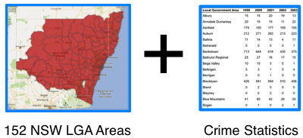

Slide 4
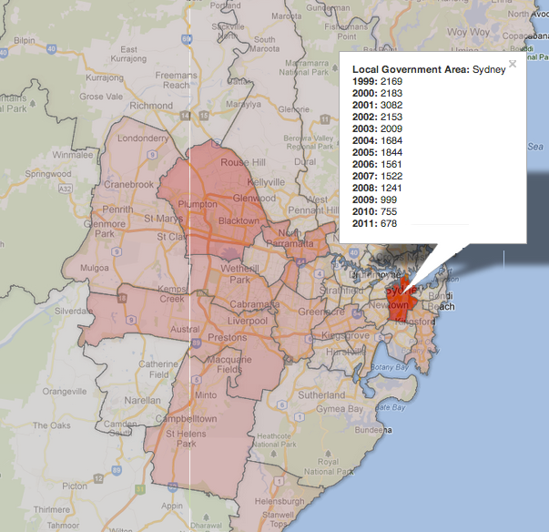
=

Slide 5
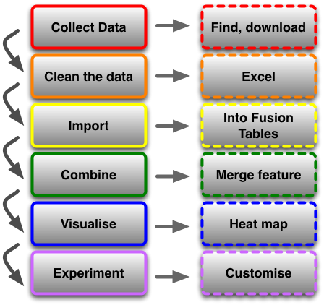

Slide 6
…let’s get under way… Exercises for this course are available at https://github.com/IntersectAustralia/TrainingMaterials/blob/master/DataVisualisationWithGoogleFusionTables/Exercises.pdf?raw=true

Slide 7
Thanks for attending!
Please complete our course survey at http://svy.mk/18c8dHa
Any further questions, contact us at training@intersect.org.au
Find out about upcoming courses by signing up to our mailing list at http://bit.ly/1aZvRqw

