Slide 1
Using Intersect's partner share of Raijin
Dr. Joachim Mai Oct 2013

Slide 2
Getting Resources
Resource allocation round in Oct for the coming year.
Smaller allocations (<20 kSUs per quarter) possible any time
Use the forms:
  http://nf.nci.org.au/accounts/forms/user_registration.php
  https://nf.nci.org.au/accounts/projects_new/APP_form.php
Connect to existing project:
  http://nf.nci.org.au/accounts/forms/user_connection.php

Slide 3
Account Details
Once the CI approves your connection to the project, your account is set up and you are sent an email with account details.
User names are of the form abc123 - abc for your initials and 123 for partner.
Passwords are sent by SMS to the mobile number provided when you registered.
Passwords can be given over the phone if necessary, but not by email.
Use the passwd command to change this when you first log in.

Slide 4

Raijin (July 2013)

Slide 5
Raijin: Overview
Fujitsu Primergy
Distributed memory machine
57,472 Sandy Bridge cores
158 TB RAM
9 PB disk
Infiniband FDR
Centos 6.4
Intersect owns about 3.8%

Slide 6
Vayu and Raijin Node Layout
Nehalem/Westmere
Vayu
Sandy Bridge/Ivory Bridge
Raijin, Orange
4
4
8
8

Slide 7
Raijin: CPUs
CPU: Intel Sandy Bridge E5-2570
2.6 GHz. Turboboost up to 3.2 GHz
4 memory channels (Vayu: Nehalem, 3 channels)
2 CPUs per node
8 cores per CP (Vayu: 4)
16 cores per node (Vayu: 8)
OpenMP program can now use up 16 cores.
But: asymmetric memory access
But: do scaling experiments and see whether your code can make good use of it.

Slide 8
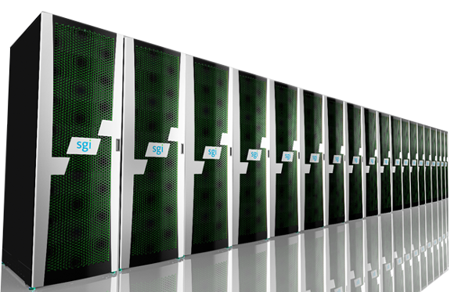
Remark: Orange (Dec 2012)
SGI Cluster
Distributed memory
1,600 Sandy Bridge cores
10 x 256GB RAM
90 x 64 GB RAM
100 TB disk
Infiniband QDR
SLES 11

Slide 9
Differences Orange ↔ Raijin
- Memory:
Orange: 90 x 64 GB
10 x 256 GB
Raijin: 2395 x 32 GB
1125 x 64 GB
72 x 128 GB
- Software
- Size: 100 nodes (Orange) vs 3,592 nodes (Raijin)

Slide 10
Raijin Stakeholders
NCMAS 15%
CSIRO 21.4%
BOM 18.9%
ANU 17.7%
Flagships 5.0%
INTERSECT 3.8%
GA 3.4%
Monash 1.7%
UNSW 1.7%
UQ 1.7%
USyd 1.7%
University of Adelaide 1.7%
Director's share and others 4%

Slide 11
Disks Raijin
Lustre parallel global FS
10 PB
300GB scratch disks per node

Slide 12
Project Accounting
Each user belongs to one or more projects
To change or set the default project, edit your .rashrc file in your home directory, and change the PROJECT variable as desired. A typical .rashrc file looks like
  setenv PROJECT c25
  setenv SHELL /bin/bash
You can also use the script: switchproj project-code
Display usage:
  nci_account -P project -p 2013.q3 –v
On Vayu was:
quotasu

Slide 13
Connecting to Raijin
  ssh -Y username@raijin.nci.org.au
For connecting under Windows use putty
For file transfer use scp, sftp or a GUI client such as Filezilla and upload.
Upload larger data to r-dm.nci.org.au (not the login node of Raijin)

Slide 14
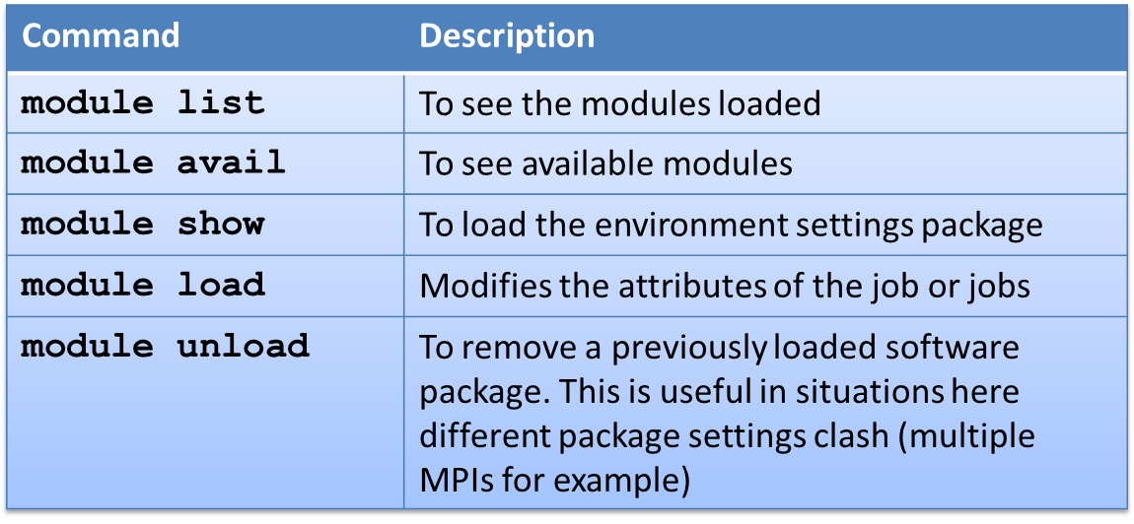
Slide <number>
Setting the Environment

Slide 15
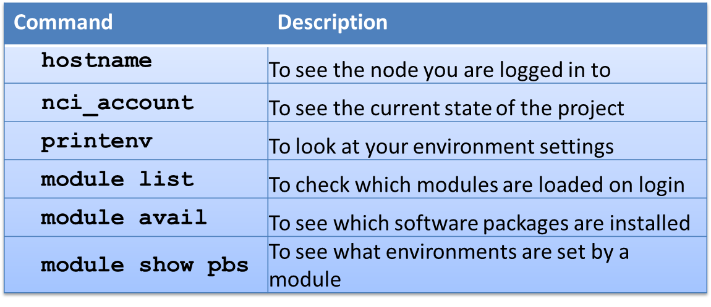
Slide <number>
Exercise 1
Log in to Raijin. Your project code is c25 and you username is aaa777 (bbb777, etc.).
Read the message of the day (MOTD).
Try the following commands:

Slide 16
Getting information and help
Message of the Day - MOTD
Downtime http://nf.nci.org.au/notices_news/
User Guide at http://nf.nci.org.au/wiki/RaijinUserGuide
FAQs at http://nf.nci.org.au/facilities/faq
Software pages at http://nf.nci.org.au/facilities/software
Email to hpc_support@intersect.org.au or help@nf.nci.org.au for NCI related problems

Slide 17
Which file-system to use
Source code and important input files: /home
Job input/output files: /short
Temporary or scratch files: JOBFS
Long term archived files: MDSS
Processing of large data files: /projects

Slide 18
Filesystem properties and limits
/home: for program, 2GB default, backup, global availability, permanent
/short: for I/O, 80GB, no backup, global availability
/JOBFS: for heavy I/O100MB, no backup, local to node, during job
MDSS: for archiving, 20GB, 2 copies, external accessing, permanent

Slide 19
Monitoring disk usage
$ lquota
--------------------------------------------------------------
fs Usage Quota Limit iUsage iQuota iLimit
--------------------------------------------------------------
mhk900 home 20.7MB 0kB 0kB 421 0 0
z00 short 1153GB 0kB 1500GB 1527750 0 10000000
z10 short 0kB 0kB 78.0GB 1 0 200000
c25 short 428kB 0kB 200GB 107 0 200000
y03 short 557GB 0kB 10.0TB 163891 0 1000000
z29 short 0kB 0kB 78.0GB 0 0 200000
ua6 short 0kB 0kB 195TB 0 0 200000
c25.data short 0kB 0kB 0kB 0 0 0
z34 short 636kB 0kB 78.0GB 29 0 200000
--------------------------------------------------------------

Slide 20
Optimise usage
Lots of small IO to /short (or /home) can be very slow and can severely impact other jobs on the system.
Avoid "dribbly" IO, e.g. writing 2 numbers from your inner loop.
Writing to /short every second is far too often!
Avoid frequent opening and closing of files (or other file operations)
Use /jobfs instead of /short for jobs that do lots of file manipulation
To achieve good IO performance, try to read or write binary files in large chunks (of around 1MB or greater)

Slide 21
Exercise 2
- Use the commands lquota and du to determine the disk space available to you in /home and /short.
- Have a look at your /short. Any user of the project can write data here.
  cd /short/$PROJECT
  ls -ld .
  ls -l DATA
  ls $USER
Extract the examples here:
  cd $USER
  tar xvf /short/c25/intro_exercises.tar
  cd INTRO_COURSE
  pwd
  ls -l

Slide 22
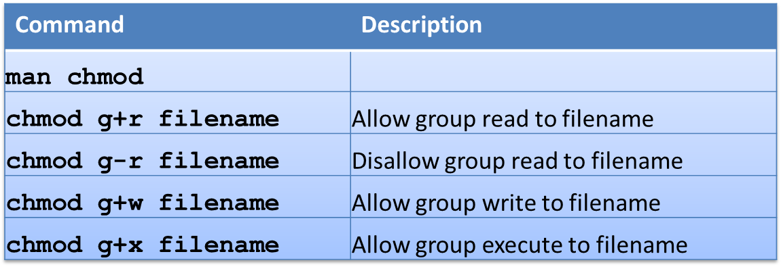
Slide <number>
Exercise 2 cont.
Change the permissions on your files and directories to allow/disallow others in your group to access them.

Slide 23
Exercise 2 (cont)
2) Use the MDSS with the following commands:
  cd /short/$PROJECT/$USER
  mdss get Data/data.tar
  ls -l
  tar xvf data.tar
  ls
  rm data.tar
  mdss mkdir $USER
Note that this creates a job in the copy queue which you can monitor
  netmv -t $USER.tar DATA $USER nqstat
  more DATA.o*
  mdss ls $USER
  mdss rm $USER/$USER.tar

Slide 24
Compiling and Optimizing
- We recommend using the Intel compilers (icc, ifort, icpc).
- Check which versions are available:
  module avail intel-fc
  module avail intel-cc
- Read the manual pages (man icc, man ifort, man icpc)
- Compiling and linking of a Fortran code:
  ifort -o matmulf matmul.f
- Options: default is O2 for Intel and O0 for Gnu compilers
- O0 means no optimisation and is very slow (-g implies -O0)
- O3 means aggressive optimisation, be careful.
Best performance with -xHost (Orange: -O3 -xAVX). This needs a never version of the compiler which makes use of the vector features.

Slide 25
Compiling and Optimizing
Default versions:
Intel v12. Some problems with v13. Try it!
Brand new: v14
Gnu v4.4. Vector features need 4.7. Load module for that.
OpenMPI: 1.6.3
  Also available: 1.4.3
  Normally: use newer versions. If that causes problems use the old one.

Slide 26
Exercise 3
1) Compile the sample code matmulf.f and matmulf.c with the Intel compilers using O3 and O0 optimisation. Compare the runtime using the time command.
2) Compile the code netcdfex.f using the netcdf library:
  module load netcdf
  module show netcdf
  module list
  cat netcdfex.f
  ifort -o netcdfex netcdfex.f -lnetcdff -lnetcdf
  netcdfex
  ncdump simple_xy.nc

Slide 27
The batch system PBSPro
The batch system distributes work evenly over the system
and ensures that jobs cannot impact each other (e.g. exhaust memory or other resources)
Raijin uses a customized version of PBSPro on Raijin. It is currently being tuned.
Batch queues:
normal: default
express: 3 times the charges of Sus
copy: to copy data, e.g. to MDSS
Walltime limits: 48h (1-255 cores), 24h (256-511 cores), 10h (512-1024 cores), 5h (>1024 cores).

Slide 28
Using PBS
- Submit your job via qsub
- Specify resources (walltime, mem, nodes PBS_JOBFS etc).
- Read the handbook!!!
Scheduling
- Jobs start when sufficient resources get available
- Jobs can be suspended when jobs with higher priority wait
- Priority depends on the amount of resources available
Use check pointing for longer running jobs

Slide 29
Differences to ANUPBS
- Use mem (not vmem)
- Use -l wd (not -wd)
- select and nodes do not work at the moment. Use ncpus as on Vayu)
-CPU sets are not supported in the current version of PBSPro. So 2 small mpijobs in one node could start on the same CPUs. to avoid this use:
  mpirun -np 8 -bind-to-none prog.exe
This is a working progress. Expect changes in the future while NCI is working with Altair to further optimize and customize PBSPro.

Slide 30
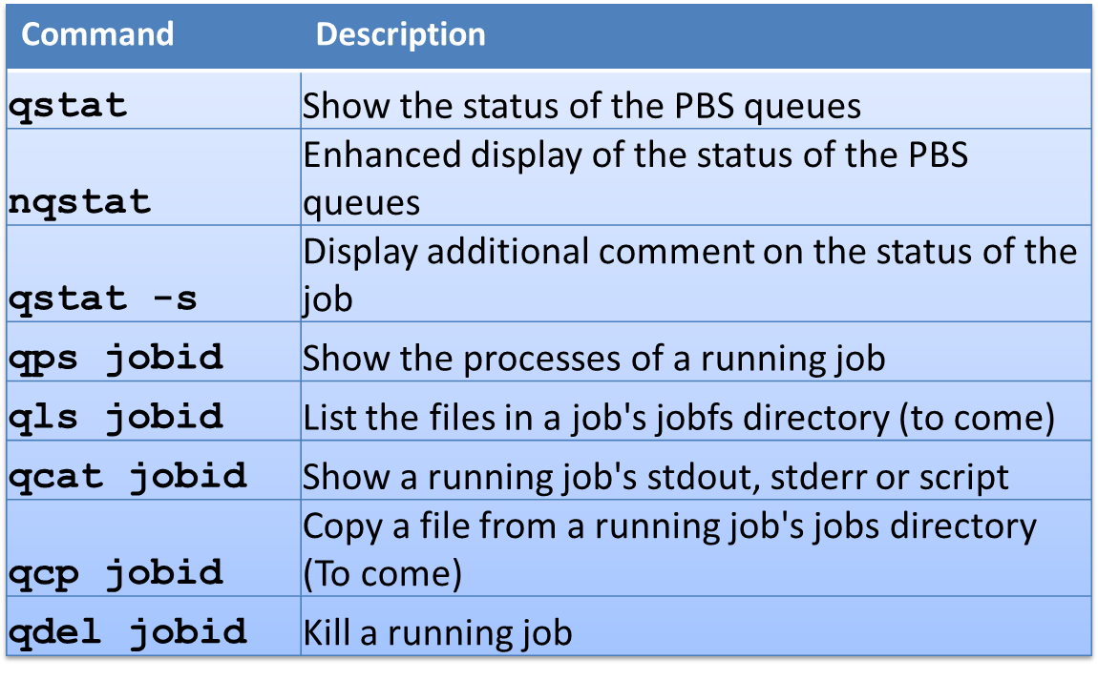
Slide <number>
Monitoring Jobs
Useful Commands

Slide 31
Exercise 4
1) Submit the following PBS script via qsub:
  #!/bin/csh
  #PBS -l wd
  #PBS -q express
  #PBS -l walltime=00:10:00,mem=52MB
  #PBS -P c25
  time ./matmuls
  time ./matmulf
2) Monitor it's progress via:
  nqstat
  qps jobid
  pbs_rusage jobid

Slide 32
Exercise 4 (cont)
3) Try an interactive batch job:
  [aaa777@raijin5 ~]$ qsub -I -l walltime=00:10:00,mem=500Mb,wd -P c25
  qsub: waiting for job 215984.r-man2 to start
  qsub: job 215984.r-man2 ready
  [aaa777@r73 ~]$ hostname
  r73
  [aaa777@r73 ~]$ module list
  Currently Loaded Modulefiles:
  1) pbs 3) intel-cc/12.1.9.293
  2) intel-fc/12.1.9.293 4) openmpi/1.6.3
  [aaa777@r73 ~]$
  [aaa777@r73 ~]$
  qsub: job 215984.r-man2 completed

Slide 33
Exercise 5
1) Compile and run the following OpenMP code
  ifort -O3 -openmp matmul_omp.f -o matmul_omp
  export OMP_NUM_THREADS=2
  time matmul_omp
  export OMP_NUM_THREADS=4
  time matmul_omp

Slide 34
Exercise 5 (cont)
2) Compile and run the following MPI code
  module list
  mpif90 mpiexample1.f -o mpiexample.exe
  mpirun -np 4 mpiexample.exe
or for a more complicated example:
  mpif90 mpiexample2.f -o mpiexample.exe
  mpirun -n 4 mpiexample.exe
mpirun is the usual instruction to start an MPI program.
man mpirun
for further details on usage.
C code simple example:
  mpicc mpiexample3.c -o mpiexample.exe
  mpirun -np 4 mpiexample.exe
and for a more complicated code:
  mpicc mpiexample4.c -o mpiexample.exe
  mpirun -n 4 mpiexample.exe

Slide 35
Profiling
On a system level use: top, iostat, vmstat
On PBS level use: qstat, qstat -f, qps etc.
Lightweight: IPM
Heavyweight: Vampir
General profiling:
  $ ifort -p -o prog.exe jacobi_serial.f
  $ ./prog.exe < input.1
  $ gprof ./prog.exe gmon.out
For the GNU compilers do
  $ gfortran -pg -o prog.exe jacobi_serial.f
  $ ./prog.exe < input.1
  $ gprof ./prog.exe gmon.out

Slide 36
Example:use of PBS_JOBFS
  #!/bin/bash
  #PBS -q express
  #PBS -l walltime=2:00
  #PBS -l jobfs=10mb
  #PBS -l mem=30mb
  cd $PBS_JOBFS
  echo "Moving files from short directory to the local directory"
  cp /short/$PROJECT/$USER/input.1 .
  cp /short/$PROJECT/$USER/jacobs .
  # Run program and write an output file to the local disk.
  time ./jacobs <input.1 > output$PBS_JOBID 2>&1
  # Move output data to /short space.
  echo "The output files are now on my /short space."
  mv output$PBS_JOBID /short/$PROJECT/$USER
  # Archive to MDSS using netcp
  cd /short/$PROJECT/$USER
  netcp -N save_data output$PBS_JOBID $USER/output$PBS_JOBID

Slide 37
Acknowledgement
This course is based on a course created by Margaret Kahn/NCI and presented to the BOM. Margaret and the NCI staff is greatly acknowledged for help, support and discussions.

Slide 38
Thanks for attending!
Please complete our course survey at:
http://svy.mk/18c8dHa
Any further questions, contact us at:
training@intersect.org.au
Find out about upcoming courses by signing up to our mailing list at:
http://bit.ly/1aZvRqw

