Slide 1
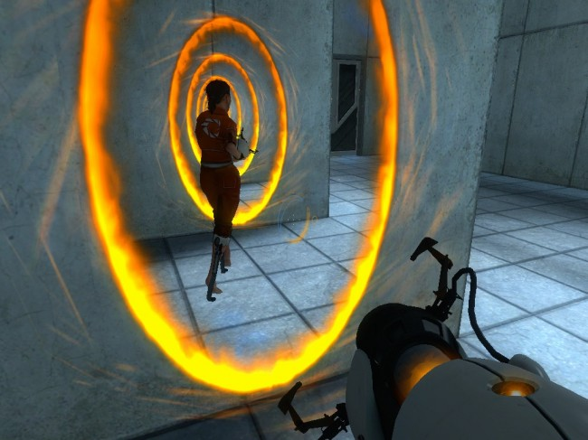
Proteomic-Genomic Nexus
14 August 2012
Ignatius Pang
Notes:
Define: nexus

Slide 2
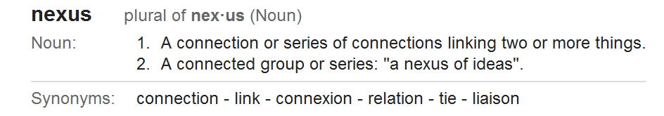
Proteomic-Genomic Nexus
The Aims of the Project.
Who are the parties involved?
What are the biological questions?
How do we solve the problems?
Suggestions and ideas are welcome!

Slide 3
Proteomic-Genomic Nexus
Co-visualization of genomics, transcriptomics, and proteomics data using Integrated Genomics Viewer (IGV)
Validate the existence of genes and alternatively spliced mRNAs using peptides identified from mass spectrometry experiments
Notes:
This work is difficult to do currently as there are a series of data processing and manipulation steps, along with the processing of outputs from many different tools. We need a pipeline to systemize these steps

Slide 4
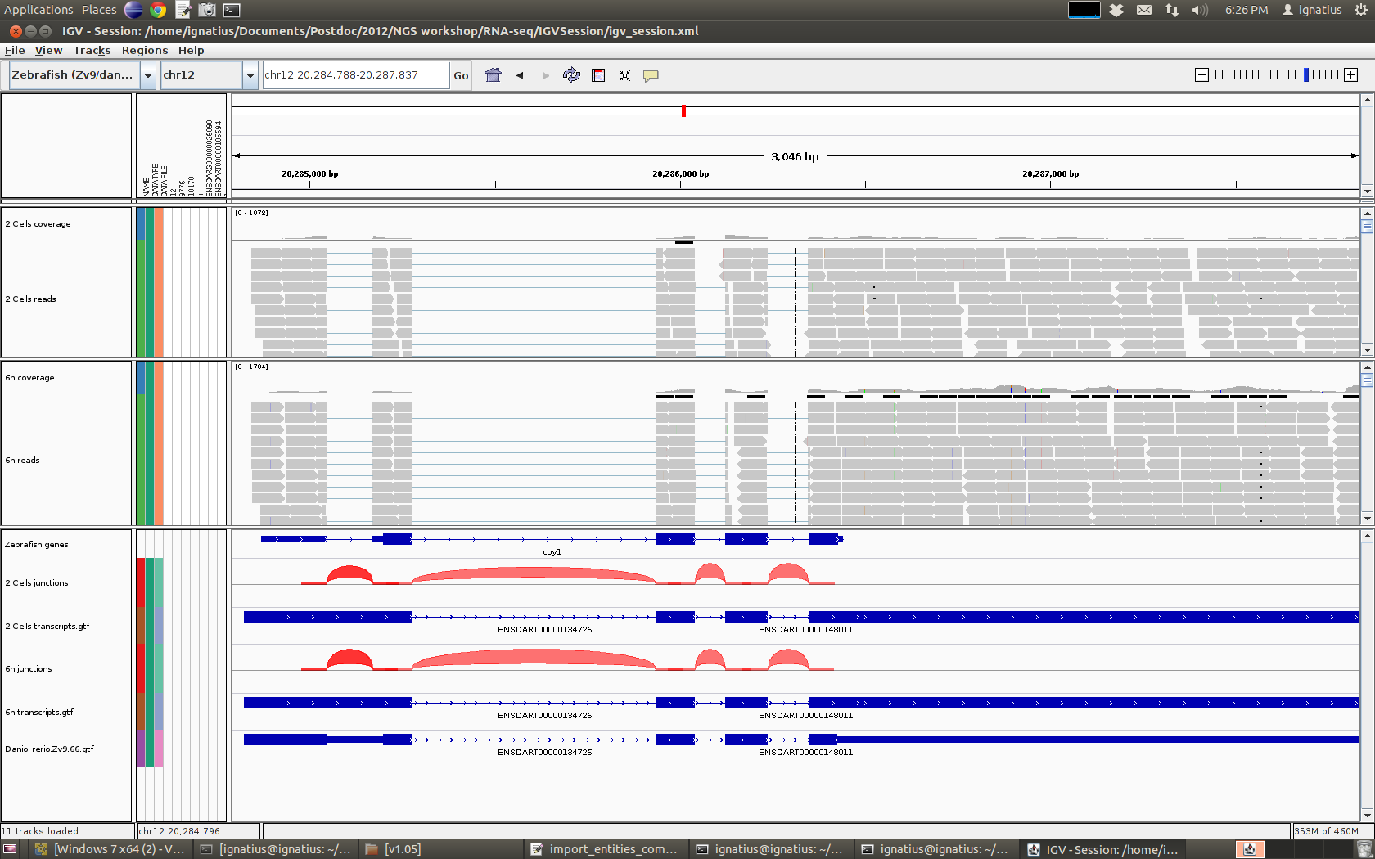
Integrative Genomics Viewer (IGV)
Peptide
Information / Mass spectrometry data
Data from EBI Next-Gen Sequencing Training Course
Notes:
1. Explain RNA-seq data
2. Explain alternative splicing
3. Why there could be errors, unknown, uncertainties

Slide 5
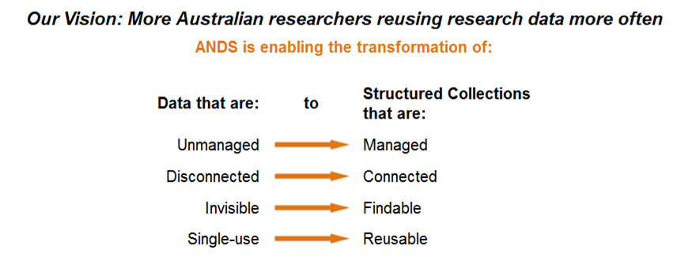

Why this collaborative project?
Funding from Australian National Data Service (ANDS)
Notes:
Data integration
Reuse of data
Software re-use

Slide 6
Our Responsibility to ANDS
Upload Metadata onto the Research Data Australia
Provide a Blog that describes the development of the Open Source software
Provide demonstration of values
All completed well before the deadline of 30 June 2013…

Slide 7
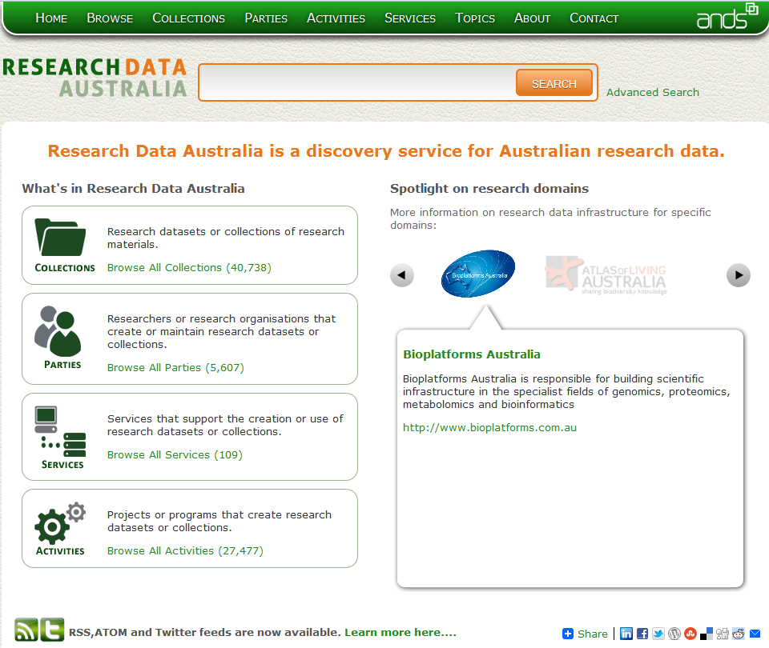
1. Upload Metadata onto the Research Data Australia

Slide 8
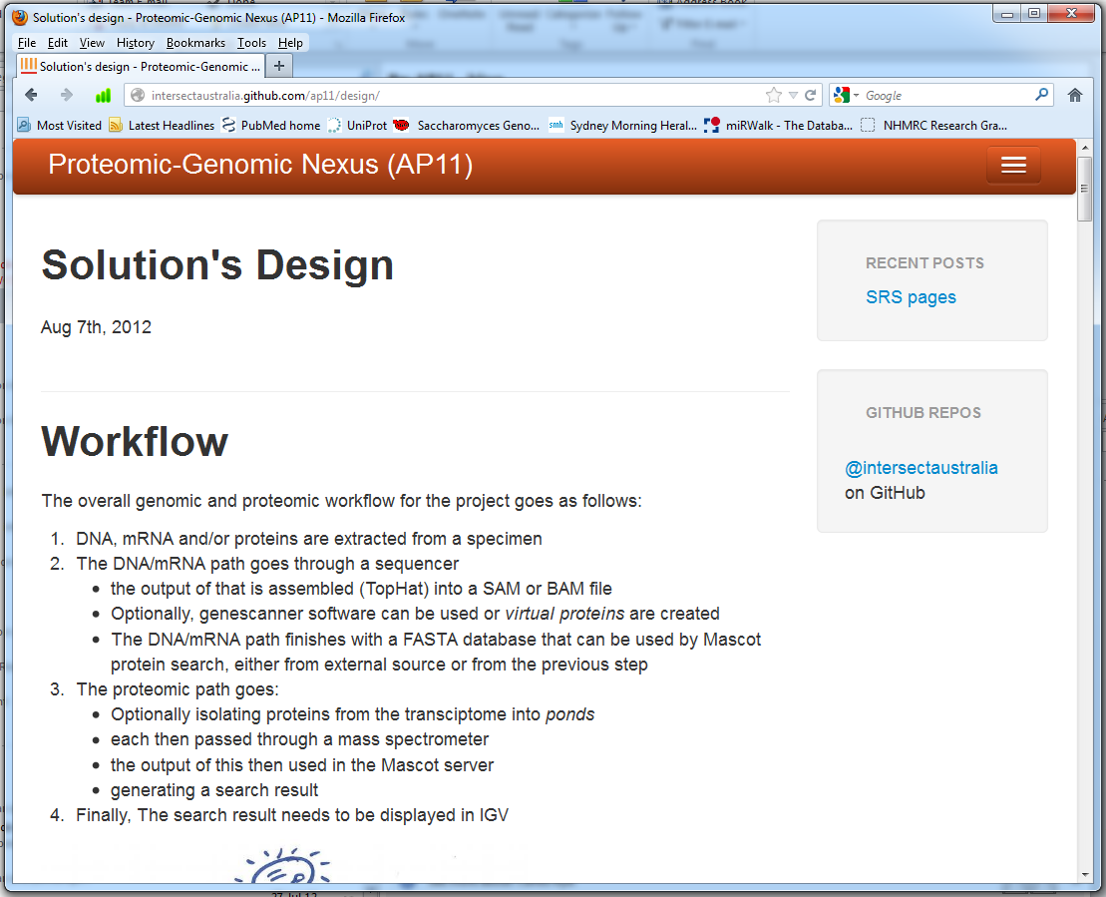
2. Project Development Blog
http://intersectaustralia.github.com/ap11/

Slide 9
3. Demonstration of Values
Genomics, Transcriptomics, and Proteomics data from three projects:
Campylobacter concisus
Prof. Hazel Mitchell, UNSW
Validate genes
Wine Yeast Project
Prof. Paul Chambers, AWRI
Validate 20 genes specific to wine yeast
Alternative start codons (?)
Mesenchymal stem cells data
Prof. Moustapha Kassem, Denmark
Validate alternatively spliced genes
Hey it is a useful tool! We can use it!
Notes:
at least four datasets

Slide 10


The Collaborative Team
ANDS
Funds Manager – Dr. Jeff Christiansen
UNSW
Project Leader – Prof. Marc Wilkins
Liaison – Igy Pang
Intersect
Project Manager - Georgina Edwards
Product Owner - Carlos Aya
Technical Leader - Sean McCarthy

Slide 11
What are the biological questions?
How do we validate the existence of genes using proteomics data?
Straight forward to do
How do we validate which alternatively spliced isoforms are translated into proteins?
Which exon is used?
Peptides which spans exon-exon junctions?

Slide 12
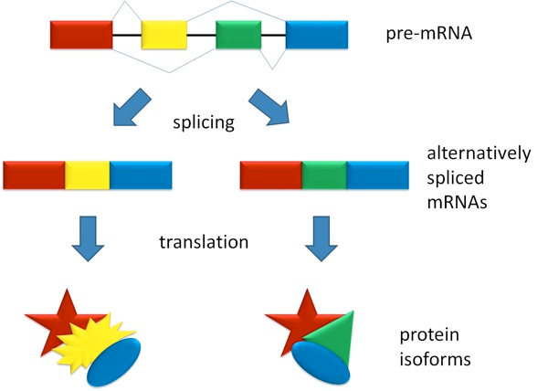
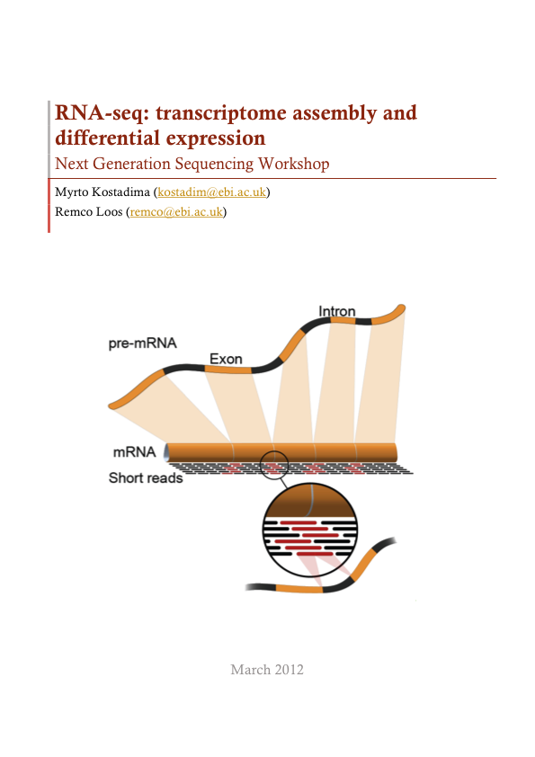
Alternative Splicing
DNA
transcription
Figure from Wikipedia.
Garber, M., et al. (2011), Nature Methods, 8(6), 469–477.

Slide 13
Spanning Peptides
Gene
1
2
3
4
mRNA isoform A
1
2
4
Peptides data A
Confirms the use of exon 1
Peptide spans exons 1 and 2
Peptide spans exons 2 and 4
mRNA isoform B
1
3
4
Peptides data B
Confirms the use of exon 1
Peptide spans exons 1 and 3
Peptide spans exons 3 and 4

Slide 14
What are the chance of finding exon-exon junction spanning peptides?
In mouse:
Average 2 to 4 unique junctions per gene
Average number of unique junctions identifiable by tryptic peptides per gene is 0.16 to 0.27
Requires the gene to have relatively high expression level
Problems with:
rare splice variants of a highly expressed gene
common variants of a low expression gene
Ning et al. 2010 BMC Bioinformatics, 11(Suppl 11):S14

Slide 15
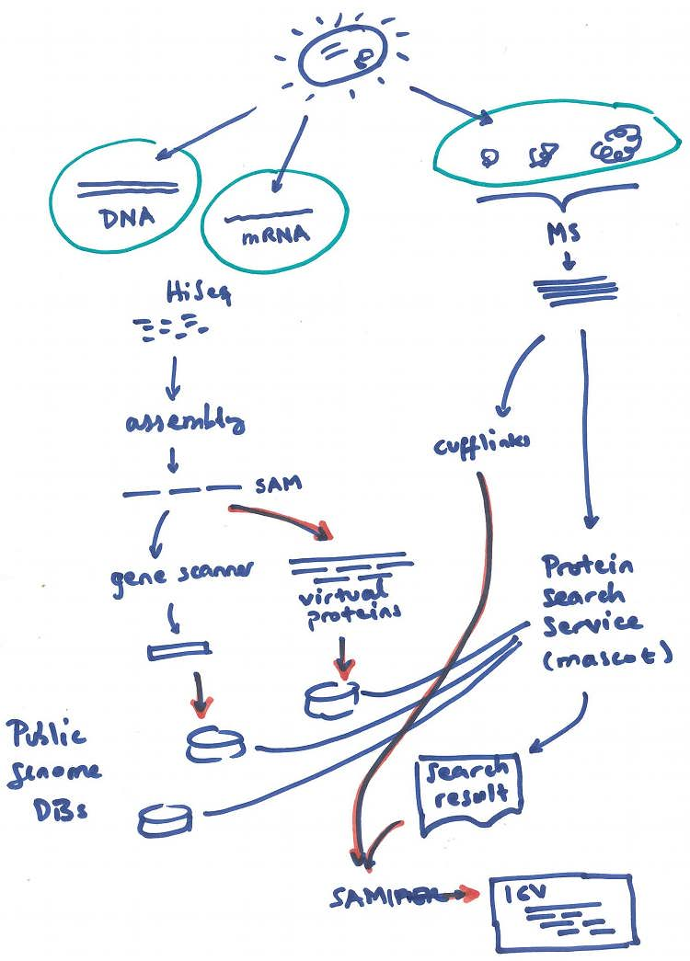
How do we solve the problems?

Slide 16
Project Outcomes
Primary software products
Mascot to SAM convert utility
Virtual protein generator
Simple collections advertiser

Slide 17
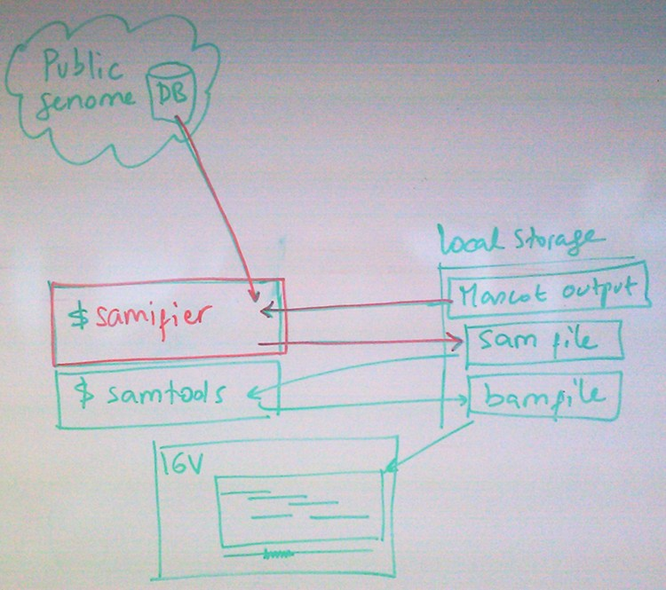
1. samifier
Command line tool
mzIdentML format
Notes:
The samifier - for lack of a better name - will convert the Mascot output to a SAM file, suitable for IGV or other genomic viewers. It will run from the researcher’s PC and interact with the local storage (hard drive or file server) to grab the mascot output and generate in said place the output. It may interact with remote protein databases if required.
The diagram below depicts this
As IGV is open sourced by LGPL, it has been discussed that the team may -once it gets more familiar with the concepts and IGV itself- implement into IGV a custom viewer that wont require the samifier.
samifier:
As researcher using the samifier, I want to be able to convert a Mascot result into a SAM file using an external genome/proteins database
As researcher using the samifier, I want to be able to use a custom genome/proteins database as generated by the VPG
As researcher using the samifier, I want to be able to customise the external genome/proteins database used by the tool
As researcher using the samifier, I want to be able to configure different strategies to deal with not-found proteins in said genome DB
As researcher using the samifier, I want to the tool to use the Unimod results to further describe relevance of fragments
As researcher using the samifier, I want to be able to use more peptide results to further describe relevance of fragments
As researcher using the samifier, I want to be able to save directly into BAM format to save space
As researcher using the samifier, I want to be able to read in the mzIdentML standard to be able to use other proteomic search engines
As researcher using the samifier, I want to use a simple GUI to provide parameters and monitor progress
As researcher using the samifier, I want to incorporate a cufflinks output into IGV in the SAM or in other format understood by IGV (.gtf?)
As researcher using the samifier, I want to be able to quickly identify split peptides when working with isotig inputs (mRNA)
Concatenate multiple results from Mascot (in mzIdentML format) and output them into one IGV result file
If time permits, the team may be able to approach the following…
As researcher using IGV, I want to be able to load and visualise mzIdentML results directly into IGV
As researcher using IGV, I want to be able to load and visualise MASCOT search results directly into IGV
As researcher using IGV, I want to be able to load and visualise cufflinks results directly into IGV
As researcher using IGV, I want to be able to load and visualise split peptides directly into IGV

Slide 18
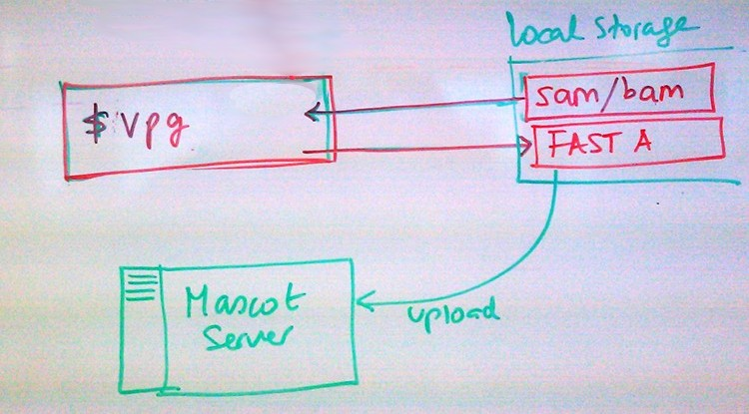
2. Virtual Protein Generator (vpg)
Notes:
The Virtual Protein Generator will run also in a local PC. As the above tool, it is expected main input and output will be to local storage, either hard drive or file server. It is not expected that it will interact with remote protein databases, at this stage. It is expected that the output, a FAST A file, will be uploaded into the Mascot search engine. The diagram below illustrates this.
VPG:
As researcher using VPG, I want to be able to use a DNA assembly file to generate a virtual protein file with certain lengths
As researcher using VPG, I want to be able to use a mRNA assembly file to generate a virtual protein file with certain lengths
As researcher using VPG, I want to be able to retrofit a MASCOT search result to improve DNA partition based on known genome
As researcher using VPG, I want to be able to retrofit a MASCOT search result to improve mRNA partition based on known genome
As researcher using VPG, I want to be able to retrofit a MASCOT search result to improve DNA partition based on threshold parameters
As researcher using VPG, I want to be able to retrofit a MASCOT search result to improve mRNA partition based on threshold parameters
As researcher using VPG, I want to be able to feed and retrofit MASCOT search engine automatically for a number of iterations
As researcher using VPG, I want to be able to feed and retrofit MASCOT search engine automatically until an average threshold is obtained
As researcher using VPG, I want to be able to feed and retrofit MASCOT search engine automatically using a stochastic approach method
As researcher using VPG, I want to be able to feed and retrofit MASCOT search engine automatically using configurable stochastic method

Slide 19
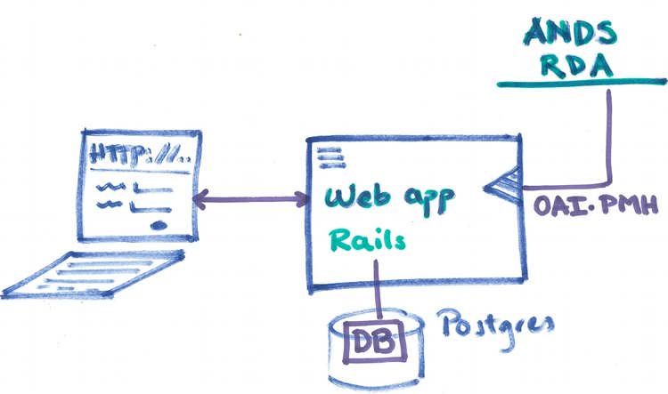
3. Advertiser Web App
Advertise datasets online
Hosted on NECTAR cloud (?)
Notes:
This will be a Rails web application, hosted in suitable server (doesn’t need top-end requirements), that will (a) allow researchers to create experiments and collections, (b) publish them to RDA, (c) offer an OAI-PMH end point to ANDS. Although the database access will be vendor-agnostic, it is expected that data will be hosted in a Postgres DB. The following picture shows the overall architecture of this component.
Web app
As researcher, I want to be able to request access to the system
As researcher, I want to be able to login into the system with username and password
As researcher, I want to be able to recover access if forgot my password
As researcher, I want to be able to create a new experiment Nexus experiment
As researcher, I want to be able to add a local input collection to an experiment
As researcher, I want to be able to add a remote input collection to an experiment
As researcher, I want to be able to edit an input collection in an experiment
As researcher, I want to be able to delete an input collection from an experiment
As researcher, I want to be able to describe the output collection from an experiment
As researcher, I want to be able to review what’s going to be published for my colelctions
As researcher, I want to be able to publish/advertise collections in a given experiment
As researcher, I want to be able to describe myself to ANDS via my own record in the system
As researcher, I want to be able to de-advertise an experiment
As researcher, I want to be able to delete an experiment from the system
As researcher, I want to be able to upload/store the outputs into the system so others can download it
As researcher, I want to be able to give editing access to others to my experiments
As researcher, I want to be able to revoke access to others to my experiments
As administrator, I want to be able to accept access requests
As administrator, I want to be able to revoke access requests
As administrator, I want to be able to block access requests for an email
As administrator, I want to be able cancel or block access to existing accounts
As administrator, I want to be able change role for an existing account
As administrator, I want to be able cancel or block access to existing accounts
As administrator, I want to be able to confirm a publication request
As administrator, I want to be able to reject a publication request
As administrator, I want to be able to grant access to a user to someone else’s experiment
As general public, I want to be able to download a ZIP file containing experiment output
As ANDS, I want to be able to harvest the repository using OAI-PMH protocol

Slide 20
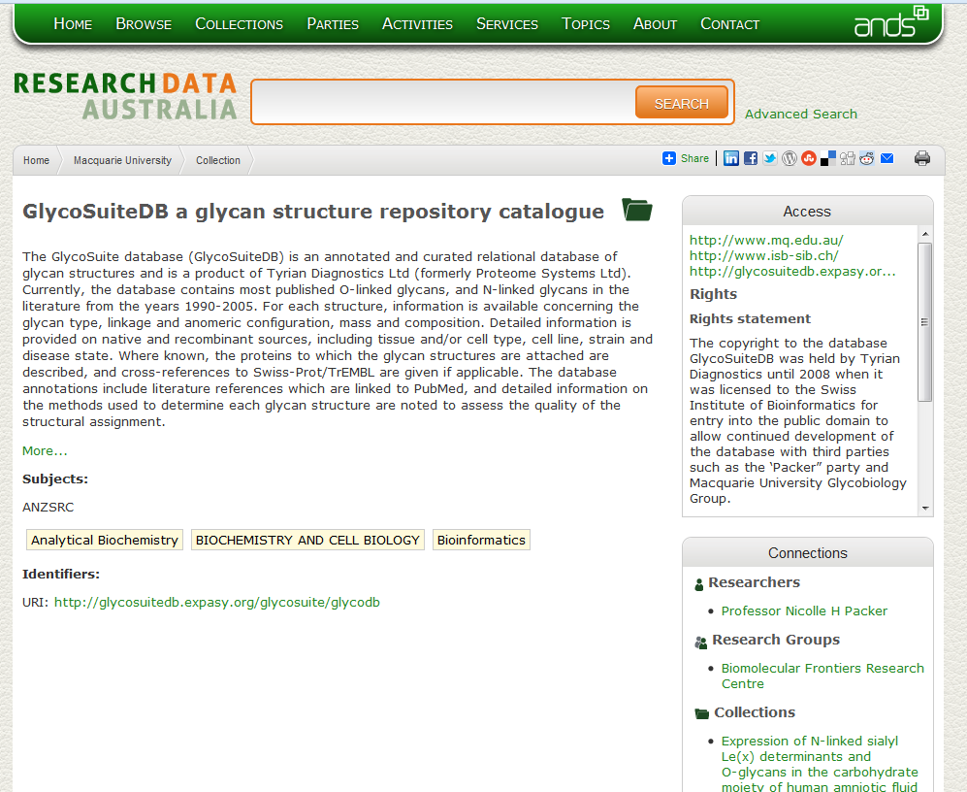
Metadata – how does it work?
Notes:
Sample Collections
Implications – NCBI, Ensembl,
Other research field may not have enjoyed these kind of open access initiative.
Marc made a good point – as data generation becomes cheaper and volume is high, we might actually need this model
Advertising

Slide 21


Research Meta-data Diagram
Researcher
Has Association With
Ramaciotti
Proteomics- Genomics Nexus
Is Managed By
Has Collector
Is Managed by
SBI
Is Produced By
Is Derived From
Genomics data
Output
Is Derived From
Is Operated On By
Public Repository
(e.g. NCBI, GEO, PRIDE)
Transcriptomics data
Is Derived From
Key
Proteomics data
Party
Service
Species Information
Collections

Slide 22
Food for thought?
Summary statistics for evidence of exons and spanning peptides
Using IGV to visualize:
Post-translational modifications
Amino acid substitutions / non-synonymous SNPs
Relative peptide intensities in SILAC-labeled experiments
Compare sequences from multiple genomes (?)

Slide 23
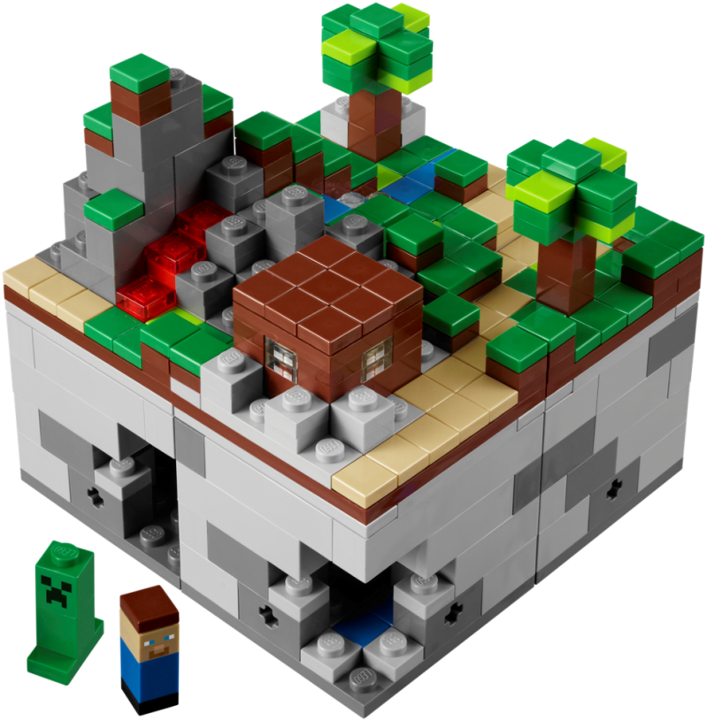
Acknowledgements
UNSW
Prof. Marc Wilkins
Dr. Nandan Deshpande
Dr. Zhiliang Chen
Natalie Twine
Simone Li
Intersect
Georgina Edwards
Carlos Aya
Sean McCarthy
Australian National Data Service
Dr. Jeff Christiansen
Image from: http://legocuusoo.posterous.com/announcing-lego-minecraft-micro-world-the-thi

Slide 25
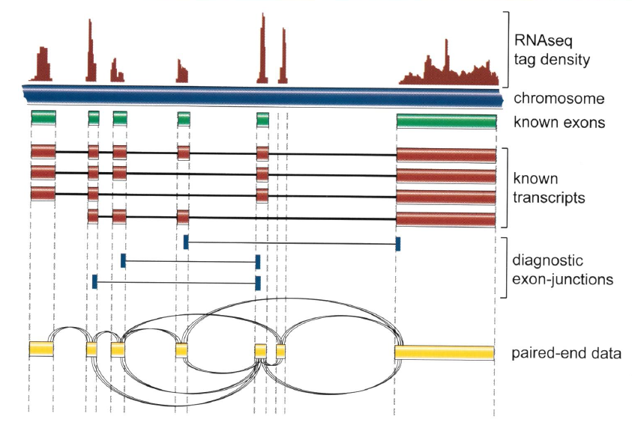
Alternative Splicing
Peptide data
Cloonan et al. (2010) Australian Biochemist. p14-17.

Slide 26
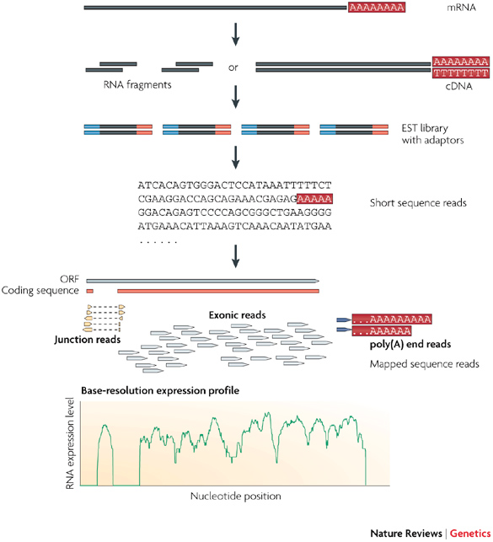
RNA-seq workflow
Library Preparation
Sequencing
Bioinformatics Analysis
Step1
Step2
Step3
Image adapted from: Wang, Z., et al. (2009), Nature Reviews Genetics, 10, 57–63.

