Slide 1
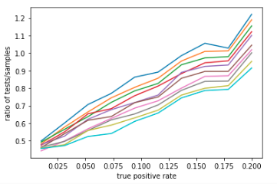
fixed false positive rate = 0.2
false negative rates from
0.01 to 0.2

Slide 2
