Slide 1
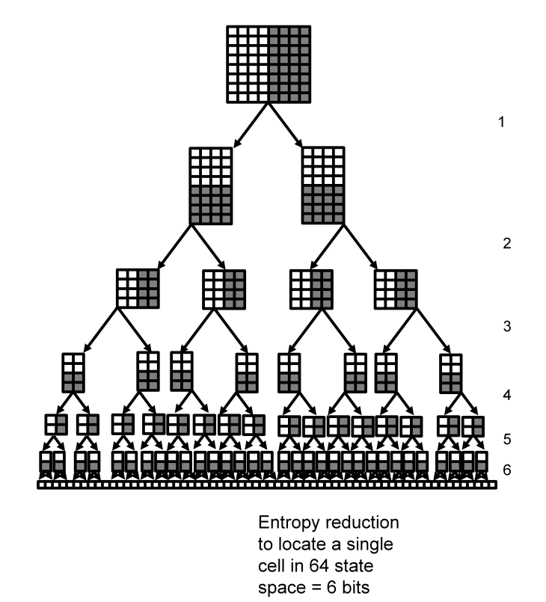

Slide 2
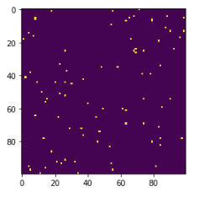
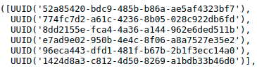

Slide 3
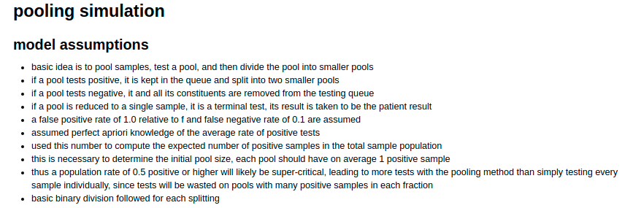
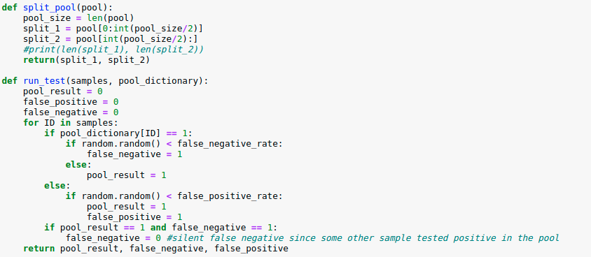

Slide 4
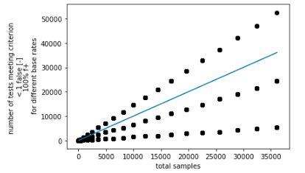
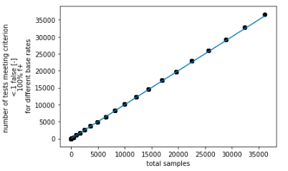

Slide 5
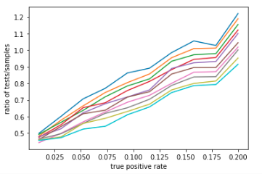
fixed false positive rate = 0.2
false negative rates from
0.01 to 0.2

Slide 6
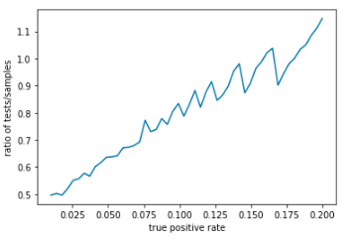

Slide 7
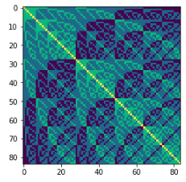

Slide 9
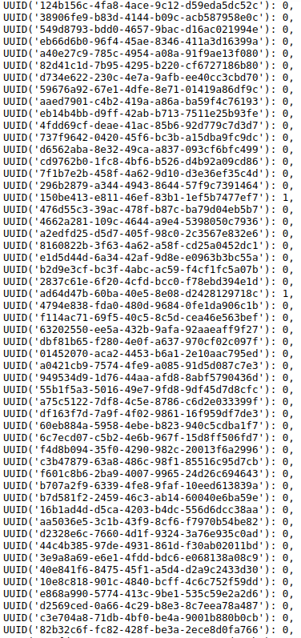

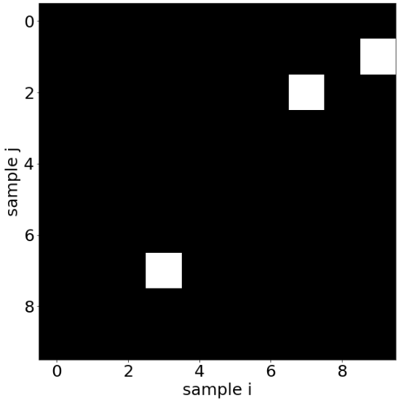

Slide 10
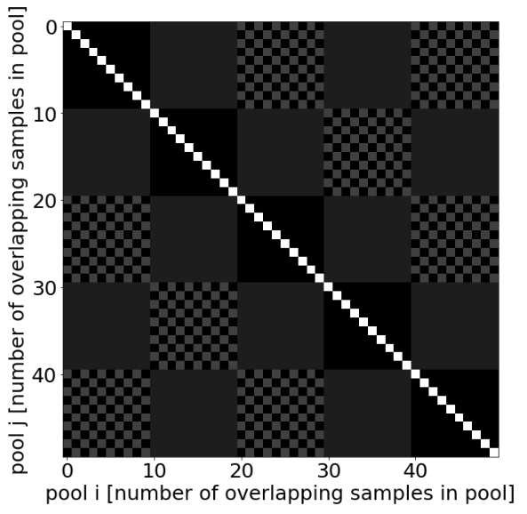

Slide 11
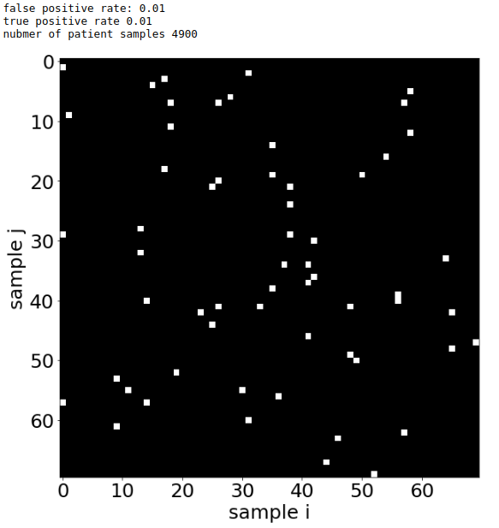
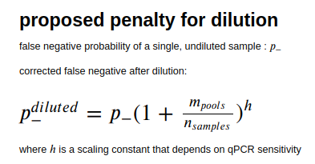
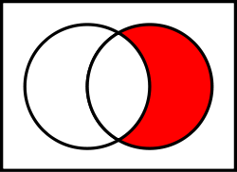
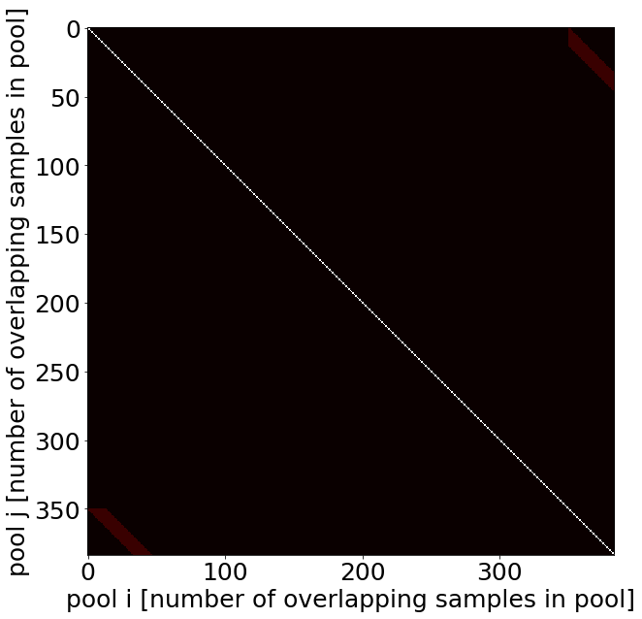
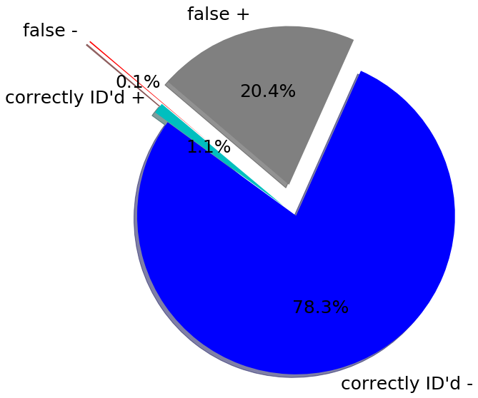
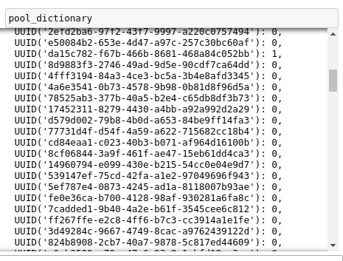
minimal ~1x coverage, 5000 samples per plate
positive samples
minimum pool size for non-overlapping but complete sample coverage 12.760416666666666
target size: 13
final pool size considering even division of chapters 14
first chapter of pools: 350
number of pools: 384
pool size: 14
dilution-dependent false negative rate 0.11985058256974526
negative pools
positive pools
false pos/ neg sample 0.20698202850650693
false neg/pos sample 0.1016949152542373
fold efficiency: 12.760416666666666 samples/test
coverage (redundancy): pools*size / samples: 1.0971428571428572 x
correctly identified rate 0.7942857142857143 correct results/sample

Slide 12
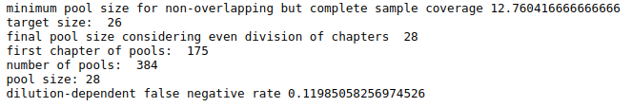
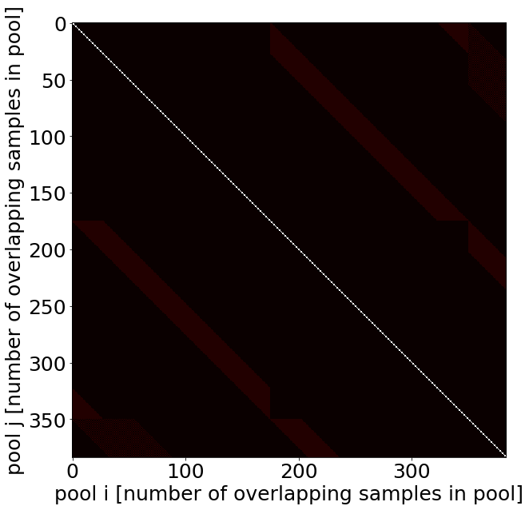
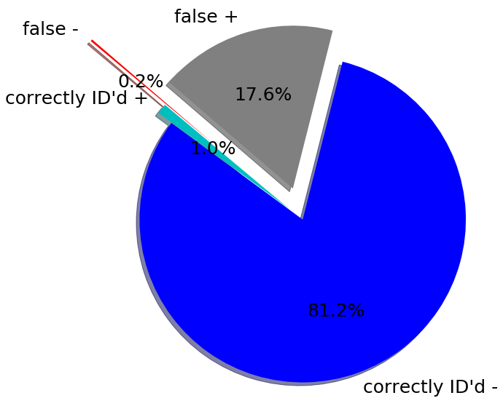
modest ~2x coverage, 5000 samples per plate
positive samples
negative pools
positive pools
false pos/ neg sample 0.17826895269572401
false neg/pos sample 0.1694915254237288
fold efficiency: 12.760416666666666 samples/test
coverage (redundancy): pools*size / samples: 2.1942857142857144 x
correctly identified rate 0.8218367346938775 correct results/sample

Slide 13
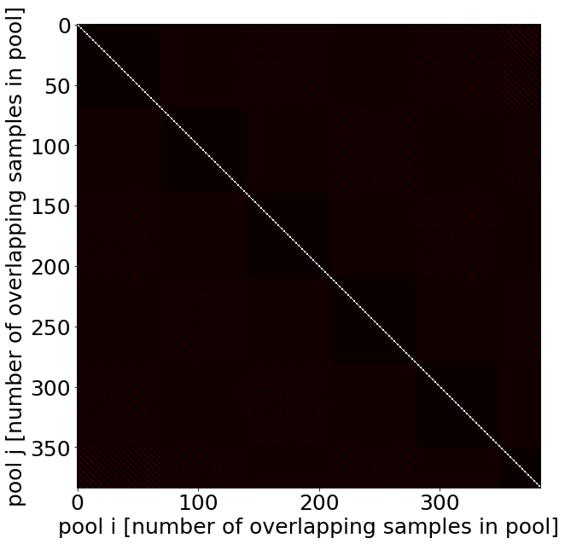
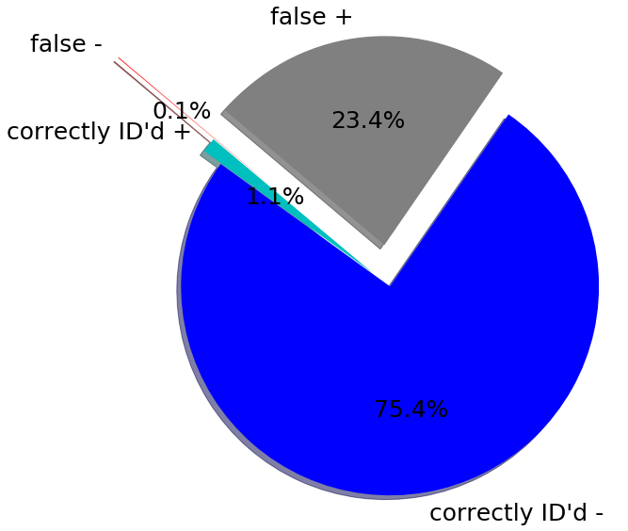
modest ~5x coverage, 5000 samples per plate
positive samples
minimum pool size for non-overlapping but complete sample coverage 12.760416666666666
target size: 65
final pool size considering even division of chapters 70
first chapter of pools: 70
number of pools: 384
pool size: 70
dilution-dependent false negative rate 0.11985058256974526
negative pools
positive pools
false pos/ neg sample 0.17826895269572401
false neg/pos sample 0.1694915254237288
fold efficiency: 12.760416666666666 samples/test
coverage (redundancy): pools*size / samples: 2.1942857142857144 x
correctly identified rate 0.8218367346938775 correct results/sample

Slide 14
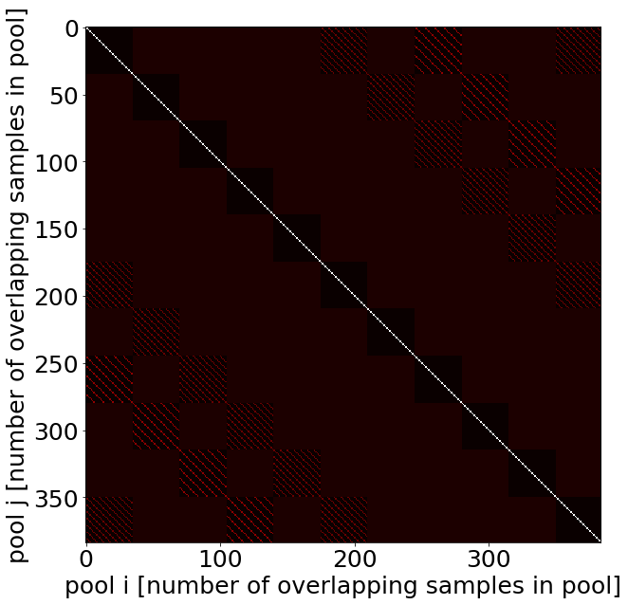
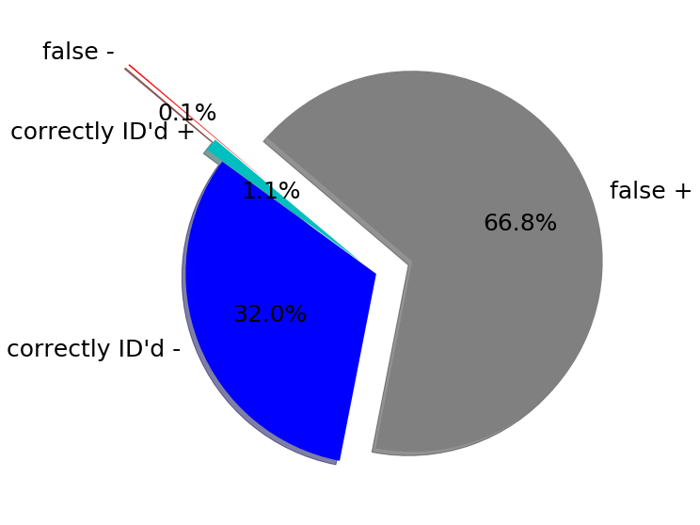
high ~10x coverage, 5000 samples per plate
positive samples
minimum pool size for non-overlapping but complete sample coverage 12.760416666666666
target size: 130
final pool size considering even division of chapters 140
first chapter of pools: 35
number of pools: 384
pool size: 140
dilution-dependent false negative rate 0.11985058256974526
negative pools
positive pools
false pos/ neg sample 0.20698202850650693
false neg/pos sample 0.1016949152542373
fold efficiency: 12.760416666666666 samples/test
coverage (redundancy): pools*size / samples: 1.0971428571428572 x
correctly identified rate 0.7942857142857143 correct results/sample

