Slide 1

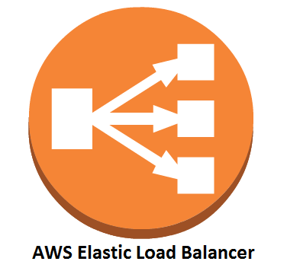



Elastic Beanstalk
EC2 Instance
Web Application

