Slide 1
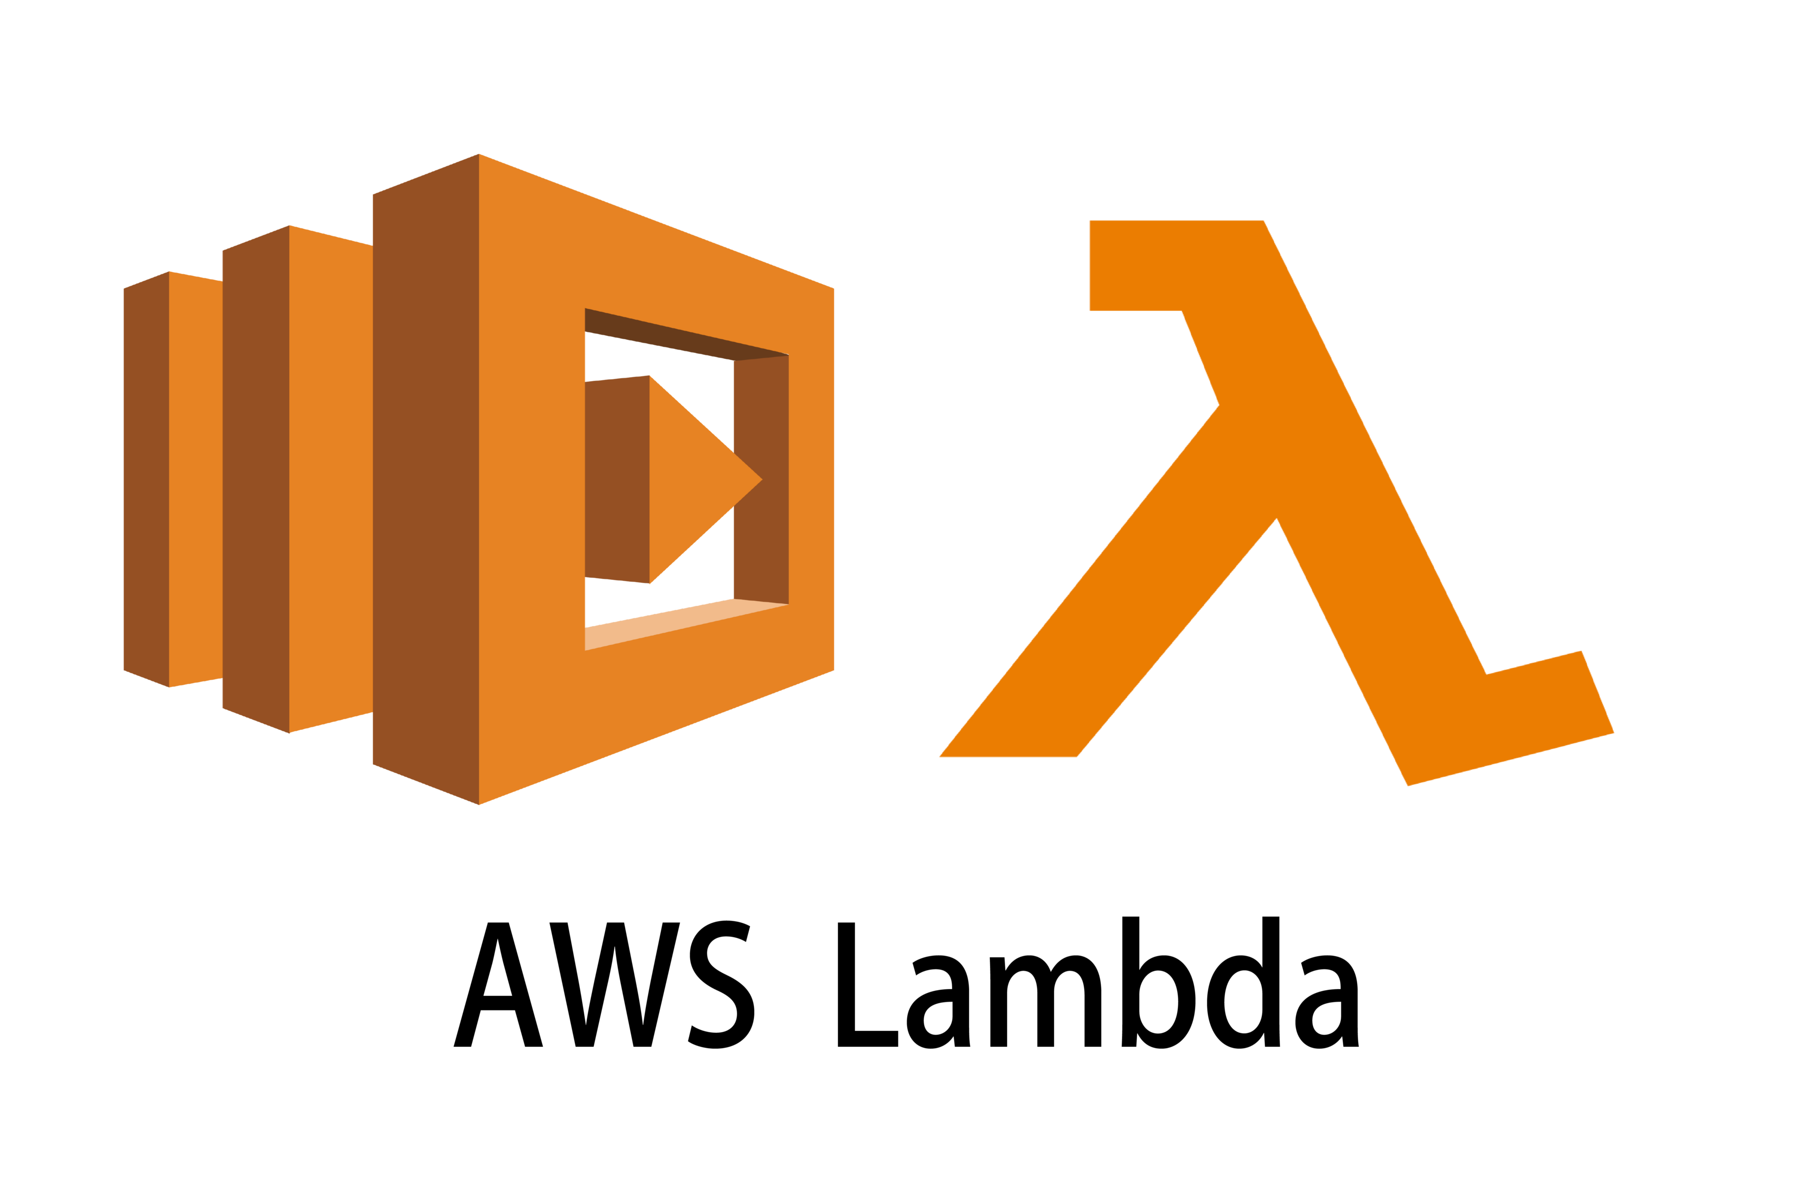
Serverless Architecture

Slide 2
Advantages :
Zero Server Management
Flexible Scaling
No Idle Capacity ( Pricing is pay-as-you-go )

Slide 3
AWS Lambda -> Serverless Programming
AWS Lambda is a serverless computing service provided by Amazon to reduce the configuration of servers, OS
AWS Lambda lets you run code without provisioning or managing servers—it scales automatically and only charges for the time your code is running

Slide 4
Where to use
When you want to expose a web endpoint, a stream processor, or a task to cloud without depending on server and OS
Reference : Spring Cloud Function

