Slide 1
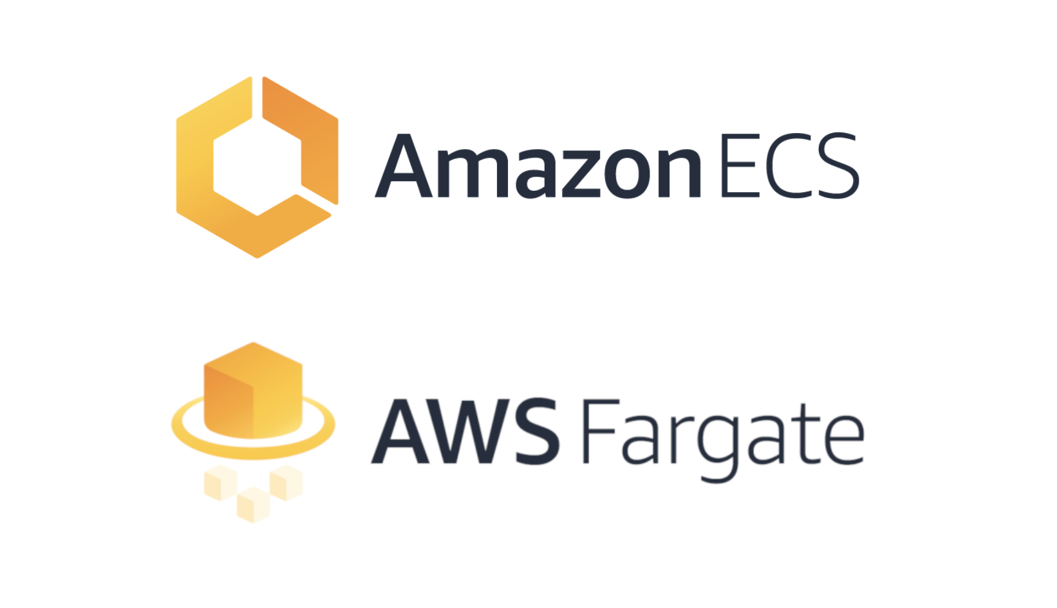

Slide 2
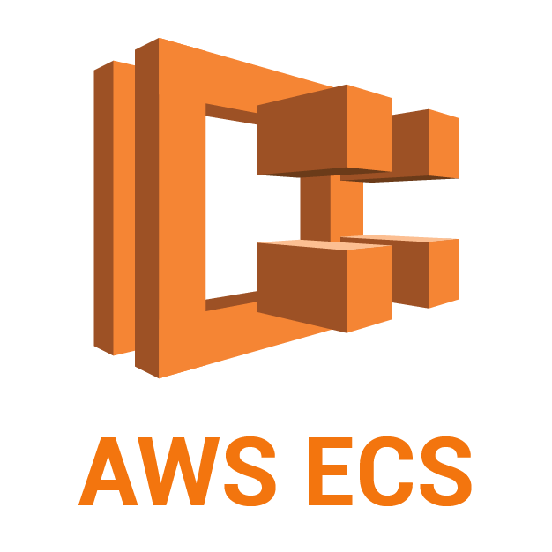
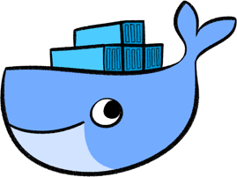
ECS
Amazon Elastic Container Service
ECS is a fully managed container orchestration service
ECS

Slide 3

AWS Fargate
AWS Fargate is a serverless compute engine for containers that works with ECS & it allow you to run containers without having provision , configure & Scaling.
Eliminate the need of EC2 instance .

Slide 4
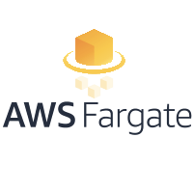



AWS Codebuild

