Slide 1

Microservice Centralize Logging

Slide 2

What is ELK ?

Slide 3



Elasticsearch is a NoSQL database that is based on the Lucene search engine which will helps us to store inputs/logs
Logstash is a log pipeline tool that accepts inputs/logs from various sources, & exports the data to various targets
Kibana is a visualization UI layer , which will helps developer to monitor application logs

Slide 4
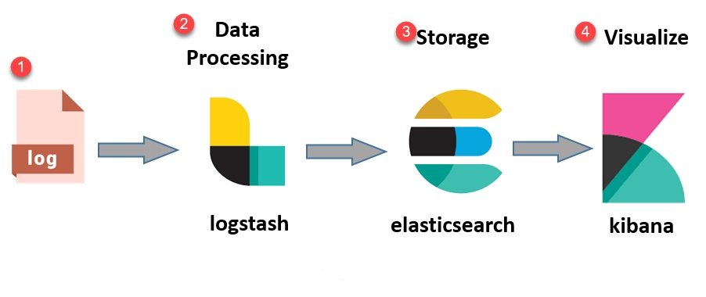

Slide 5





