Slide 1
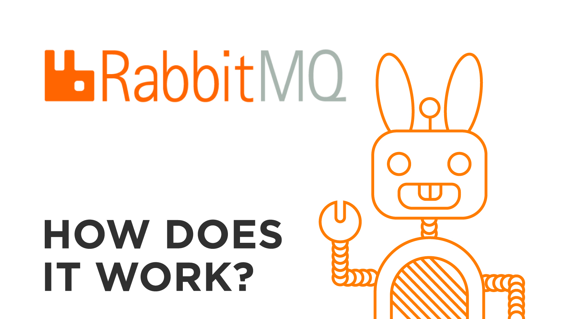

Slide 2
What is RabbitMQ ?
RabbitMQ is a message broker that originally implements the Advance Message Queuing Protocol (AMQP)
AMQP standardizes messaging using Producers, Broker and Consumers.
AMQP standards was designed with the following main characteristics
Security, Reliability, Interoperability

Slide 3
Key Features :
Security —support authentication, authorization, LDAP, and TLS via RabbitMQ plugins.
Reliability — confirms the message was successfully delivered to the message broker and confirms that the message was successfully processed by the consumer
Interoperability — message is transfer as stream of bytes so any clients can operate on it irrespective of any languages.

Slide 4
Routing Key
Message
Queue
Consumer
Message
Routing Key
Message
Producer
Exchange
Queue
Consumer
Routing Key
Message
Queue
Consumer

