Slide 1

How Spring Security Works !

Slide 2
Security Flow !
Request
Filter
Authenticate
Client
Server

Slide 3
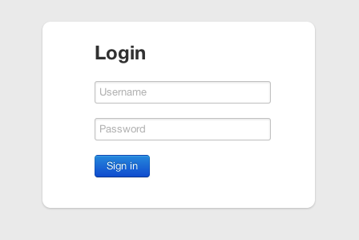
DelegatingFilterProxy
Username & Password
Convert(Request)
Authentication

Slide 4
Authentication
Manager
Authentication
Provider
Filter
authenticate(Authentication auth)
false
Authentication
Provider
Manager
Authentication
Provider
false
true
Authentication
Authentication
Authentication
Provider
UserDetails
service
SecurityContextHolder.getContext().setAuthentication(authentication);
UserDetails

