Slide 1
Post COVID-19 NYC Taxi Industry
Immanuel Augustine, Haolin Chen, Yifei Gu, Xiang Lin, Michael Suare

Slide 2
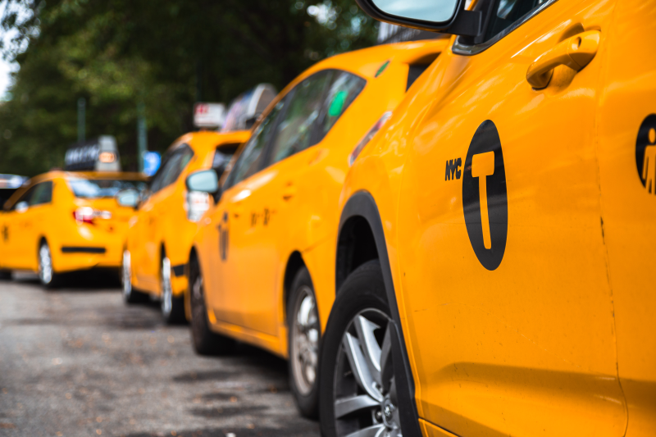
https://github.com/iaugustine/CIS9650TaxiAnalysis

Slide 3
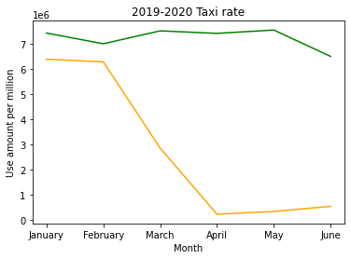
Coming Into 2020
January 21, 2020 | First confirmed COVID-19 case in the U.S.
January 30, 2020 | The W.H.O. declares a global health emergency
March 1, 2020 | First COVID-19 case in New York State
March 7, 2020 | NY Governor Andrew Cuomo declares a state of emergency
March 13, 2020 | President Trump declares a national emergency
June 8, 2020 | NYC begins Phase 1 reopening

Slide 4




Factors
Weather/Temperature
Location
Time of the Day
Payment Method

Slide 5
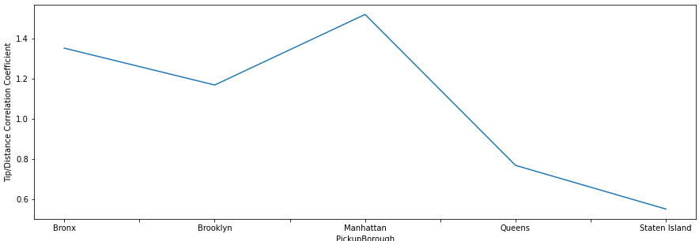
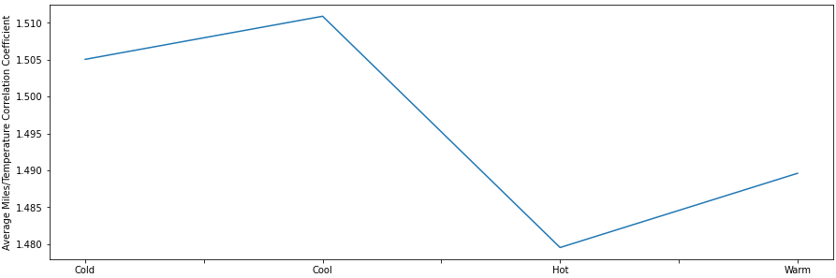
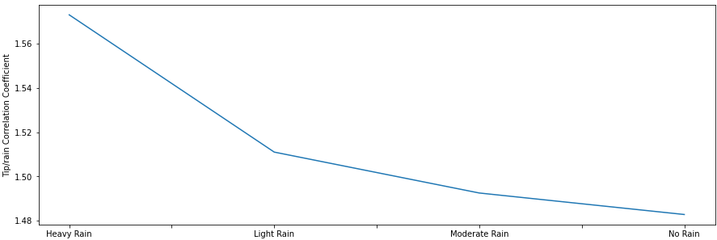
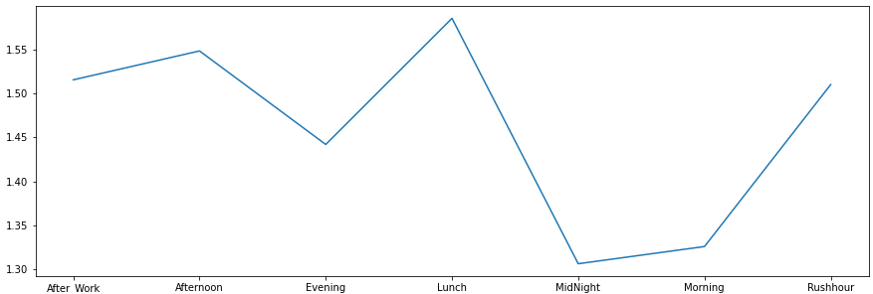
Insight 1: Major Factors Affecting Tip
Hot (77 degrees +), Warm (65 - 77 degrees), Cool (50 to 65 degrees), Cold (50 degrees -)

Slide 6

Insight 2: What to do if you want to stay within your Boroughs?
Avoid Staten Island
Brooklyn Money
Unlimited Pickups

Slide 7
Surprises?
Manhattan isn’t the most expensive
Plenty of JFK to LaGuardia taxis. Maybe a lot of people go to the wrong airport.
No Cash Tips Reported
Notes:
Manhattan isn’t the most expensive
Plenty of JFK to LaGuardia taxis. Maybe a lot of people go to the wrong airport.
No Cash Tips are Reported, the taxi drivers are pocketing cash so tips are not taxed

Slide 8
Feature Engineering & Model
For Feature engineering, we added multiple calculated fields which expanded the dataset from 20 columns to 48.
After analysis, we selected the 8 most important features to apply to a linear regression model.
Major issues for data modelling was out of range data and outliers.
Used streamlit to create a Taxi Price prediction application

Slide 9
Q&A

