Slide 1
Test Slide Deck
Cars and the time they take to stop
2025-04-23
Daniel Kaschek, IntiQuan

Slide 2
Plain Slides

Slide 3
Just a test
Cars data set from R datasets
The data vie the speed of cars and distances taken to stop shown as plot
script_IQSlidedeck.R | Date: 2025-04-23 16:52:01.844054

Slide 4
Slides with plots

Slide 5
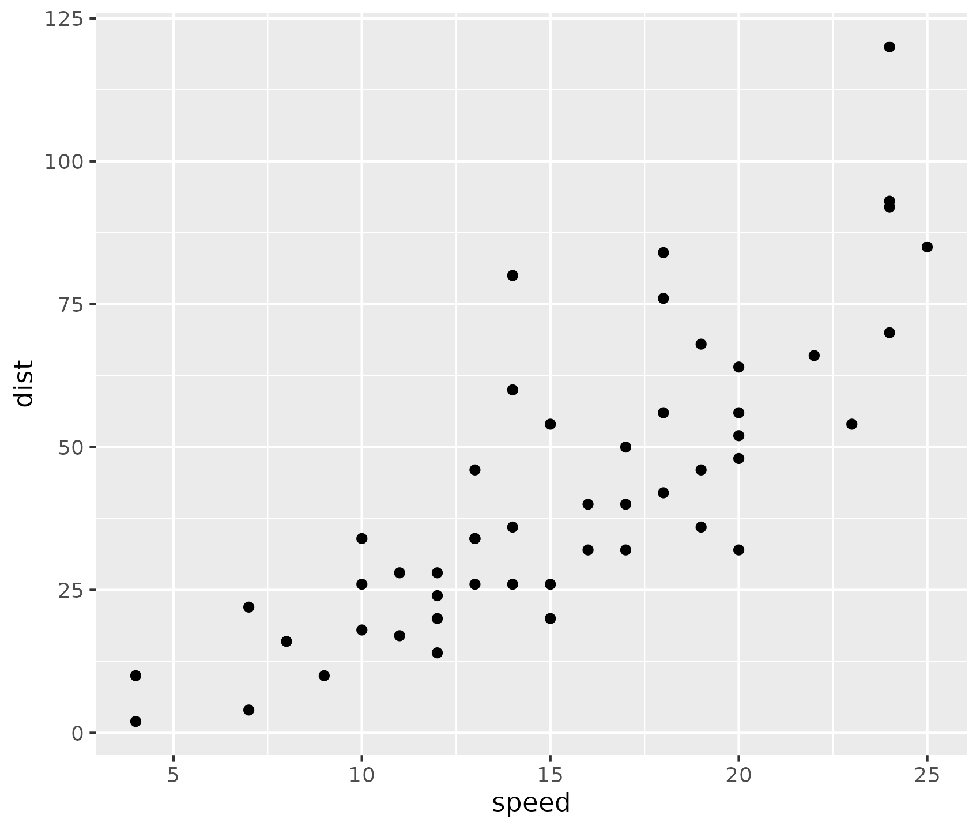
Overview of cars distance vs time to stop
Cars data set from R datasets
The data vie the speed of cars and distances taken to stop shown as plot
Source: Ezekiel, M. (1930) Methods of Correlation Analysis. Wiley.
script_IQSlidedeck.R | Date: 2025-04-23 16:52:02.007061

Slide 6
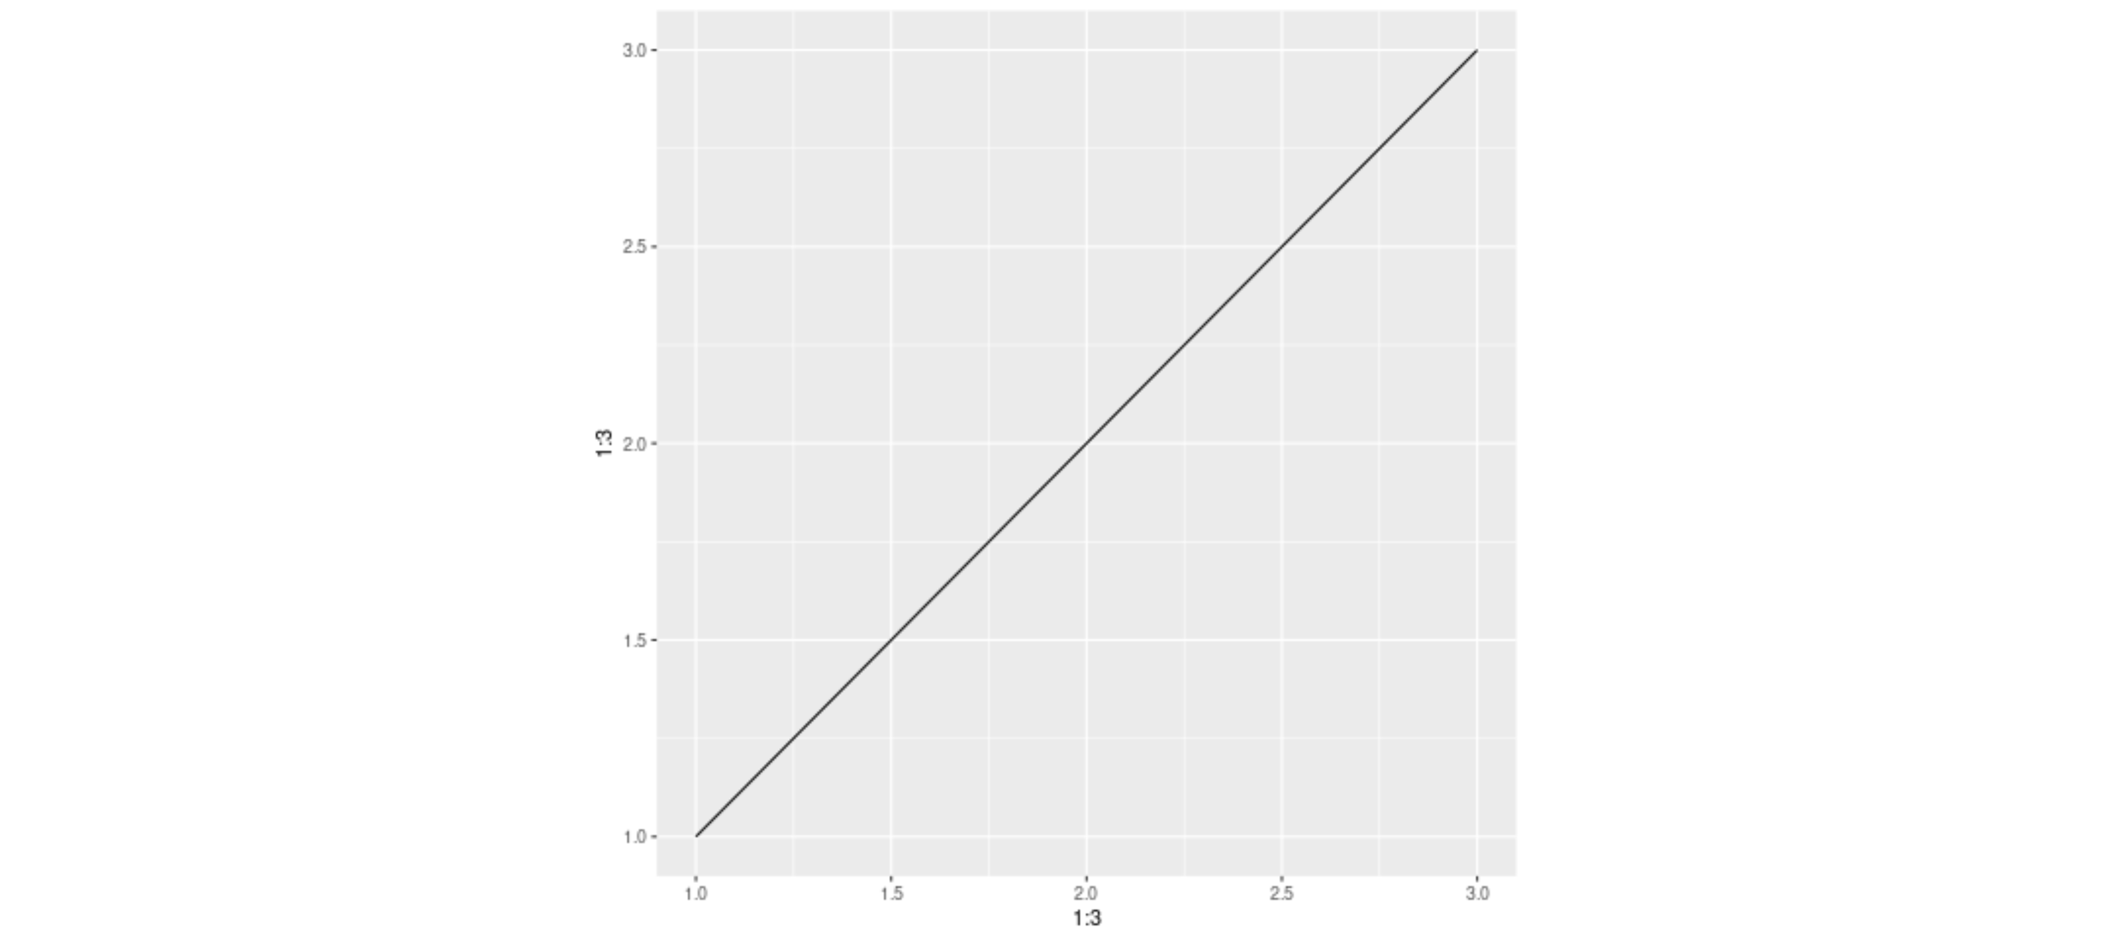
Plot from png file
script_IQSlidedeck.R | Date: 2025-04-23 16:52:05.054469

Slide 7

Plot from pdf file
script_IQSlidedeck.R | Date: 2025-04-23 16:52:06.064167

Slide 8
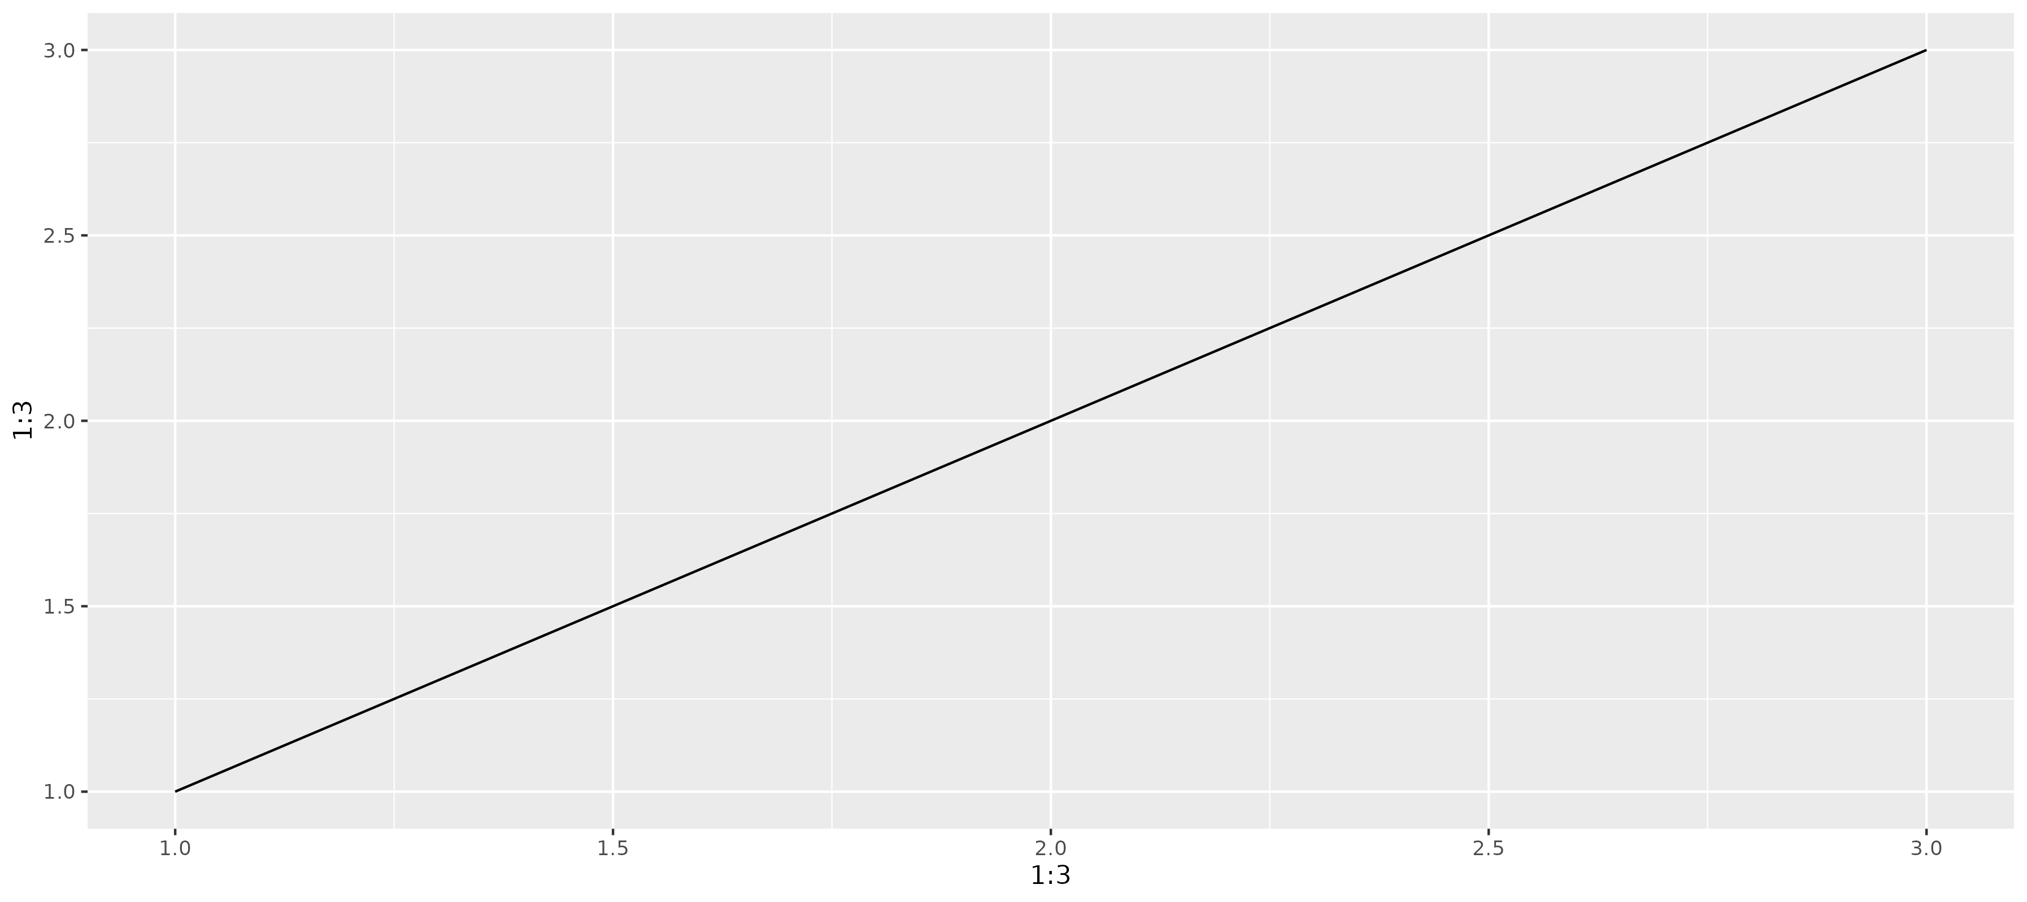
Plot from ggplot object
script_IQSlidedeck.R | Date: 2025-04-23 16:52:11.532092

Slide 9
Slides with tables

Slide 10
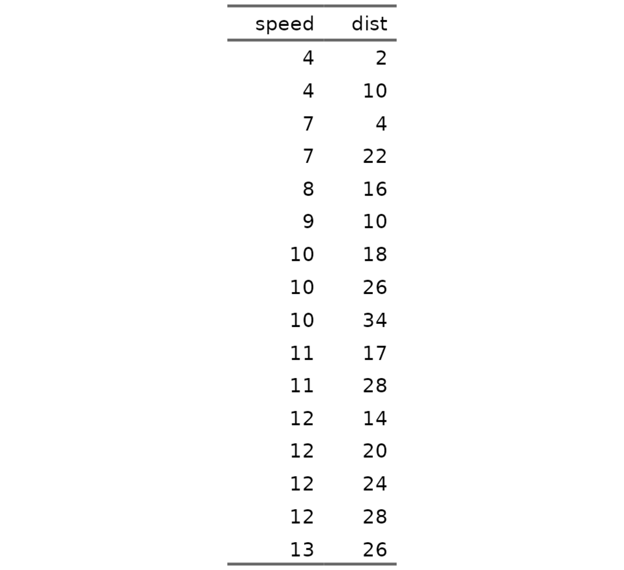
Overview of cars distance vs time to stop shown as table
Cars data set from R datasets
The data vie the speed of cars and distances taken to stop
script_IQSlidedeck.R | Date: 2025-04-23 16:52:02.697434

Slide 11
Overview of cars distance vs time to stop shown as table
Bullet point with bold and italic
Another bullet point
Indented by two spaces
Another one
And back to really outer level
Some sort of formula E_{rel} = m*c²
script_IQSlidedeck.R | Date: 2025-04-23 16:52:03.538924

Slide 12
Overview of cars distance vs time to stop shown as table
Bullet point with bold and italic
Another bullet point
Indented by two spaces
Another one
And back to really outer level
Some sort of formula E_{rel} = m*c²
script_IQSlidedeck.R | Date: 2025-04-23 16:52:04.421185

Slide 13
Layouts

Slide 14
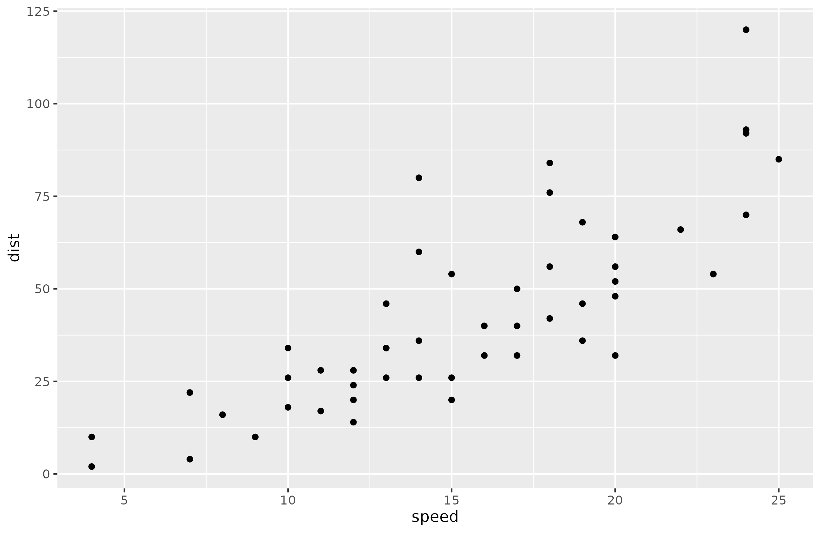
Two Content Right Bigger
Cars data set from R datasets
The data vie the speed of cars and distances taken to stop
script_IQSlidedeck.R | Date: 2025-04-23 16:52:11.97824

Slide 15
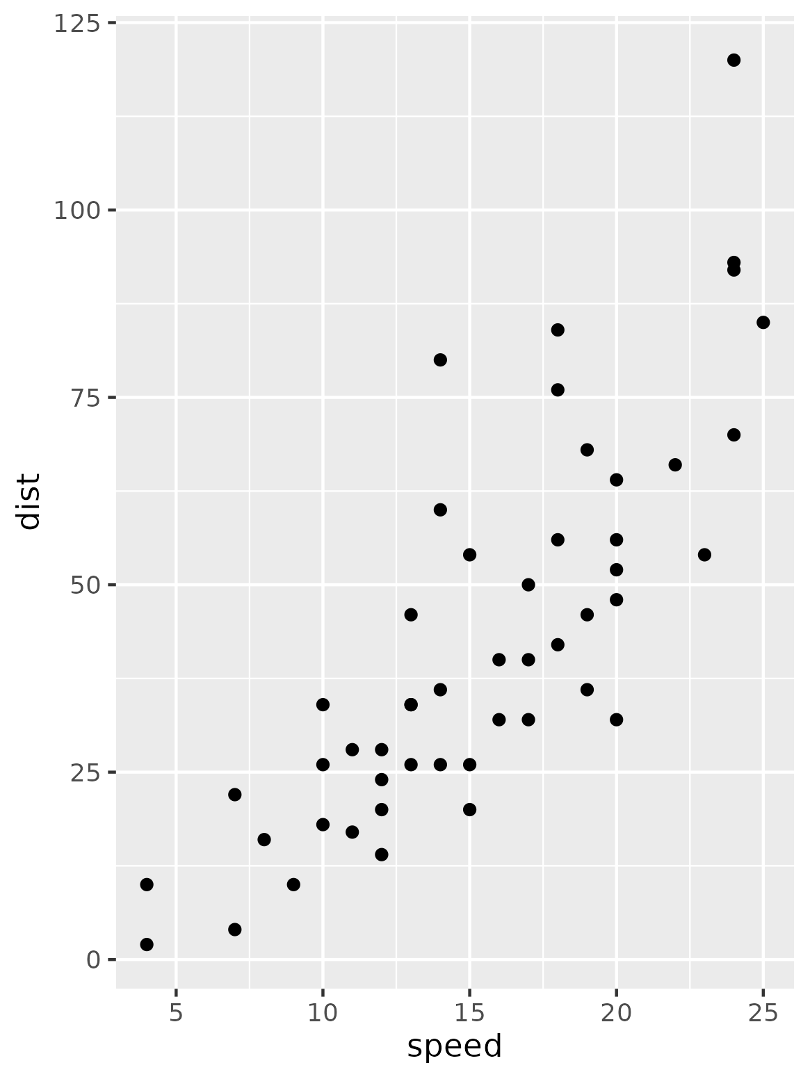
Two Content Right Bigger
script_IQSlidedeck.R | Date: 2025-04-23 16:52:12.011498

Slide 16
Two Content Right Bigger
Cars data set from R datasets
The data vie the speed of cars and distances taken to stop
script_IQSlidedeck.R | Date: 2025-04-23 16:52:12.04445

Slide 17
Two Content Right Bigger
Cars data set from R datasets
The data vie the speed of cars and distances taken to stop
script_IQSlidedeck.R | Date: 2025-04-23 16:52:12.077639

