Slide 1
My first slidedeck with IQSlides
Exploration of mtcars data Anne Kuemmel, IntiQuan 2020-02-23

Slide 2
Introduction

Slide 3
This slide contains bullet list
Bullet point with bold and italic
Another bullet point
Indented by two spaces
Another one
And back to really outer level
Some sort of formula E_{rel} = m*c²

Slide 4
Tables

Slide 5
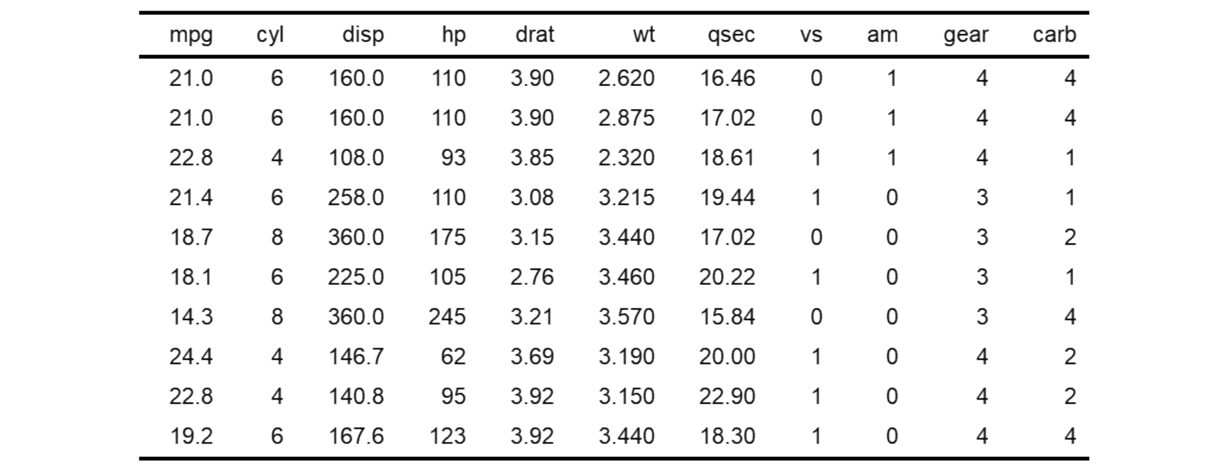
Snapshot of mtcars data
Source: Henderson and Velleman (1981), Building multiple regression models interactively. Biometrics, 37, 391–411.

Slide 6
Snapshot of mtcars data (IQRoutputTable)
Source: Henderson and Velleman (1981), Building multiple regression models interactively. Biometrics, 37, 391–411. File: Output/mtcars_snapshot.txt

Slide 7
Figures

Slide 8
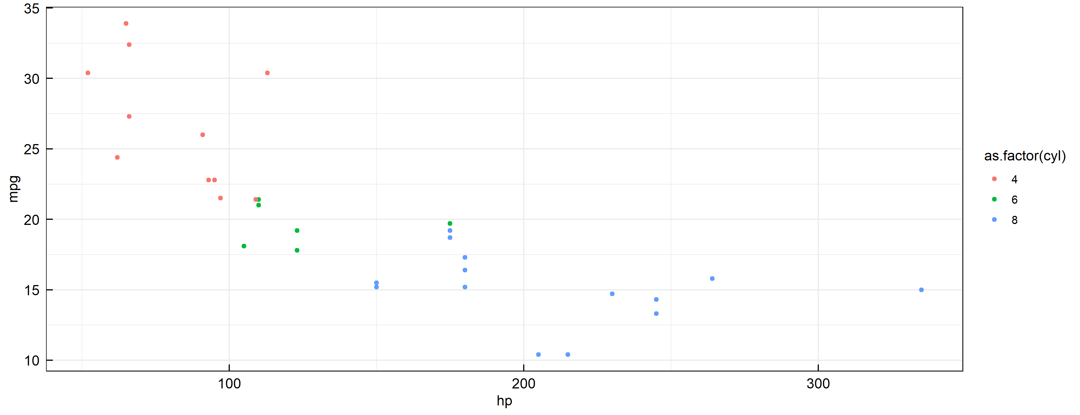
Correlation of fuel consumption with horse power
mpg: miles per gallon; hp: horsepowerr; cyl: number of cylinders

Slide 9
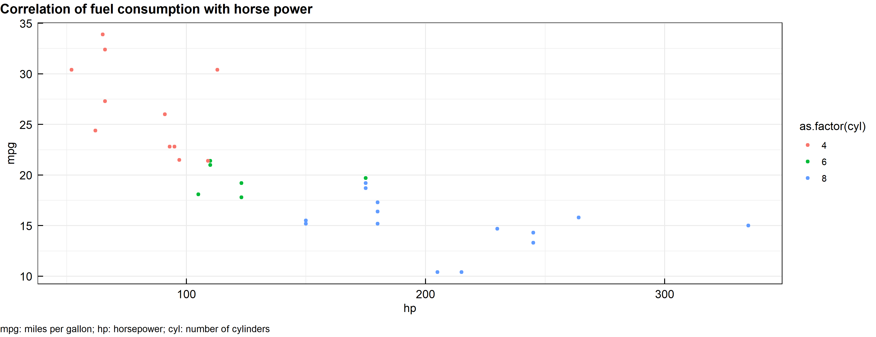
Correlation of fuel consumption with horse power (IQRoutputFigure)
File: Output/MPG_HP_corr.png

Slide 10
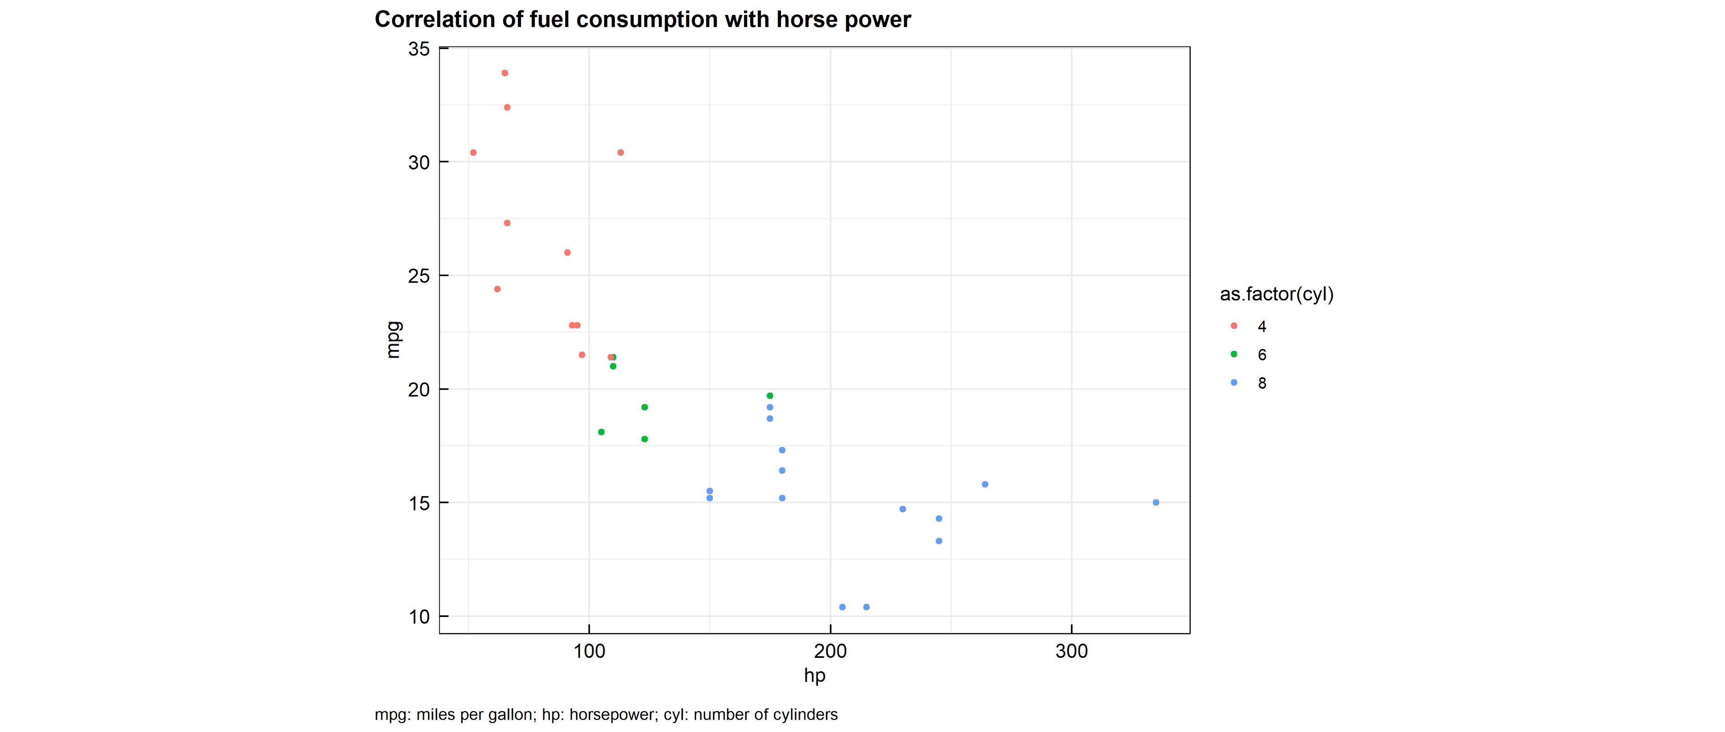
Correlation of fuel consumption with horse power (from file)

Slide 11
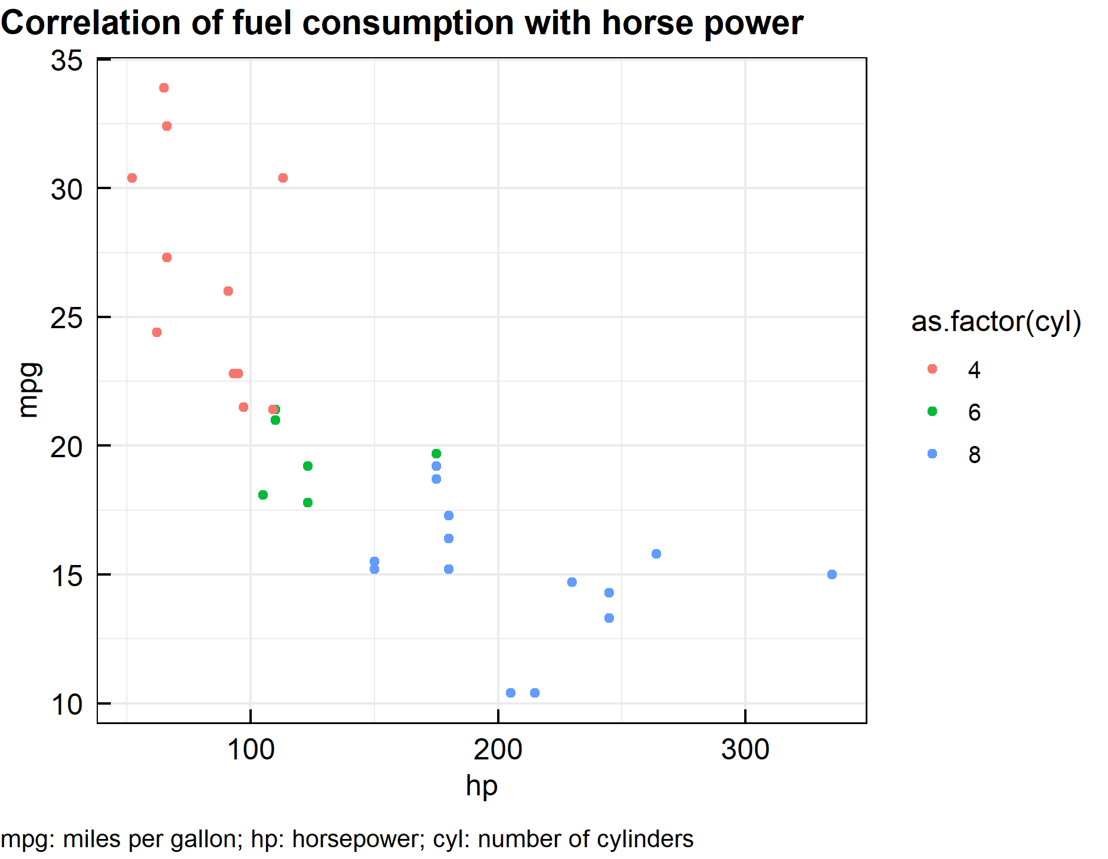
Conclusion on fuel consumption, horse power and number of cylinders
Cars with large horse power tend to have shorter cruising range per gallon fuel.
More horse power can be gained with more cylinders.
File: Output/MPG_HP_corr.png

Slide 12
Summary

Slide 13
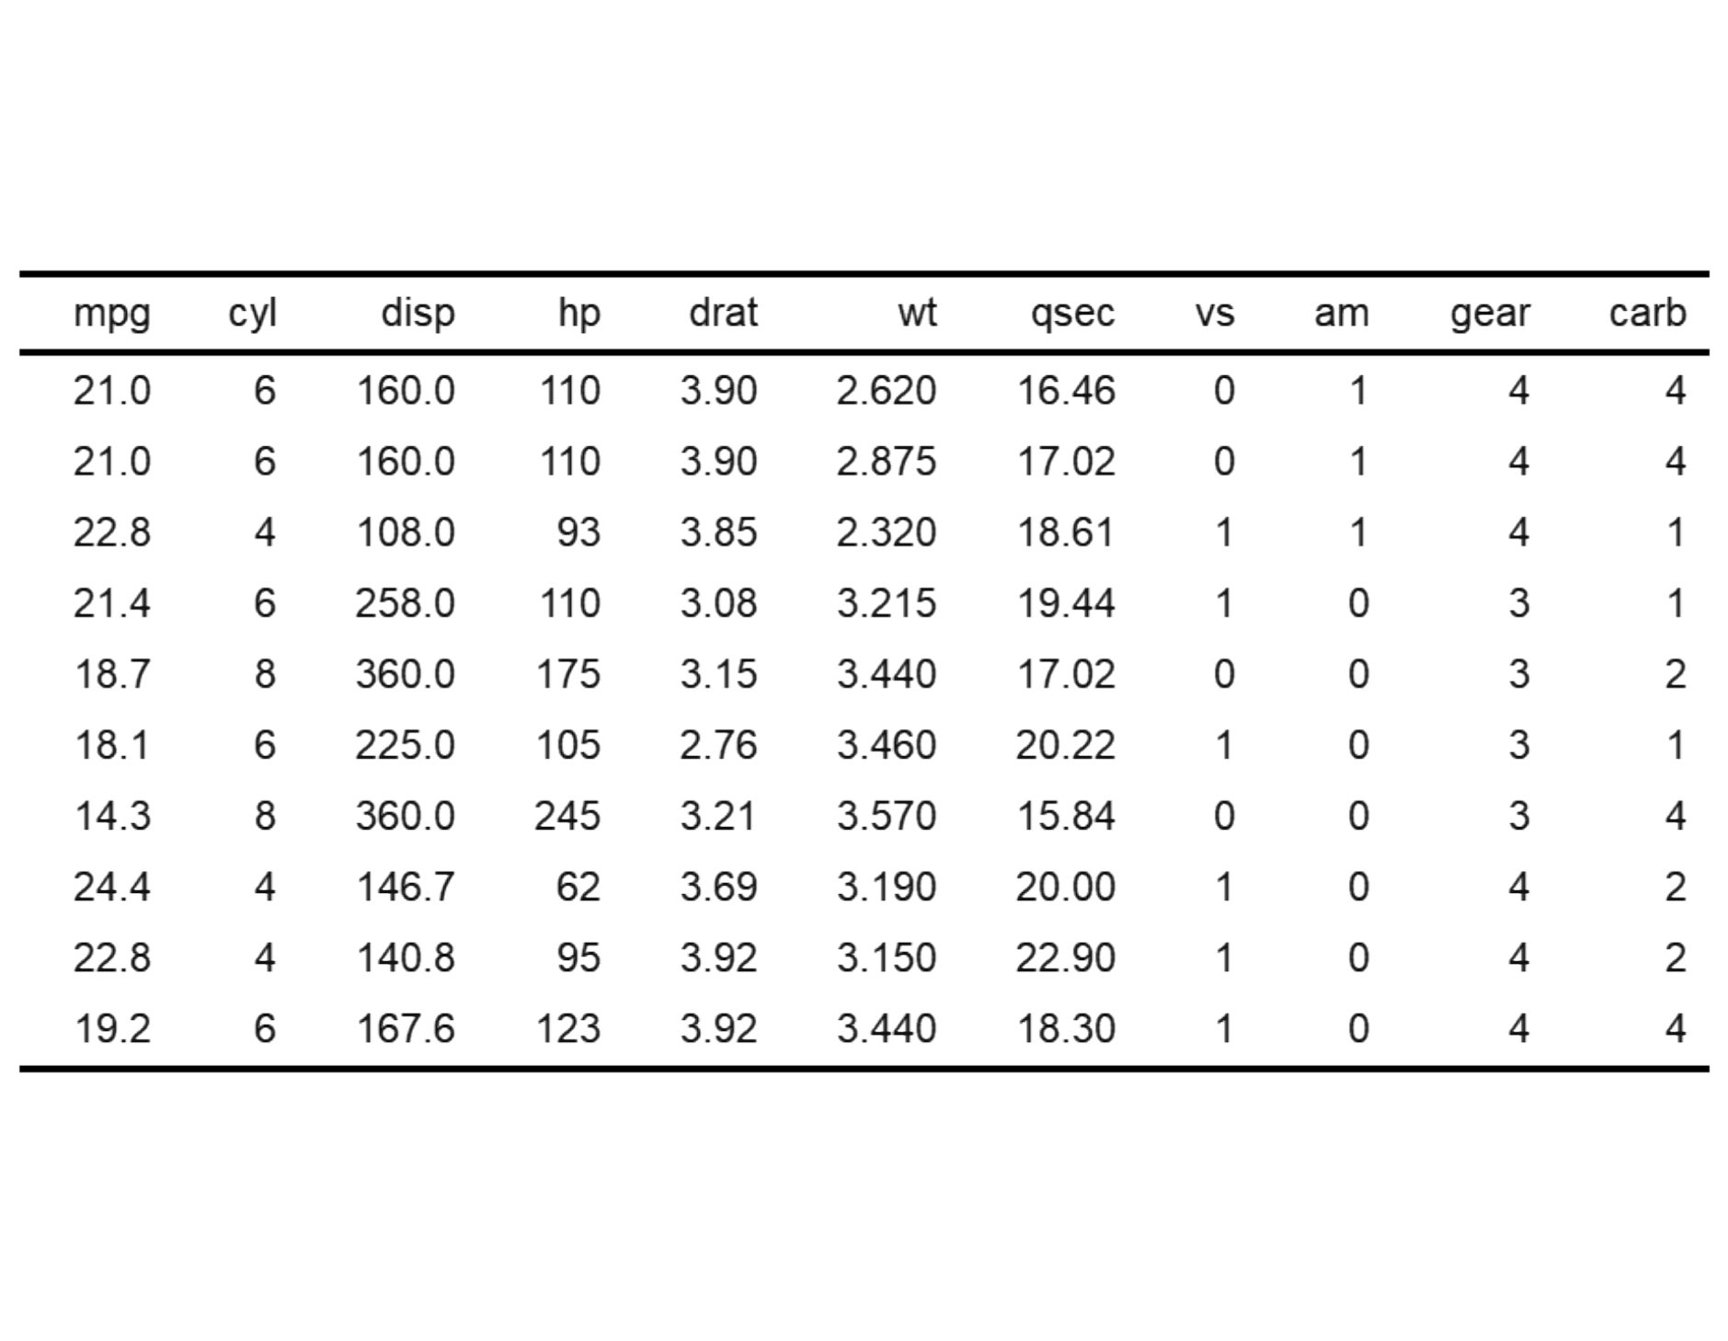
Summary of the data explored
Data from the 1974 Motor Trend US magazine was used to explore power, cruising range, and number of cylinders for cars.
The table on the left displays a snapshot of the explored data.
Source: Henderson and Velleman (1981), Building multiple regression models interactively. Biometrics, 37, 391–411.

