Slide 1
Test Slide Deck
IQR Objects Daniel Kaschek, IntiQuan 2020-05-01

Slide 2
Test IQR Objects

Slide 3
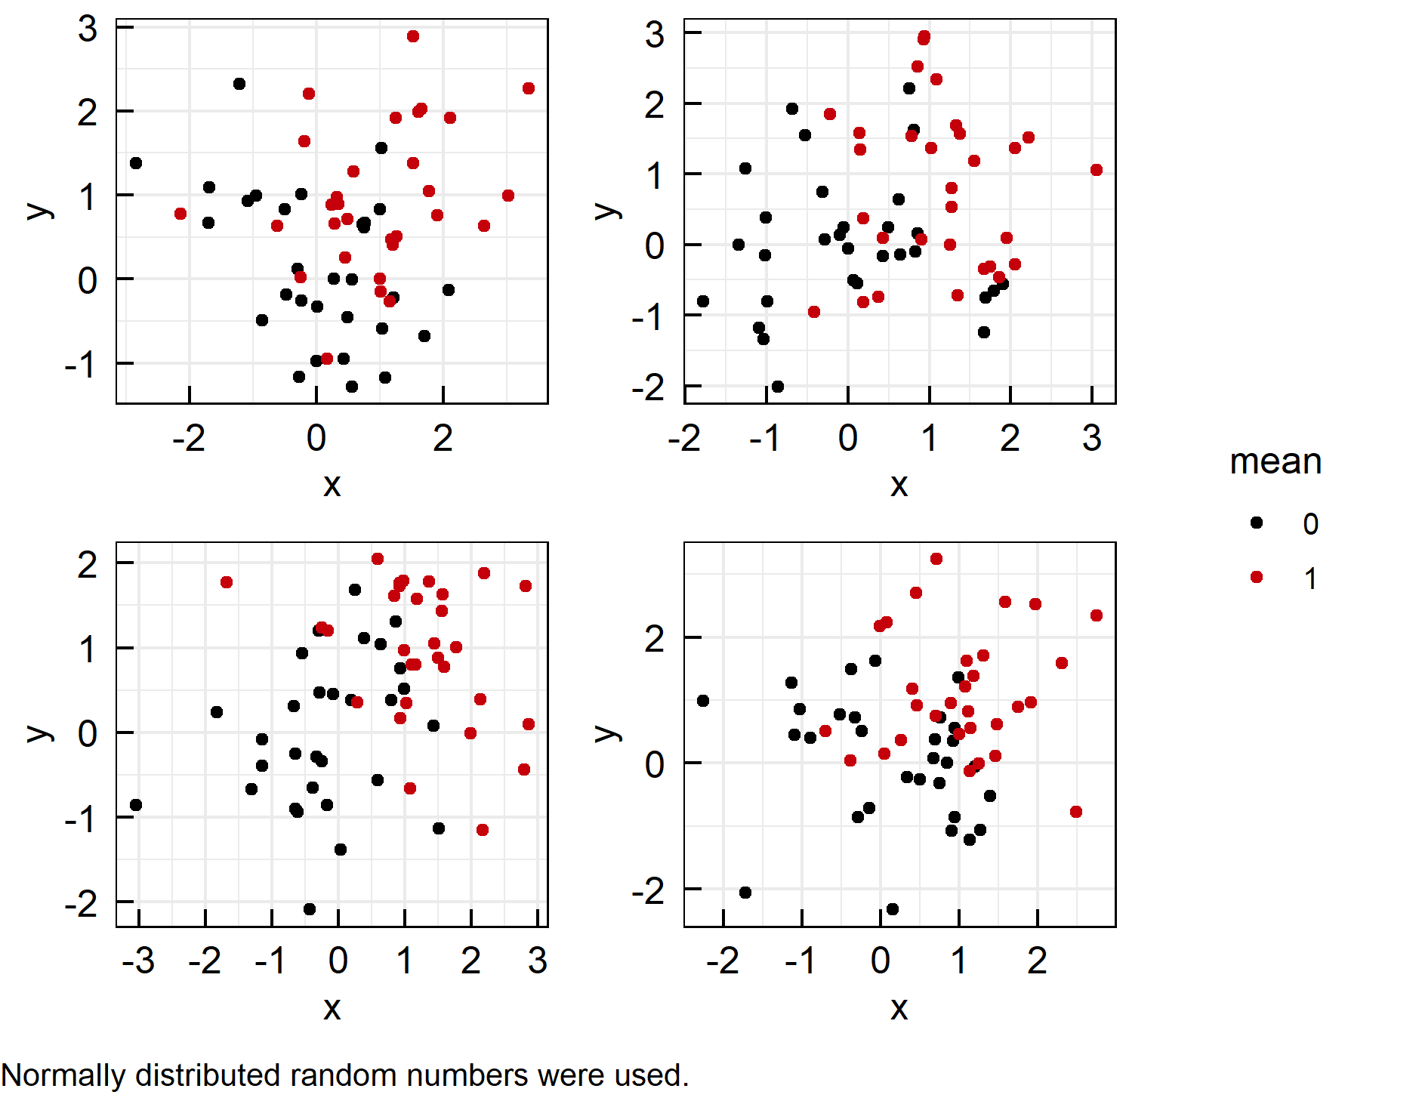
Plotting white noise (1)
A list of ggplot objects was created
Called IQRoutputFigure with arguments nrow, ncol, footer and filename
Called IQRoutputPPTX with bullet point list and IQRoutputFigure object.
File: ../Output/01_test/normal_distributions.pdf

Slide 4
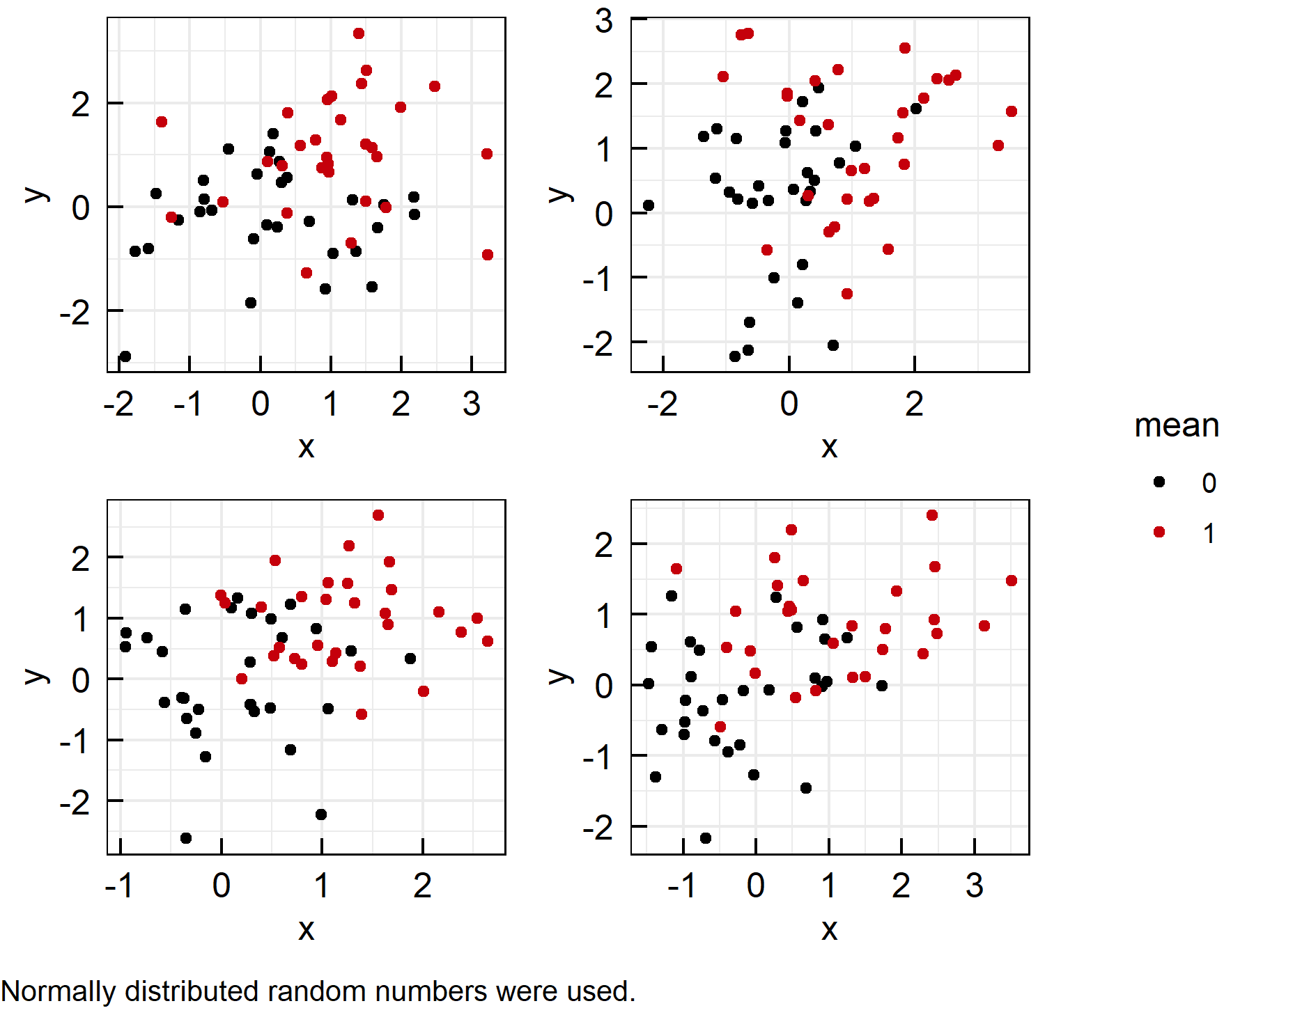
Plotting white noise (2)
A list of ggplot objects was created
Called IQRoutputFigure with arguments nrow, ncol, footer and filename
Called IQRoutputPPTX with bullet point list and IQRoutputFigure object.
File: ../Output/01_test/normal_distributions.pdf

Slide 5
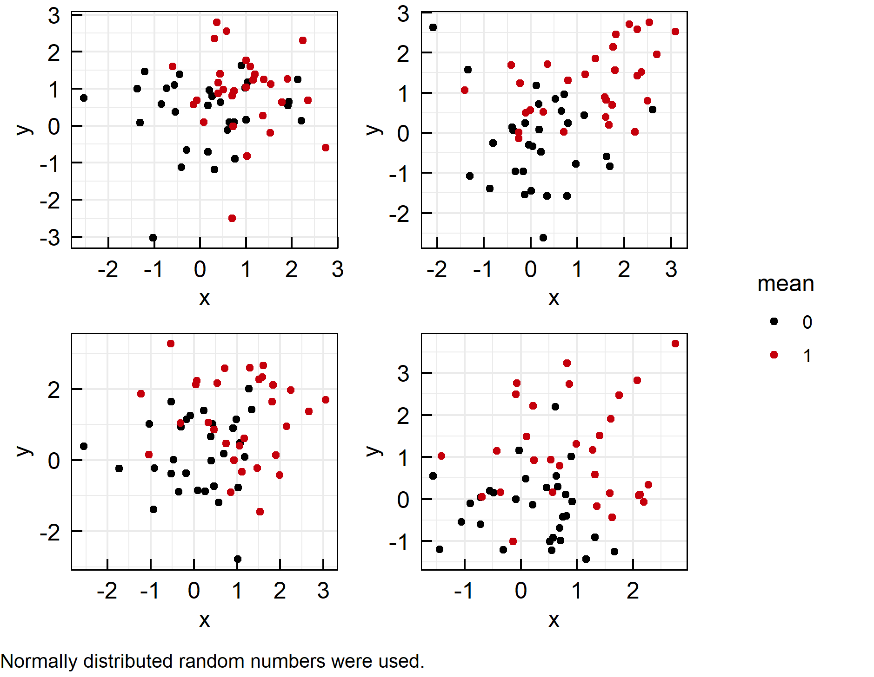
Plotting white noise (3)
A list of ggplot objects was created
Called IQRoutputFigure with arguments nrow, ncol, footer and filename
Called IQRoutputPPTX with bullet point list and IQRoutputFigure object.
File: ../Output/01_test/normal_distributions.pdf

Slide 6
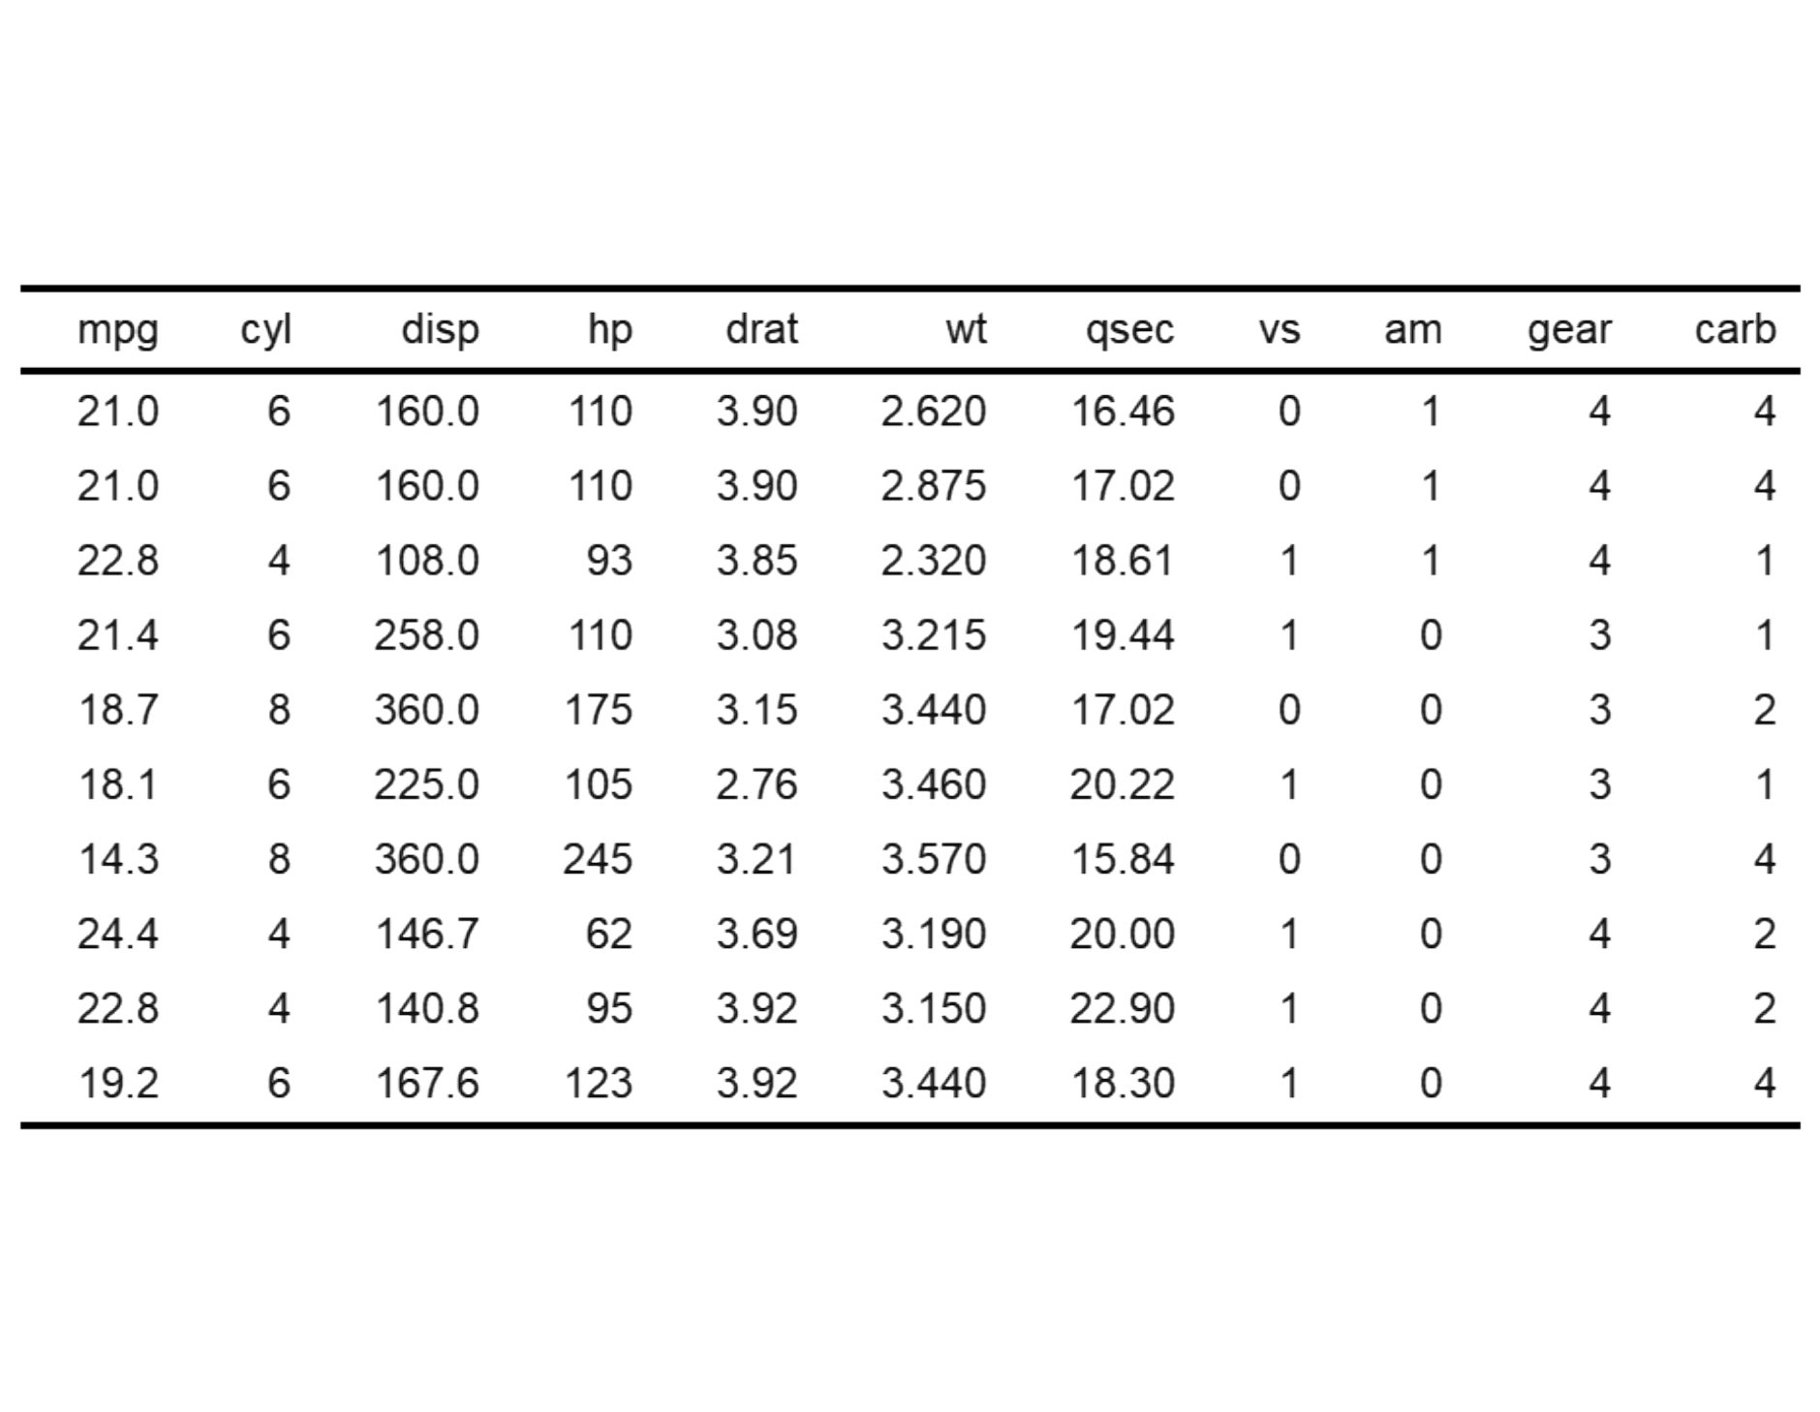
Well-known table
Used well known standard data set mtcars
Applied IQRoutputTable with arguments xfooter and filename
Called IQRoutputPPTX with bullet point list and IQRoutputTable object
See R datasets::mtcars File: ../Output/01_test/cars_table.txt

Slide 7
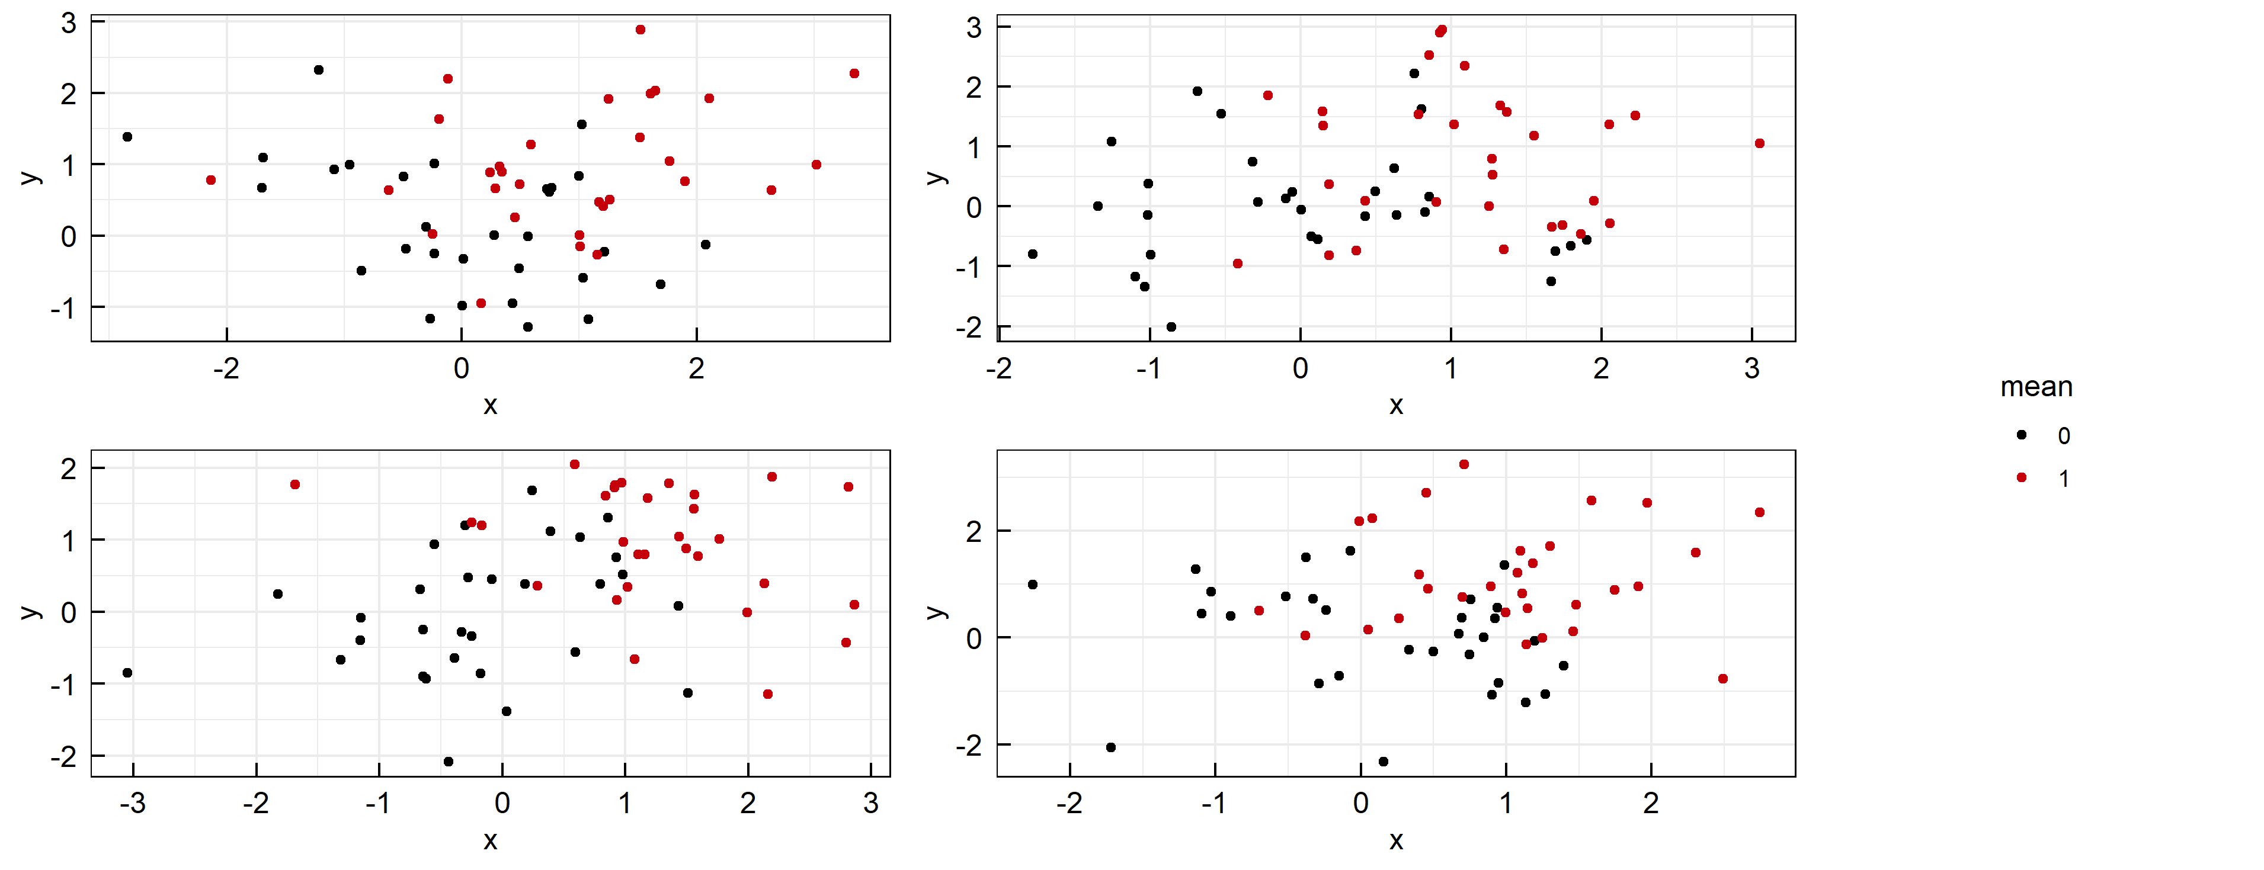
Plotting white noise
File: ../Output/01_test/subset_normal_distributions.pdf

