Slide 1
Test Slide Deck
IQR Objects (non-QCed) Daniel Kaschek, IntiQuan 2024-10-25

Slide 2
Plain Slides

Slide 3
Just a test
Cars data set from R datasets
The data vie the speed of cars and distances taken to stop shown as plot

Slide 4
Slides with plots

Slide 5
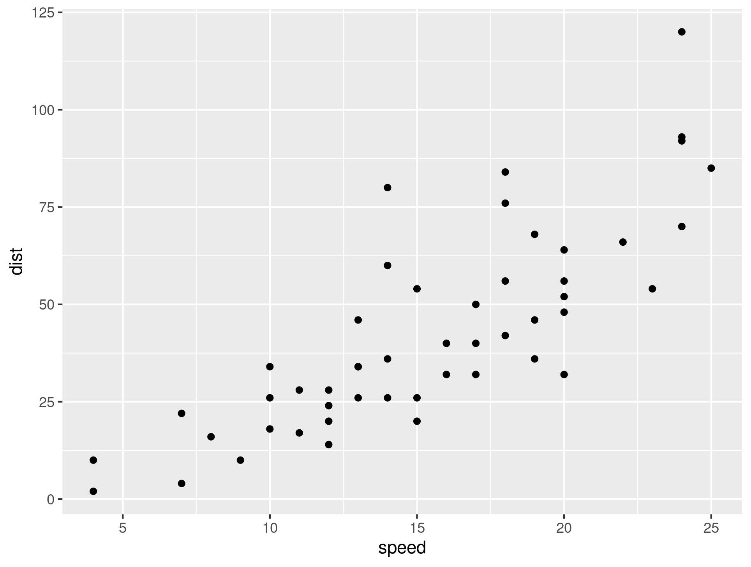
Overview of cars distance vs time to stop
Cars data set from R datasets
The data vie the speed of cars and distances taken to stop shown as plot
Source: Ezekiel, M. (1930) Methods of Correlation Analysis. Wiley.

Slide 6
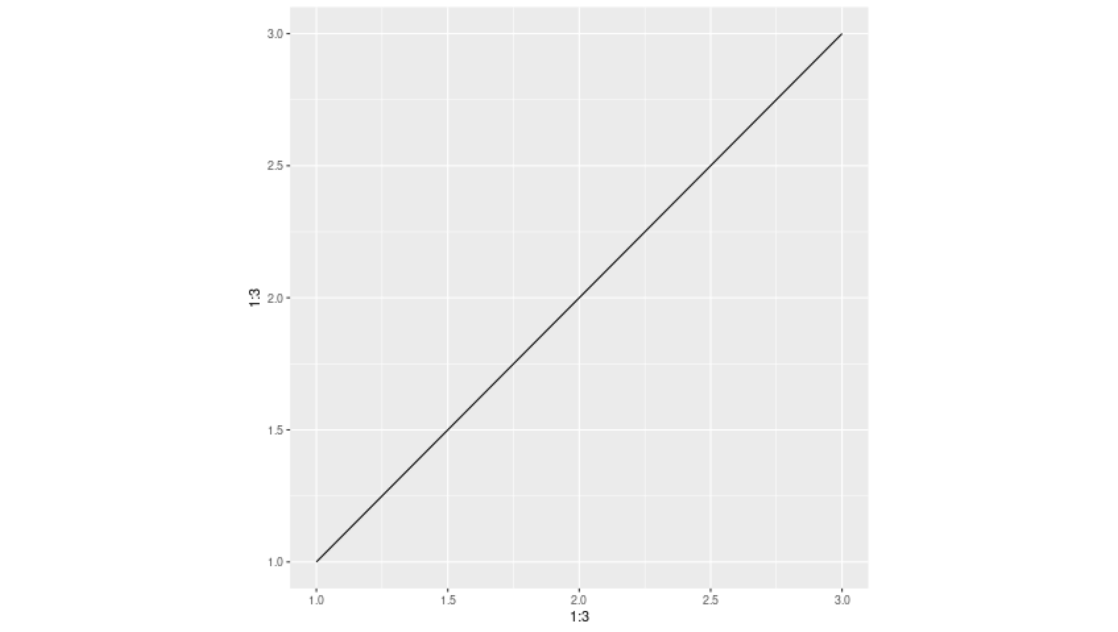
Plot from png file

Slide 7

Plot from pdf file

Slide 8
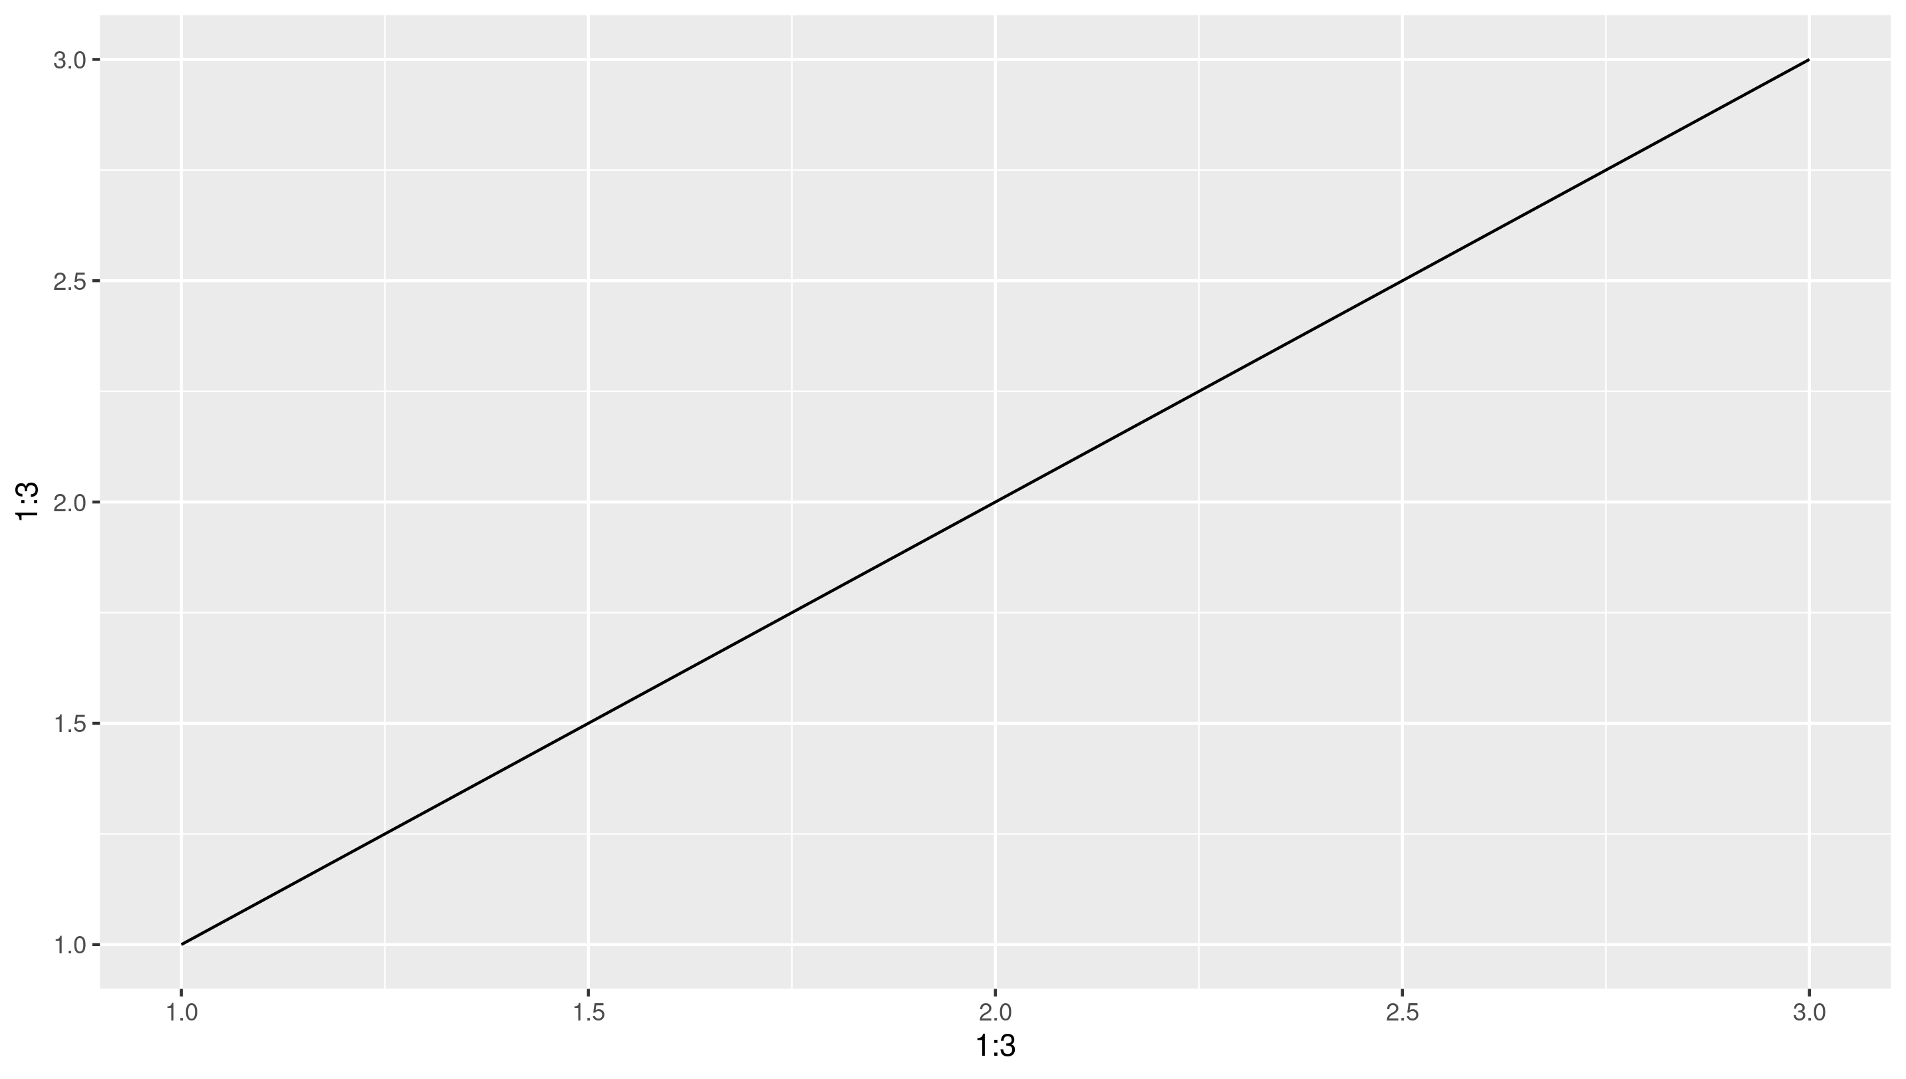
Plot from ggplot object

Slide 9
Slides with tables

Slide 10
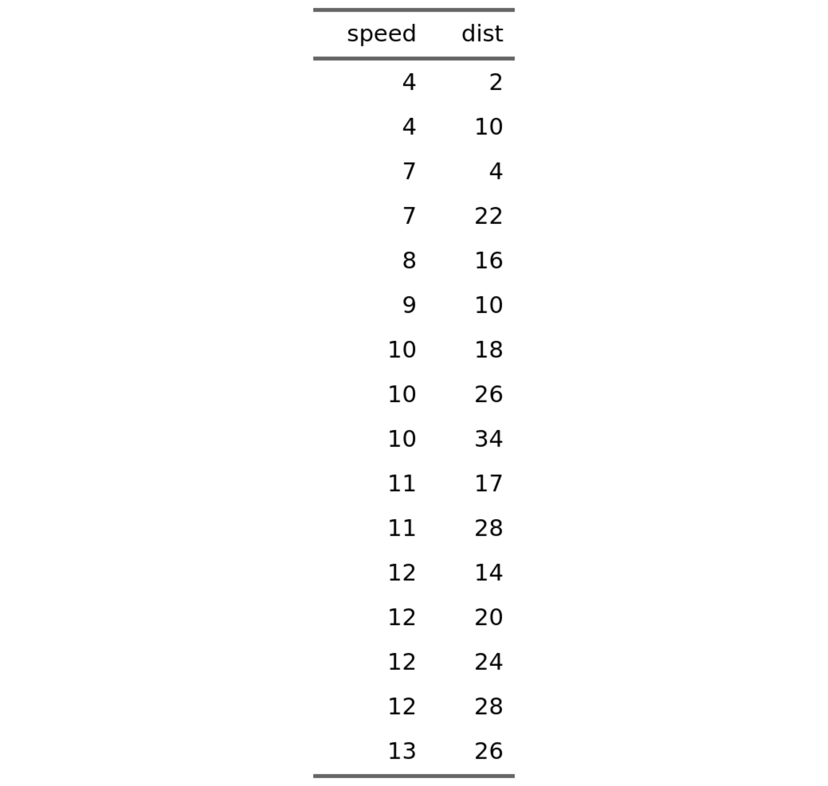
Overview of cars distance vs time to stop shown as table
Cars data set from R datasets
The data vie the speed of cars and distances taken to stop

Slide 11
Overview of cars distance vs time to stop shown as table
Bullet point with bold and italic
Another bullet point
Indented by two spaces
Another one
And back to really outer level
Some sort of formula E_{rel} = m*c²

Slide 12
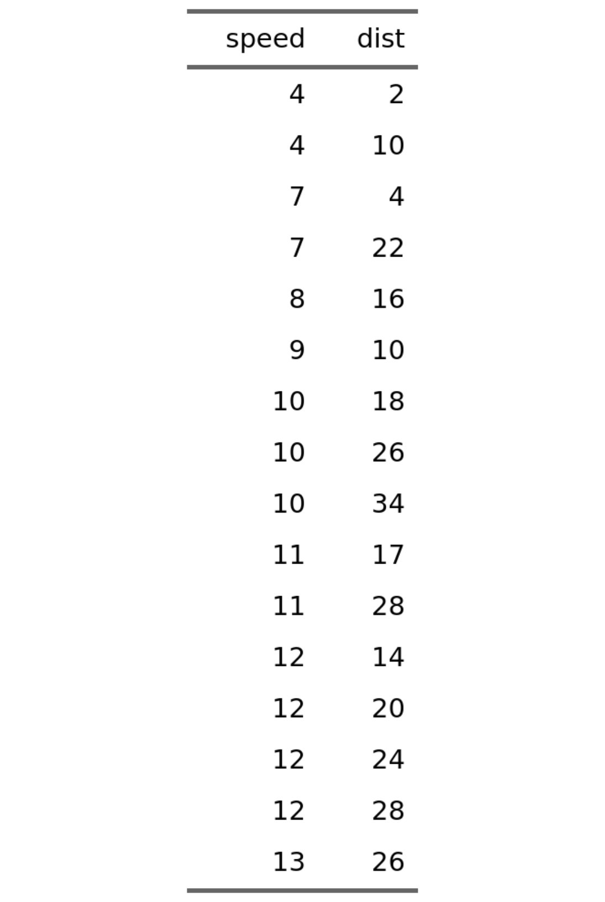
Overview of cars distance vs time to stop shown as table
Bullet point with bold and italic
Another bullet point
Indented by two spaces
Another one
And back to really outer level
Some sort of formula E_{rel} = m*c²

Slide 13
Layouts

Slide 14
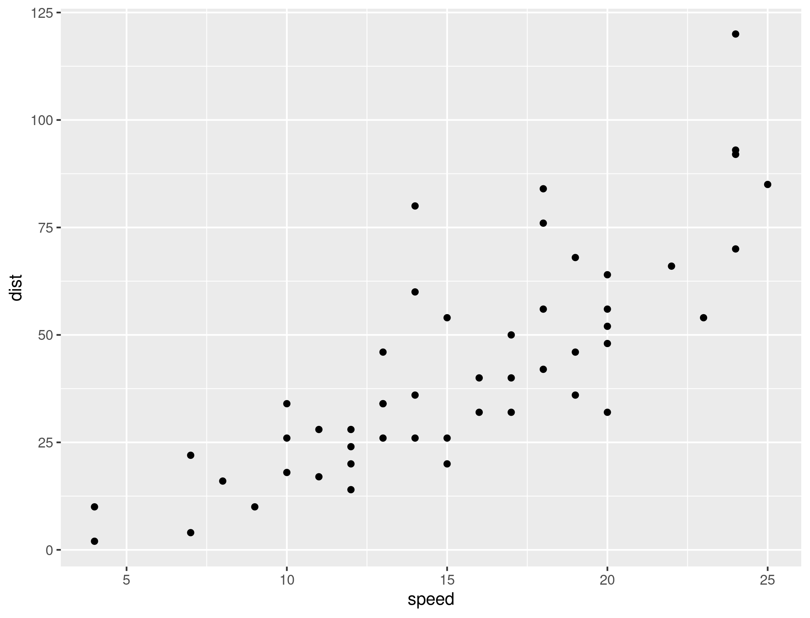
Two Content Right Bigger
Cars data set from R datasets
The data vie the speed of cars and distances taken to stop

Slide 15
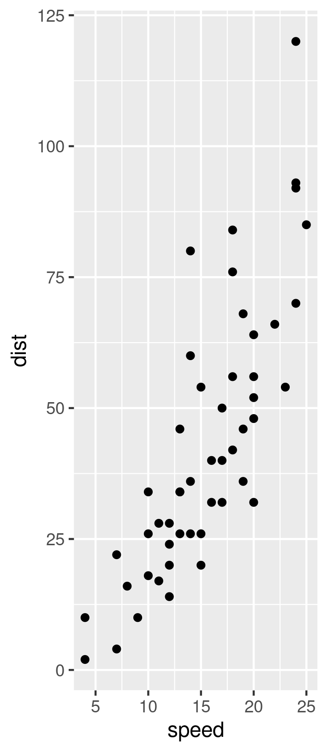
Two Content Right Bigger

Slide 16
Two Content Right Bigger
Cars data set from R datasets
The data vie the speed of cars and distances taken to stop

Slide 17
Two Content Right Bigger
Cars data set from R datasets
The data vie the speed of cars and distances taken to stop

Slide 18
Test IQR Objects

Slide 19
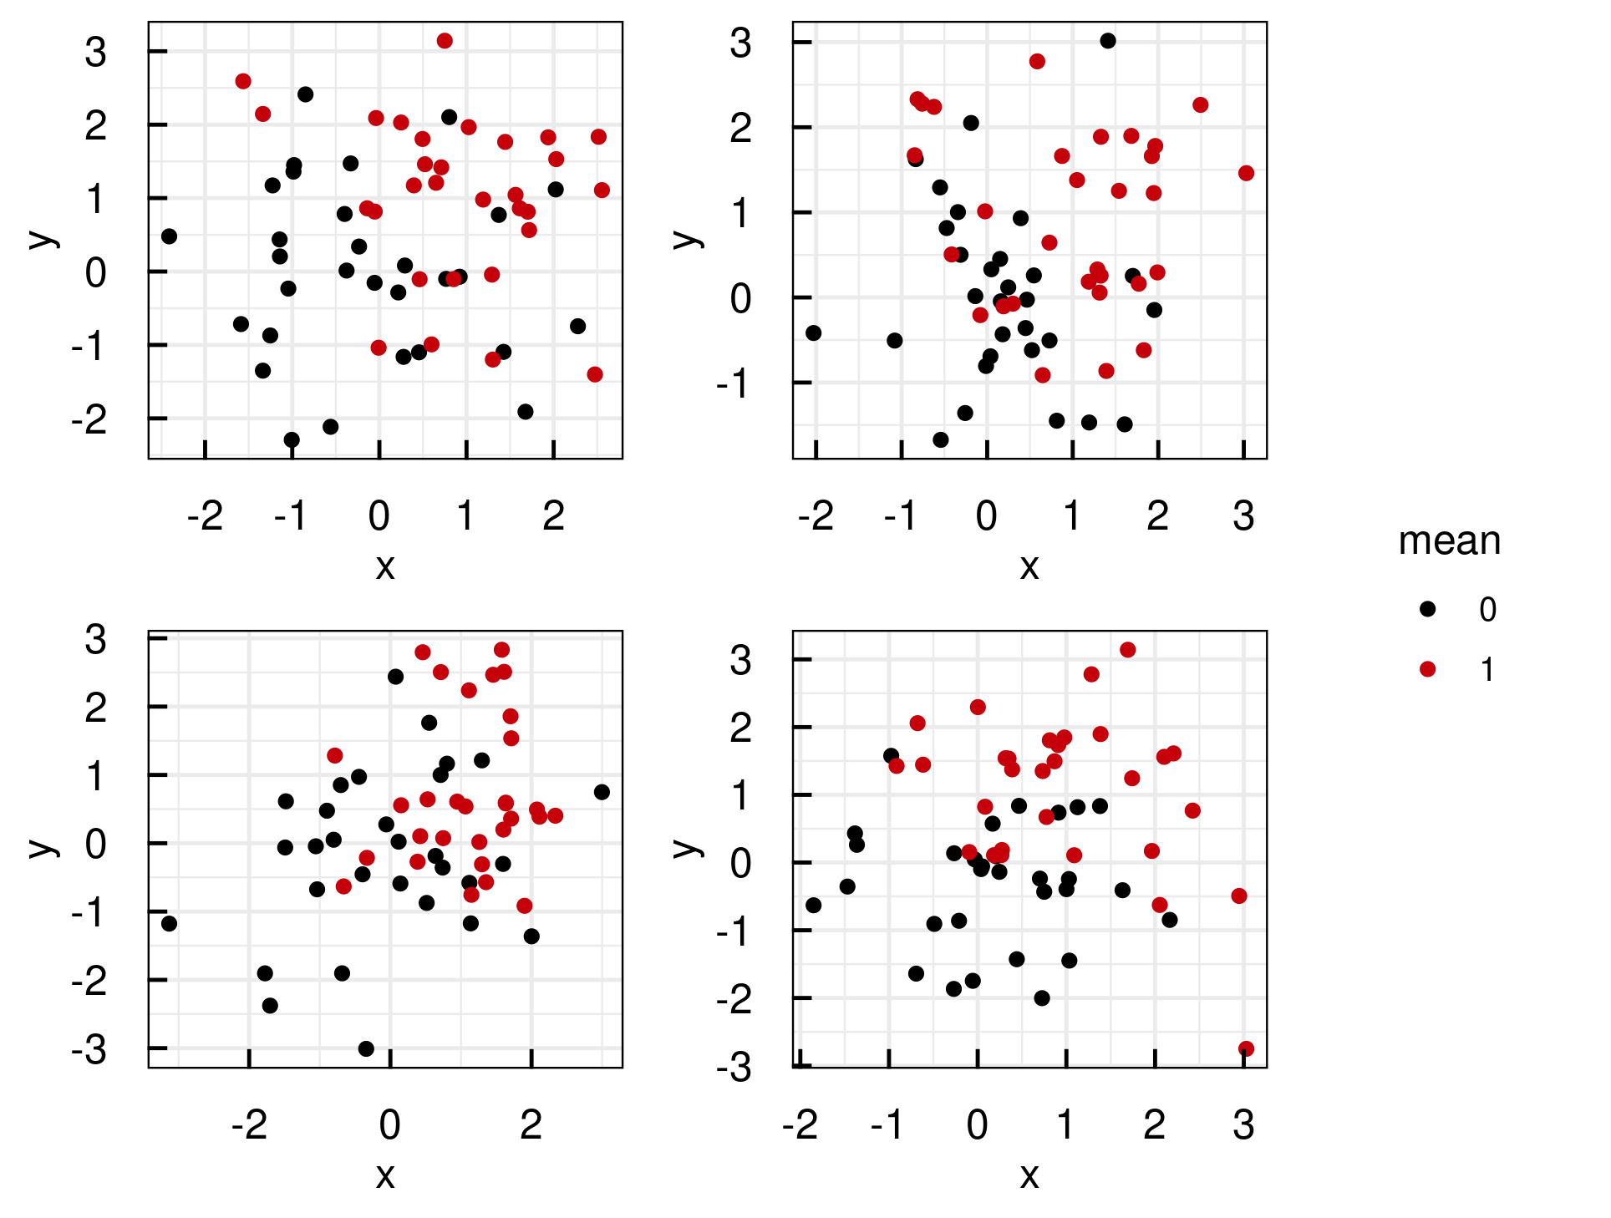
Plotting white noise (1)
A list of ggplot objects was created
Called IQRoutputFigure with arguments nrow, ncol, footer and filename
Called IQRoutputPPTX with bullet point list and IQRoutputFigure object.
Normally distributed random numbers were used. File: ../Output/01_test/normal_distributions.pdf

Slide 20
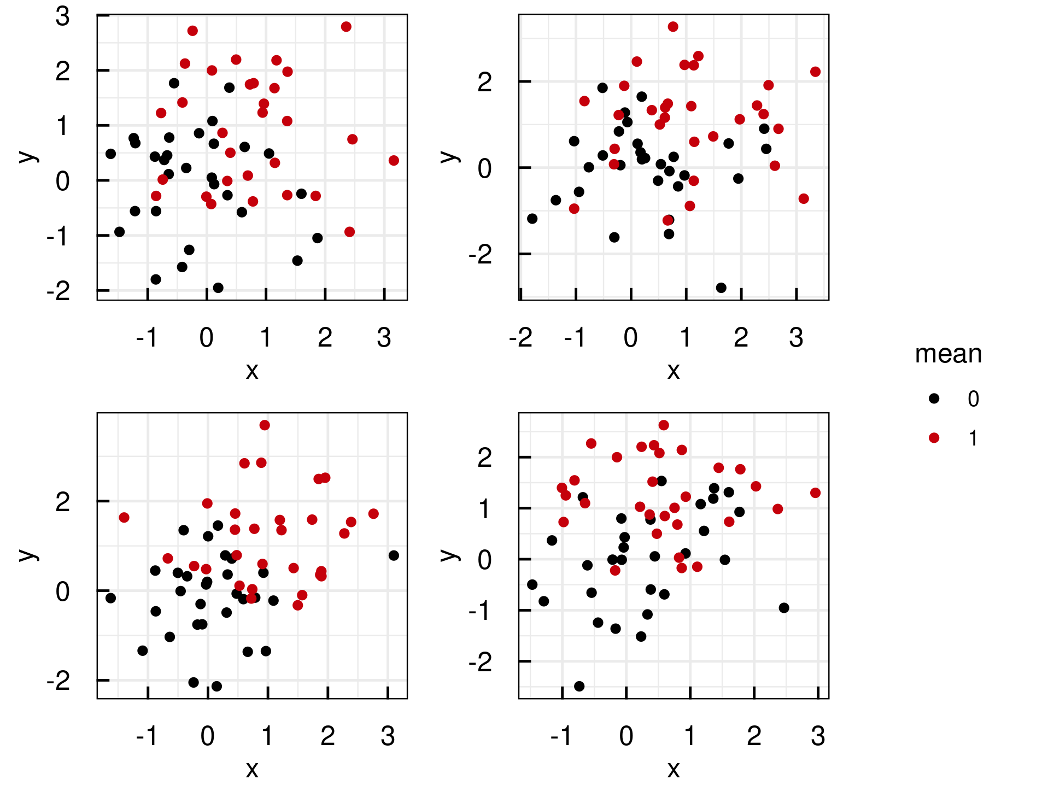
Plotting white noise (2)
A list of ggplot objects was created
Called IQRoutputFigure with arguments nrow, ncol, footer and filename
Called IQRoutputPPTX with bullet point list and IQRoutputFigure object.
Normally distributed random numbers were used. File: ../Output/01_test/normal_distributions.pdf

Slide 21
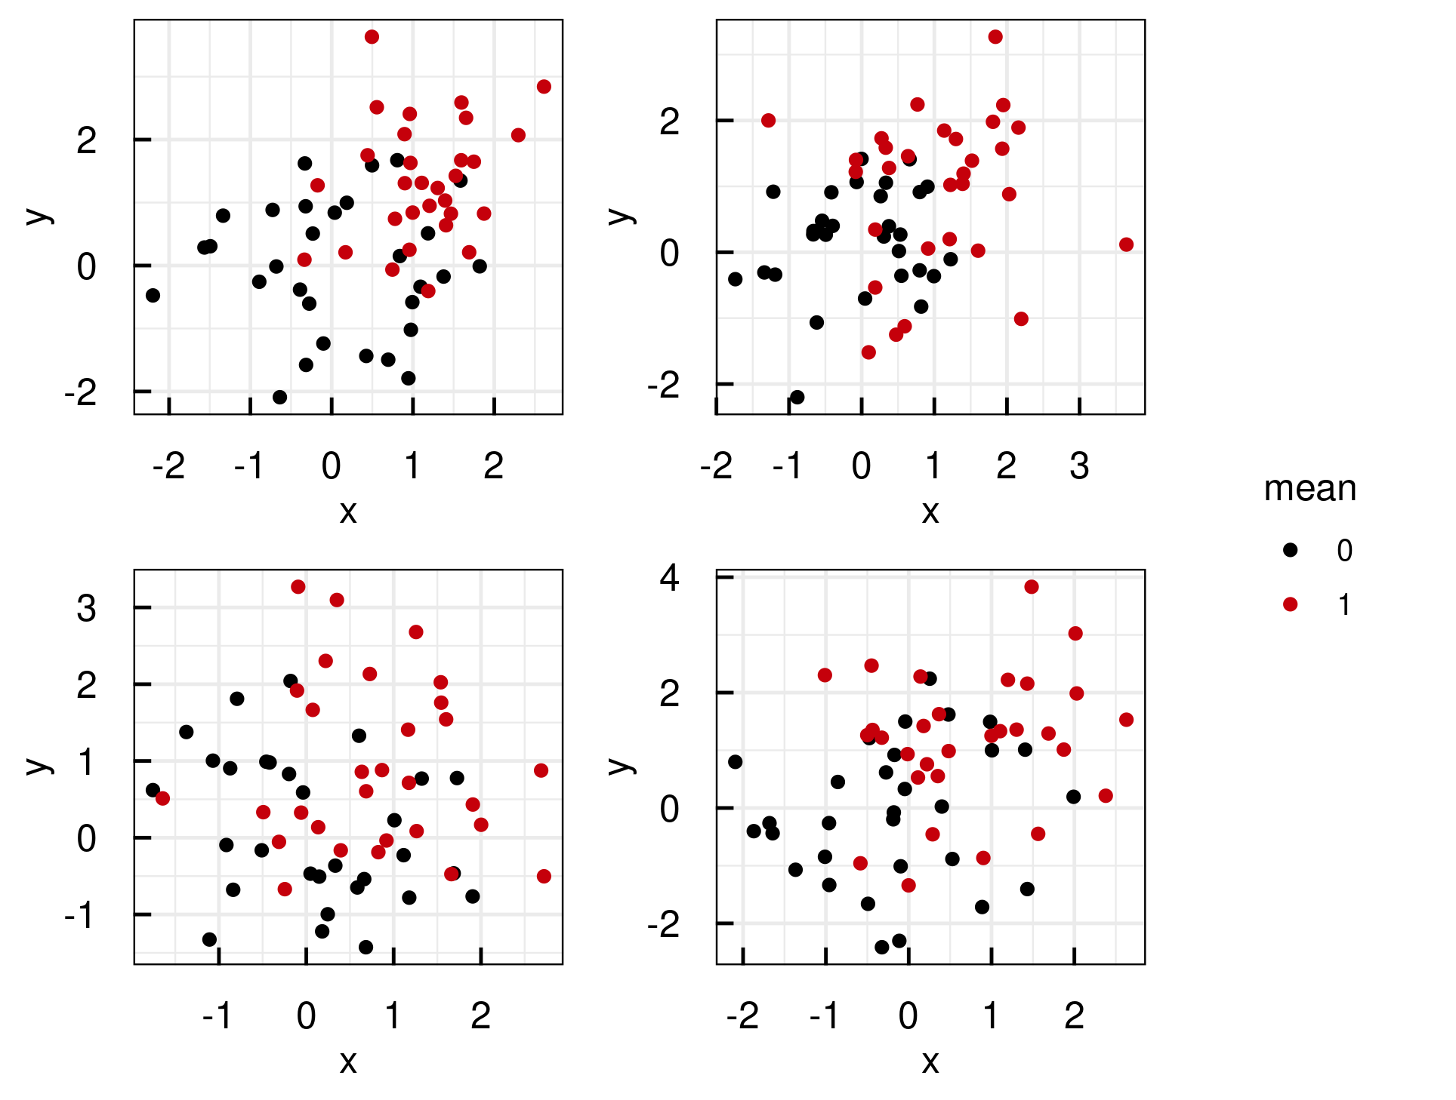
Plotting white noise (3)
A list of ggplot objects was created
Called IQRoutputFigure with arguments nrow, ncol, footer and filename
Called IQRoutputPPTX with bullet point list and IQRoutputFigure object.
Normally distributed random numbers were used. File: ../Output/01_test/normal_distributions.pdf

Slide 22
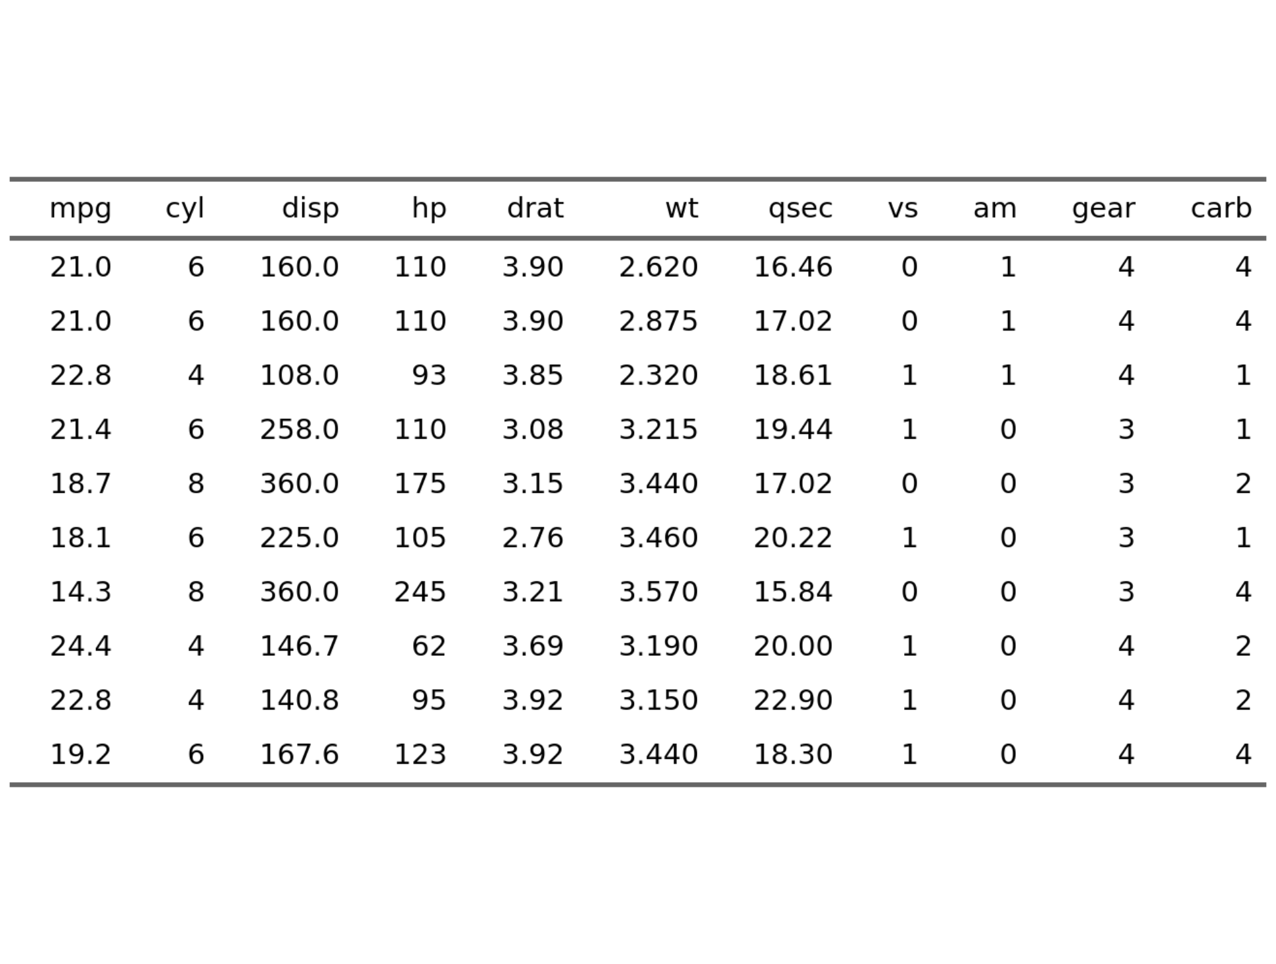
Well-known table
Used well known standard data set mtcars
Applied IQRoutputTable with arguments xfooter and filename
Called IQRoutputPPTX with bullet point list and IQRoutputTable object
See R datasets::mtcars File: ../Output/01_test/cars_table.txt

Slide 23
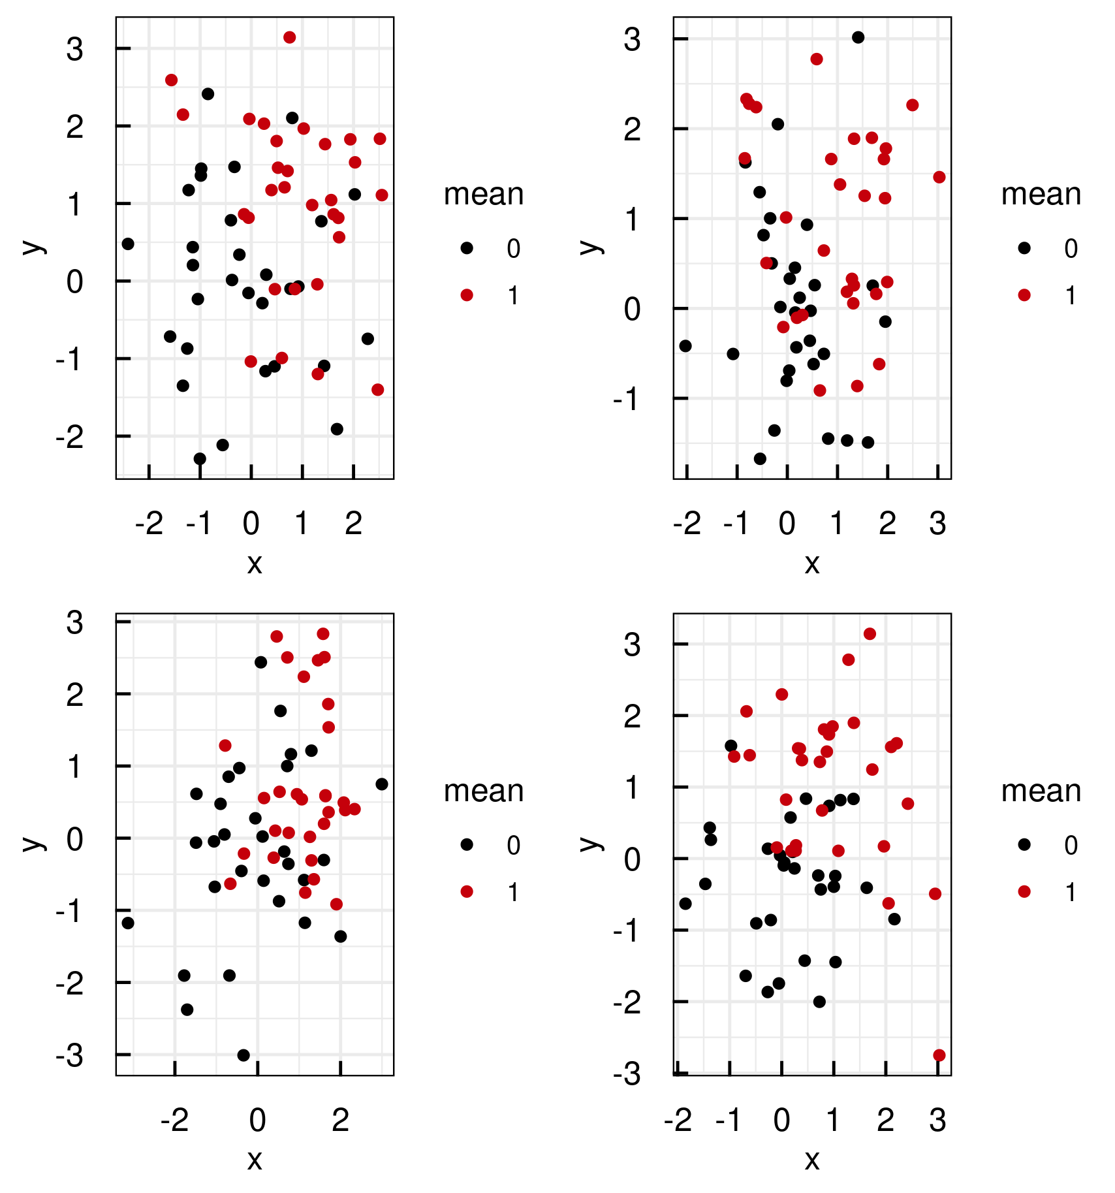
Plotting white noise and testing the wide title layout
File: ../Output/01_test/subset_normal_distributions.pdf

Slide 24
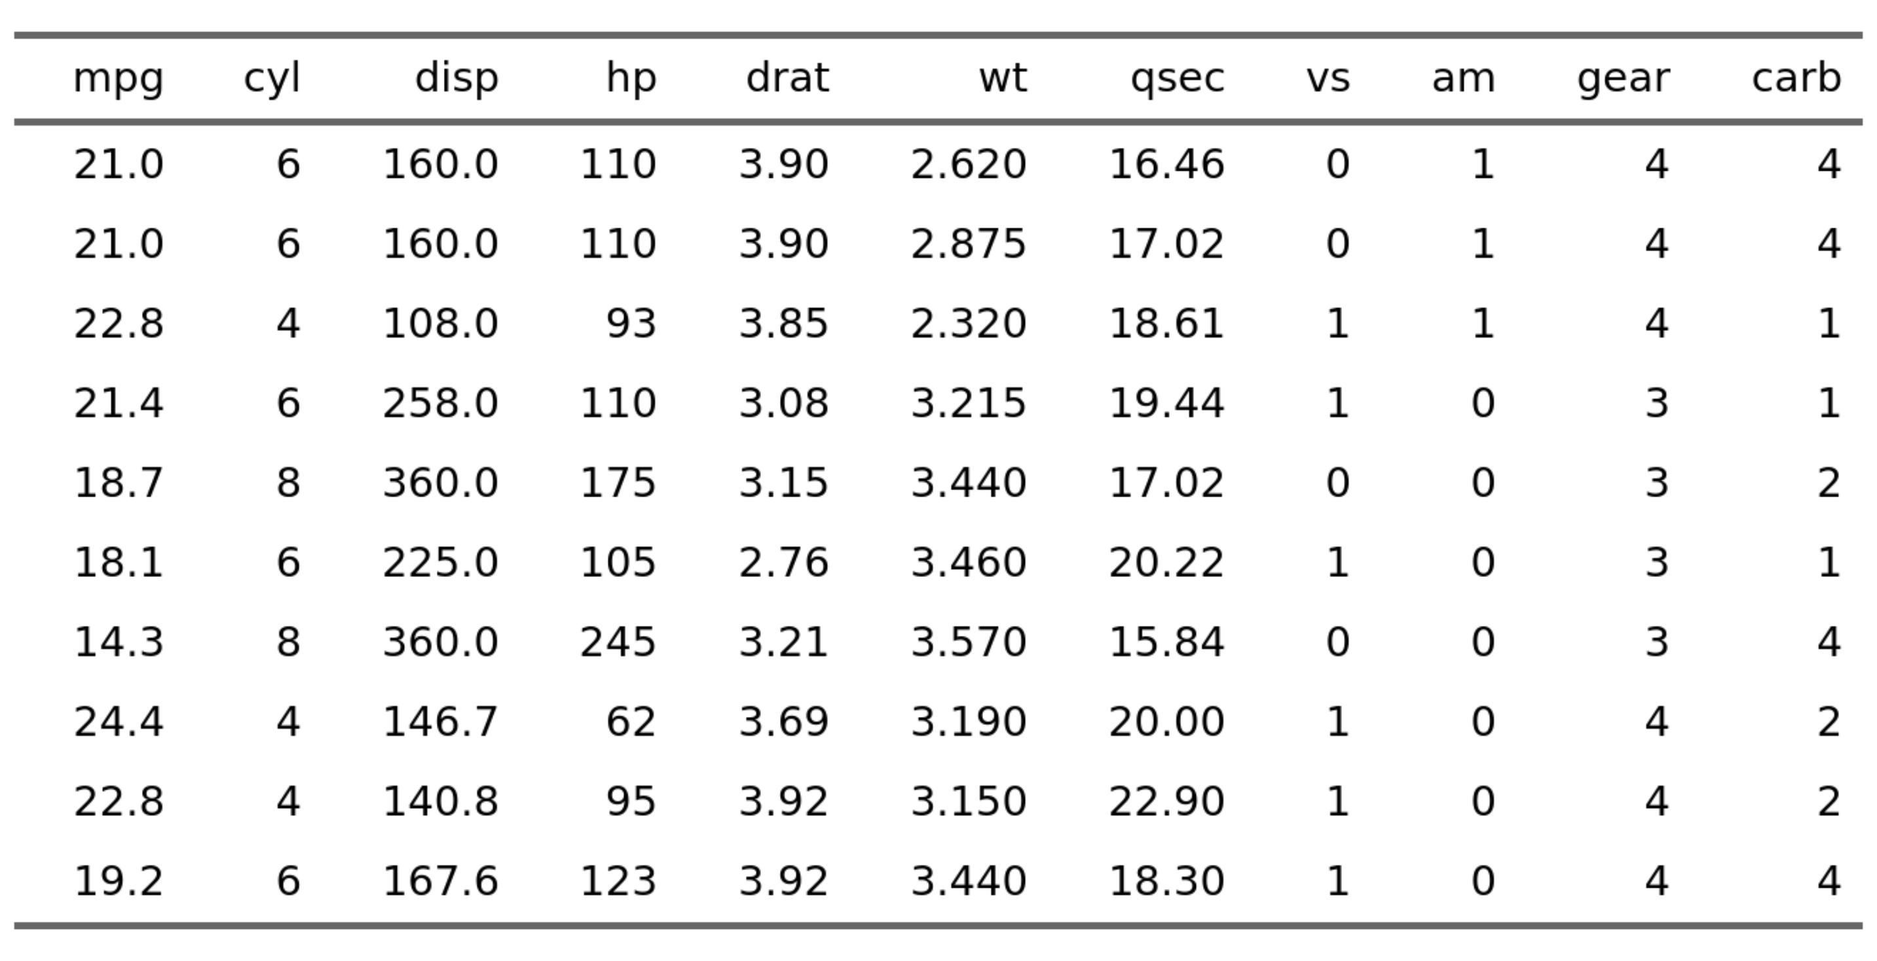
Cars data set
See R datasets::mtcars File: ../Output/01_test/cars_table.txt

Slide 25
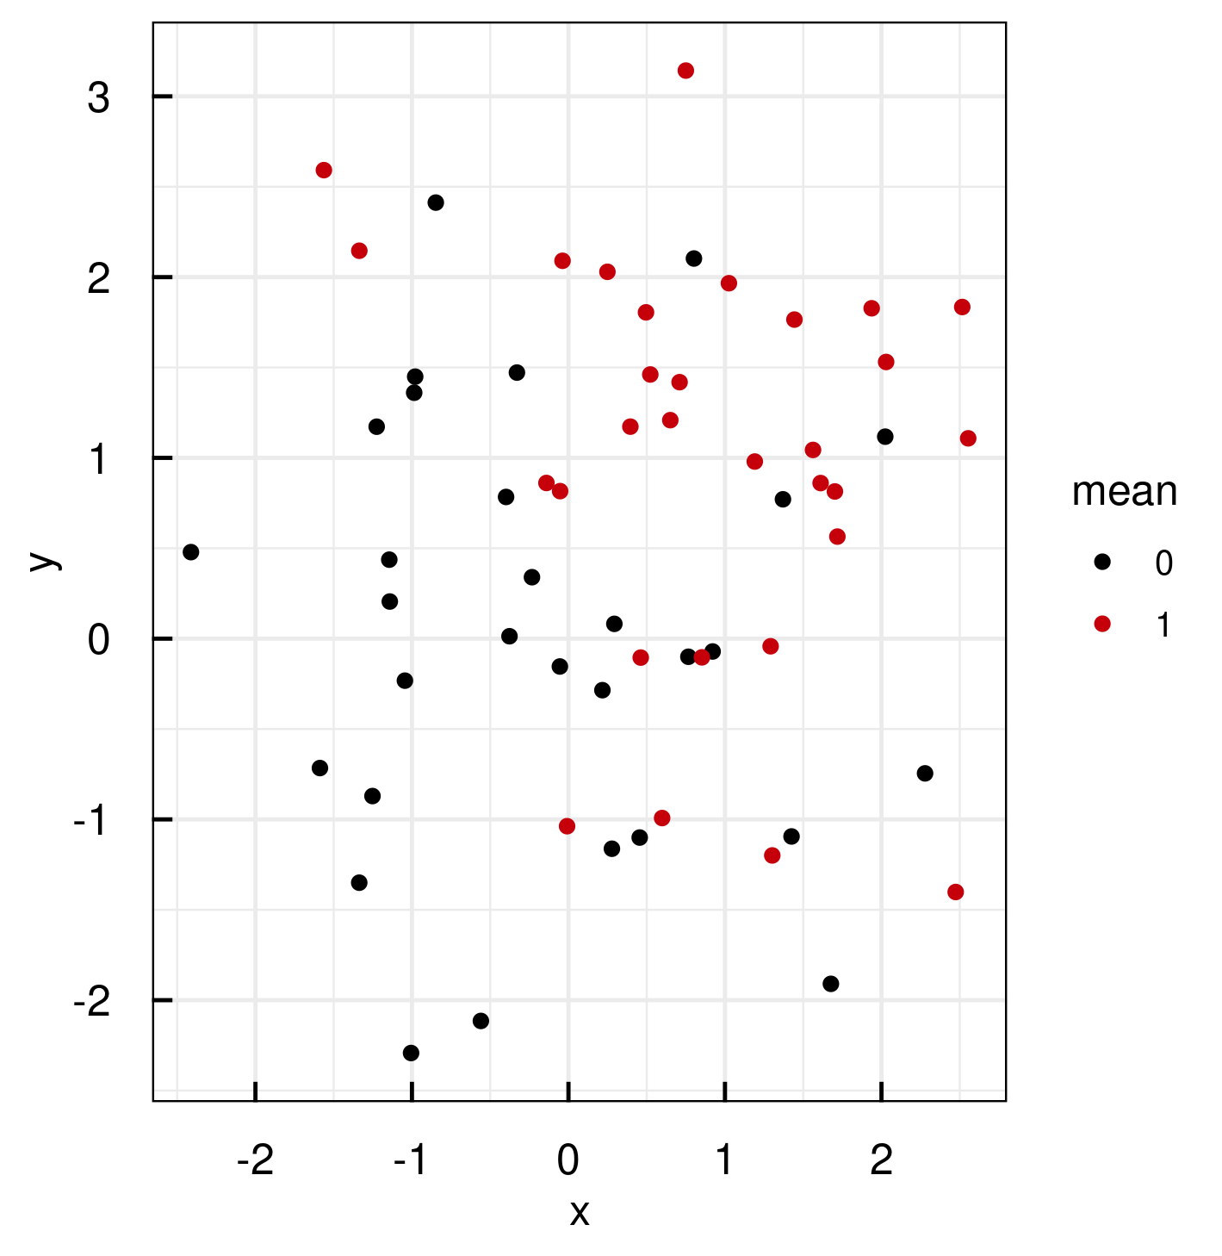
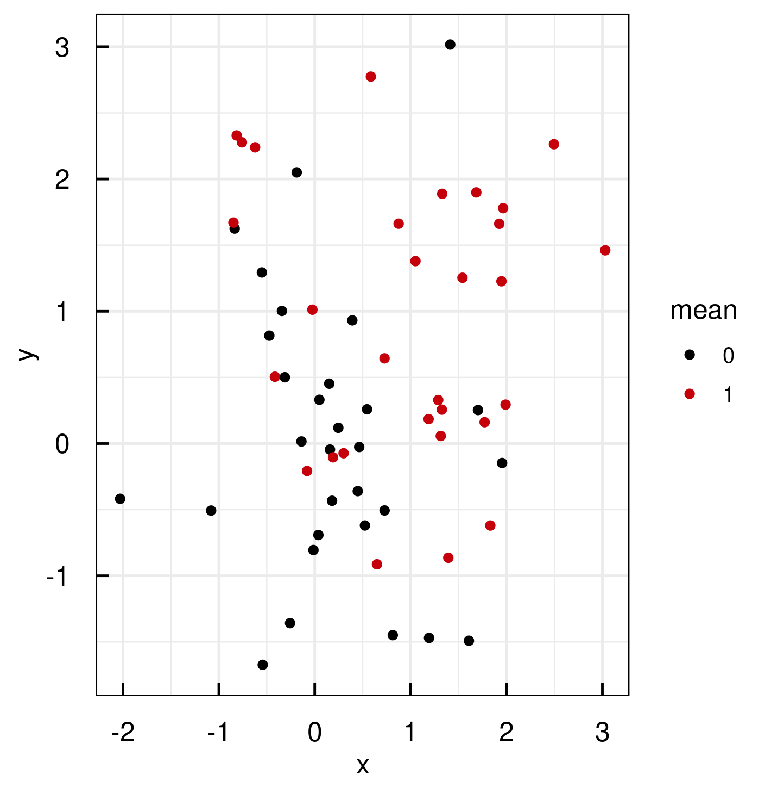
Normally distributed random numbers were used. File: ../Output/01_test/normal_distributions_longlist.pdf
Normally distributed random numbers were used. File: ../Output/01_test/normal_distributions_longlist.pdf

