Slide 1
Test Slide Deck
IQR Objects
2026-06-09
Daniel Kaschek, IntiQuan

Slide 2
Plain Slides

Slide 3
Just a test
Cars data set from R datasets
The data vie the speed of cars and distances taken to stop shown as plot
script_IQSlidedeck.R | Date: 2026-06-09 09:47:06.003796

Slide 4
Slides with plots

Slide 5
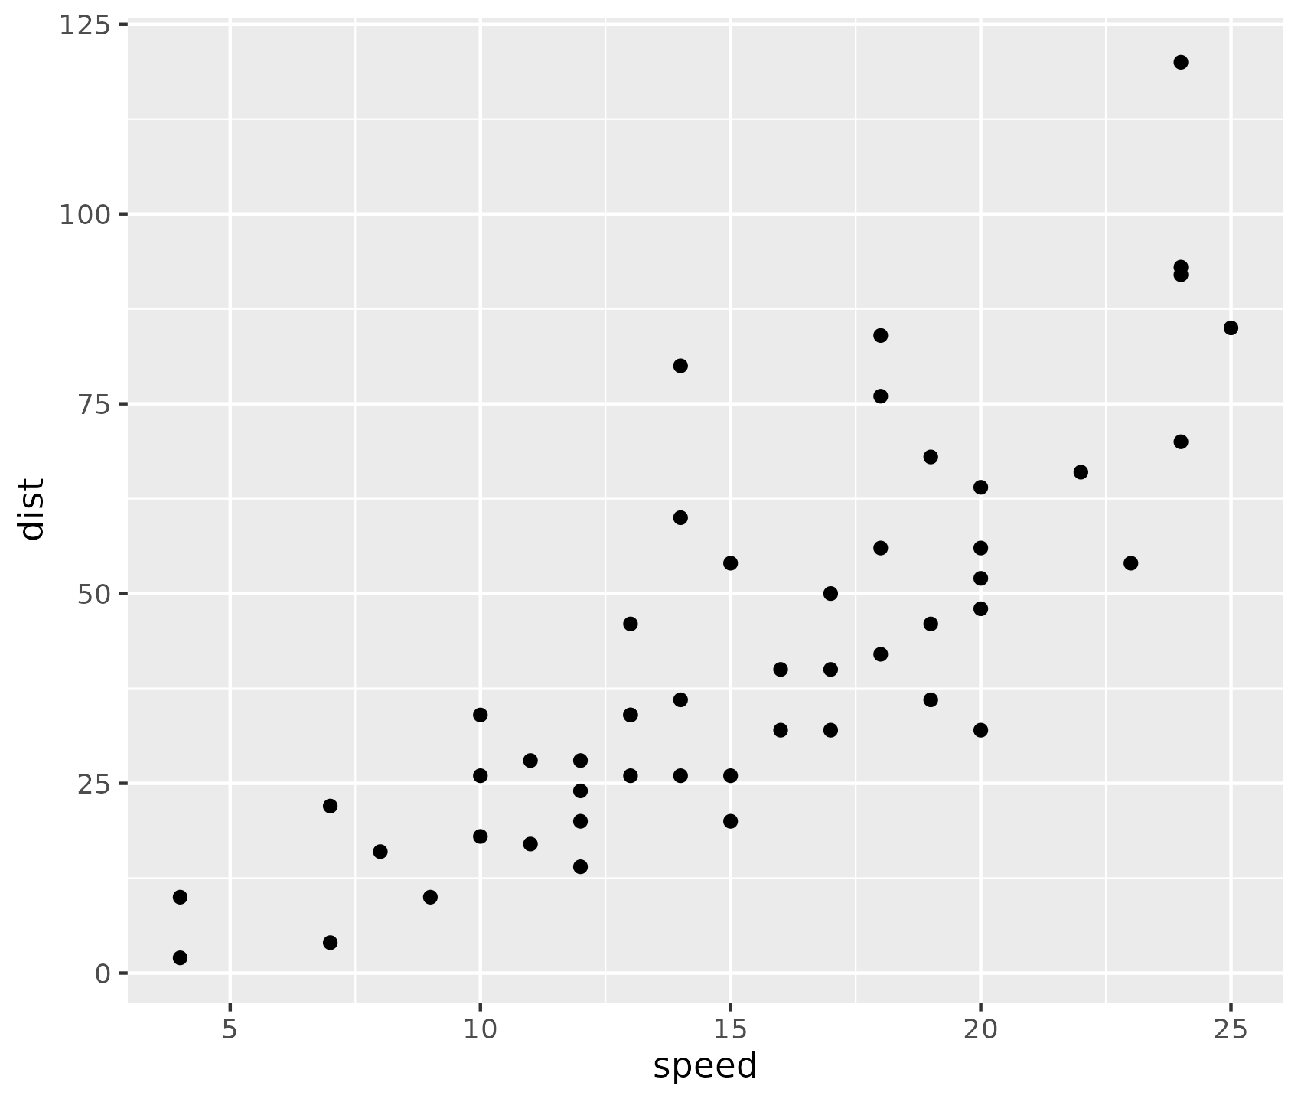
Overview of cars distance vs time to stop
Cars data set from R datasets
The data vie the speed of cars and distances taken to stop shown as plot
Source: Ezekiel, M. (1930) Methods of Correlation Analysis. Wiley.
script_IQSlidedeck.R | Date: 2026-06-09 09:47:06.191096

Slide 6
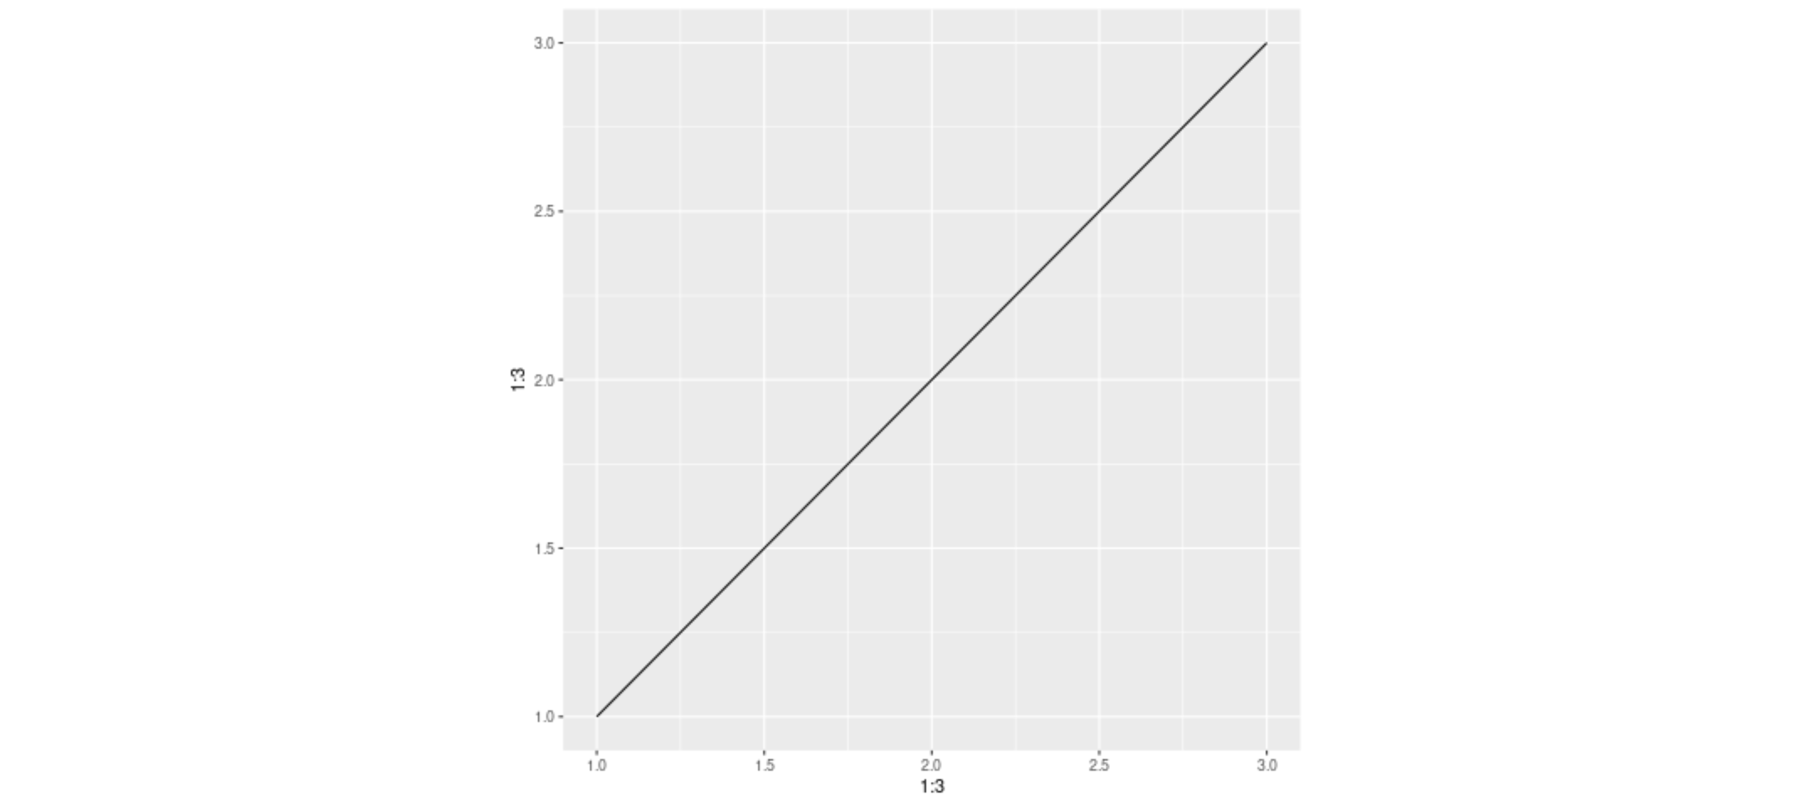
Plot from png file
script_IQSlidedeck.R | Date: 2026-06-09 09:47:10.047847

Slide 7

Plot from pdf file
script_IQSlidedeck.R | Date: 2026-06-09 09:47:11.742142

Slide 8
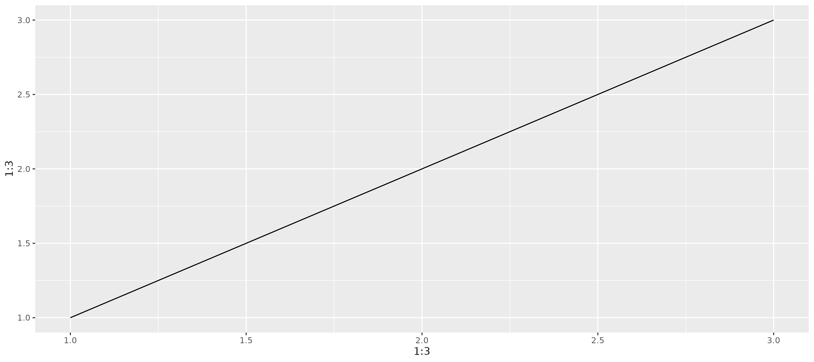
Plot from ggplot object
script_IQSlidedeck.R | Date: 2026-06-09 09:47:16.873372

Slide 9
Slides with tables

Slide 10
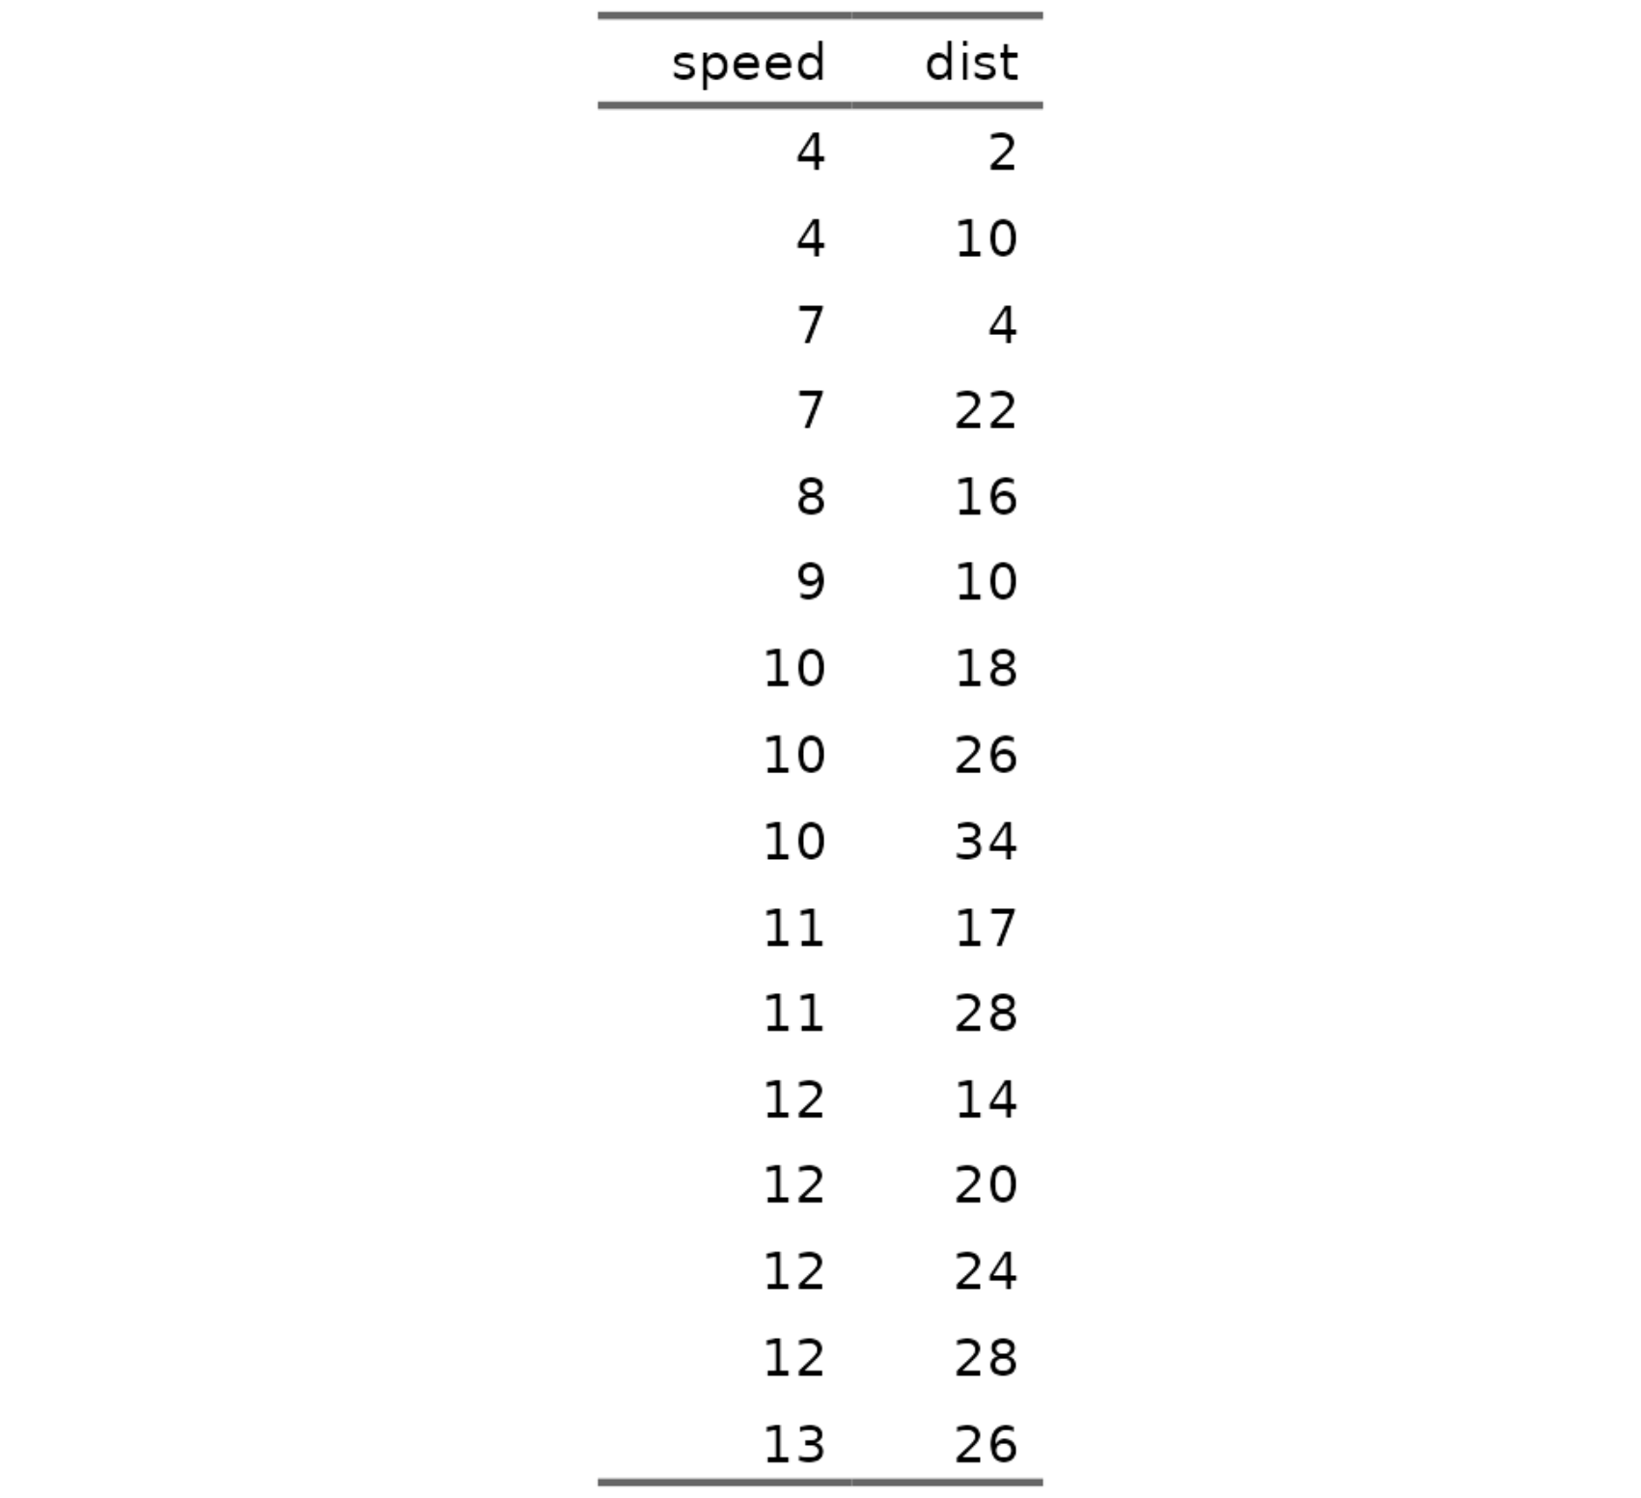
Overview of cars distance vs time to stop shown as table
Cars data set from R datasets
The data vie the speed of cars and distances taken to stop
script_IQSlidedeck.R | Date: 2026-06-09 09:47:06.949497

Slide 11
Overview of cars distance vs time to stop shown as table
Bullet point with bold and italic
Another bullet point
Indented by two spaces
Another one
And back to really outer level
Some sort of formula E_{rel} = m*c²
script_IQSlidedeck.R | Date: 2026-06-09 09:47:07.894159

Slide 12
Overview of cars distance vs time to stop shown as table
Bullet point with bold and italic
Another bullet point
Indented by two spaces
Another one
And back to really outer level
Some sort of formula E_{rel} = m*c²
script_IQSlidedeck.R | Date: 2026-06-09 09:47:09.029357

Slide 13
Layouts

Slide 14
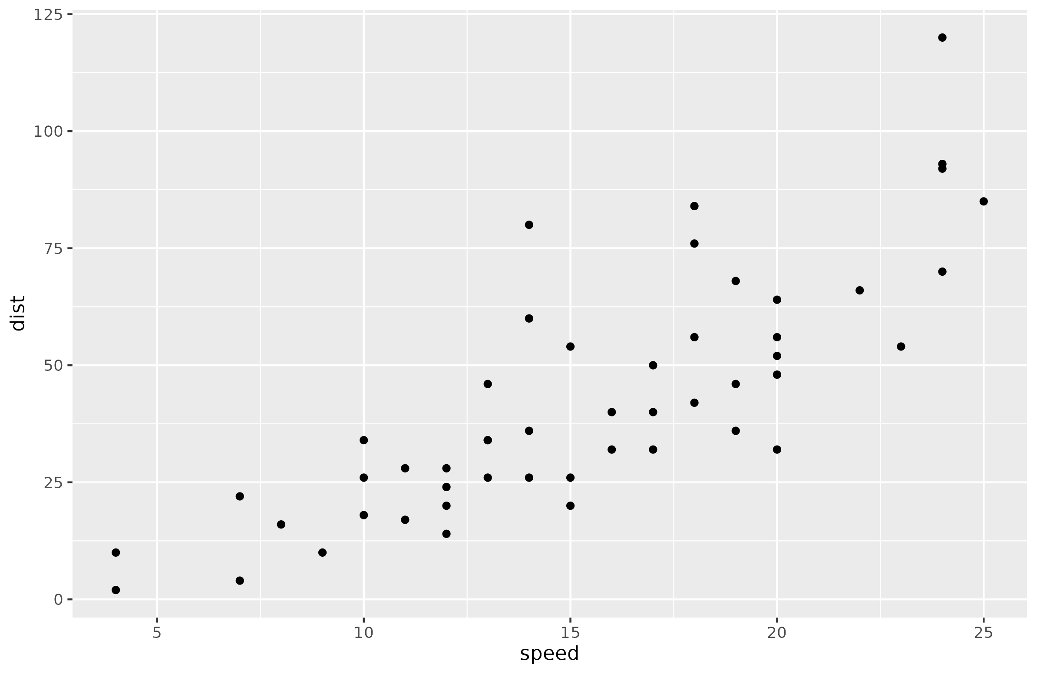
Two Content Right Bigger
Cars data set from R datasets
The data vie the speed of cars and distances taken to stop
script_IQSlidedeck.R | Date: 2026-06-09 09:47:17.913721

Slide 15
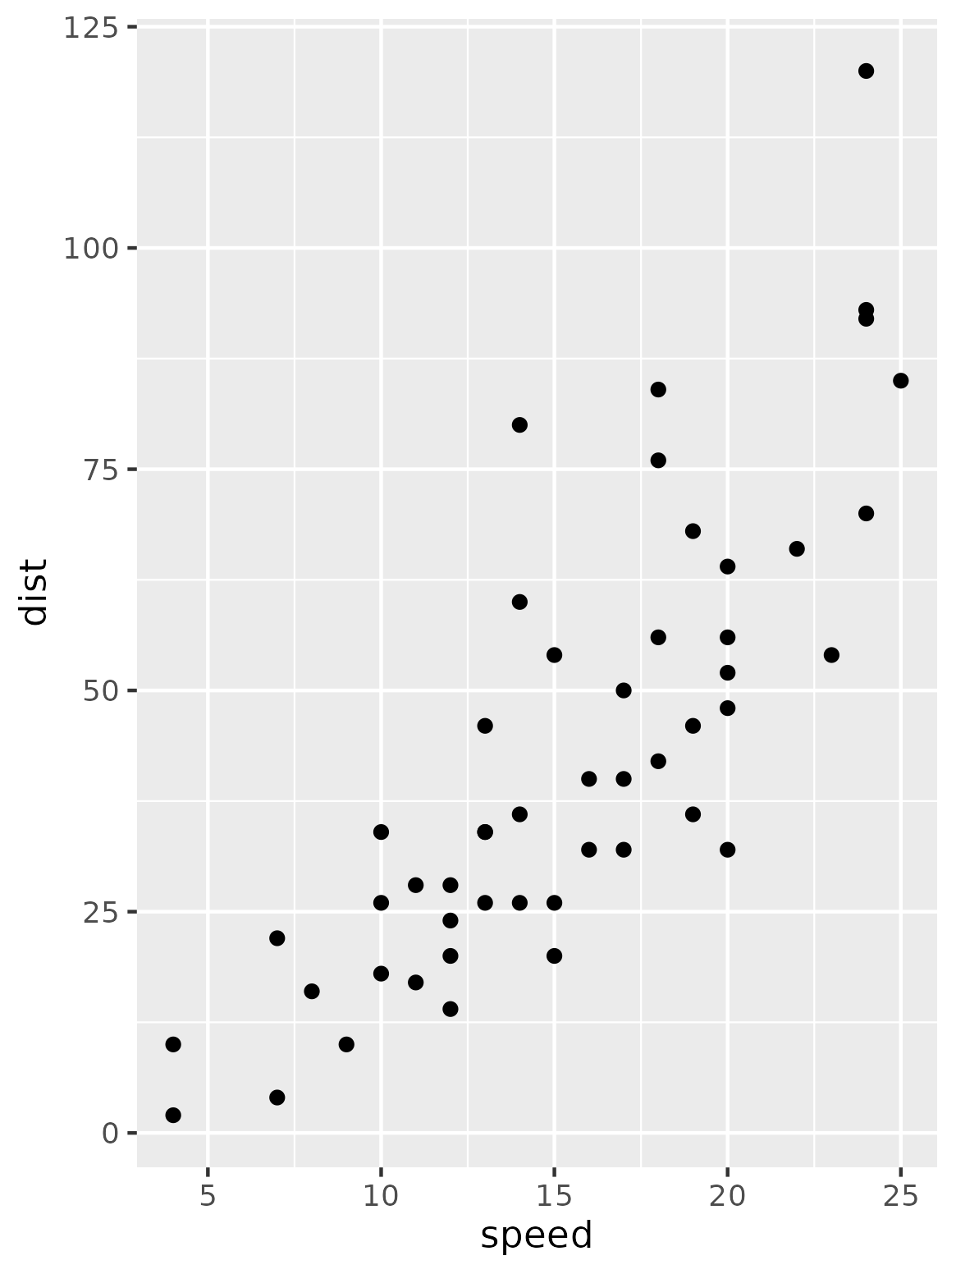
Two Content Right Bigger
script_IQSlidedeck.R | Date: 2026-06-09 09:47:17.981216

Slide 16
Two Content Right Bigger
Cars data set from R datasets
The data vie the speed of cars and distances taken to stop
script_IQSlidedeck.R | Date: 2026-06-09 09:47:18.055995

Slide 17
Two Content Right Bigger
Cars data set from R datasets
The data vie the speed of cars and distances taken to stop
script_IQSlidedeck.R | Date: 2026-06-09 09:47:18.126241

Slide 18
Test IQR Objects

Slide 19
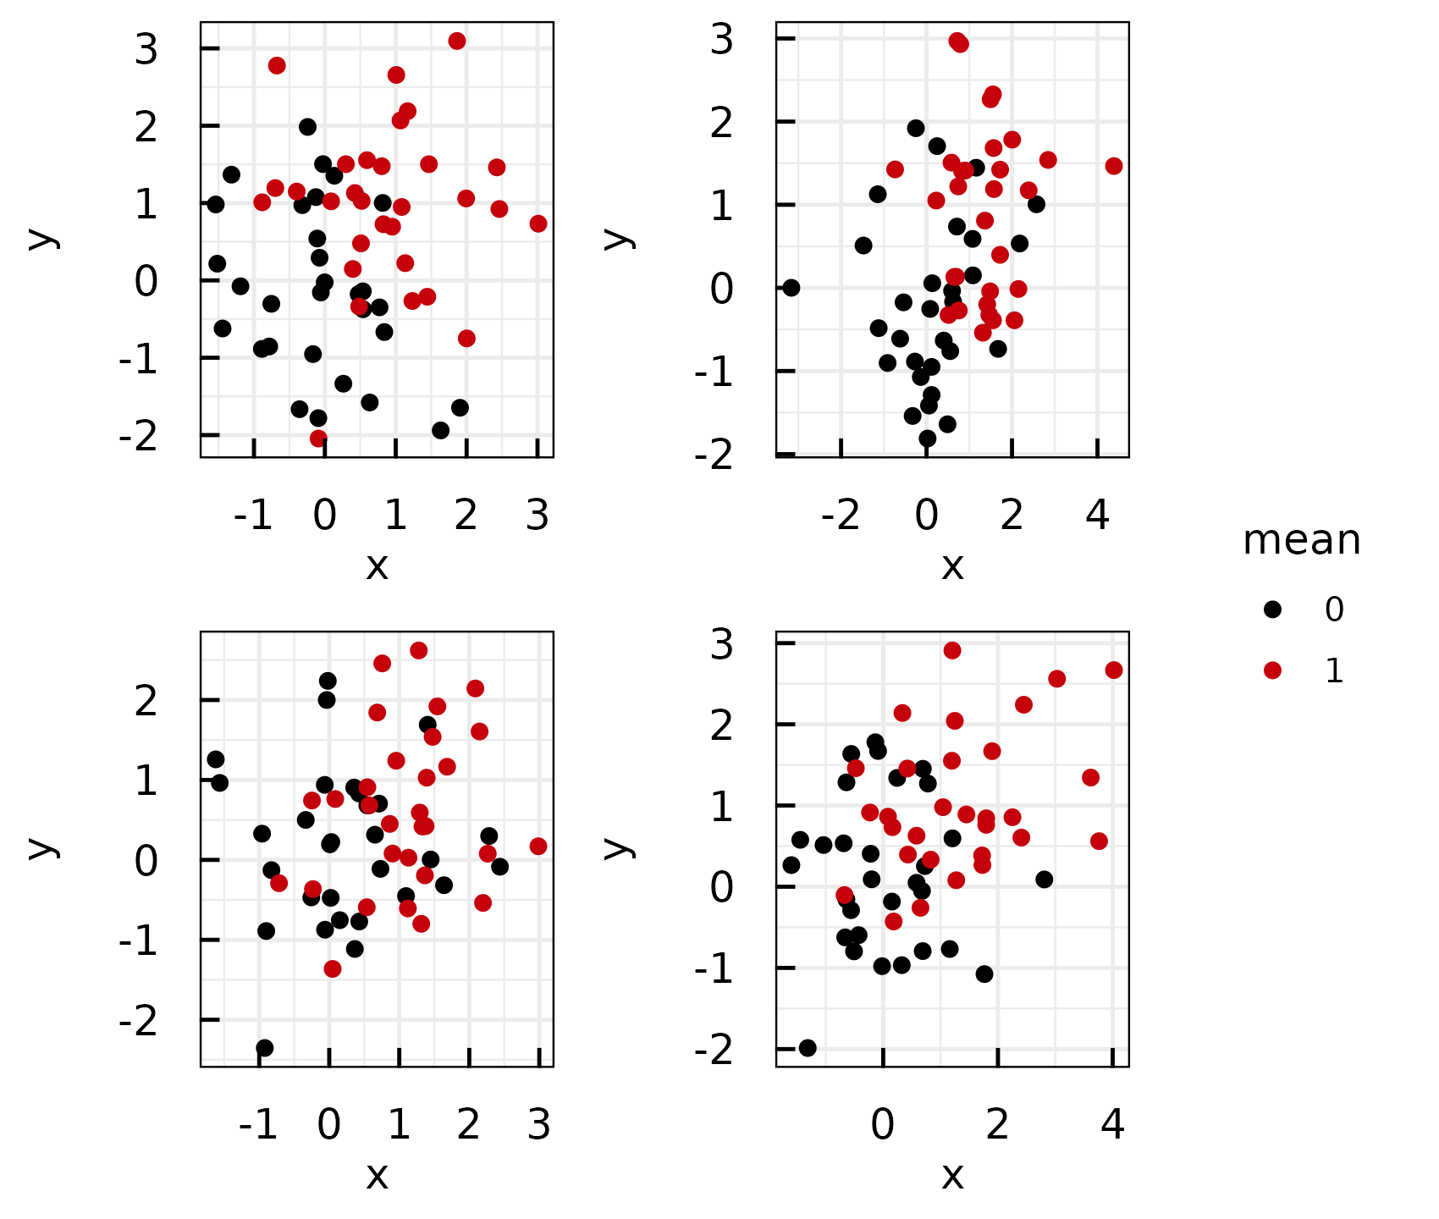
Plotting white noise (1)
A list of ggplot objects was created
Called IQRoutputFigure with arguments nrow, ncol, footer and filename
Called IQRoutputPPTX with bullet point list and IQRoutputFigure object.
Normally distributed random numbers were used. File: ../Output/01_test/normal_distributions.pdf
IQSlidedeck_IQRobjects.R | Date: 2026-06-09 09:48:12.23004

Slide 20
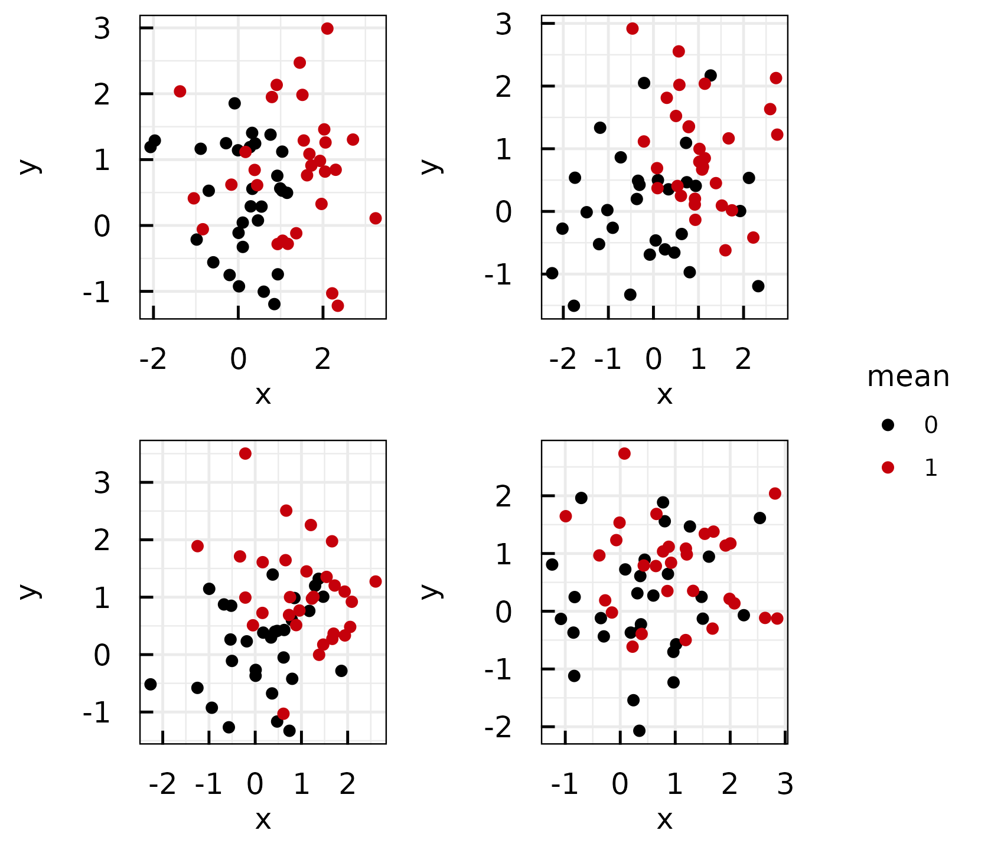
Plotting white noise (2)
A list of ggplot objects was created
Called IQRoutputFigure with arguments nrow, ncol, footer and filename
Called IQRoutputPPTX with bullet point list and IQRoutputFigure object.
Normally distributed random numbers were used. File: ../Output/01_test/normal_distributions.pdf
IQSlidedeck_IQRobjects.R | Date: 2026-06-09 09:48:14.337468

Slide 21
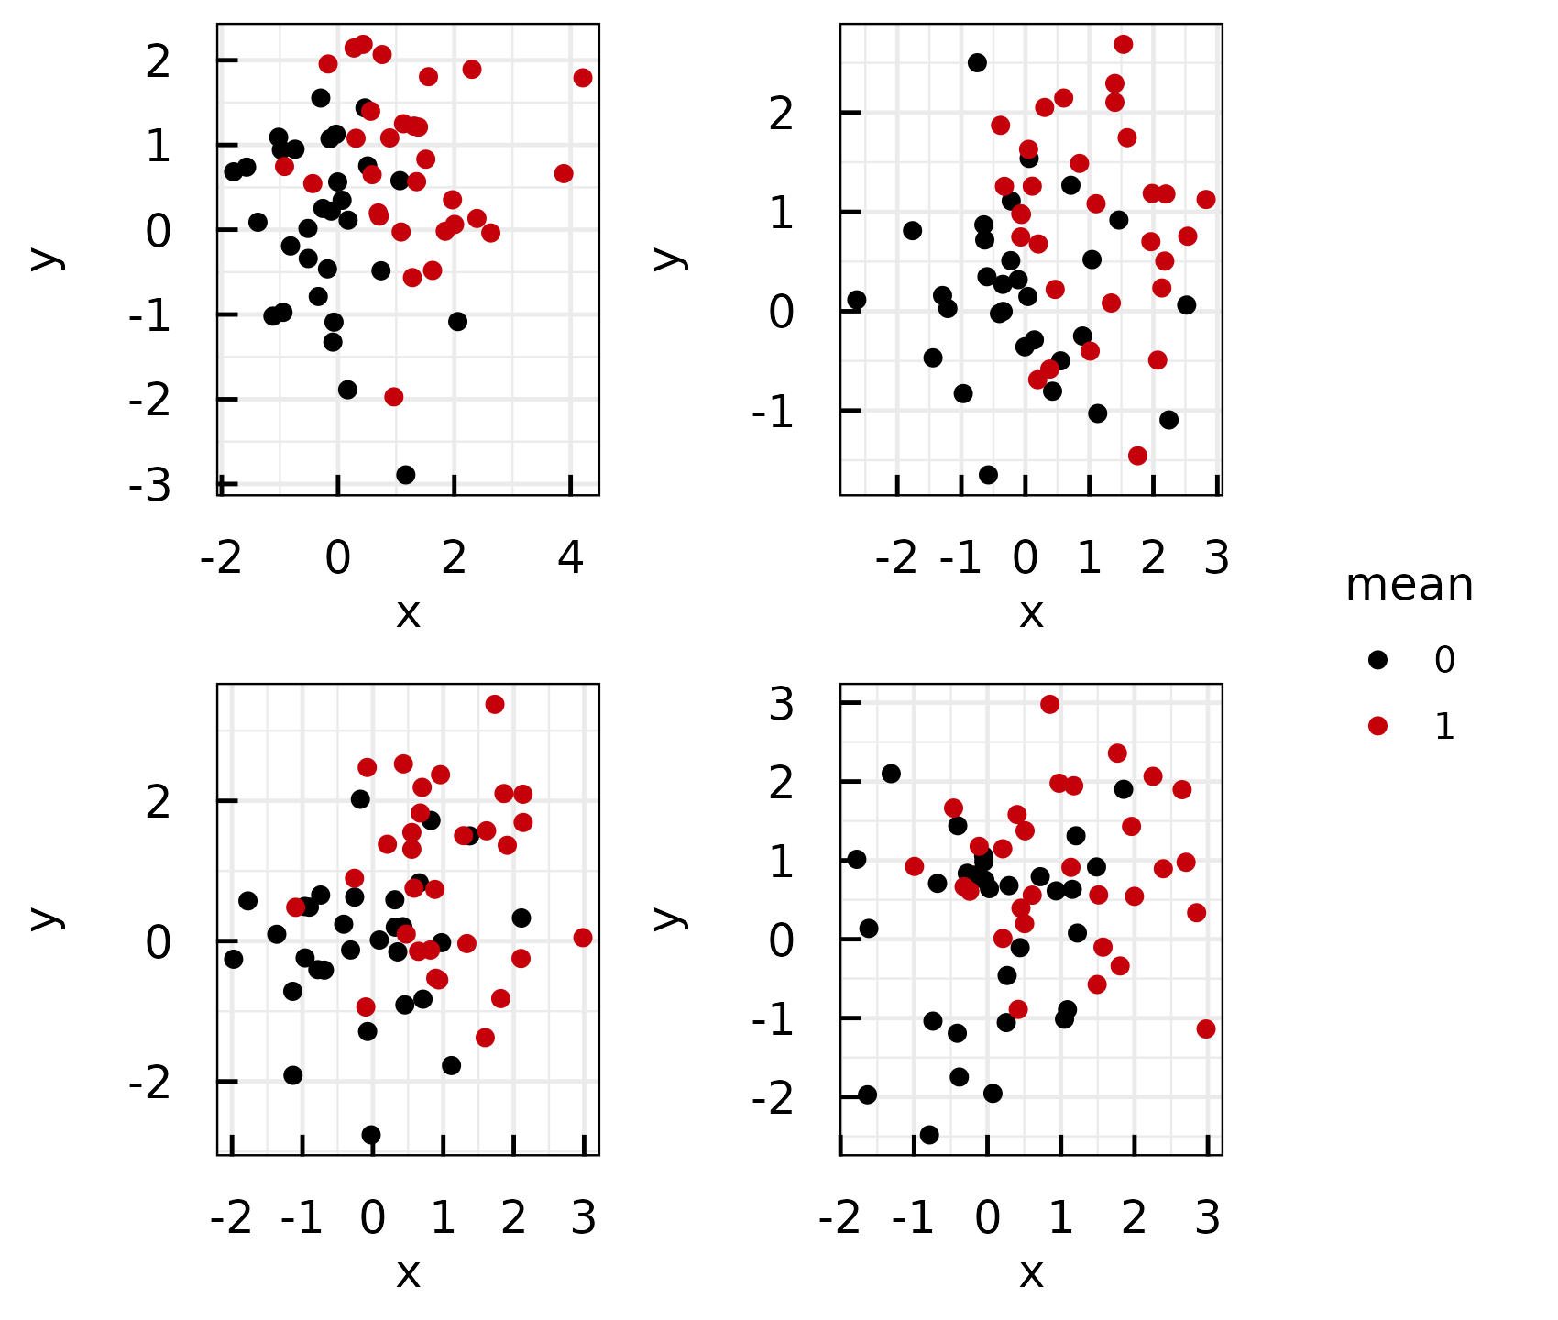
Plotting white noise (3)
A list of ggplot objects was created
Called IQRoutputFigure with arguments nrow, ncol, footer and filename
Called IQRoutputPPTX with bullet point list and IQRoutputFigure object.
Normally distributed random numbers were used. File: ../Output/01_test/normal_distributions.pdf
IQSlidedeck_IQRobjects.R | Date: 2026-06-09 09:48:16.673334

Slide 22
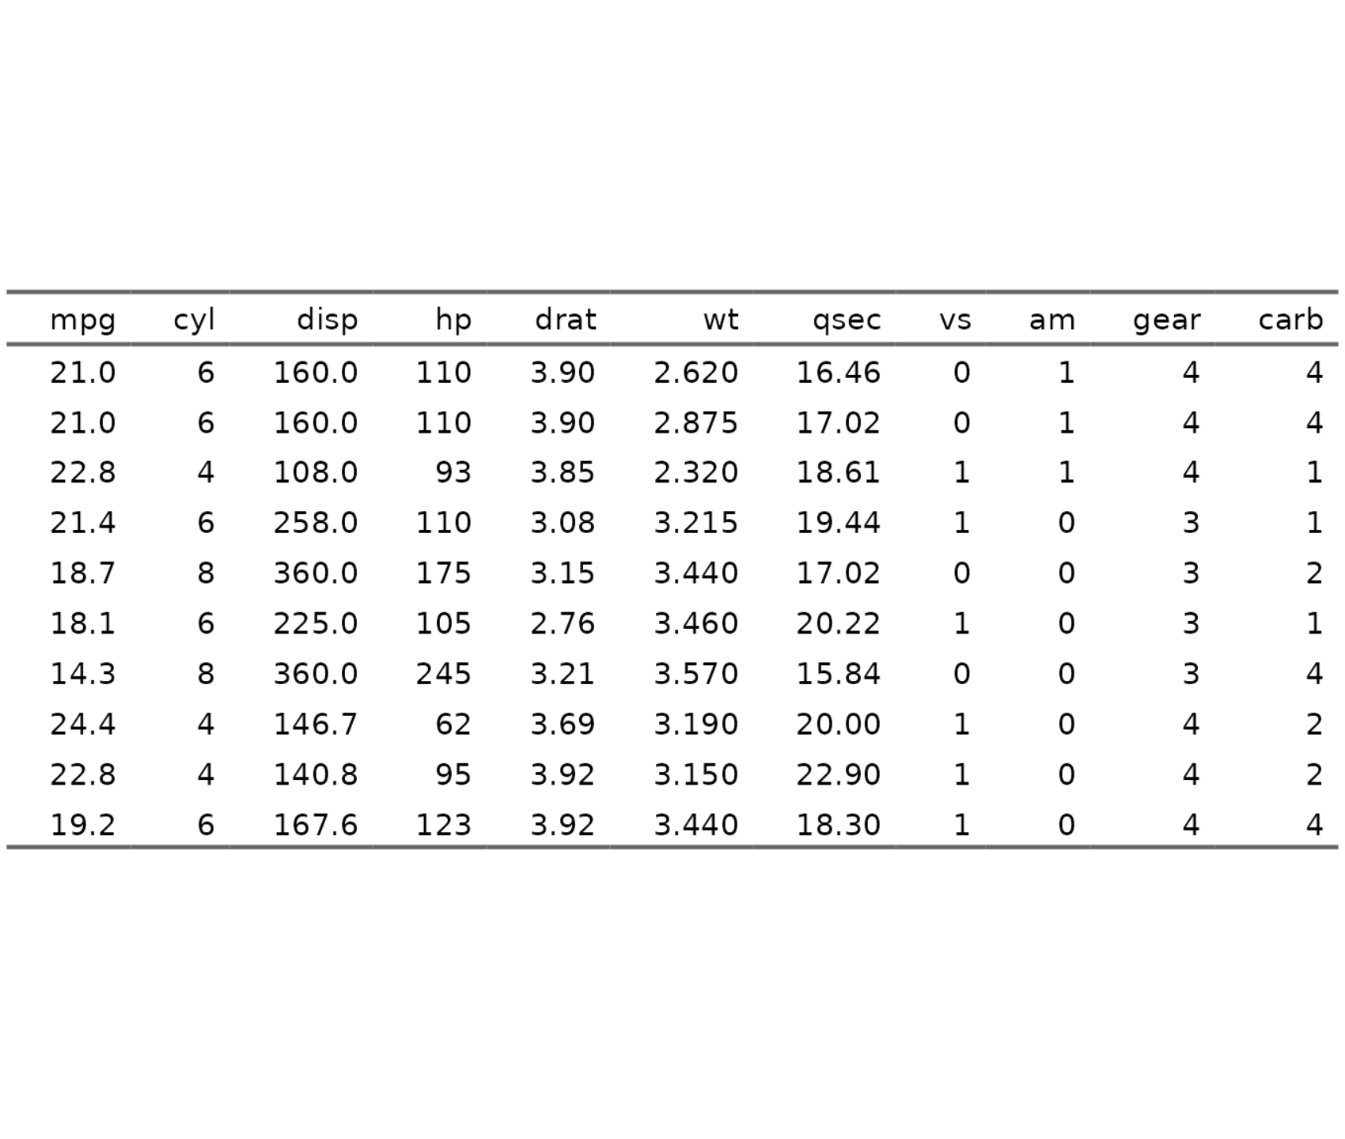
Well-known table
Used well known standard data set mtcars
Applied IQRoutputTable with arguments xfooter and filename
Called IQRoutputPPTX with bullet point list and IQRoutputTable object
See R datasets::mtcars File: ../Output/01_test/cars_table.txt
IQSlidedeck_IQRobjects.R | Date: 2026-06-09 09:48:20.406817

Slide 23
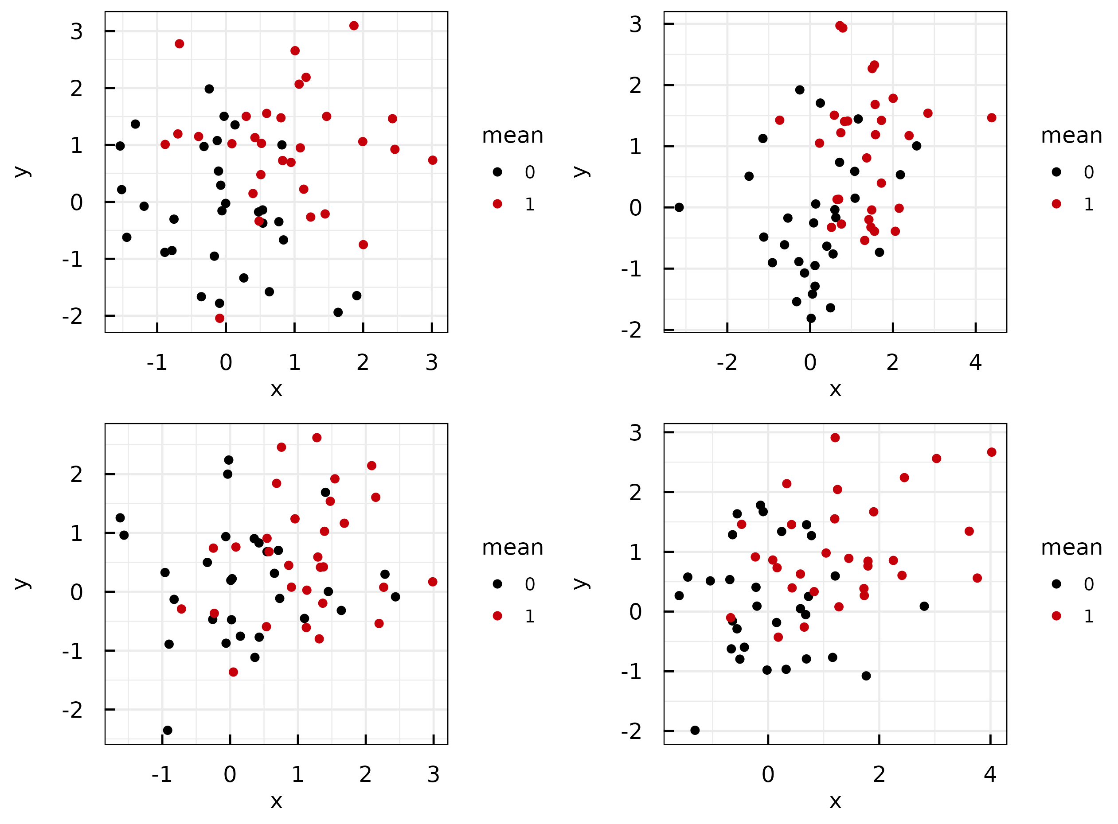
Plotting white noise and testing the wide title layout
File: ../Output/01_test/subset_normal_distributions.pdf
IQSlidedeck_IQRobjects.R | Date: 2026-06-09 09:48:24.229172

Slide 24
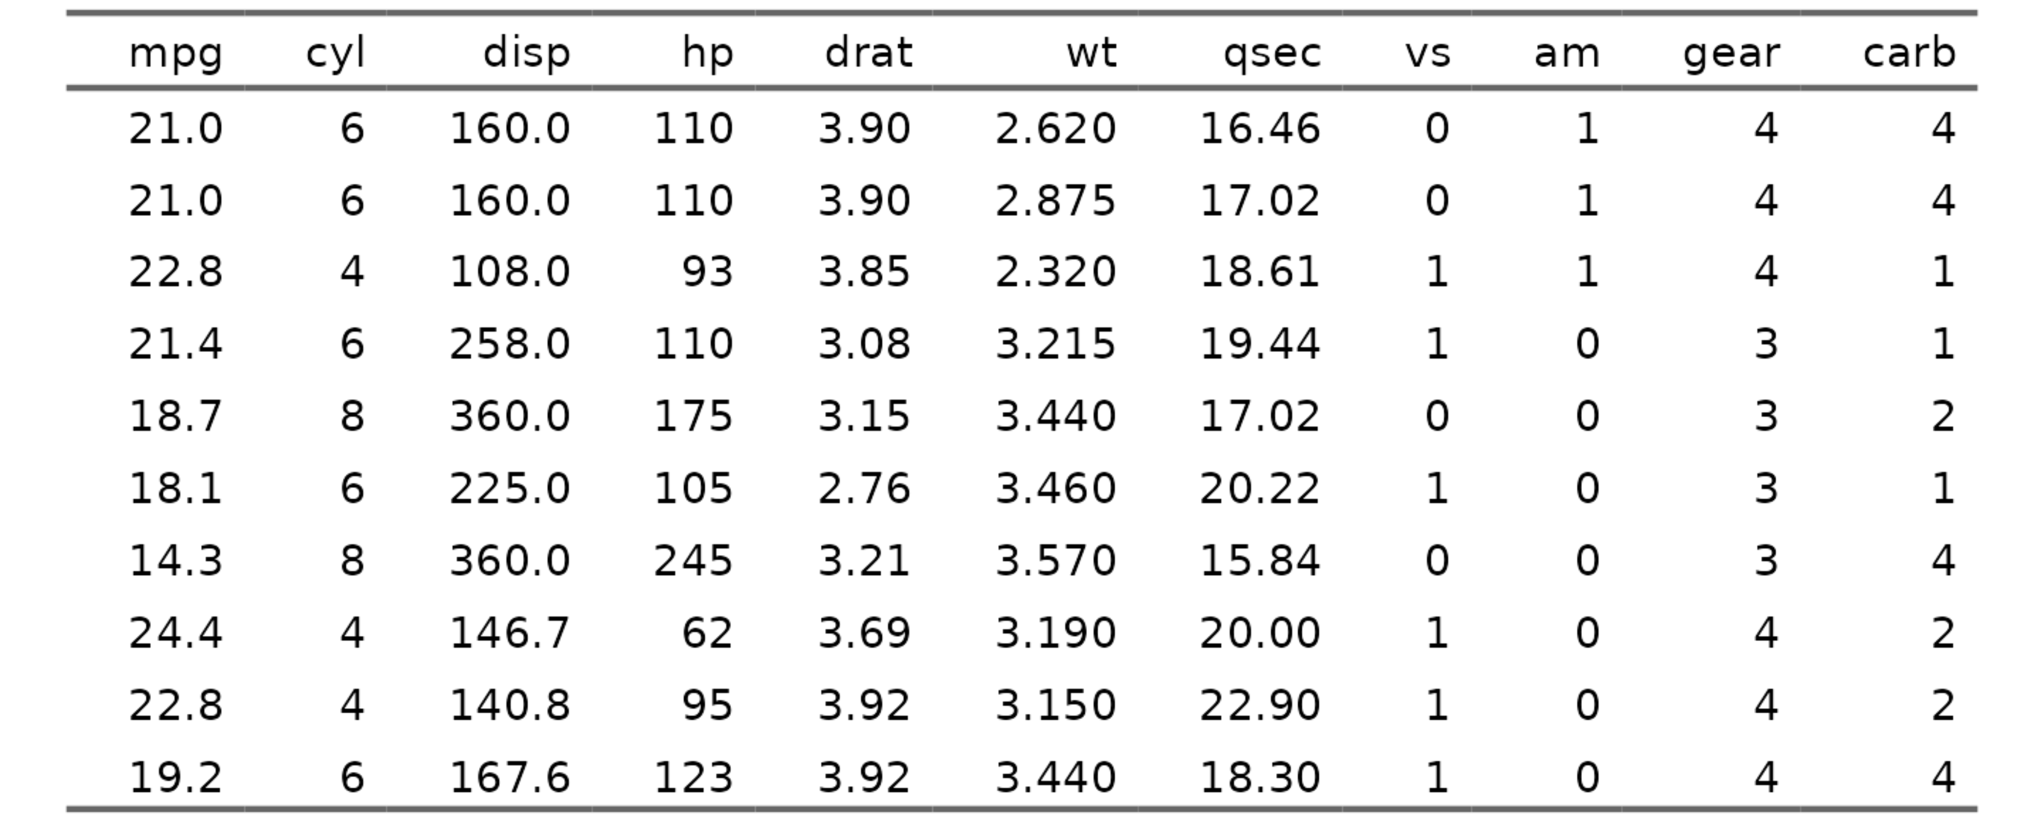
Cars data set
See R datasets::mtcars File: ../Output/01_test/cars_table.txt
IQSlidedeck_IQRobjects.R | Date: 2026-06-09 09:48:27.041398

Slide 25
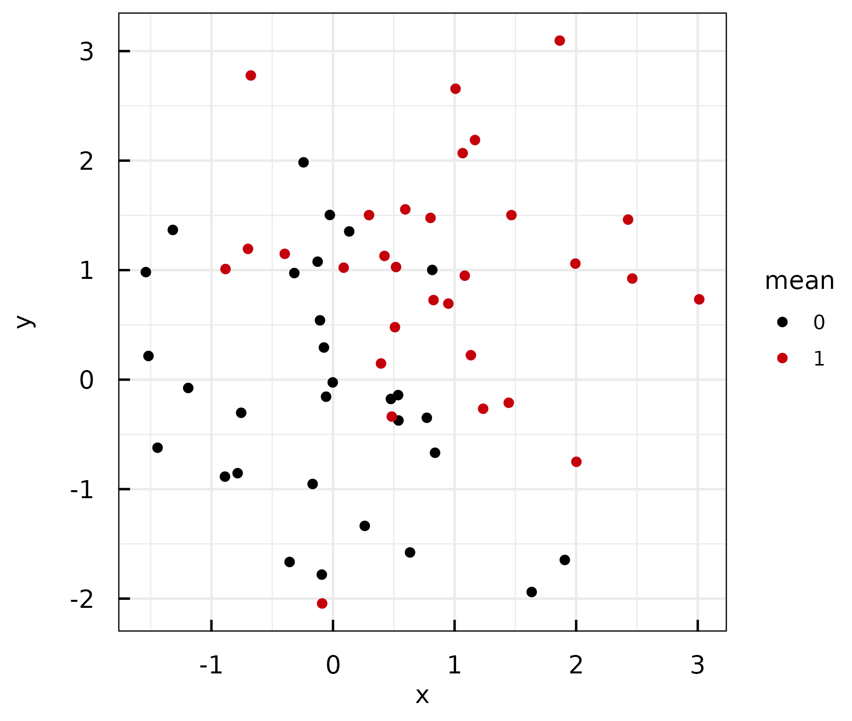
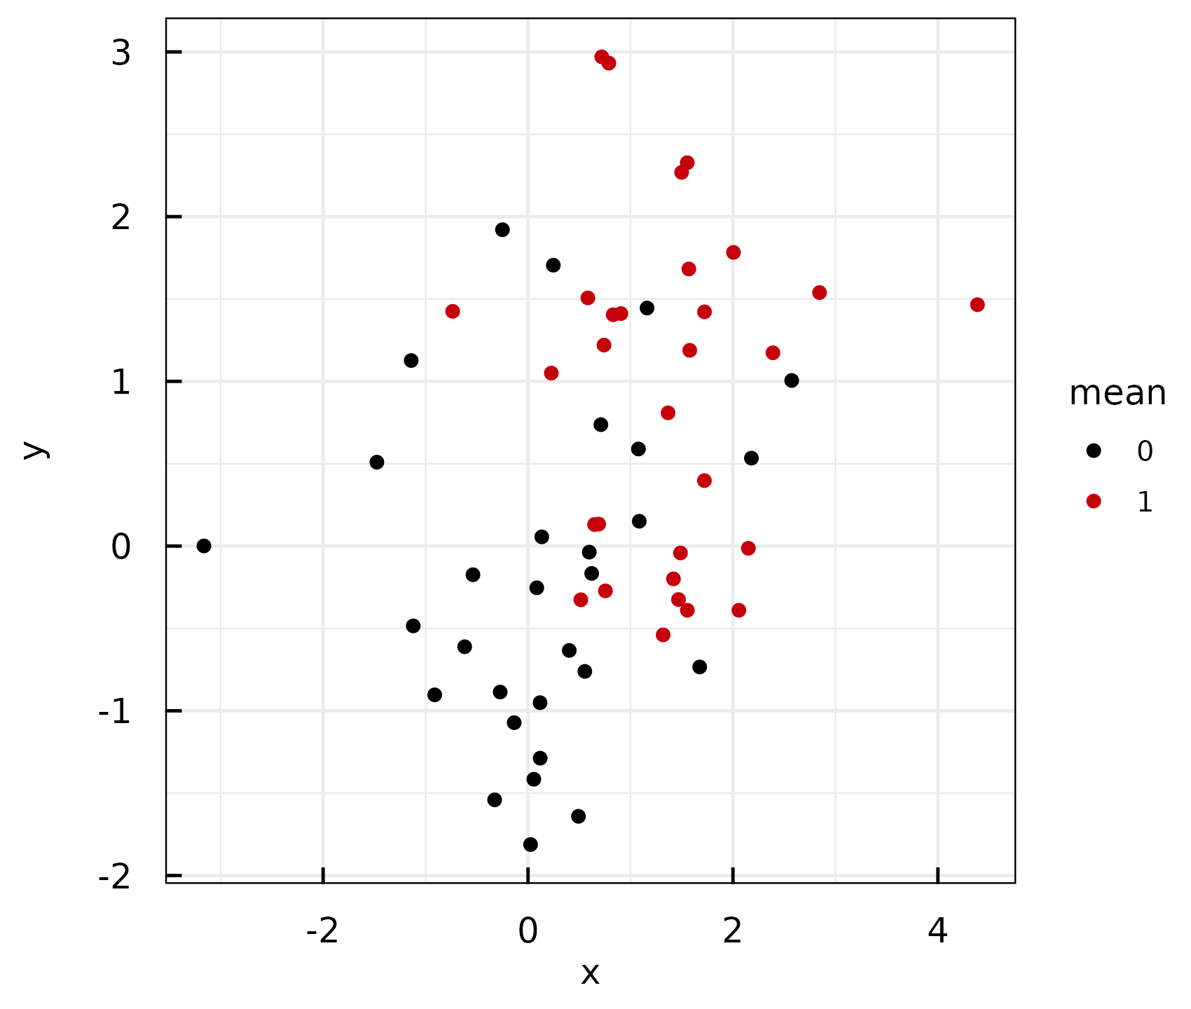
Normally distributed random numbers were used. File: ../Output/01_test/normal_distributions_longlist.pdf
Normally distributed random numbers were used. File: ../Output/01_test/normal_distributions_longlist.pdf
IQSlidedeck_IQRobjects.R | Date: 2026-06-09 09:48:28.695461

