Slide 1
Test Slide Deck
Cars and the time they take to stop
2024-10-03
Daniel Kaschek, IntiQuan

Slide 2
Plain Slides

Slide 3
Just a test
Cars data set from R datasets
The data vie the speed of cars and distances taken to stop shown as plot
script_IQSlidedeck.R | Date: 2024-10-03 11:57:35.957633

Slide 4
Slides with plots

Slide 5
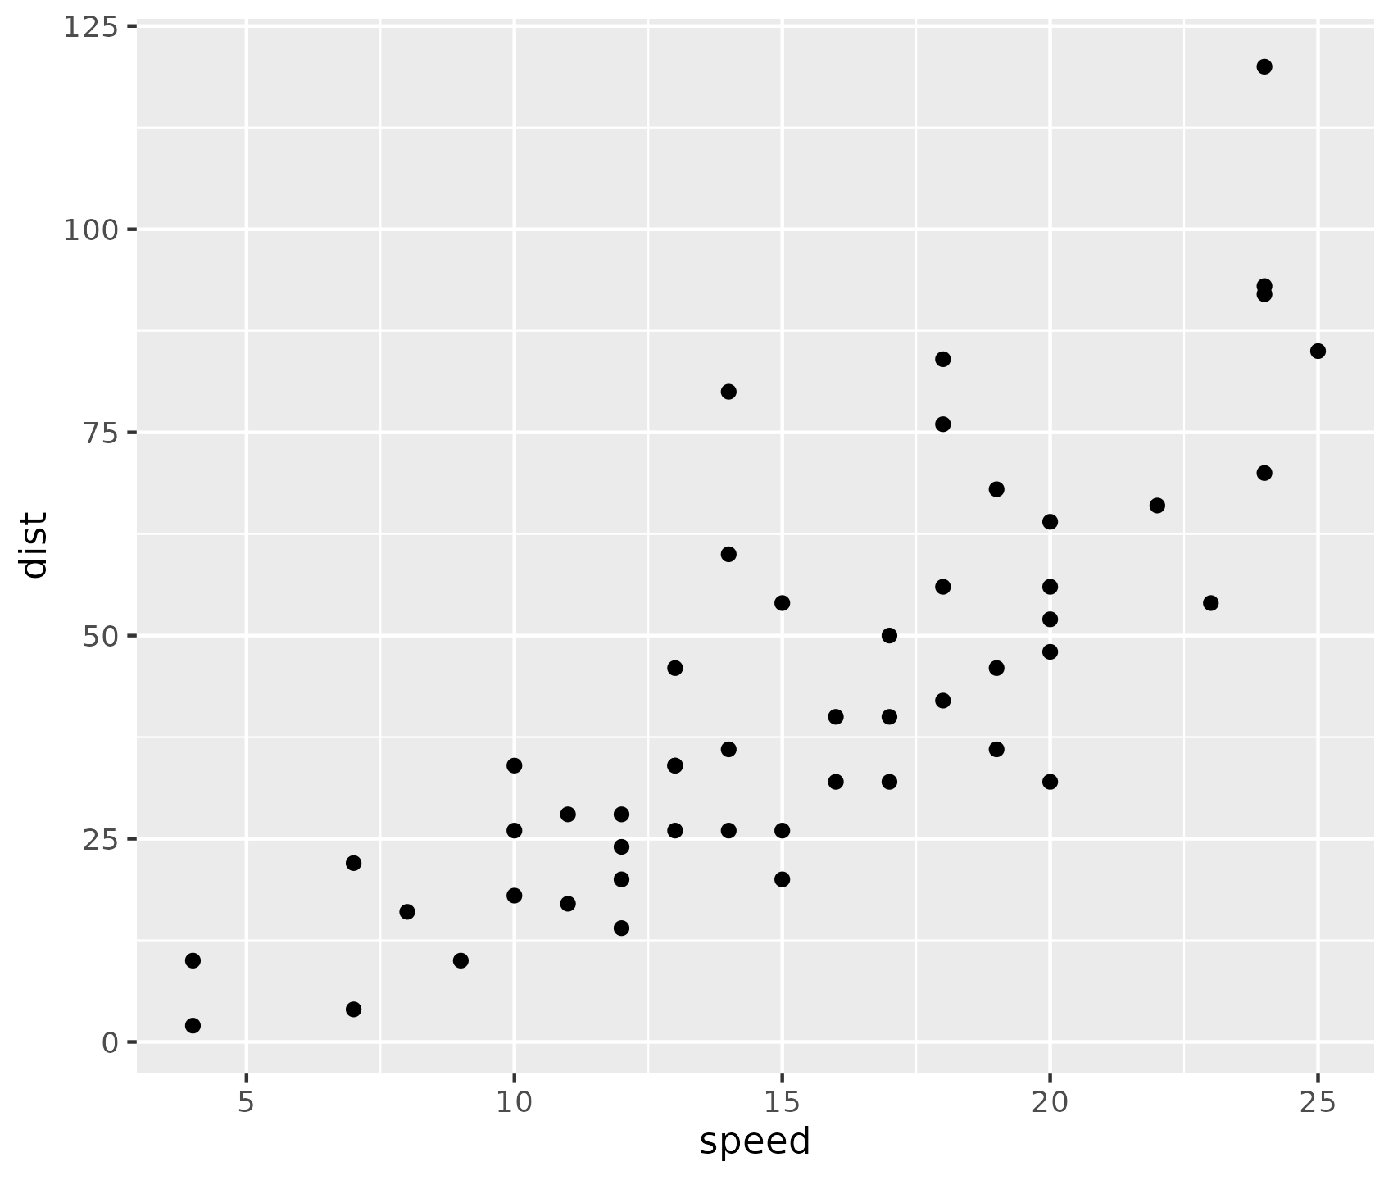
Overview of cars distance vs time to stop
Cars data set from R datasets
The data vie the speed of cars and distances taken to stop shown as plot
Source: Ezekiel, M. (1930) Methods of Correlation Analysis. Wiley.
script_IQSlidedeck.R | Date: 2024-10-03 11:57:36.096123

Slide 6
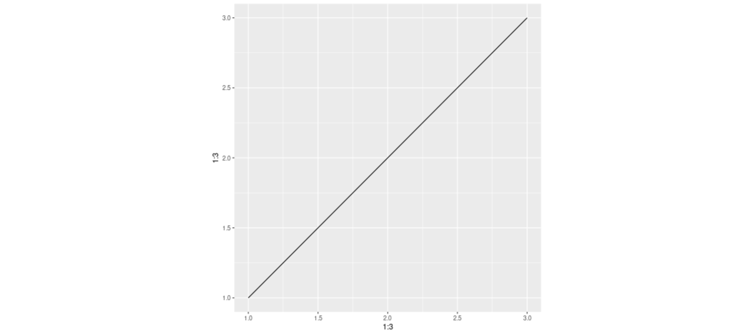
Plot from png file
script_IQSlidedeck.R | Date: 2024-10-03 11:57:39.334171

Slide 7

Plot from pdf file
script_IQSlidedeck.R | Date: 2024-10-03 11:57:40.800531

Slide 8
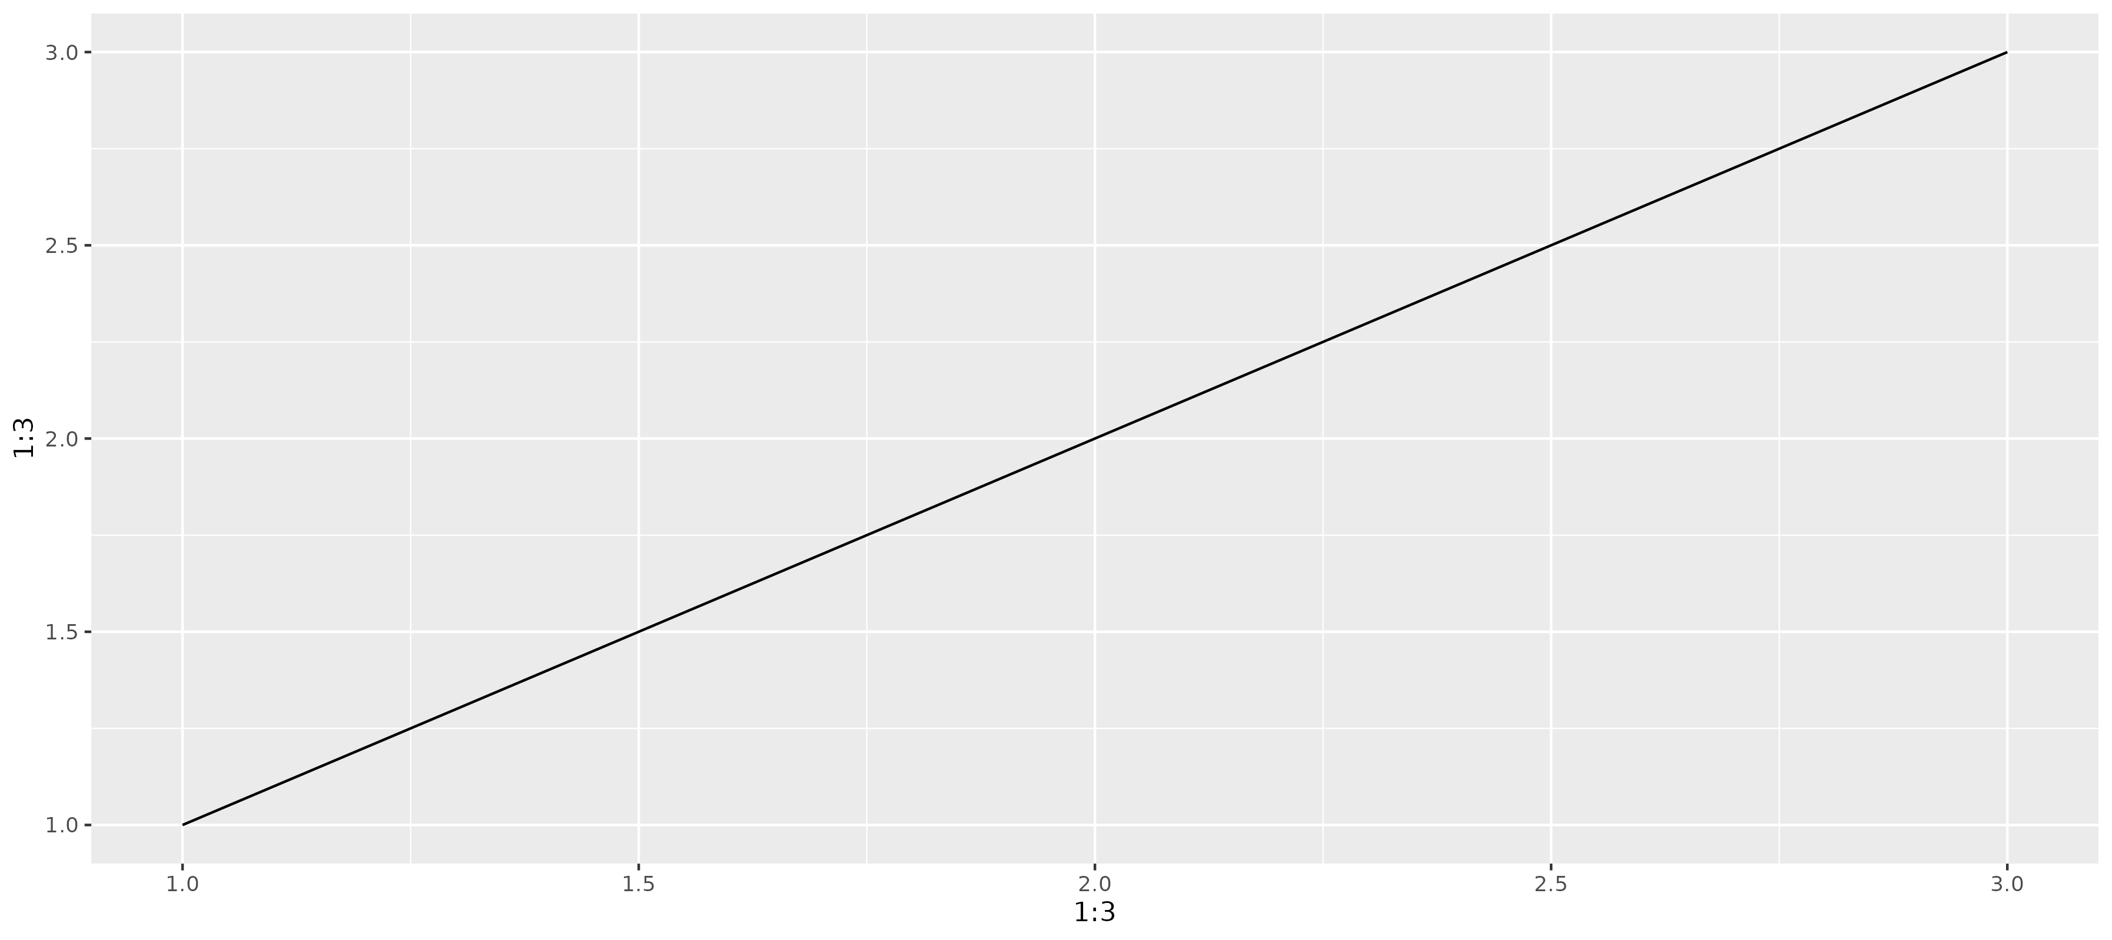
Plot from ggplot object
script_IQSlidedeck.R | Date: 2024-10-03 11:57:47.295396

Slide 9
Slides with tables

Slide 10
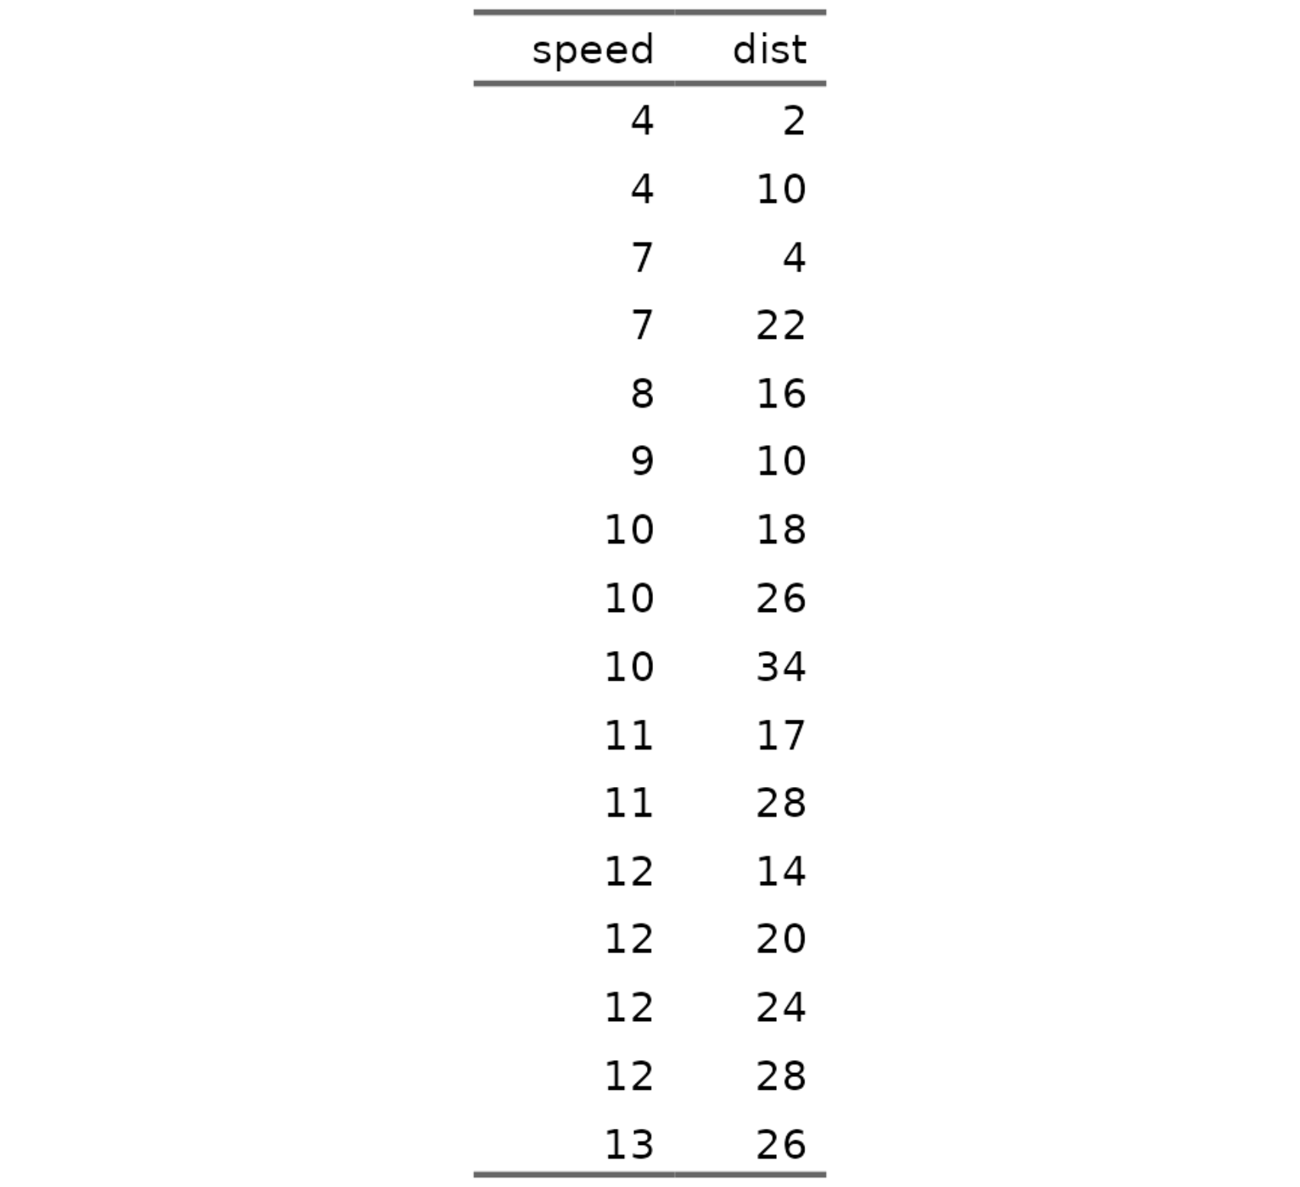
Overview of cars distance vs time to stop shown as table
Cars data set from R datasets
The data vie the speed of cars and distances taken to stop
script_IQSlidedeck.R | Date: 2024-10-03 11:57:36.691939

Slide 11
Overview of cars distance vs time to stop shown as table
Bullet point with bold and italic
Another bullet point
Indented by two spaces
Another one
And back to really outer level
Some sort of formula E_{rel} = m*c²
script_IQSlidedeck.R | Date: 2024-10-03 11:57:37.544605

Slide 12
Overview of cars distance vs time to stop shown as table
Bullet point with bold and italic
Another bullet point
Indented by two spaces
Another one
And back to really outer level
Some sort of formula E_{rel} = m*c²
script_IQSlidedeck.R | Date: 2024-10-03 11:57:38.573462

Slide 13
Layouts

Slide 14
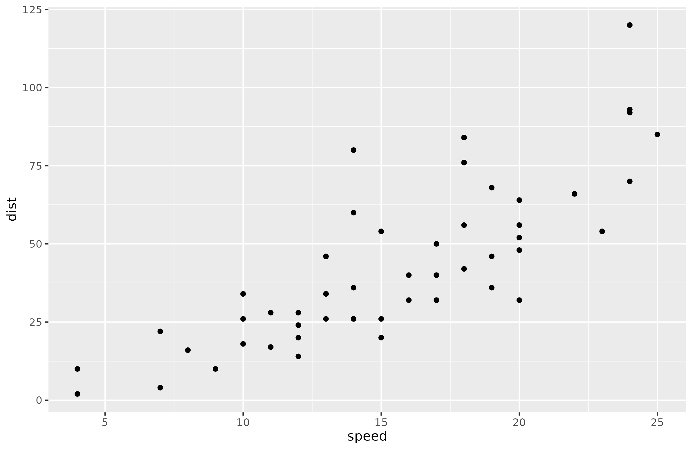
Two Content Right Bigger
Cars data set from R datasets
The data vie the speed of cars and distances taken to stop
script_IQSlidedeck.R | Date: 2024-10-03 11:57:47.755544

Slide 15
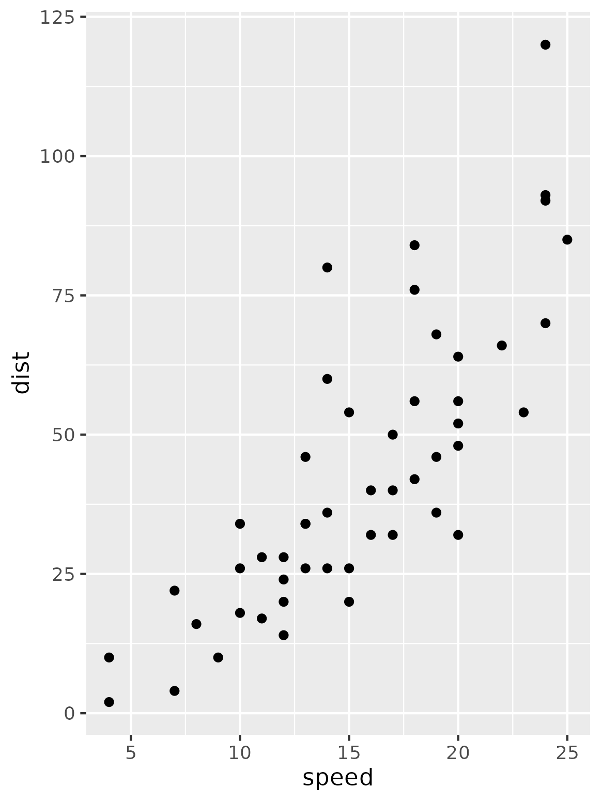
Two Content Right Bigger
script_IQSlidedeck.R | Date: 2024-10-03 11:57:47.794485

Slide 16
Two Content Right Bigger
Cars data set from R datasets
The data vie the speed of cars and distances taken to stop
script_IQSlidedeck.R | Date: 2024-10-03 11:57:47.830845

Slide 17
Two Content Right Bigger
Cars data set from R datasets
The data vie the speed of cars and distances taken to stop
script_IQSlidedeck.R | Date: 2024-10-03 11:57:47.865052

