Slide 1
Is Randall Munroe Normal?
Pretty Fly
A study from the heart and mind of Noah Elbaum

Slide 2
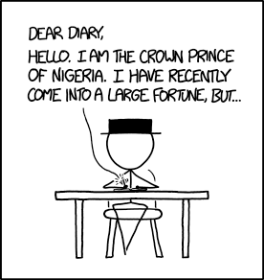
Who Is Randall Munroe?

Slide 3
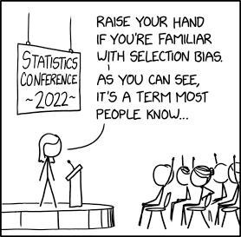
What is Normal?
Similar word frequency as general written English
Writing sample: xkcd alt texts

Slide 4
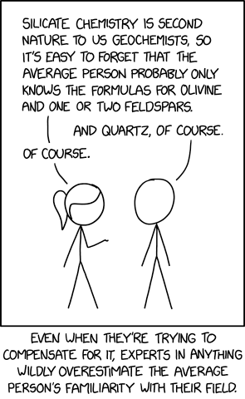
Prediction
Obscure scientific words much more frequently
Mr. Moden also thought we would see a distinct word choice/writing style

Slide 5
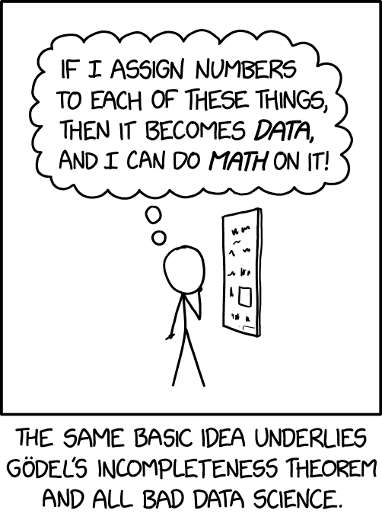
Scraping the website(s)
xkcd websites follow a formula: https://m.xkcd.com/{number Of Comic}/
Data scraped:
Alt-texts
The penultimate comic’s number

Slide 6
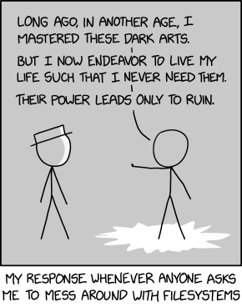
Working With Files
Binary file of all alt-texts
In binary because of special characters
CSV file of over 32,000 English words and how frequently they appear (presumably the file was made by counting the number of times it appears in a lot of texts and storing the word and its count)

Slide 7
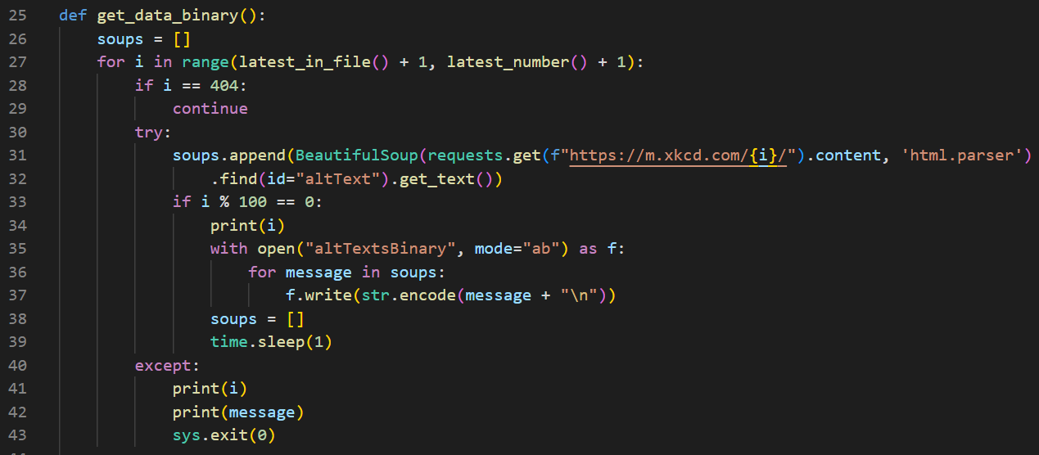
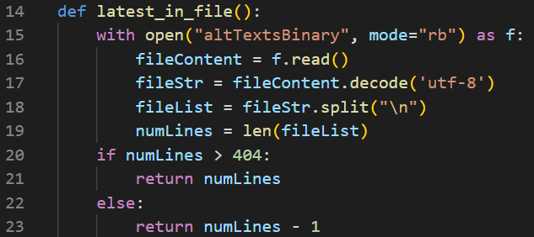

Slide 8
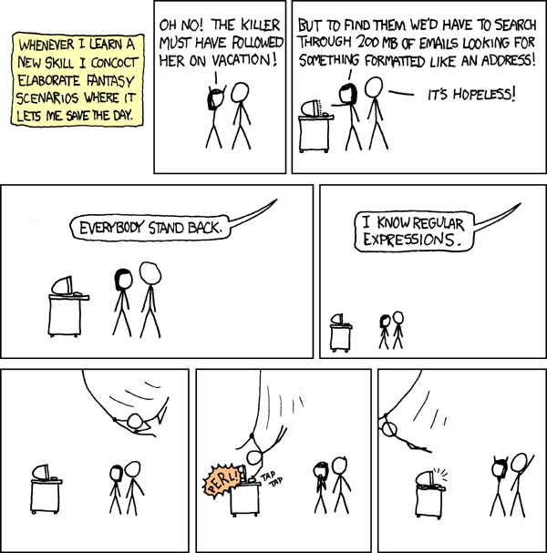
Other Stuff I Did
Regex pattern
Data Structures: lists and dictionaries
Functions: reduce and map

Slide 9
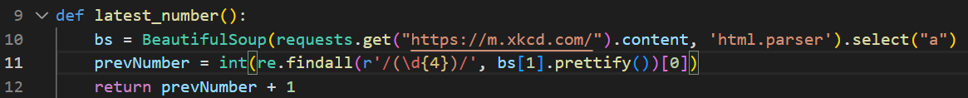
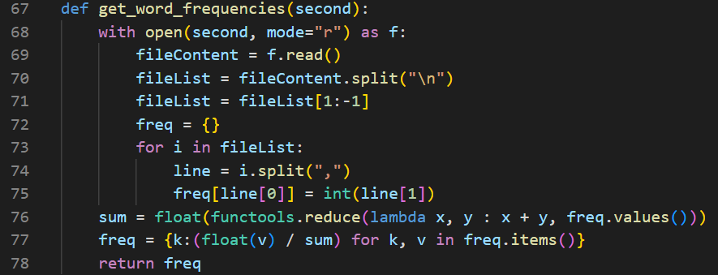
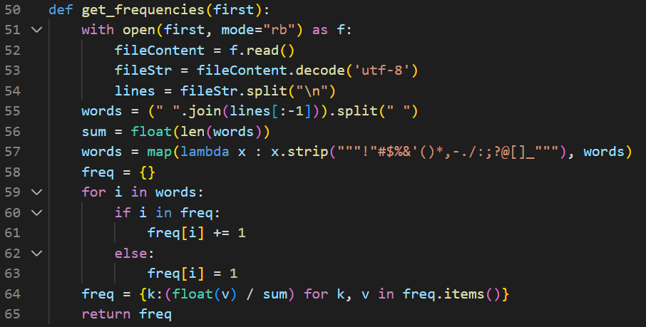

Slide 10
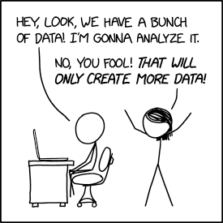
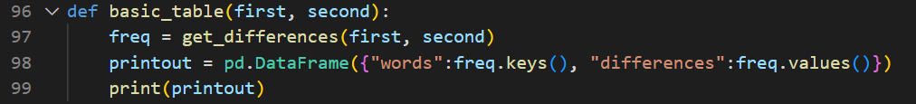
DataFrames

Slide 11
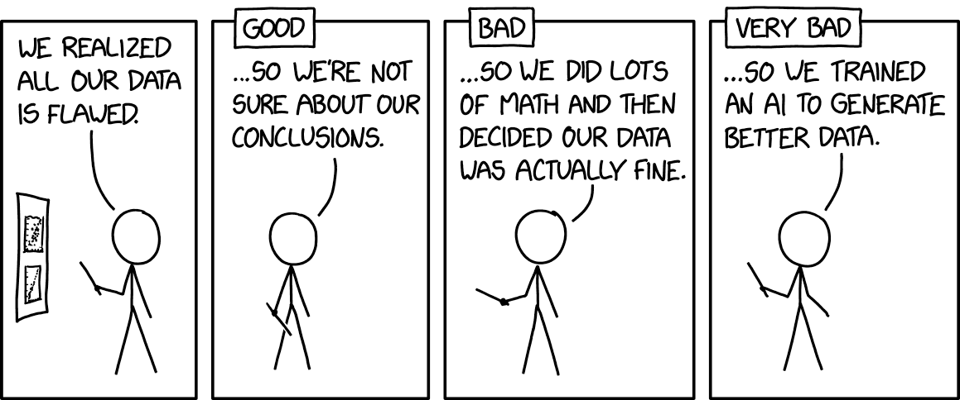
Conclusions
Randall Munroe is normal
Uses “I” 1.2% more frequently
“we” “a” “to” “about” “the” “into” “it’s” “that” “can” “be”
Alt-texts are very short captions that need a base level of grammatical words and have space for only 1-2 complex, meaningful words, so lots more basic words are used.

