Slide 1

Chapter 10
Trees Plus

Slide 2
Trees Plus
Chapter 8 introduced the binary tree, a useful structure for implementing ADTs
However, its efficiency is only guaranteed if the tree is balanced (near log₂N height)
This chapter explores binary trees that self-balance when nodes are added or removed

Slide 3
Balanced Binary Trees
Balance Factor: The difference in height between the two subtrees of a binary tree
A tree is balanced if its balance factor is 0 or 1
By rebalancing when the balance factor grows too large, tree operations will remain efficient
This should be checked after insertion and deletion operations, since these can change the height of the tree

Slide 4
AVL Trees
AVL Tree: A binary search tree that balances itself when the balance factor is greater than 1
It uses tree rotations to rebalance the tree if necessary after insertion and deletion
AVL Trees are O(log₂N) in the average and worst cases

Slide 5
Tree Rotations
Rotation: Switching the positions of a child node and its parent
The direction to rotate depends on the structure of the tree and the location of the inserted or deleted node
Every imbalance can be solved with only one or two rotations

Slide 6
The Four Rotation Cases
The rotation cases are based on the location of the inserted node
They’re the same for deleting a node; for simplicity, this discussion focuses on inserting nodes
The following examples discuss the rotations in terms of an unbalanced node T with two children, L (on the left) and R (on the right)
Remember, rotations are only used if the tree becomes unbalanced

Slide 7
The Four Rotation Cases (cont.)
Right rotation: Used when inserting into the left subtree of T’s left child
Left rotation: Used when inserting into the right subtree of T’s right child
Right-Left rotation: Used when inserting into the left subtree of T’s right child
Left-Right rotation: Used when inserting into the right subtree of T’s left child

Slide 8
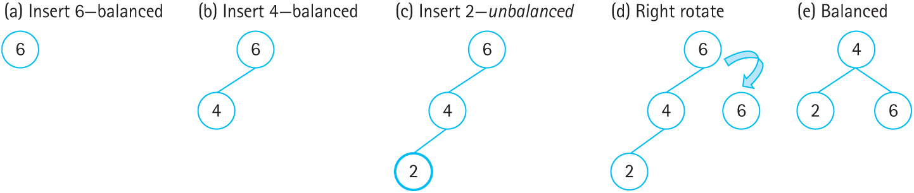
Right Rotation
Figure 10.2 Right rotation on an unbalanced tree (a) Insert 6- balanced
(b) Insert 4- balanced (c) Insert 2- unbalanced (d) Right rotate (e) balanced

Slide 9
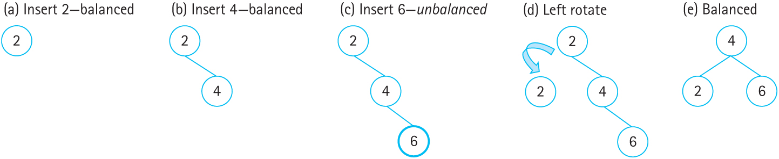
Left Rotation
Figure 10.3 Left rotation on an unbalanced tree (a) Insert 2- balanced
(b) Insert 4-balanced (c) Insert 6- unbalanced (d) Left rotate (e) Balanced

Slide 10
Single Rotations
A single left or right rotation reduces the height of the tree by 1
A right rotation is used if the height of the left subtree is greater than the right subtree
A left rotation is used if the height of the right subtree is greater than the left subtree

Slide 11
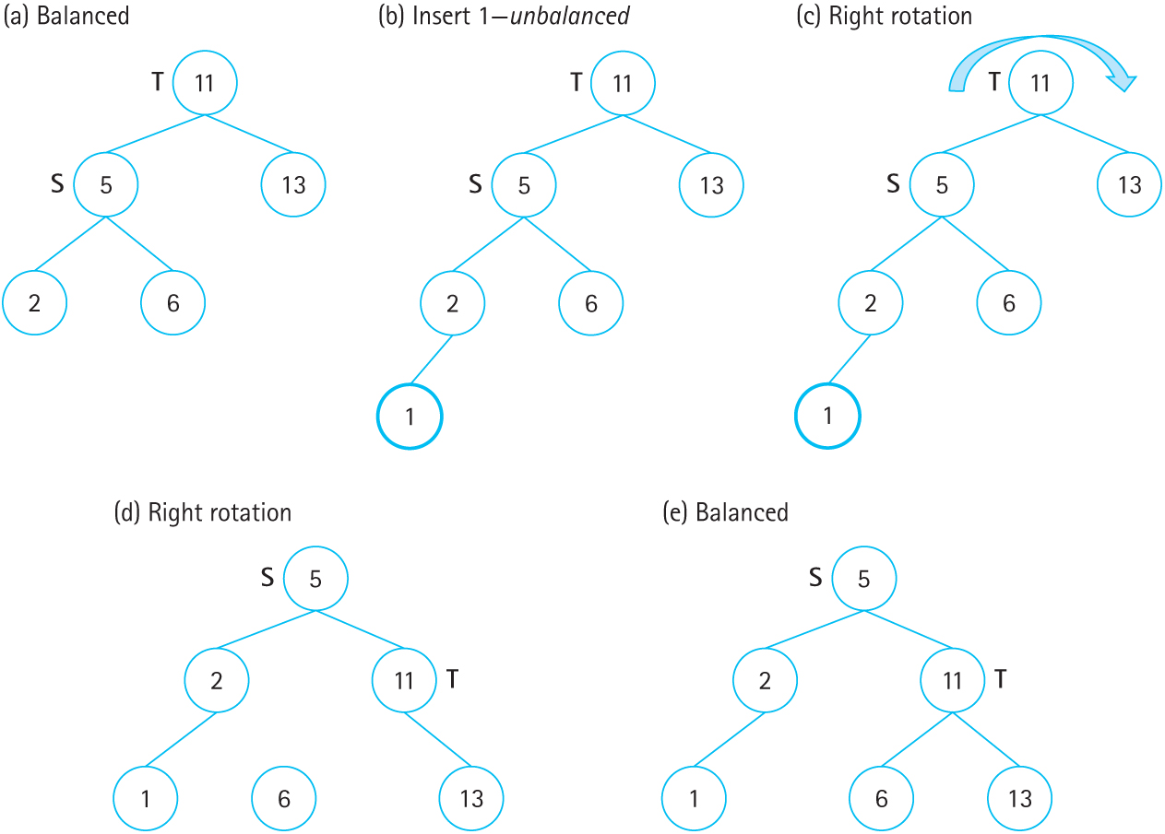
Right Rotation
Figure 10.6 Right rotation on AVL tree after insert (a) Balanced (b) Insert 1- unbalanced (c) Right rotation (d) Right rotation (e) Balanced

Slide 12
Double Rotations
Sometimes a single rotation is not enough
Instead, a double rotation is used
The first rotation in the double sets up the tree for the second rotation

Slide 13
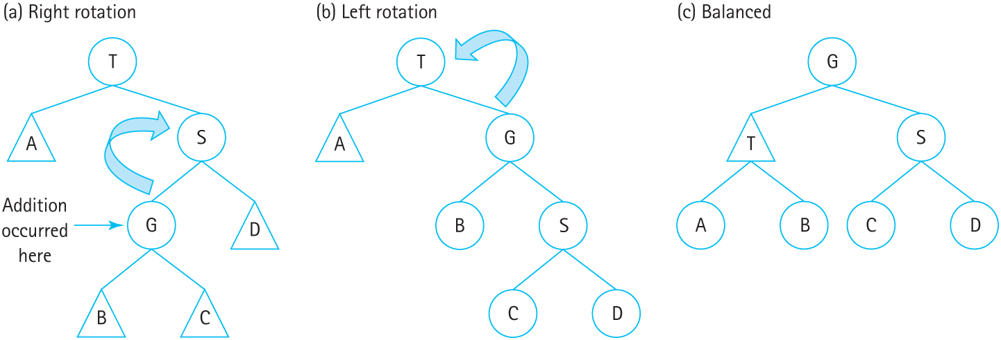
Right-Left Rotation
Figure 10.9 General right-left rotation on AVL tree (a) right-rotation (b) left-rotation
(c) balanced

Slide 14
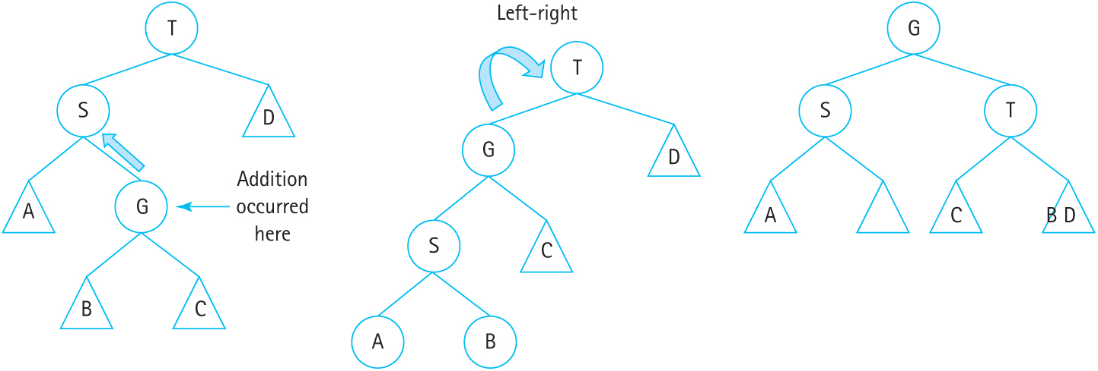
Left-Right Rotation
Figure 10.10 General right-left rotation on AVL tree (a) right-rotation (b) left-rotation
(c) balanced

Slide 15
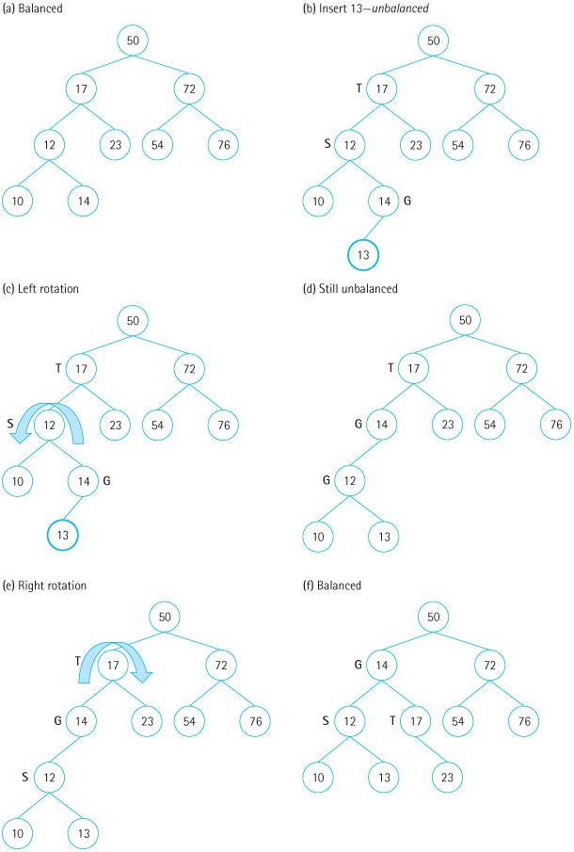
Figure 10.8 Left-right rotation on AVL tree after insert (a) Balanced (b) Insert 13- unbalanced (c) Left rotation (d) Still unbalanced (e) Right rotation (f) Balanced

Slide 16
AVL Trees: Logical Level
AVL trees and binary search trees share the same operations
AVL trees add additional conditions to PutItem and DeleteItem: The tree will be balanced before and after these operations are performed

Slide 17
AVL Trees: Application Level
Binary search trees are great for random, unchanging data; the tree can be balanced once and left alone
AVL trees are better when insertion and deletion operations are performed over the lifetime of the tree

Slide 18
AVL Trees: Implementation Level
The AVL Tree implementation has a few more helper functions:
The four rotation functions
Difference, for finding the difference in height between two subtrees
Balance, for deciding which rotation is needed
PutItem and DeleteItem call Balance after performing the insertion/deletion

Slide 19
Rotation Functions
The rotations themselves are straightforward
Each one takes the unbalanced node as a parameter and returns the updated root node
Compare the code to the rotations diagrams

Slide 20
RotateRight
TreeNode* RotateRight(TreeNode* T)
// Returns the tree node resulting from
// a right rotation.
{
TreeNode* S = T->left;
TreeNode* B = S->right;
S->right = T;
T->left = B;
return S;
}

Slide 21
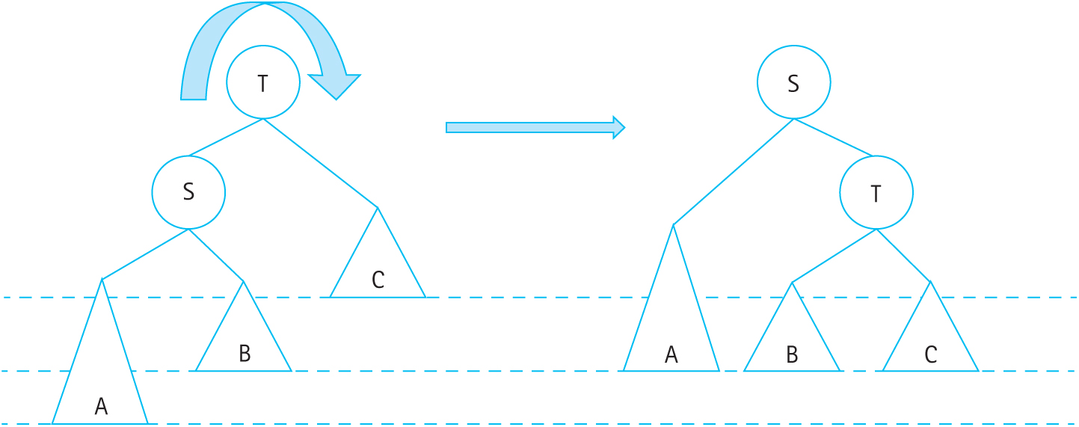
RotateRight (cont.)
Figure 10.4 Right rotation on an AVL tree to maintain balance

Slide 22
RotateRight (cont.)
Figure 10.6 Right rotation on AVL tree after insert (a) Balanced (b) Insert 1- unbalanced (c) Right rotation (d) Right rotation (e) Balanced

Slide 23
RotateLeft
TreeNode* RotateLeft(TreeNode* T)
// Returns the tree node resulting from
// a left rotation.
{
TreeNode* S = T->right;
TreeNode* B = S->left;
S->left = T;
T->right = B;
return S;
}

Slide 24
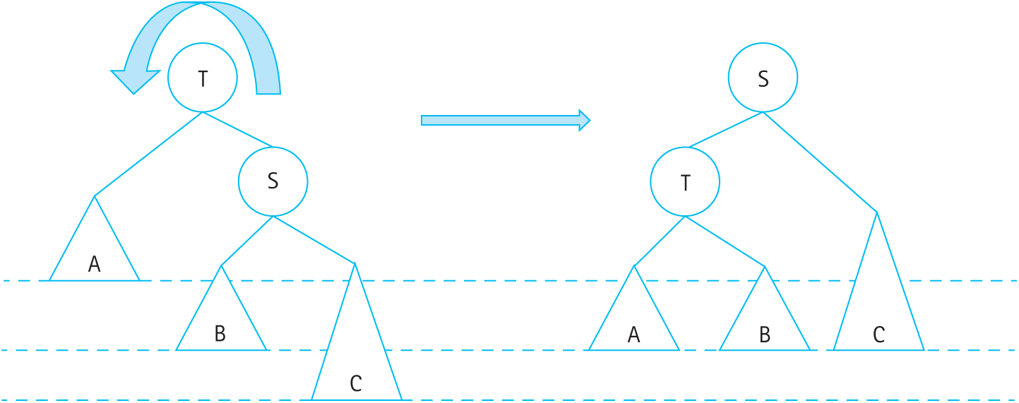
RotateLeft (cont.)
Figure 10.5 Left rotation on an AVL tree to maintain balance

Slide 25
RotateRightLeft
TreeNode* RotateRightLeft(TreeNode* T)
// Returns the tree node resulting from a
// right-left rotation.
{
TreeNode* S = T->right;
T->right = RotateRight(S);
return RotateLeft(T);
}

Slide 26
RotateRightLeft (cont.)
Figure 10.9 General right-left rotation on AVL tree (a) right-rotation (b) left-rotation (c) balanced

Slide 27
RotateLeftRight (cont.)
TreeNode* RotateLeftRight(TreeNode* T)
// Returns the tree node resulting from a
// left-right rotation.
{
TreeNode* S = T->left;
T->left = RotateLeft(S);
return RotateRight(T);
}

Slide 28
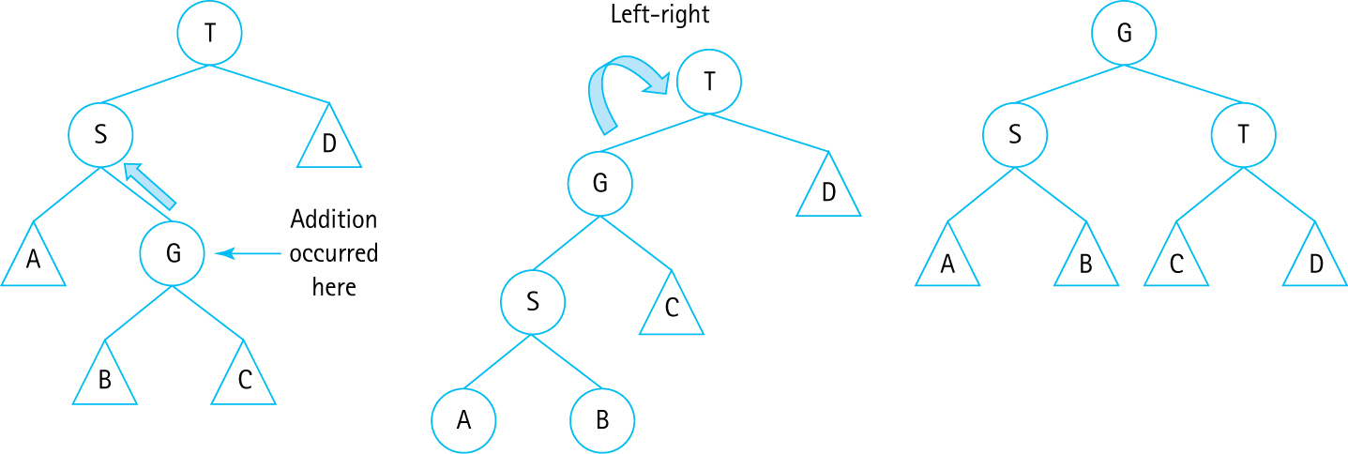
RotateLeftRight (cont.)
Figure 10.10 General left-right rotation on AVL tree

Slide 29
Difference
Difference returns the difference in height between the two subtrees of the given node
If the difference is positive, the left tree is taller
If the difference is negative, the right tree is taller
This is used by Balance to determine which rotation to use

Slide 30
Difference (cont.)
int Difference(TreeNode* T) const
// Returns the difference between the heights
// of the left and right subtrees of T.
// Assumes the given TreeNode* T is not null.
{
return Height(T->left) – Height(T->right);
}

Slide 31
Height
A recursive helper function that calculates the height of the tree rooted at the given node
The height of a tree is the height of its tallest subtree + 1
If the node is NULL, the height is 0 (base case)

Slide 32
Height (cont.)
int Height(TreeNode* T) const
// Returns the height of a tree T.
{
if (T == null)
return 0;
else {
int heightLeft = Height(T->left);
int heightRight = Height(T->right);
if (heightLeft > heightRight)
return heightLeft + 1;
else
return heightRight + 1;
}
}

Slide 33
Balance
Balance is called by Insert to check if a rotation is needed to balance the tree
If a node’s height difference (the balance factor) is greater than 1, it is unbalanced
The Difference function is used to determine which rotation is needed

Slide 34
Balance (cont.)
TreeNode* Balance(TreeNode* T)
// Checks and balances the subtree T.
{
int balanceFactor = Difference(T);
if (balanceFactor > 1) { // Left subtree is taller
if (Difference(T->left) > 1)
return RotateRight(T);
else
return RotateLeftRight(T);
}
else if (balanceFactor < -1) { // Right subtree is taller
if (Difference(T->right) < 0)
return RotateLeft(T);
else
return RotateRightLeft(T);
}
else
return T;
}

Slide 35
Insert and PutItem
These methods are almost identical to the BST versions, except for calls to Balance
Insert: After inserting into the left or right subtree, Balance is called on that subtree
PutItem: After the call to Insert, the root is balanced

Slide 36
AVL Tree Limitations
AVL Trees have increased overhead due to the rotation operations
The cost is somewhat amortized across searches, but many updates will overwhelm the savings from balancing the tree
Is there another structure that promises balanced trees and O(log₂N) efficiency?

Slide 37
Red-Black Trees
Red-Black trees reduce the number of rotations at the cost of a perfectly balanced tree
This reduces overhead while still maintaining efficient O(log₂N) search time
They are widely used in many applications, such as the C++ standard library

Slide 38
Red-Black Tree Properties
A node in a Red-Black tree is labeled as either red or black
The root is labeled black
All leaves that are NULL are black
If a node is labeled red, both of its children must be labeled black
Every path from a given node to a NULL node must have the same number of black nodes

Slide 39
Red-Black Tree Properties
Coloring NULL nodes black makes the implementation simpler
Black nodes can have children of either color
The property that all paths must have the same number of black nodes is called black-height

Slide 40
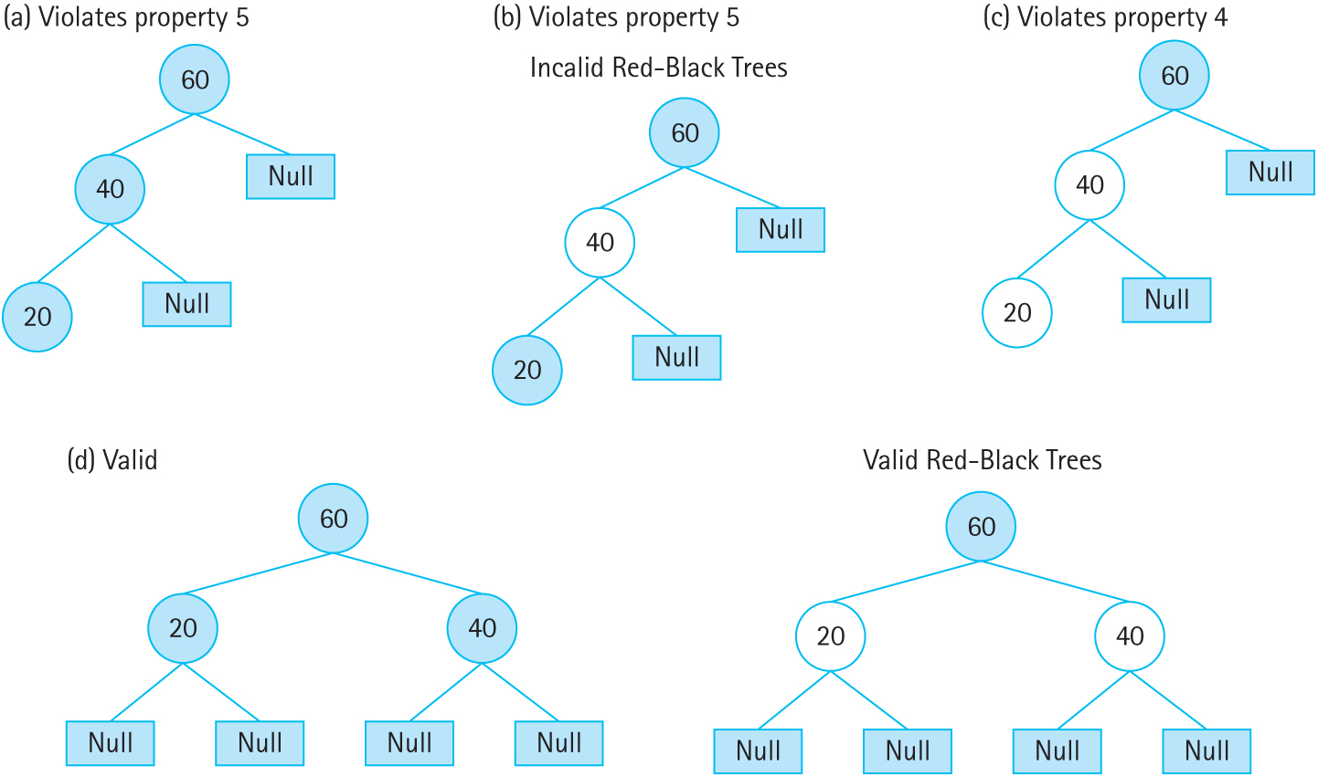
Red-Black Tree Examples
Figure 10.11 Valid/Invalid Red-Black Trees (a) violates property 5 (b) violates property 5 (c) violates property 4 (d) valid (e) valid red-black trees

Slide 41
Red-Black Tree Changes
Red-Black trees require a few small changes
Each node has a color, Red or Black
Nodes also have a pointer to their parent node

Slide 42
Inserting into Red-Black Trees
Red-Black trees use recoloring to determine if a tree is balanced
If recoloring fails, the red-black properties are violated and rotations are needed
New nodes are automatically labeled red
Recoloring is best described in relation to a node’s “family”

Slide 43
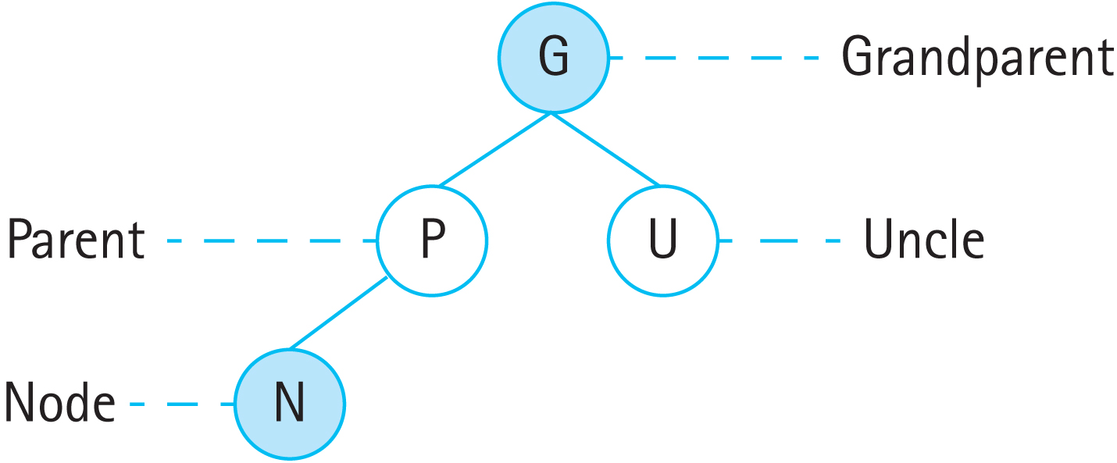
Node Family Tree
Parent: The node whose child is N
Uncle: N’s parent’s sibling
Grandparent: The parent of N’s parent
Figure 10.12 The Family Tree

Slide 44
Inserting into Red-Black Trees
If N (the new node) is the root node, change its color to black
If N’s parent is black, nothing needs to be done
If N’s parent and uncle are both red, change both to black, change N’s grandparent to red and recursively recolor N’s grandparent
If N’s parent is red and the uncle is black, the tree must be restructured

Slide 45
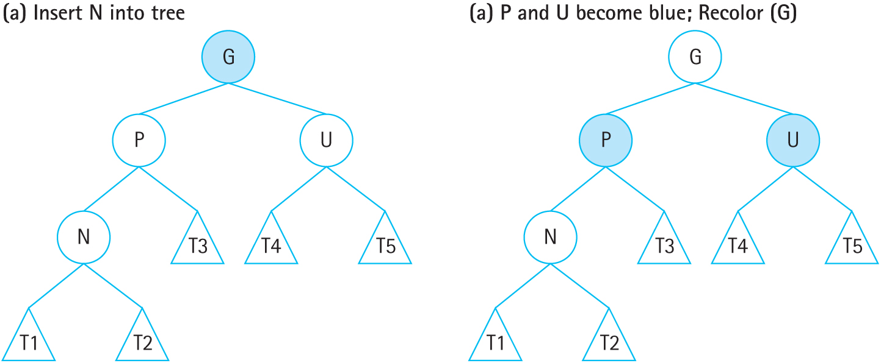
Recoloring
Figure 10.13 ReColor after Inserting N (a) Insert N into tree (b) P and U become
black; ReColor(G)

Slide 46
Restructuring
Like AVL trees, there are four cases for using rotations to balance the tree
However, the cases are based on the colors of the nodes, not on the balance factor
Restructuring also involves swapping colors

Slide 47
The Four Restructuring Cases
N is the left child of P, P is the left child of G:
Right rotation and swap the colors of G and P
N is the right child of P, P is the left child of G:
Left-Right rotation and swap G’s and N’s colors
N is the right child of P, P is the right child of G:
Left rotation and swap the colors of G and P
N is the left child of P, P is the right child of G:
Right-Left rotation and swap G’s and N’s colors

Slide 48
The Four Restructuring Cases
These should look familiar: They’re the same cases as with AVL trees
Instead of rotating based on which subtree of which child was changed, it looks at the colors of the parent and grandparent
Note the parallels between cases
Single rotations swap the colors of P and G
Double rotations swap the colors of G and N

Slide 49
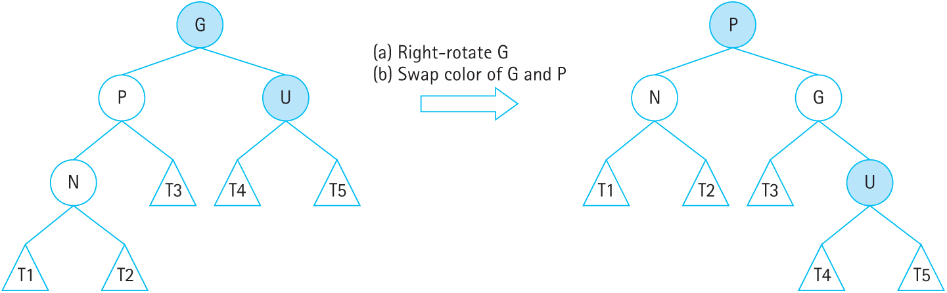
Left-Left Restructuring
Figure 10.14 Left-Left Restructuring

Slide 50
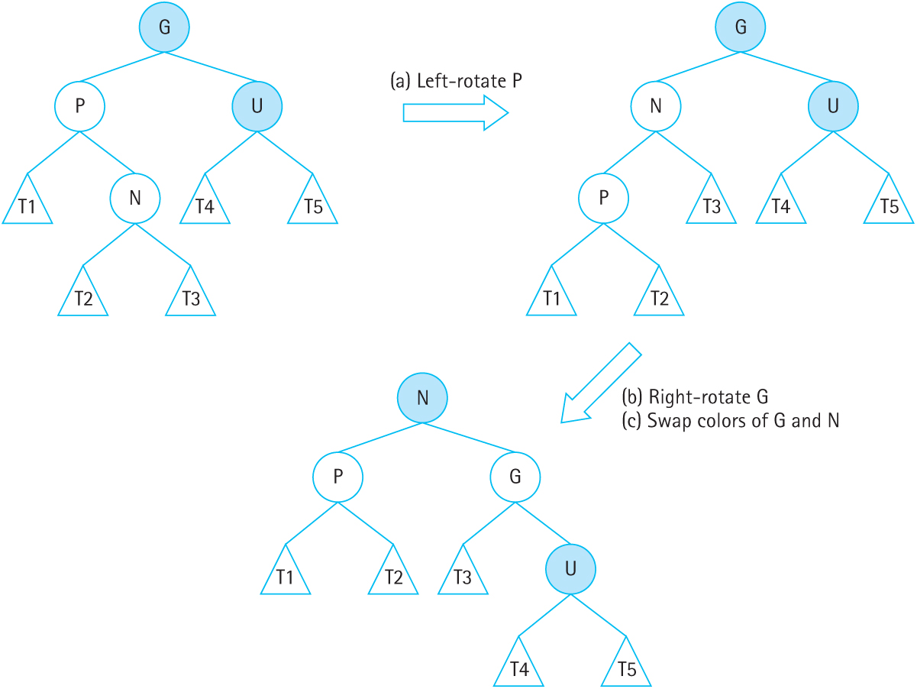
Left-Right Restructuring
Figure 10.15 Left-Right Restructuring

Slide 51
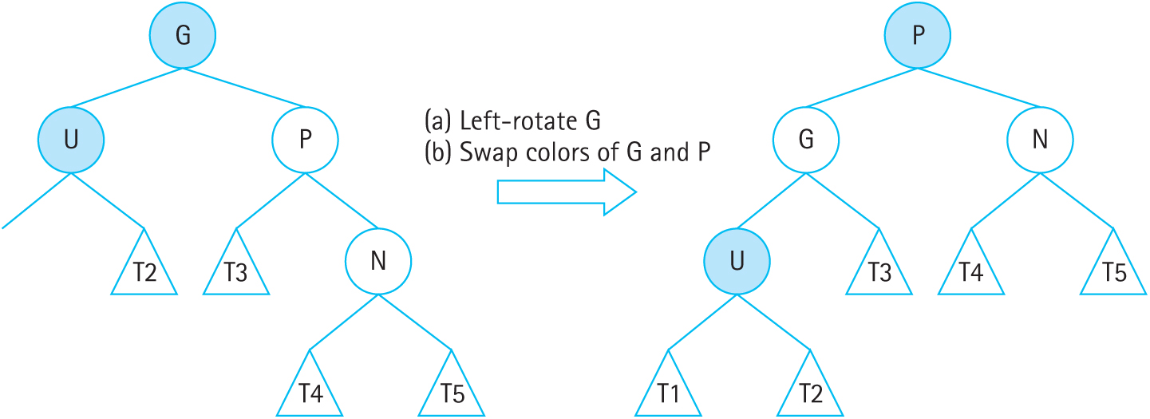
Right-Right Restructuring
Figure 10.16 Right-Right Restructuring

Slide 52
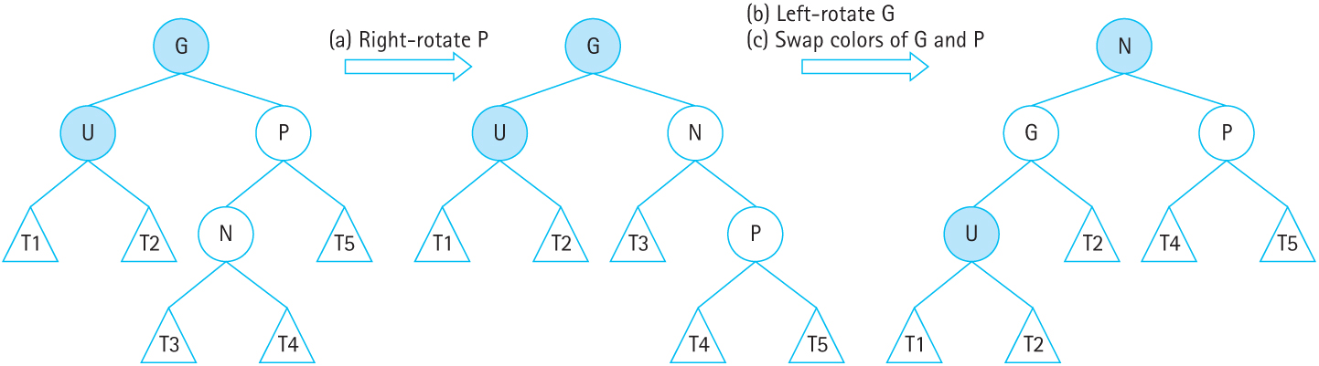
Right-Left Restructuring
Figure 10.17 Right-Left Restructuring

Slide 53
Implementing Recoloring
The red/black color is coded as an enum
Each node has a color and a pointer to its parent in addition to the usual BST fields
Helper functions are used for getting the parent, grandparent, and uncle of a node to improve the clarity of the code
Two more helpers are used to get and set the color of a node

Slide 54
Recolor
void ReColor(TreeNode* N)
{
if (N == NULL) return; // do nothing if N is NULL
TreeNode* P = Parent(N);
TreeNode* G = GrandParent(N);
TreeNode* U = Uncle(N);
if (P == NULL) N->color = BLACK; // N is the root node
else if (P != NULL || GetColor(P) != BLACK) {
if (GetColor(U) == RED) {
SetColor(P, BLACK);
SetColor(U, BLACK);
SetColor(G, RED);
ReColor(G);
}
else
ReStructure(N); // Left as an exercise for the reader
}
}

Slide 55
PutItem
The algorithm is generally the same, except for coloring the node
All nodes are red when inserted, and a call to Recolor fixes the tree
The PutItem implementation walks the tree to find the correct place to insert the new node, then calls Recolor on the new node

Slide 56
Insert
void Insert(TreeNode*& tree, TreeNode* parent, ItemType item)
// Inserts item into tree.
// Post: item is in tree; search property is maintained.
{
if (tree == NULL)
{// Insertion place found.
tree = new TreeNode;
tree->right = NULL;
tree->left = NULL;
tree->parent = parent;
tree->info = item;
ReColor(tree);
}
else if (item < tree->info)
Insert(tree->left, tree, item); // Insert in left subtree.
else
Insert(tree->right, tree, item); // Insert in right subtree.
}

Slide 57
B-Trees
B-Trees are a generalization of binary trees
Each node in a B-Tree contains multiple data values and links to multiple children
Nodes in a B-Tree have a maximum number of children, m; this is the order of the B-Tree
B-Trees are self-balancing with O(log₂N) search

Slide 58
B-Tree Properties
Each node must have at most m children
Each internal node has at least m/2 children
The root node must have at least 2 children, if it is not a leaf
A nonleaf node with k children must have k-1 data items
All leaves must appear at the same level of the tree

Slide 59
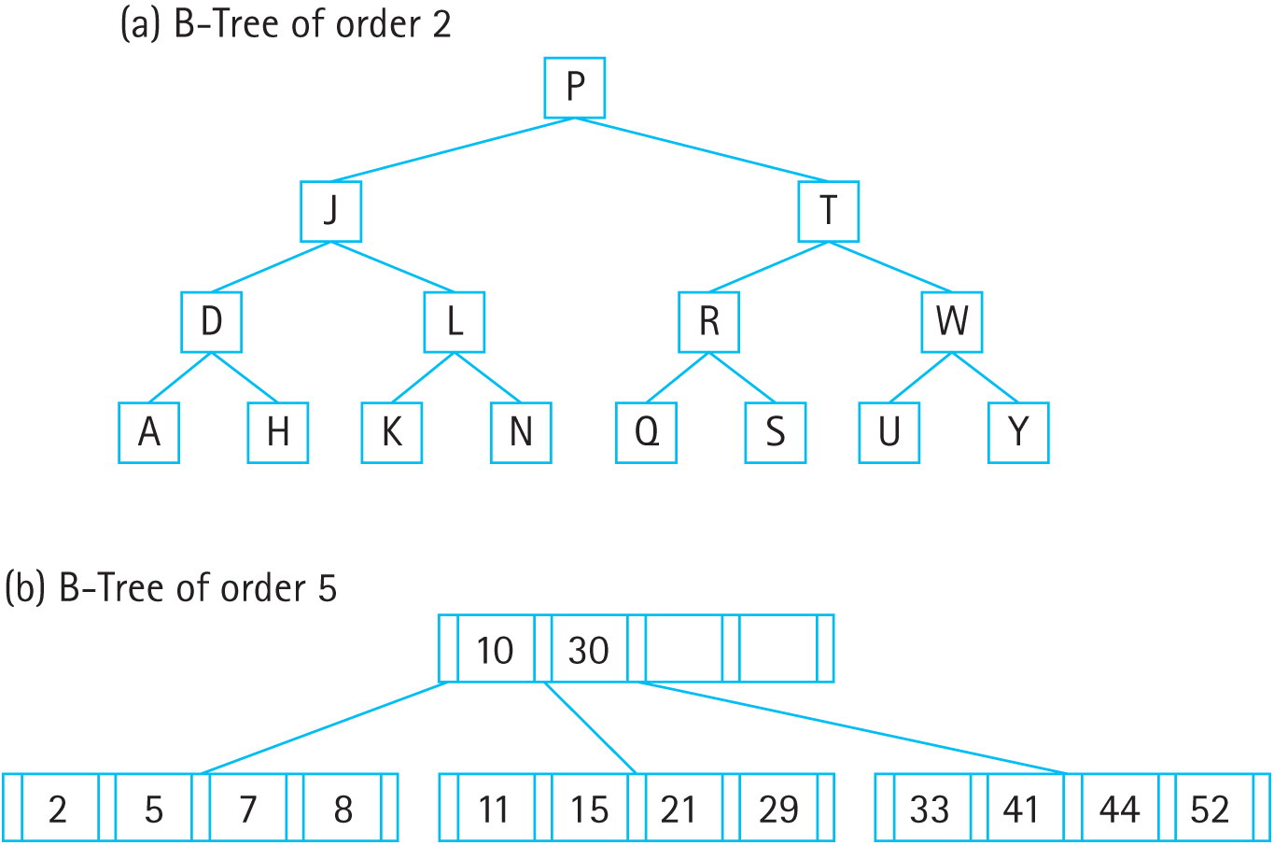
B-Tree Examples
Figure 10.18 B-tree Examples (a) B-Tree of order 2 (b) B-Tree of order 5

Slide 60
Searching a B-Tree
Searching a B-Tree requires comparing the item to multiple keys in each node
If the item is less than the first key, the first child is searched
If the item is greater than the last key, the last child is searched
If the item is between two keys, the child that is between those two keys is searched

Slide 61
Searching Walkthrough
Using the B-Tree of order 5, search for the key 21:
Is 21 <= 10? No. Check the next key.
Is 21 <= 30? Yes. It’s not equal, so proceed to the second child.
Is 21 <= 11? No.
Is 21 <= 15? No.
Is 21 <= 21? Yes. The value has been found.

Slide 62
Inserting into B-Trees
Unsurprisingly, insertion (and deletion) into a B-Tree is somewhat complex
Insertion attempts to fill nodes that don’t have a full complement of keys
If a node is full, the algorithm splits nodes to make more room

Slide 63
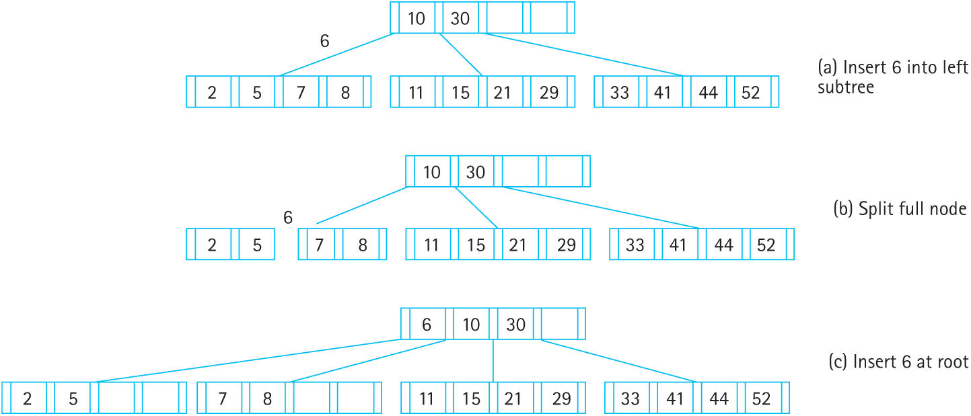
Splitting Nodes
Figure 10.19 B-tree Insertion (a) Insert 6 into left subtree (b) Split full node
(c) Insert 6 at root

Slide 64
InsertBTree (Node N)
Search the B-Tree for the leaf N should be inserted into
If there are fewer than m-1 keys in the leaf, add N into the appropriate place, shifting other keys if necessary
If there is no room, the node must be split

Slide 65
InsertBTree (Node N) (cont.)
Split the node into two equal parts and one middle element
Add the middle element to the parent and add the two parts as children
If the parent is full, continue splitting recursively up the tree
Split the root and add a new root node if necessary

Slide 66
Splitting Nodes
Figure 10.19 B-tree Insertion (a) Insert 6 into left subtree (b) Split full node
(c) Insert 6 at root

Slide 67
B-Tree Applications
B-Trees are well suited to being written to and read from disks
Each node can the size of an I/O block, which can be read/written quickly, by setting the order of the B-Tree to an appropriate size
Applications like databases and file systems, which can store terabytes of data, are often implemented using B-Trees

